Slide 1
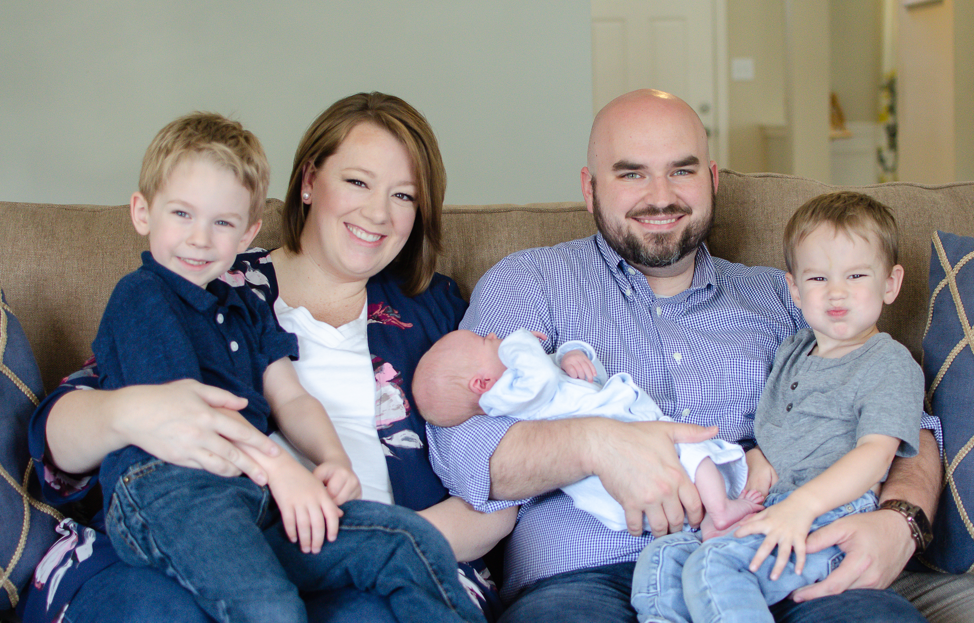

Slide 3
Start Open-Minded
Open to the truth of God’s word
Ahab’s closed-minded folly (2 Chron. 18)
Expect only to learn from God

Slide 4
See God In It
The nature & character of God
God is love (1 John 4:8), and there’s more!
He has made himself known (Psa. 98:2)
Look for God on every page

Slide 5
See Its Value For Life
Enjoy what is good for you
A steady diet of godly thoughts
God’s power for righteous living
God’s power for eternal salvation

