Slide 2
David & Absalom
2 Samuel 13-18
Absalom kills one of David’s sons
Runs away (3 yrs)
David allows him home, but won’t see him (2 yrs)
David welcomes him back into the family
Absalom subverts David’s reign
Overthrows his father in a conspiracy

Slide 3
David & Absalom
2 Samuel 13-18
David driven from Jerusalem, temple
Servants forsake him and lie to him
Publicly cursed
His best counselor betrays him
His son, Absalom, murdered in midst of battle

Slide 4
Running Wounded
Hated by the world
“Friendly fire”
Wounded by family
Wounded by life

Slide 5
Faith On The Run
God will deliver (Psa. 3:7-8)

Slide 8
Faith On The Run
God will deliver (Psa. 3:7-8)
Pain & wounds happen (Psa. 3:1-2)
Keep confidence in God (Psa. 3:3-6)

Slide 9
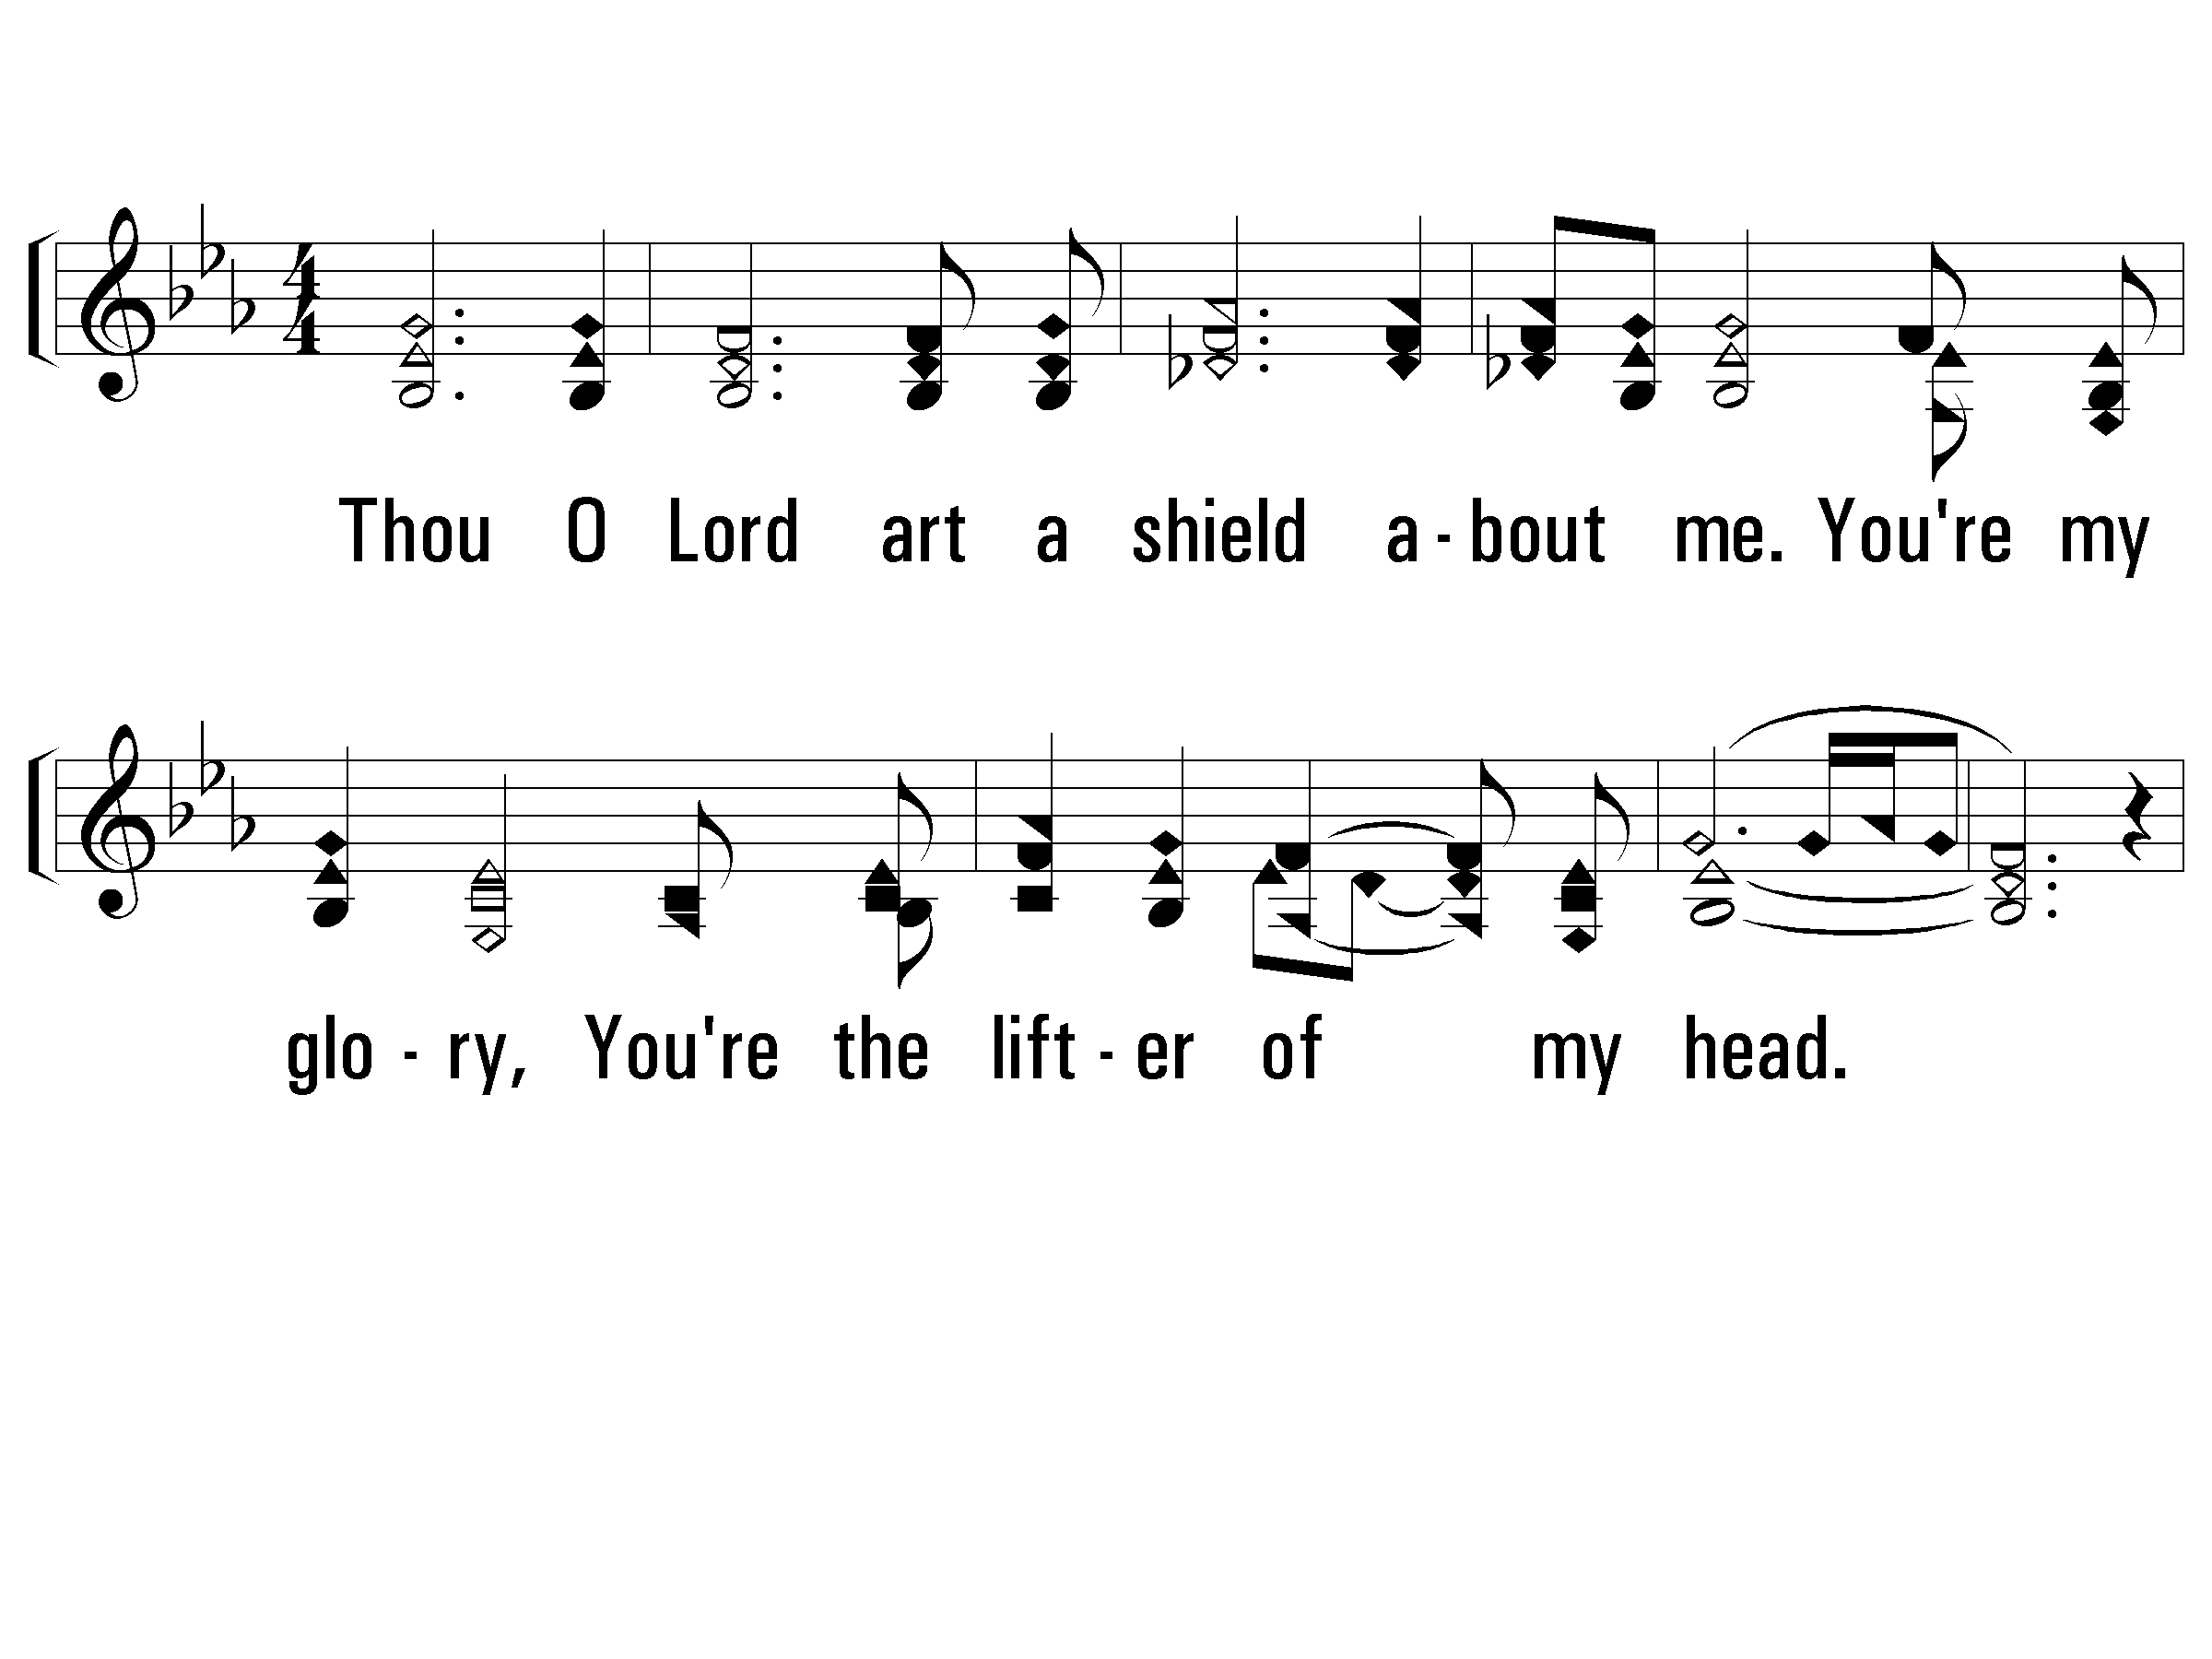
1 – A Shield About Me
Thou O Lord art a shield about me.
You're my glory,
You're the lifter of my head.
Hallelujah, Hallelujah, Hallelujah,
You're the lifter of my head.
Words & Music: Donn Thomas & Charles Williams
Copyright © 1991 by Spoone Music (a div. of Word Music, Inc.), Word Music, Inc.
All Rights Reserved. Used By Permission.
PaperlessHymnal.com

Slide 10
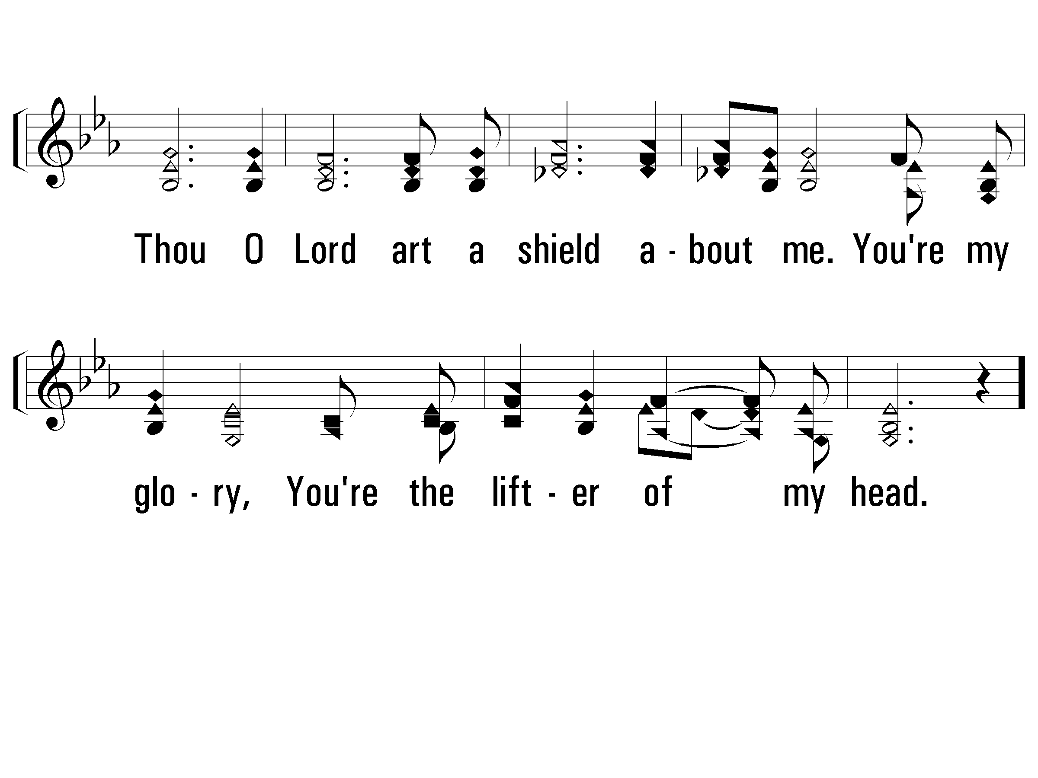
1 – A Shield About Me
PaperlessHymnal.com

Slide 11
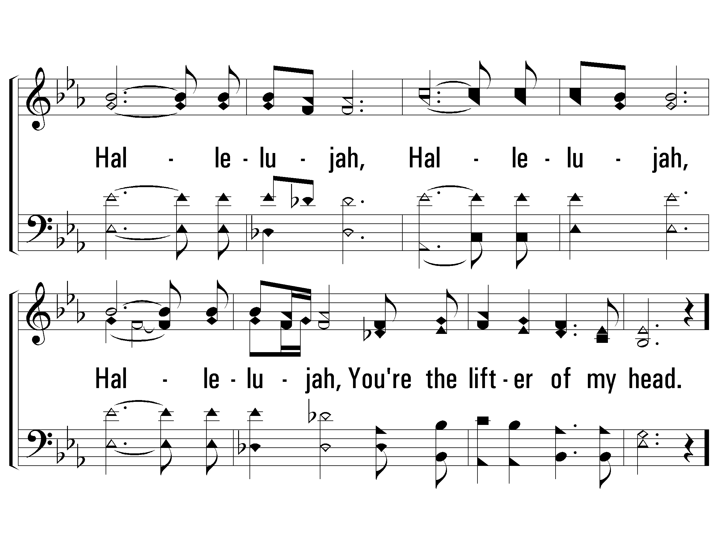
1 – A Shield About Me
PaperlessHymnal.com

Slide 12
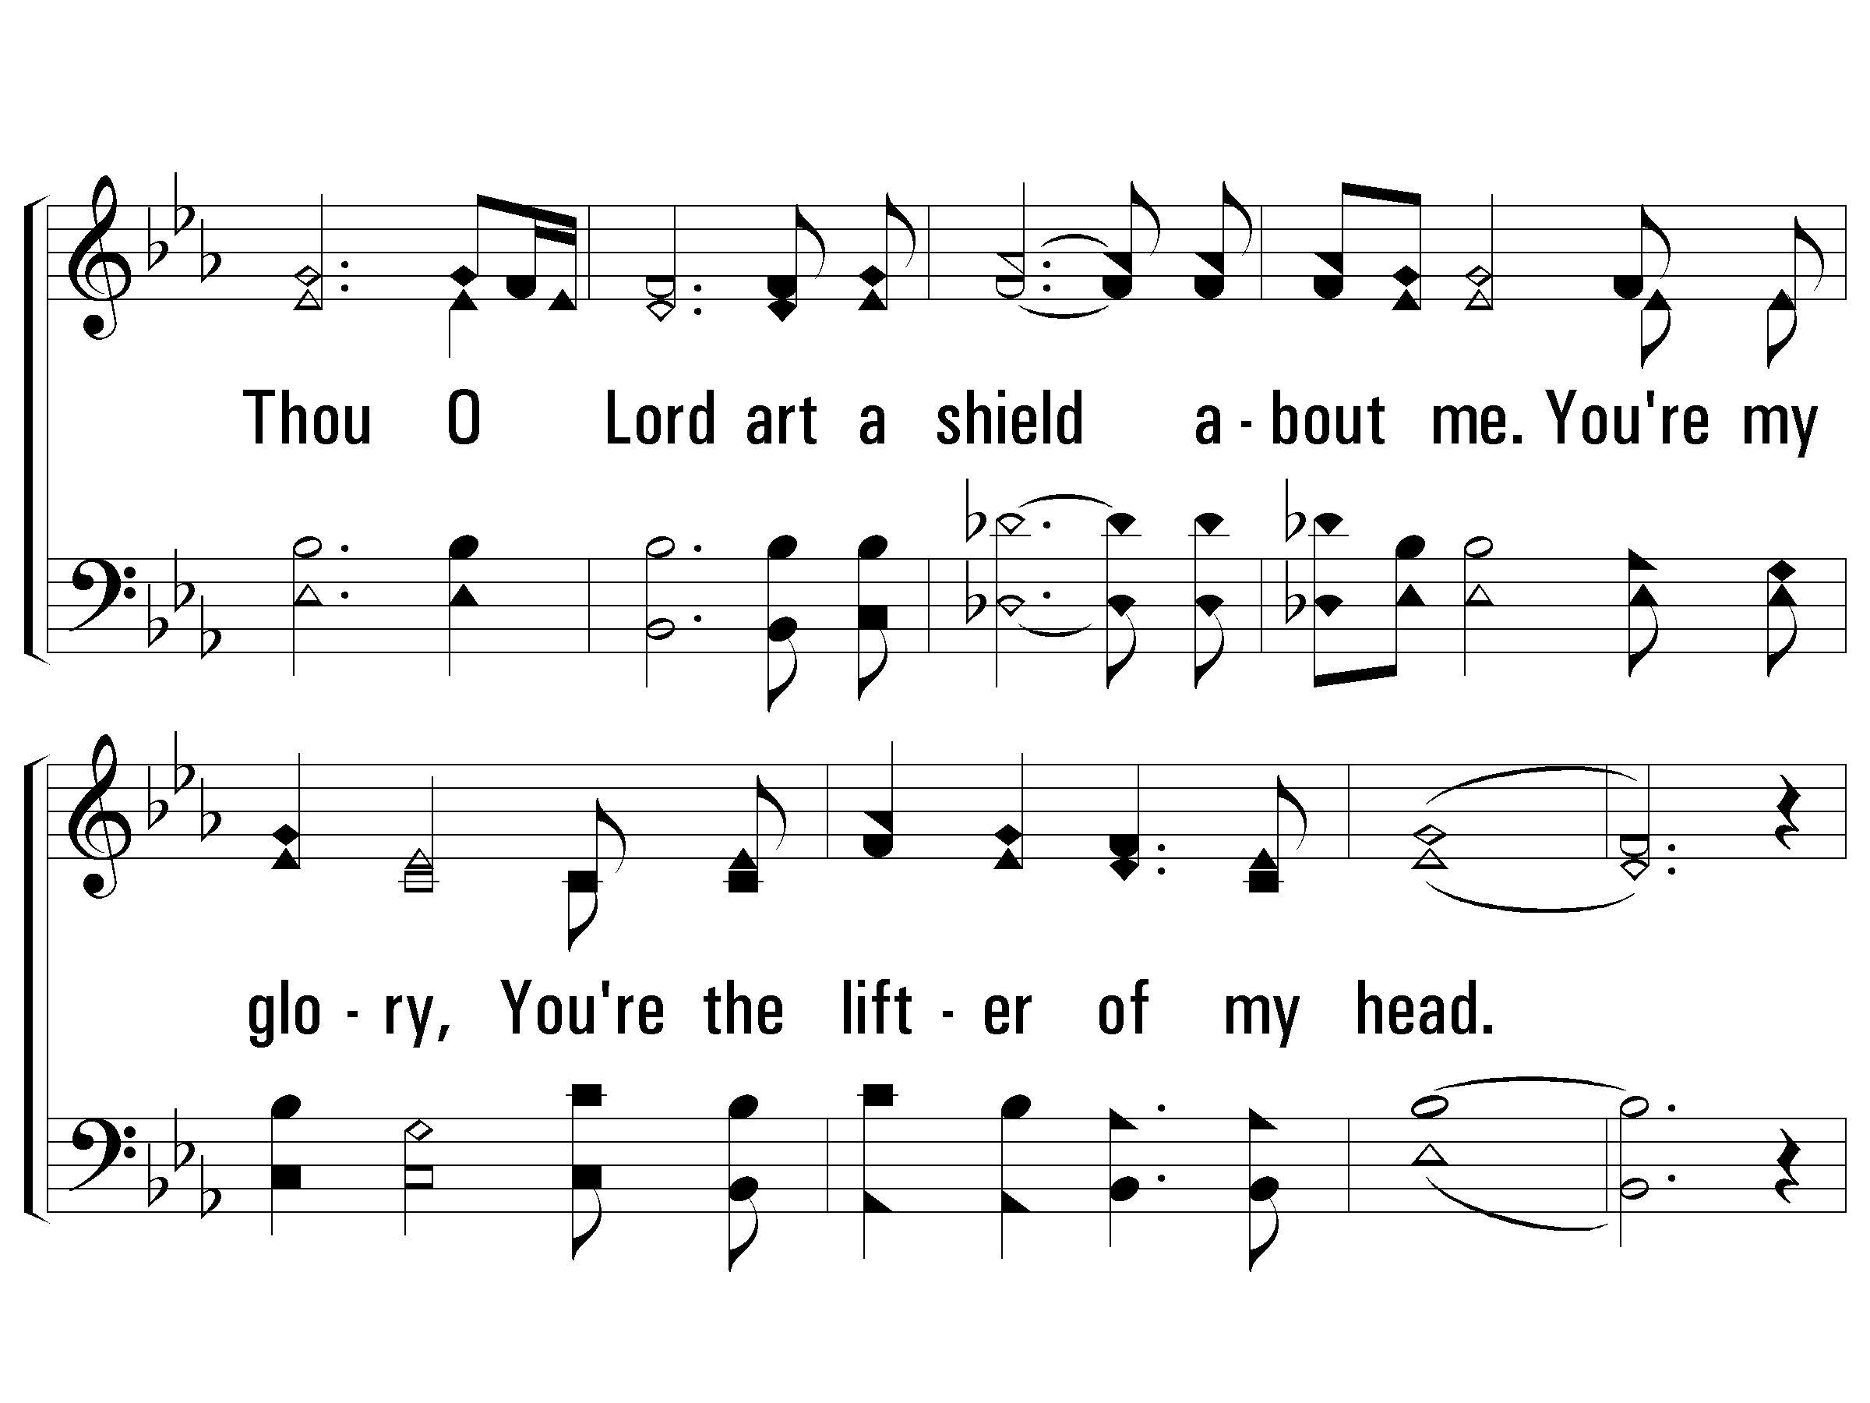
1 – A Shield About Me
PaperlessHymnal.com

Slide 13
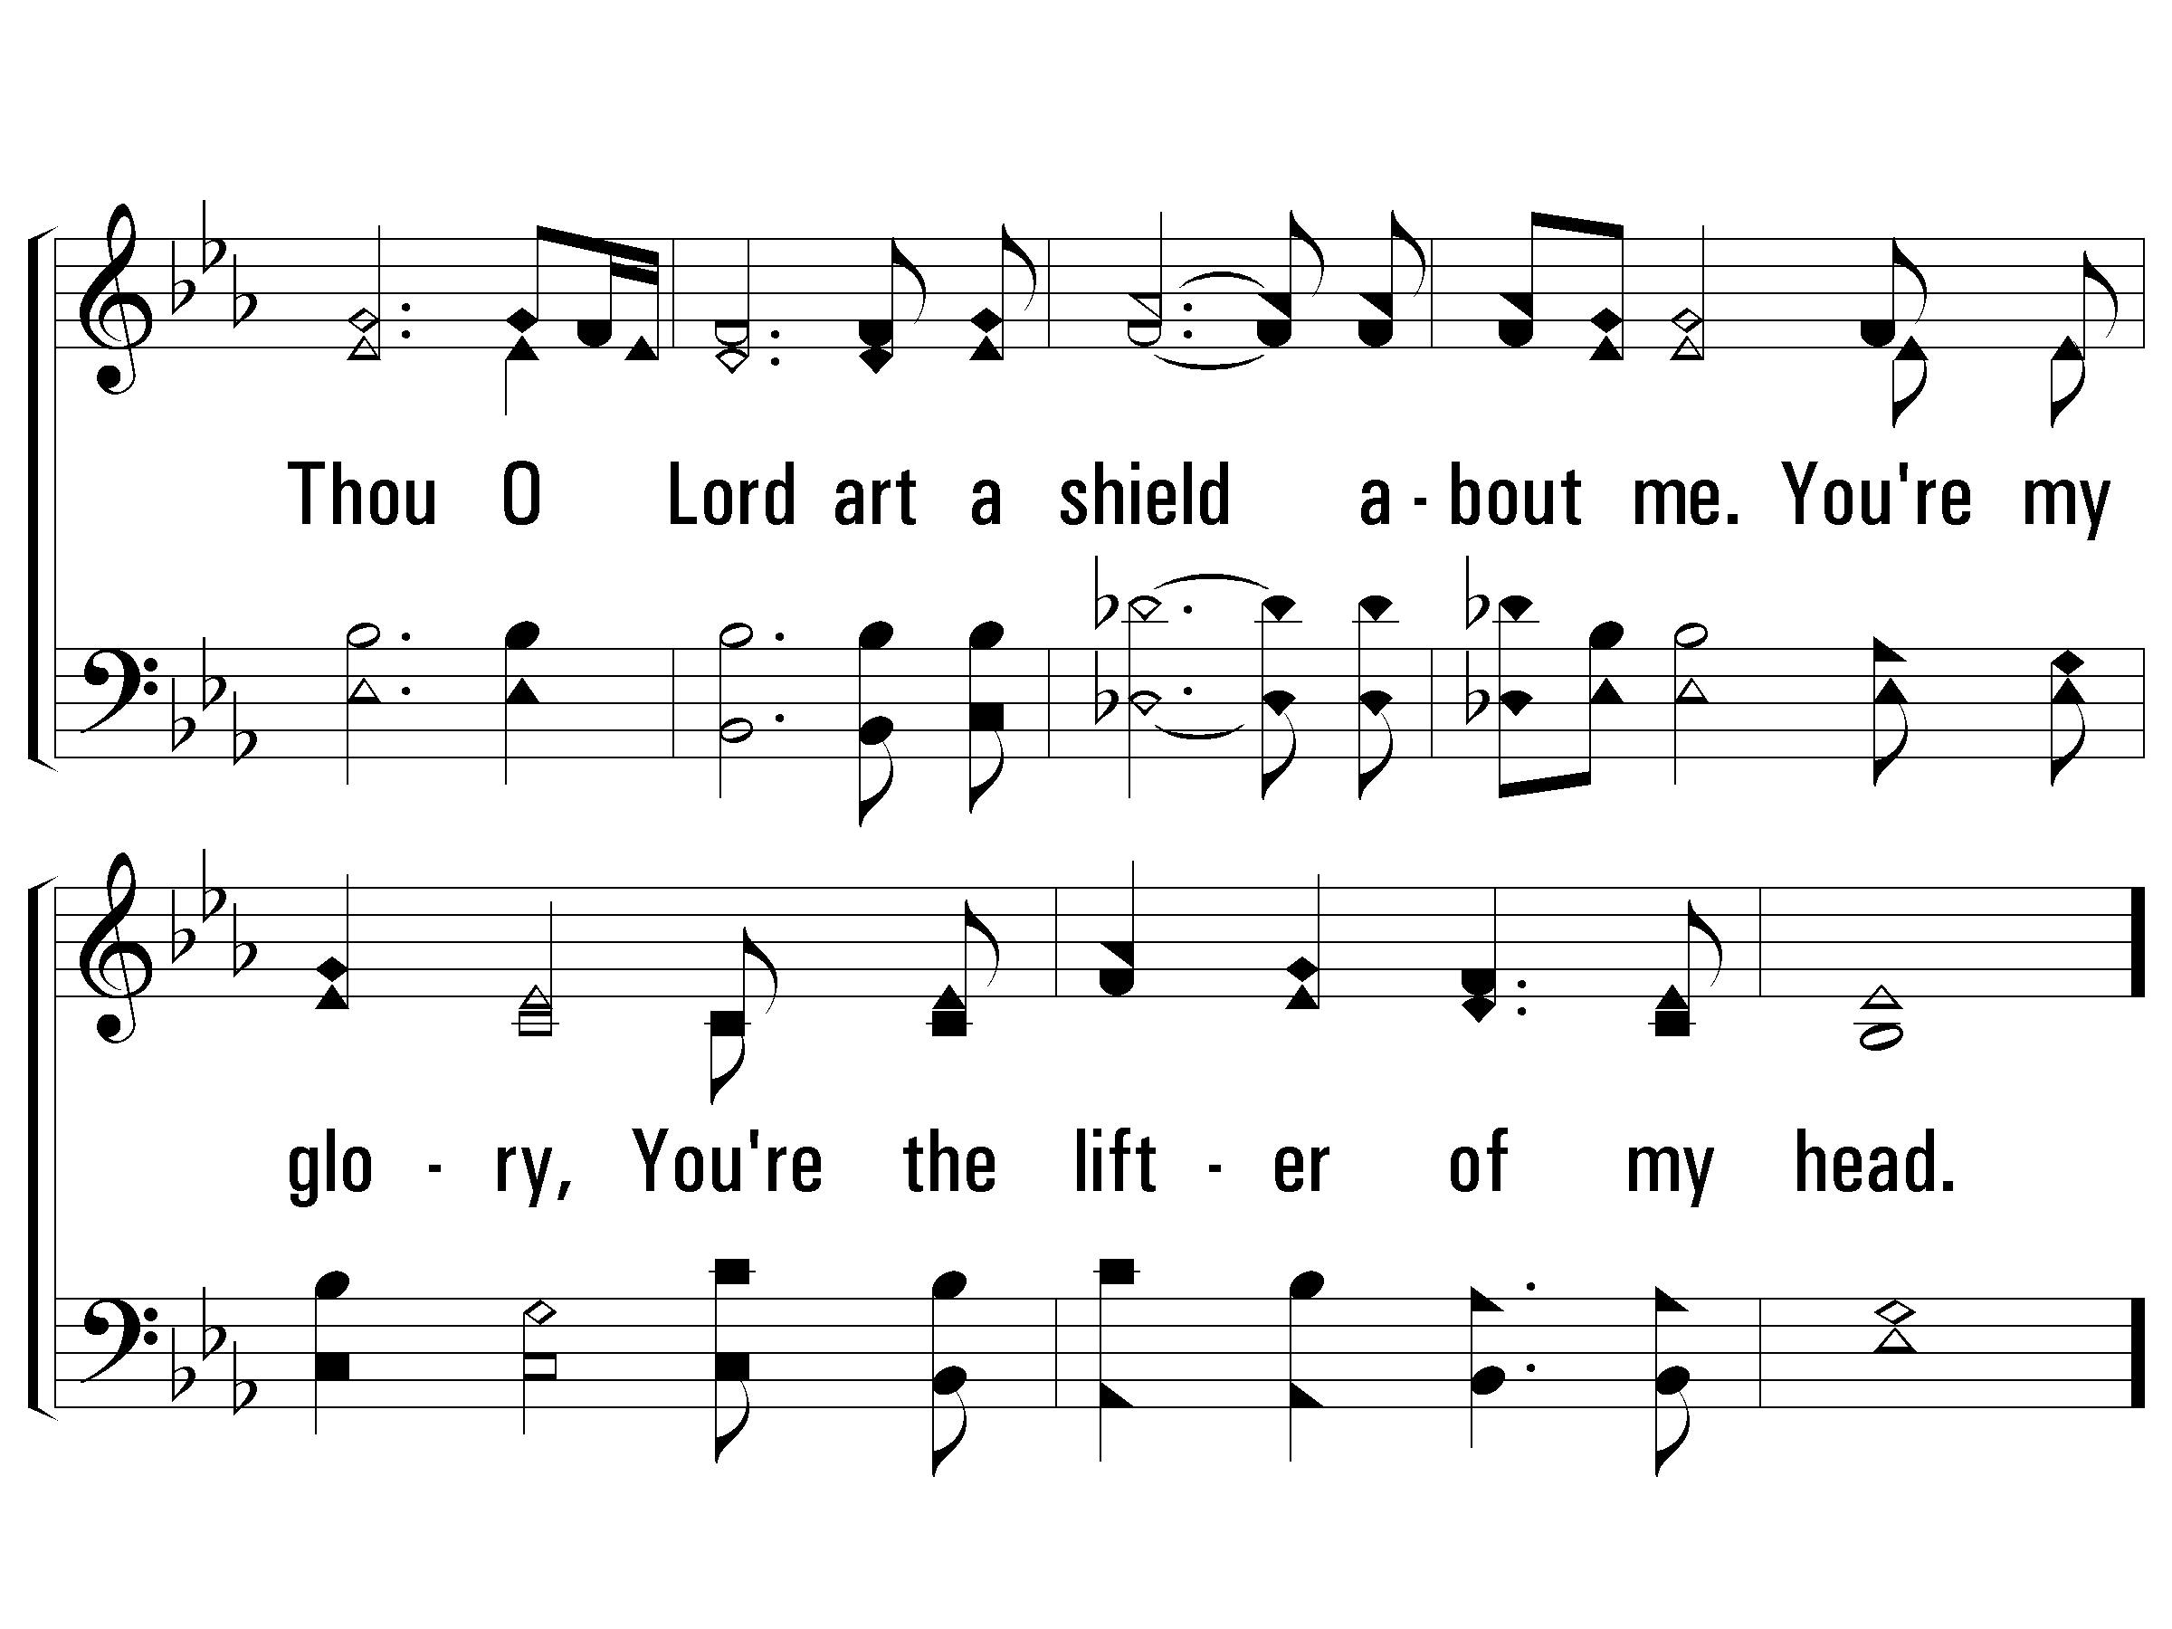
1 – A Shield About Me
PaperlessHymnal.com

Slide 14
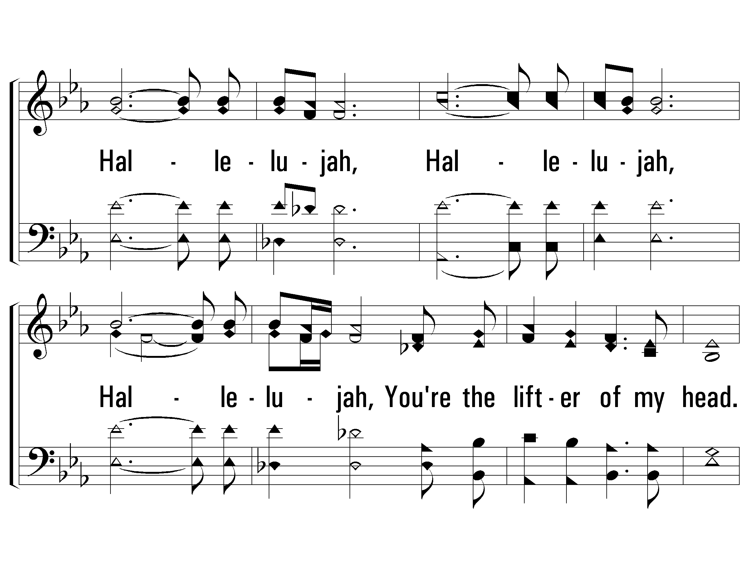
1 – A Shield About Me
PaperlessHymnal.com

Slide 15
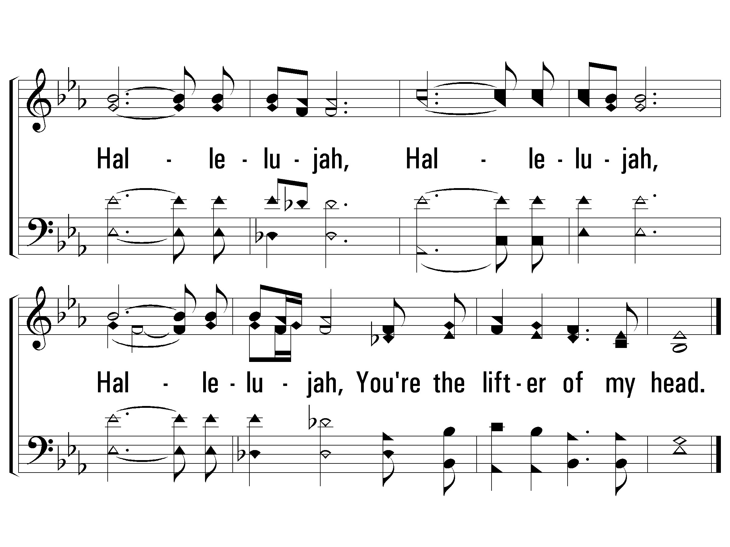
1 – A Shield About Me
PaperlessHymnal.com

