Slide 2
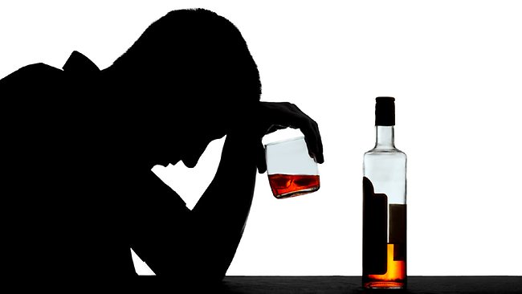
Alcohol:
What’s
The
Big Deal?

Slide 3
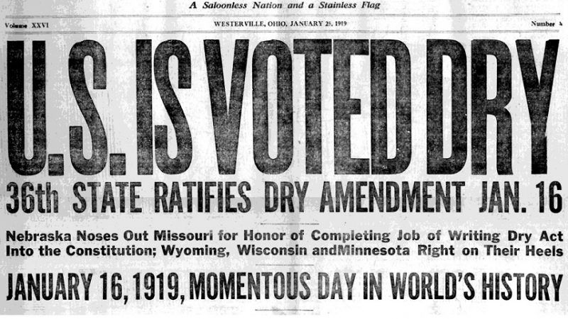

Slide 4
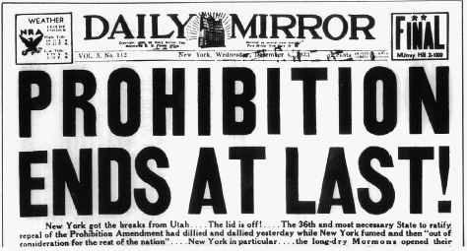

Slide 5
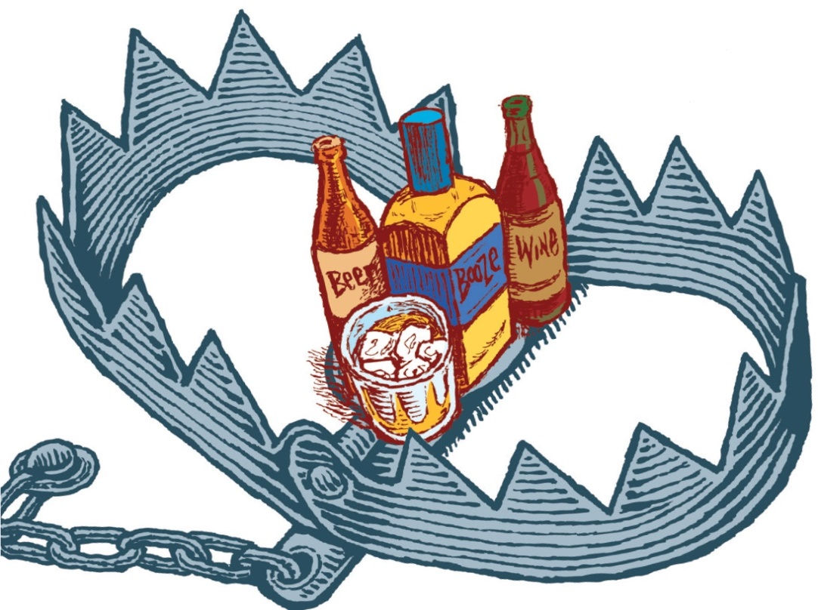
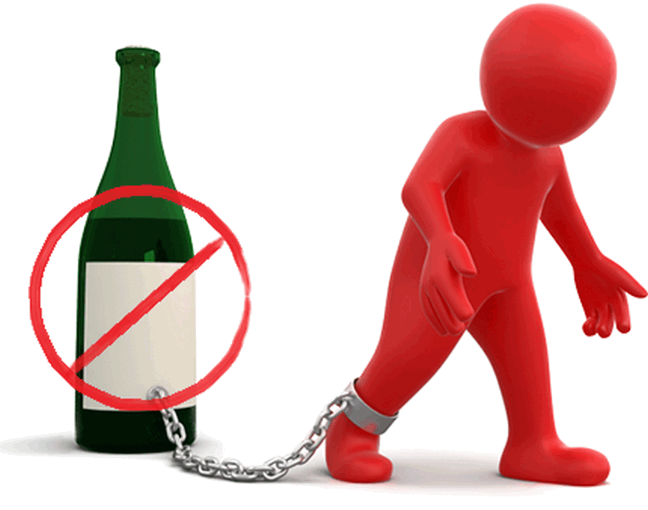
1 Pet 4:4 – “In all this, they are surprised that you do not run with them into the same excesses of dissipation, and they malign you”
Alcohol…
Mocks – Prov 20:1
Destroys – Nah 1:10
Poverty – Prov 23:21
Woes – Hab 2:15; Isa 5:11,22
Sorrow – Prov 23:29
Contention – Prov 23:29
Harms judgment – Prov 31:4-5; Isa 28:7
Complaining – Prov 23:29
Perversion – Prov 23:33b
Worries without cause – Prov 23:29
Inflames passions – Isa 5:11
Enslaves – Tit 2:3

Slide 6
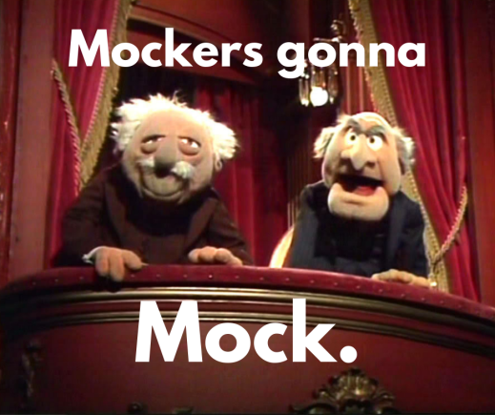
Prov 20:1 – “Wine is a mocker, strong drink a brawler, and whoever is intoxicated by it is not wise.”
Unity Is Worth Fighting For!

Slide 7
Jesus turned water into wine
Gluttony is a sin too
Line between being drunk/not drunk unclear

Slide 8
Caveats
Jesus turned water into wine (John 2)
“Wine” in the bible could be fermented or unfermented
Isa 65:8 – “Thus says the LORD, ‘As the new wine is found in the cluster, and one says, “Do not destroy it, for there is benefit in it,” so I will act on behalf of My servants in order not to destroy all of them.”’”
Isa 16:10 – “Gladness and joy are taken away from the fruitful field; in the vineyards also there will be no cries of joy or jubilant shouting, no treader treads out wine in the presses, for I have made the shouting to cease.”
Isa 5:22 – “Woe to those who are heroes in drinking wine and valiant men in mixing strong drink”
Bible words with different meanings today: baptism, pastor, Christian, disciple, saint, church, bishop, elder, fellowship, priest, love, works, grace, believe, etc.

Slide 9
Caveats
Jesus turned water into wine
“Wine” in the bible could be fermented or unfermented
Jesus produced 120–180 gallons of alcoholic wine w/o sinning?
Luke 17:1-2 – “He said to His disciples, ‘It is inevitable that stumbling blocks come, but woe to him through whom they come! It would be better for him if a millstone were hung around his neck and he were thrown into the sea, than that he would cause one of these little ones to stumble.’”

Slide 10
Caveats
Jesus turned water into wine
Gluttony is a sin too
Food is necessary. Ethyl alcohol is a poison
Long term health vs. short term effects
Col 2:16 – “Therefore no one is to act as your judge in regard to food or drink or in respect to a festival or a new moon or a Sabbath day”
Health benefits? Not in ethyl alcohol, but in resveratrol

Slide 11
Caveats
Jesus turned water into wine
Gluttony is a sin too
Line between being drunk/not drunk unclear
Shouldn’t that be the reason we don’t drink?
Alcohol absorption rate varies day to day
Alcohol absorption isn’t instantaneous
Can we rely on good judgment while consuming a beverage that robs us of judgment?
Eph 5:15 – “Therefore be careful how you walk, not as unwise men but as wise”

Slide 12
Why Christians Shouldn’t Drink
Control/Sobriety
1 Cor 6:12d – “I will not be mastered by anything”
1 Cor 9:27a – “but I discipline my body and make it my slave”
Prov 23:29-35 – “Who has woe? Who has sorrow? Who has contentions? Who has complaining? Who has wounds without cause? Who has redness of eyes? Those who linger long over wine, those who go to taste mixed wine. Do not look on the wine when it is red, when it sparkles in the cup, when it goes down smoothly; at the last it bites like a serpent and stings like a viper. Your eyes will see strange things and your mind will utter perverse things. And you will be like one who lies down in the middle of the sea, or like one who lies down on the top of a mast. ‘They struck me, but I did not become ill; they beat me, but I did not know it. When shall I awake? I will seek another drink.’”
1 Pet 5:8 – “Be of sober spirit, be on the alert. Your adversary, the devil, prowls around like a roaring lion, seeking someone to devour.”

Slide 13
Why Christians Shouldn’t Drink
Control/Sobriety
Provision
Rom 13:14 – “But put on the Lord Jesus Christ, and make no provision for the flesh in regard to its lusts.”

Slide 14
Why Christians Shouldn’t Drink
Control/Sobriety
Provision
Wisdom
Eph 5:15 – “Therefore be careful how you walk, not as unwise men but as wise”

Slide 15
Why Christians Shouldn’t Drink
Control/Sobriety
Provision
Wisdom
Separation
Tit 2:11-12 – “For the grace of God has appeared, bringing salvation to all men, instructing us to deny ungodliness and worldly desires and to live sensibly, righteously and godly in the present age”

Slide 16
Why Christians Shouldn’t Drink
Control/Sobriety
Provision
Wisdom
Separation
Leadership
Prov 31:4-5 – “It is not for kings, O Lemuel, it is not for kings to drink wine, or for rulers to desire strong drink, for they will drink and forget what is decreed, and pervert the rights of all the afflicted.”
Lev 10:9-11 – “Do not drink wine or strong drink, neither you nor your sons with you, when you come into the tent of meeting, so that you will not die—it is a perpetual statute throughout your generations—and so as to make a distinction between the holy and the profane, and between the unclean and the clean, and so as to teach the sons of Israel all the statutes which the Lord has spoken to them through Moses.”
2 Cor 3:2 – “You are our letter, written in our hearts, known and read by all men”

Slide 17
Why Christians Shouldn’t Drink
Control/Sobriety
Provision
Wisdom
Separation
Leadership
Influence
Matt 18:6-7 – “but whoever causes one of these little ones who believe in Me to stumble, it would be better for him to have a heavy millstone hung around his neck, and to be drowned in the depth of the sea. Woe to the world because of its stumbling blocks! For it is inevitable that stumbling blocks come; but woe to that man through whom the stumbling block comes!”
1 Cor 8:9 – “But take care that this liberty of yours does not somehow become a stumbling block to the weak.”

Slide 18
