Slide 2
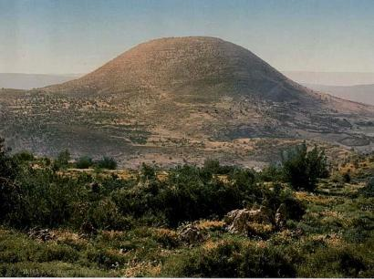
Mount of Glory
To The
Valley of Sorrow

Slide 3
The crisis
A Demon-Possessed Child
Mark 9:17-18, 20
A Desperate Father Struggling w/His Faith
Mark 9:22b-24
Failure of the Apostles
Mark 9:18b, 28-29
Scribes Seizing Upon The Apostles’ Failure
Mark 9:14c
Unbelieving Multitude Drawn to the Spectacle
Mark 9:14b, 19

Slide 4
Application
Our Failures Can Discourage Others
Rom 2:24
God Never Lets Us Down
Mark 9:23
Dependence On God Key To Spiritual Success
Mark 9:28-29; Matt 17:20a
Don’t Allow Others’ Failures To Dampen Your Faith
2 Cor 4:9
Life Is Full Of Mountains & Valleys
Eccl 3:1-4

