Slide 2
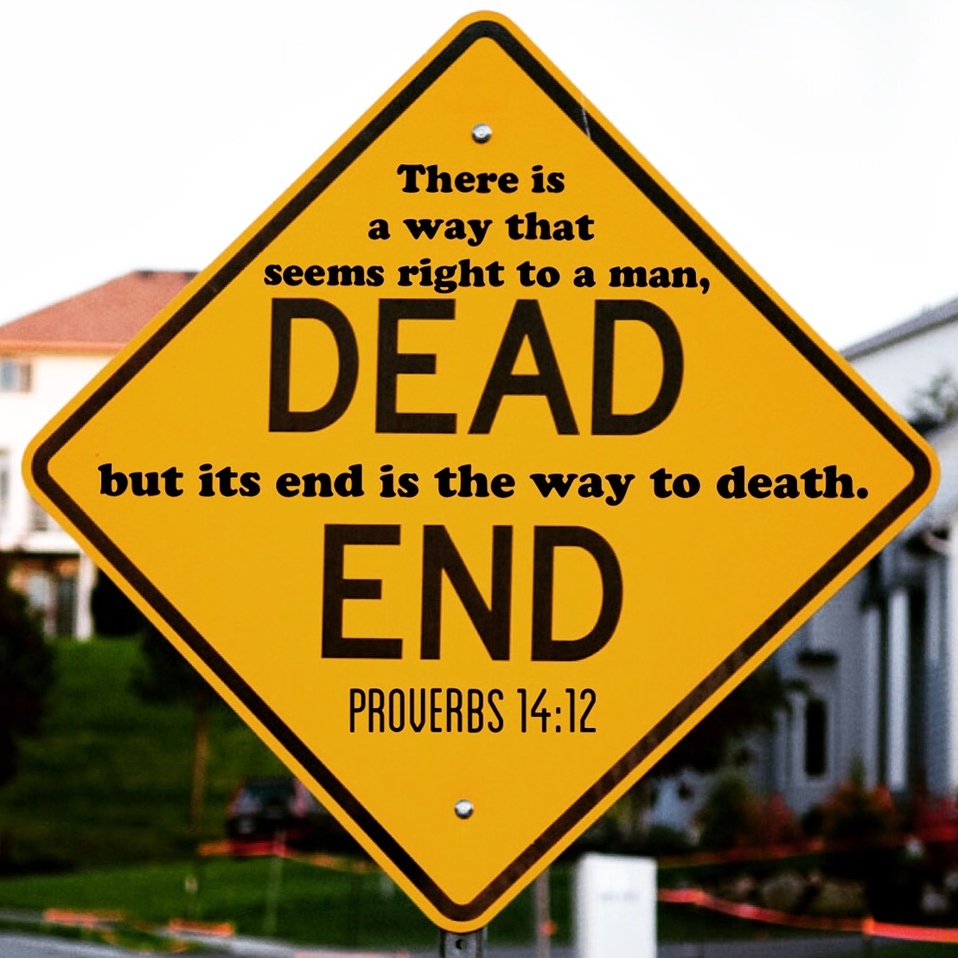

Slide 3
Ways That Seem Right
Things Not Explicitly Condemned In Scripture
1 Tim 3:14-15 vs. Gal 5:19-21a; Heb 5:14
It Is Legal
Rom 13:1 vs. Acts 5:29b; Matt 7:12; 14:4; 19:3-9
Majority Rule
Rom 12:17b-18; Phil 4:5; Acts 2:47a vs. Ex 23:2a; Matt 7:13-14
Ecclesiastical Sanction
Heb 13:7, 17 vs. 1 Kings 22:1-8
Safe/Agreeable/Consent
Gen 39:9c
Conscience
Rom 14:23 vs. Acts 23:1
Serves A Good Cause
Acts 10:38 vs. Matt 7:21-23
Happiness
John 15:11 vs. 1 Pet 4:19; 2 Tim 3:12

