Slide 3
Resistance
Jas 4:7 – “Submit therefore to God. Resist the devil and he will flee from you.”
1 Pet 5:8-9 – “Be of sober spirit, be on the alert. Your adversary, the devil, prowls around like a roaring lion, seeking someone to devour. But resist him, firm in your faith, knowing that the same experiences of suffering are being accomplished by your brethren who are in the world.”
Rom 8:13 – “for if you are living according to the flesh, you must die; but if by the Spirit you are putting to death the deeds of the body, you will live.”
Jas 1:3 – “knowing that the testing of your faith produces endurance.”

Slide 4
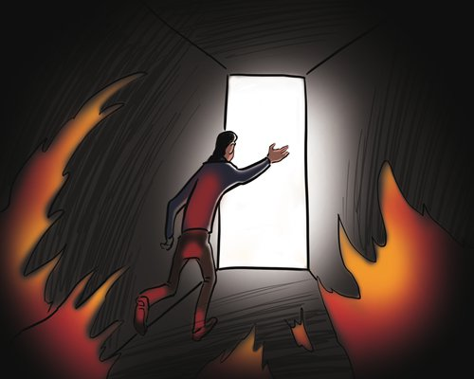
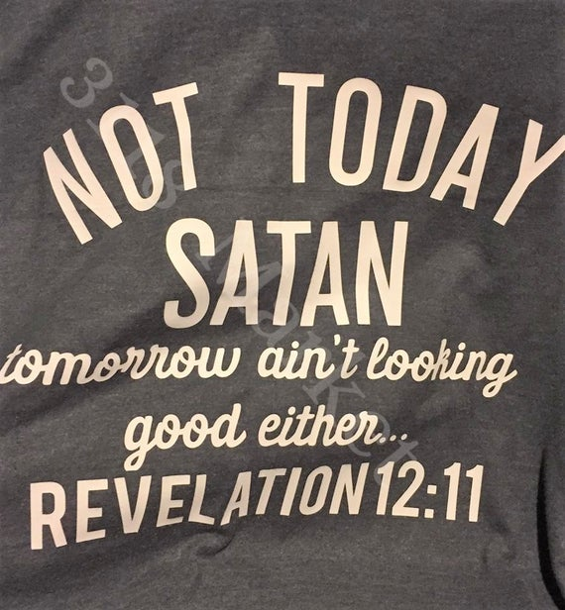
Resistance
1 Cor 10:13 – “No temptation has overtaken you but such as is common to man; and God is faithful, who will not allow you to be tempted beyond what you are able, but with the temptation will provide the way of escape also, so that you will be able to endure it.”
2 Pet 2:9a – “the Lord knows how to rescue the godly from temptation”
Heb 12:4 – “You have not yet resisted to the point of shedding blood in your striving against sin”
Heb 12:11 – “All discipline for the moment seems not to be joyful, but sorrowful; yet to those who have been trained by it, afterwards it yields the peaceful fruit of righteousness.”

Slide 5
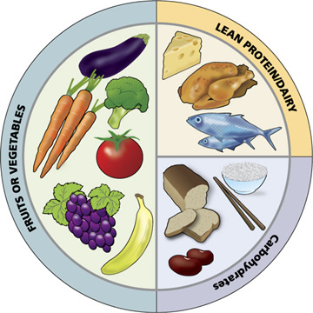
Reception
1 Pet 2:2 – “like newborn babies, long for the pure milk of the word, so that by it you may grow in respect to salvation”
1 Tim 4:6 – “In pointing out these things to the brethren, you will be a good servant of Christ Jesus, constantly nourished on the words of the faith and of the sound doctrine which you have been following.”
Jer 15:16a – “Your words were found and I ate them, and Your words became for me a joy and the delight of my heart”
Matt 4:4 – “Man shall not live on bread alone, but on every word that proceeds out of the mouth of God.’”
John 6:63 – “It is the Spirit who gives life; the flesh profits nothing; the words that I have spoken to you are spirit and are life.”

Slide 6
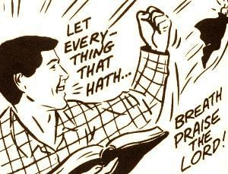
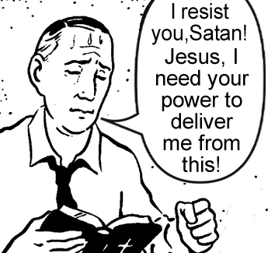
Reception
2 Pet 1:4 – “For by these He has granted to us His precious and magnificent promises, so that by them you may become partakers of the divine nature, having escaped the corruption that is in the world by lust.”

Slide 7
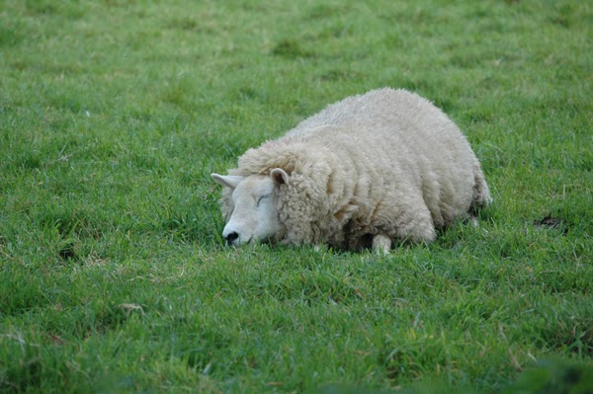
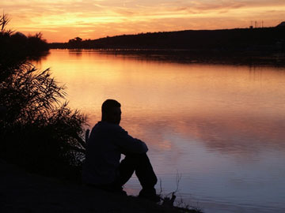
Rest
Psa 23:1-2 – “The Lord is my shepherd, I shall not want. He makes me lie down in green pastures”
Psa 46:10 – “Be still, and know that I am God.”
Mark 6:31a-32 – “And He said to them, ‘Come away by yourselves to a secluded place and rest a while.’”
Phil 1:12, “Now I want you to know, brethren, that my circumstances have turned out for the greater progress of the gospel.”

