Slide 2
2 Tim 2:15 – “Be diligent to present yourself approved to God as a workman who does not need to be ashamed, accurately handling the word of truth.”
John 7:24 – “Do not judge according to appearance, but judge with righteous judgment.”

Slide 3
“Anakrino”: “judge upward toward a conclusion”
Acts 17:11 – “Now these were more noble-minded than those in Thessalonica, for they received the word with great eagerness, examining the Scriptures daily to see whether these things were so.”
1 Cor 2:14-15 – “But a natural man does not accept the things of the Spirit of God, for they are foolishness to him; and he cannot understand them, because they are spiritually appraised. But he who is spiritual appraises all things, yet he himself is appraised by no one.”
“Diakrino”: “judge back-and-forth, separate, examine”
1 Cor 11:29 – “For he who eats and drinks, eats and drinks judgment to himself if he does not judge the body rightly.”
Acts 15:9 – “and He made no distinction between us and them, cleansing their hearts by faith.”

Slide 4
Builds
Discernment
Kills
Discernment
Knowledge
Emotion
Psa 119:99 – “I have more insight than all my teachers, for Your testimonies are my meditation.”
Prov 28:26 – “He who trusts in his own heart is a fool, but he who walks wisely will be delivered.”
Understanding
Fear of Failure
Prov 2:3 – “For if you cry for discernment, lift your voice for understanding”
Heb 5:14 – “But solid food is for the mature, who because of practice have their senses trained to discern good and evil.”
Trust
Bad Company
Psa 119:66 – “Teach me good discernment and knowledge, for I believe in Your commandments.”
1 Cor 15:33 – “Do not be deceived: ‘Bad company corrupts good morals.’”
Prov 14:7 – “Leave the presence of a fool, or you will not discern words of knowledge.”

Slide 5
Discerning Between…
Right Vs. Wrong
1 Kings 3:9 – “So give Your servant an understanding heart to judge Your people to discern between good and evil. For who is able to judge this great people of Yours?”
2 Cor 11:14-15 – “No wonder, for even Satan disguises himself as an angel of light. Therefore it is not surprising if his servants also disguise themselves as servants of righteousness, whose end will be according to their deeds.”
1 John 4:1 – “Beloved, do not believe every spirit, but test the spirits to see whether they are from God, because many false prophets have gone out into the world.”
1 Thes 5:21 – “But examine everything carefully; hold fast to that which is good”

Slide 6
Discerning Between…
Right Vs. Wrong
Good Vs. Better
1 Cor 7:25 – “Now concerning virgins I have no command of the Lord, but I give an opinion as one who by the mercy of the Lord is trustworthy.”
1 Cor 7:26 – “I think then that this is good in view of the present distress, that it is good for a man to remain as he is.”
1 Cor 7:28 – “But if you marry, you have not sinned; and if a virgin marries, she has not sinned. Yet such will have trouble in this life, and I am trying to spare you.”
1 Cor 7:38 – “So then both he who gives his own virgin daughter in marriage does well, and he who does not give her in marriage will do better.”

Slide 7
Discerning Between…
Right Vs. Wrong
Good Vs. Better
Better Vs. Best
1 Cor 7:8-9 – “But I say to the unmarried and to widows that it is good for them if they remain even as I. But if they do not have self-control, let them marry; for it is better to marry than to burn with passion.”
Rom 8:18 – “For I consider that the sufferings of this present time are not worthy to be compared with the glory that is to be revealed to us.”

Slide 8
Discerning Between…
Right Vs. Wrong
Good Vs. Better
Better Vs. Best
Permanent Vs. Transient
2 Cor 4:18 – “while we look not at the things which are seen, but at the things which are not seen; for the things which are seen are temporal, but the things which are not seen are eternal.”
Psa 39:4 – “Lord, make me to know my end and what is the extent of my days; let me know how transient I am.”

Slide 9
Discerning Between…
Right Vs. Wrong
Good Vs. Better
Better Vs. Best
Permanent Vs. Transient
Primary Vs. Secondary
1 Cor 15:3-4 – “For I delivered to you as of first importance what I also received, that Christ died for our sins according to the Scriptures, and that He was buried, and that He was raised on the third day according to the Scriptures”
Matt 23:23 – “Woe to you, scribes and Pharisees, hypocrites! For you tithe mint and dill and cummin, and have neglected the weightier provisions of the law: justice and mercy and faithfulness; but these are the things you should have done without neglecting the others.”

Slide 10
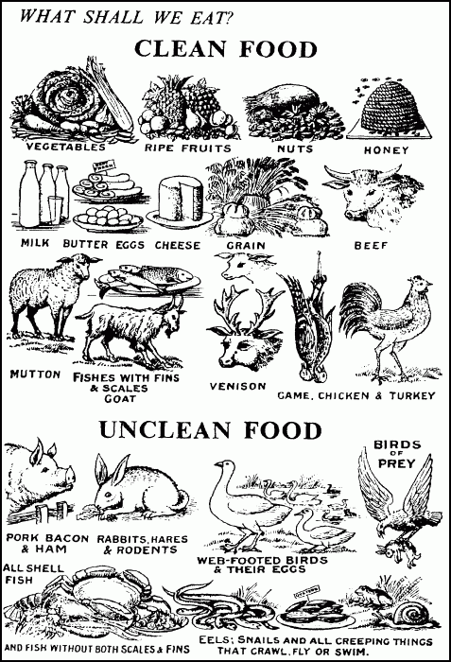
Discerning Between…
Right Vs. Wrong
Good Vs. Better
Better Vs. Best
Permanent Vs. Transient
Primary Vs. Secondary
Essential Vs. Indifferent
Rom 14:5-6 – “One person regards one day above another, another regards every day alike. Each person must be fully convinced in his own mind. He who observes the day, observes it for the Lord, and he who eats, does so for the Lord, for he gives thanks to God; and he who eats not, for the Lord he does not eat, and gives thanks to God.”
Rom 14:13 – “Therefore let us not judge one another anymore, but rather determine this—not to put an obstacle or a stumbling block in a brother’s way.”

