Slide 2
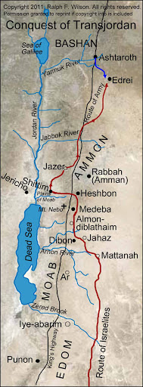
Lessons
From
Transjordania

Slide 3
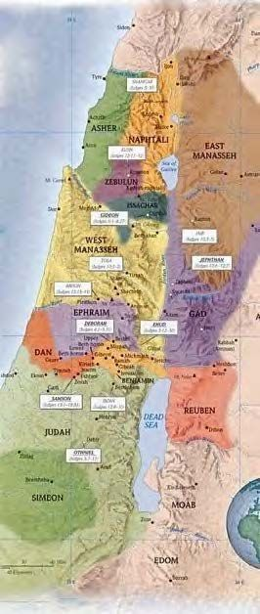
Possessions Became a Distraction
Num 32:1a – “Now the sons of Reuben and the sons of Gad had an exceedingly large number of livestock”
2 Cor 5:7 – “for we walk by faith, not by sight”
2 Tim 2:4 – “No soldier in active service entangles himself in the affairs of everyday life, so that he may please the one who enlisted him as a soldier.”
1 Tim 6:9 – “But those who want to get rich fall into temptation and a snare and many foolish and harmful desires which plunge men into ruin and destruction”

Slide 4
Possessions Became a Distraction
Inaction Discourages Brothers
Num 32:6-7 – “But Moses said to the sons of Gad and to the sons of Reuben, ‘Shall your brothers go to war while you yourselves sit here? Now why are you discouraging the sons of Israel from crossing over into the land which the Lord has given them?’”
Num 32:8-9 – “This is what your fathers did when I sent them from Kadesh-barnea to see the land. For when they went up to the valley of Eshcol and saw the land, they discouraged the sons of Israel so that they did not go into the land which the Lord had given them.”
Obad 1:11 – “On the day that you stood aloof, on the day that strangers carried off his wealth, and foreigners entered his gate, and cast lots for Jerusalem – you too were as one of them.”

Slide 5
Possessions Became a Distraction
Inaction Discourages Brothers
Separation Leads To Misunderstanding
Josh 22:10 – “When they came to the region of the Jordan which is in the land of Canaan, the sons of Reuben and the sons of Gad and the half-tribe of Manasseh built an altar there by the Jordan, a large altar in appearance.”
Josh 22:12 – “When the sons of Israel heard of it, the whole congregation of the sons of Israel gathered themselves at Shiloh to go up against them in war.”
1 Cor 13:7 – “[love]...believes all things, hopes all things…”
Prov 18:13 – “He who gives an answer before he hears, it is folly and shame to him.”
1 Cor 8:9 – “take care that this liberty of yours does not somehow become a stumbling block to the weak.”

Slide 6
Possessions Became a Distraction
Inaction Discourages Brothers
Separation Leads To Misunderstanding
Josh 22:22-23 – “The Mighty One, God, the Lord, the Mighty One, God, the Lord! He knows, and may Israel itself know. If it was in rebellion, or if in an unfaithful act against the Lord do not save us this day! If we have built us an altar to turn away from following the Lord, or if to offer a burnt offering or grain offering on it, or if to offer sacrifices of peace offerings on it, may the Lord Himself require it.”
Josh 22:30 – “So when Phinehas the priest and the leaders of the congregation, even the heads of the families of Israel who were with him, heard the words which the sons of Reuben and the sons of Gad and the sons of Manasseh spoke, it pleased them.”

Slide 7
Possessions Became a Distraction
Inaction Discourages Brothers
Separation Leads To Misunderstanding
Separation Exposes Us To Enemy
1 Chron 5:26 – “So the God of Israel stirred up the spirit of Pul, king of Assyria, even the spirit of Tilgath-pilneser king of Assyria, and he carried them away into exile, namely the Reubenites, the Gadites and the half-tribe of Manasseh…”
1 Pet 5:8 – “Be of sober spirit, be on the alert. Your adversary, the devil, prowls around like a roaring lion, seeking someone to devour.”

