Slide 1
Psalms
A discussion of Three Psalms - 1,2 & 3

Slide 2
Psalm 1 – The Truly Happy Man
1 Blessed is the man (stair step \ progressive) who walks not in the counsel of the wicked, nor stands in the way of sinners, nor sits in the seat of scoffers
2 but his delight is in the law of the Lord, (cause & effect \ synthetic) and on his law he meditates day and night.
3 He is like a tree planted by streams of water that yields its fruit in its season, and its leaf does not wither. In all that he does, he prospers.
The blessings of the righteous man are described from the negative by showing what he will NOT do. The truly happy (or blessed) man is described as not allowing himself into the presence or under the influence of the wicked.
On the positive side we see his joy is in the law of the Lord which nourishes him like a strong tree planted by a stream of water
Woven through it all “happiness can only be found in God”

Slide 3
Psalm 1 – The Way of the Wicked
4 The wicked are not so, (simile \ metaphor) but are like chaff that the wind drives away.
5 Therefore the wicked will not stand in the judgment, (repetition \ synonymous) nor sinners in the congregation of the righteous;
By contrast to the righteous we see the wicked are NOT blessed. The are like chaff driven by the wind. In the judgement they will not stand and they aren’t blessed to be in the congregation of the righteous.
6 for the Lord knows the way of the righteous, (contrast \ antithetical) but the way of the wicked will perish.
The Psalm ends with a contrast between the “two ways”. This Psalm in many ways sets the tone and mindset for much of what is to come in the entire collection.

Slide 4
Psalm 2 – Victory of the Messiah
Scene 1: The Nations Rebel (vs 1- 3)
Humanity has always sought to set itself above God or in a place without any guidance from Him.
Scene 2: God Laughs (vs 4 – 6)
God laughs at mankind's plans against him
Scene 3: The Anointed Ruler (vs 7 – 9)
God has chosen His Son King over the nations. When we look at the world today we understand that Jesus will return and justice will come with Him.
Scene 4: The Warning (vs 10 – 12)
God gives the Ruler’s of this world hope. Serve the Lord and take refuge in Him.

Slide 5
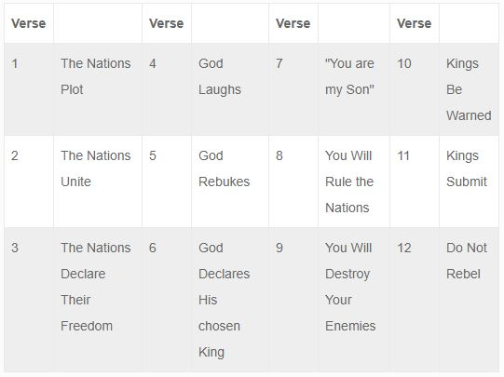
Psalm 2 – Victory of the Messiah

Slide 6
Psalm 3 – Confronting Our Fears\Anxieties
A Psalm of David, when he fled from Absalom his son.
The first Psalm attributed to David
Deals with real life struggle of fear\anxiety many of us deal with
In no way does David deny his emotions
In no way does David allow his emotions to control him
David lays the emotions before God and takes refuge in God
Instead of taking confidence in himself, he takes confidence in God
Heb 9:12-14 (our confidence is so much greater)
David’s faith made him whole

