Slide 1
Notes:
The Sermon On The Mount is arguably the greatest teaching of Jesus that we have recorded in scripture. There is not a preacher or teacher of the bible who can eclipse what Jesus said in these 3 chapters of Matthew. This teaching has gone on to inspire and transform the lives of millions if not billions of people since the time it left Jesus’ mouth.
One thing that makes the SOTM so great is that it covers every aspect of our life. In the OT, they treated the 10 Commandments as such, a template for day to living. What many of the Jews didn’t realize, though, was that the 10 Commandments were simply a template of the 2 greatest commandments, loving God above all else as represented in the first 4 commandments, and then loving your neighbor as yourself in the last 6. The SOTM is the same way. It covers many aspects of our duty toward both God and man, loving God with everything we’ve got and loving our neighbor as ourselves (Matt 22:37-40).
Yet this was a very different kind of sermon than what the people had heard on a weekly basis from the religious elite. It ran completely against the grain of everything they had been taught and come to accept by the scribes and Pharisees who had twisted the law and obscured the nature of the kingdom by forcing through their traditions. And for that reason alone, what Jesus taught here would have come across as very radical, yet profoundly revolutionary. Because When Jesus preached the kingdom, He was preaching something different. It’s not that what He taught hadn’t already been addressed in the OT; it had. It’s just that the Jews had conveniently missed a lot of it. And so, this was new only in that sense.
This sermon describes the transformation that occurs in a person who truly repents. It teaches the righteousness of true children of God as opposed to someone who just decides to call themselves “Christian”.

Slide 2
Notes:
And it begins with the Beatitudes, a Latin word that means “blessed”, in fact “supremely blessed”, blessed in the highest imaginable terms. And this words appear 8 times in the beginning of Matthew 5. To be “blessed” is to perceived by Almighty God Himself as a person truly fit for the kingdom. In other words, if you were to ask, “Does God consider me blessed?”, you can answer that by doing an inventory of your life against these 8 Beatitudes, because every characteristic of the Beatitudes is a characteristic of a true child of God, a person that is truly fit for the kingdom of God. We’re going to need to be able to put a check mark beside each of these Beatitudes if we’re going to make such a claim.
One of the worst translations of this word, though, are those translations that use the word “happy”. Because as we observe what a blessed people look like, we’re going to see that this blessedness is not a happiness based on external qualities or external circumstances. None of these attributes are physical in nature. There is nothing here about being good looking, rich, charming, or intelligent. In fact, it doesn’t look like people with these attitudes are in very good condition. But they are. People that reflect these qualities, despite external circumstances, are in the best possible condition a person can be in despite the trouble it brings on them from those in the world.
Also, none of these qualities are inherited. They won’t be programmed in your genes or chromosomes. It’s not that some people are just born w/these qualities and others aren’t and so “what do you?” No, these are things that we must choose for ourselves by virtue of what we recognize about God and recognize about ourselves.
Also, none of these Beatitudes are about an elite group of disciples. They are not qualities you would only expect to find in those who are elders, deacons, or preachers. If there is anything the SOTM teaches that I would want to instill in you, it’s that the highest calling a person can have in the kingdom of God is to simply be a Christian. Not “called” a Christian, but a real Christian. That is what these first 12 verses are describing: a peculiar, different kind of people who make a real difference in the world.

Slide 3
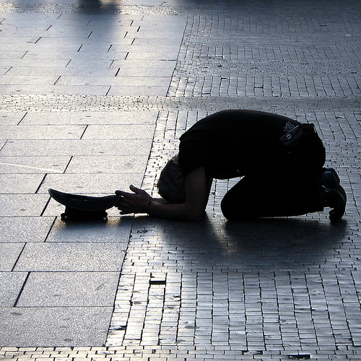
The Poor In Spirit
Matt 5:3 – “Blessed are the poor in spirit, for theirs is the kingdom of heaven.”
Deep sense of spiritual bankruptcy
Recognize the great chasm created between ourselves and God
Example: Beggar
Conclusion: Qualifies a person to inherit the kingdom of heaven
Notes:
The poor in spirit are those who have a deep and abiding sense of their spiritual bankruptcy before the holy God of heaven. Most people in this world don’t recognize the great chasm that sin creates between us and God. And then there are few who do, and they recognize in a very way that this, “I did this. I’m responsible for it.”
And so being poor in spirit can be compared to a man who is begging for food. He’s not begging because he’s owed anything or because he’s earned it. He’s begging because he needs it more than anything, and he’s pleading for mercy on behalf of the one who can help him, like Lazarus begged for scrap at the rich man’s table in Luke 16. And if you want an apt definition of what true Evangelism is all about, it’s one beggar telling another beggar where he can get bread.
There are certain things a person poor in spirit will never do:
The poor in spirit do not minimize sin through generalization (Rom 3:23) . To this person, their sin is personal; they are personally aware of it to their core.
The poor in spirit do not rationalize (1 Sam 15:21). “I know I’ve sinned, but…” – The poor in spirit take full responsibility.
The poor in spirit do not play the blame game (Gen 3:12-13). They feel personally accountable for their mistakes and confess them openly - full disclosure.
The poor in spirit does not sit in a bible class or sermon thinking about everyone else who needs to hear the lesson. They’re thinking about their own personal, spiritual needs.
To be a person that never tries to save face as it pertain to their sin, that is such a rare thing. This is a revolutionary sort of thing, and God has prepared a special place for them called the kingdom of heaven

Slide 4
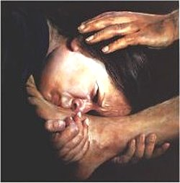
The Mournful
Matt 5:4 – “Blessed are those who mourn, for they shall be comforted.”
Choose to mourn over our sin
The mournful are deeply grieved they have let down their Creator
Examples: Isa 6:5; Luke 7:36-40; 2 Cor 7:10
Conclusion: God provides a comfort to the spiritually mournful that the world cannot (2 Cor 1:3; Rev 21:4)
Notes:
“Those who mourn” are not to be confused w/all people who have experienced physical loss. Hitler knew this pain, so did the Apostle Judas up to the point that he killed himself. The most wicked of men have experienced this kind of mournfulness. The mournful of the beatitudes are those who choose to be mournful about the sin in their life. They feel the pain of having let down their Creator and they are deeply grieved by that.
In Isa 6, Isaiah mourned over his uncleanness as he stood before God in heaven – Isa 6:5 – “Woe is me, for I am ruined! Because I am a man of unclean lips, and I live among a people of unclean lips; for my eyes have seen the King, the Lord of hosts.”
In Luke 7, we read about a woman who wept at the feet of Jesus, wiping the tears from His feet w/her hair and kissing them and anointing them w/perfume. Jesus went on to say that her sins, which are many, were forgiven because she loved much.
In 2 Cor 7:10, Paul alluded to a “godly sorrow” that must exist before real repentance can be manifest. There’s a worldly sorrow of the likes of Judas, who grieves but then goes and hangs himself. Then there is a godly sorrow of the likes of Peter who though denying the Lord 3 times, wept, went on to repent, and became a bedrock in the kingdom. Paul says godly sorrow produces a repentance w/o regret.
Those of this mentality are comforted by God in ways we can’t possibly imagine. In Rev 21:4, we’re told that once in heaven, God will wipe away every tear from our eye. 2 Cor 1:3 calls God “the God of all comfort”. But to receive this comfort, we must come to full terms w/our sinfulness and response w/the mournfulness and godly sorrow incumbent of true spiritual regret.

Slide 5
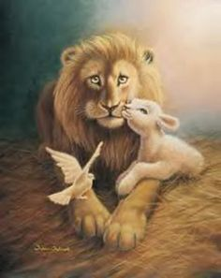
The Meek
Matt 5:5 – “Blessed are the meek, for they shall inherit the earth.”
Meekness is strength under control
Places principle before passion
Examples: Num 12:3; Matt 26:53
Conclusion: The future belongs to those who are of this disposition
Notes:
Some of your translations say “gentle” instead of meek, which IMHO doesn’t do justice to the idea. Because while a meek person is gentle, a gentle person is not necessarily meek. Meekness is strength under control. Meekness is displayed most fully when a person has power and passion, but he sacrifices them for godly principle.
Meekness is not indifference to sin. In Num 12:3, we are told that Moses was the meekest most humble man on the planet. But at the same time, he defended rebuked the Israelites when they made the golden calf and even grinded it into dust, sprinkled it on the water and made the ones responsible drink it. Does that sound like a man indifferent to sin?
There is also an expression that says, “meekness is weakness”, as if the fact that 2 words rhyme mean they are the same thing. Meekness is not weakness. In Matt 26:53, Jesus claims to have 12 legions of angels at His disposal. That’s 72,000, far more than “the 10,000 angels” we sing that he could have called. Yet 1 angel killed 185,000 Assyrian troops overnight, so how many did He need? And could He not have wiped them out Himself? No, meekness is not weakness. A person who is meek is always looking out for both the interests of God and the interests of his fellow man and so he sacrifices certain rights afforded to him, including his own power and strength, to achieve a greater cause of godliness.
That he will inherit the “earth” means he will inherit the “land”. The land of Canaan is probably a type used to describe heaven. Its safe to say that the future belongs to the meek.

Slide 6
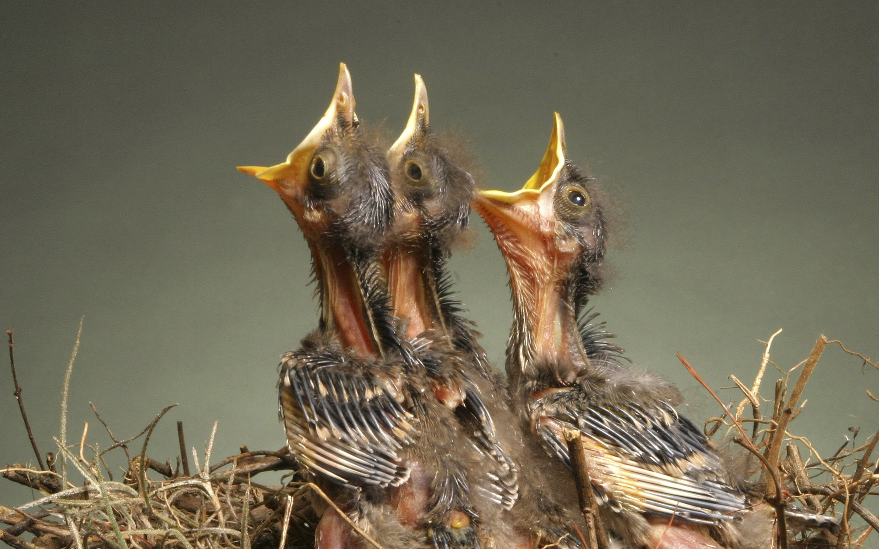
Hunger & Thirst For Righteousness
Matt 5:6 – “Blessed are those who hunger and thirst for righteousness, for they shall be satisfied.”
Spiritual poverty and mourning will starve us into seeking righteousness at all costs
Our effort as Christians should come from a desire to be close to God
Examples: Psa 63:1; John 4:14
Conclusion: Such people will not be denied the satisfaction and peace they long for (Psa 107:9)
Notes:
Going back to the poor in spirit, those who recognize the immense chasm created between them and God, will respond w/mournfulness. This creates a vacuum that needs to be filled. And so, those who hunger and thirst after righteousness do so as a result of the spiritual poverty and mournfulness already exhibited. This Beatitude is the natural consequence of the first 2.
Everything we do as Christians should come from a desire to be closer to God and for no other reason. We should be coming to bible class and to worship not because we belong here, but because we’re starving to be right with God. We seek to fill ourselves w/carnal pursuits because we think they’ll bring ultimate fulfillment and satisfaction. But as Solomon said in Ecclesiastes, it’s all vanity. They don’t ultimately satisfy.
Psa 63:1 – “O God, You are my God; I shall seek You earnestly; my soul thirsts for You, my flesh yearns for You, in a dry and weary land where there is no water.” David’s own soul thirsted and longed for God to the point that it dehydrated him spiritually.
Why? Because we are made in God’s image, and people made in God’s image can’t be satisfied by things that are fleeting. The only thing that leads to pure, utter satisfaction is longing for God above all else – the greatest commandment. Every other idol in life will leave us as empty as the idol itself.

Slide 7
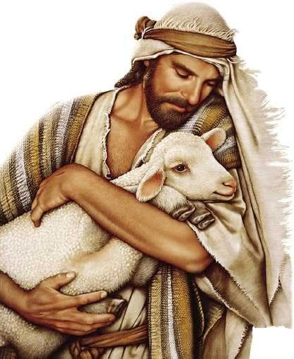
The Merciful
Matt 5:7 – “Blessed are the merciful, for they shall receive mercy.”
Those forgiven by God should show mercy and forgiveness to others
Example: Matt 18:21-35
Count how many times we’ve been forgiven by God and extend this same forgiveness to others
Conclusion: Only the merciful will find mercy on judgment day
Notes:
It should go without saying that a person who has been forgiven by God and is therefore trying to be holy as God is holy, he should by default show mercy and forgiveness towards those who sin against him. If he doesn’t, that is a person who Jesus says later on in the Lord’s prayer He will not forgive – Matt 6:14-15 – “For if you forgive others for their transgressions, your heavenly Father will also forgive you. But if you do not forgive others, then your Father will not forgive your transgressions.”
A prime example is in Matt 18:21-35 regarding the parable of the debtors. One debtor owed an enormous amount: 10,000 talents. (1 talent = 6000-manhours of labor; 10,000 talents = ~29,000 years of work). This means he couldn’t pay off that amount if he lived 500 lifetimes. Yet the master forgives his debt. Then there is a second debtor who owes the first debtor far less: 100 denarii which some say would be the cost of a pair of soldier’s boots. The first debtor wouldn’t forgive this second debtor. Matt 18:34-35 – “And his lord, moved with anger, handed him over to the torturers until he should repay all that was owed him. My heavenly Father will also do the same to you, if each of you does not forgive his brother from your heart.”
A helpful way to look at this is to count up how many times God has forgiven you, and if you can even fathom a number, that is how often we should forgive our brother. If you cannot bring yourself to do so, you will forsake eternity. Only the merciful will find mercy on judgment day.

Slide 8
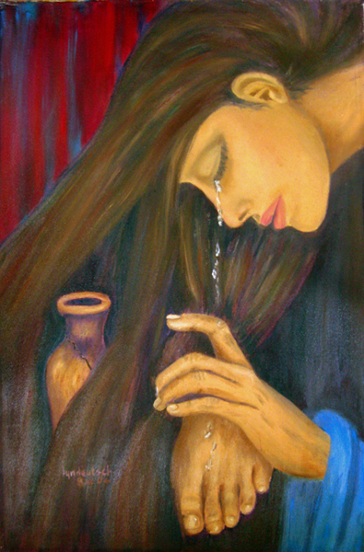
The Pure In Heart
Matt 5:8 – “Blessed are the pure in heart, for they shall see God.”
Genuine, sincere desire to be pure in heart
A broken-heart that wants single-minded devotion to God
Examples: Luke 8:15; Psa 24:3-4
Conclusion: Will begin to see and understand God in the present
Notes:
The pure in heart are not those who are perfectly moral and infallible in every sense of the word. If that were the meaning, none of us could be blessed and it would make you wonder what we had to mourn over and be bankrupt in spirit over. Rather, those pure in heart are people who have a genuine desire to be right. It’s a broken-heart that desires single-minded devotion toward their Savior. Going back to Luke 7 and the woman who wept at Jesus’ feet, she was far from morally pure. Jesus even said, “her sins are many”. But her heart was pure in that she desired to be better and nothing was going to stand in her way to seek Jesus, not even the scowling hypocritical Pharisees.
Luke 8:15 – “But the seed in the good soil, these are the ones who have heard the word w/an honest and good heart, and hold it fast, and bear fruit with perseverance.” That’s what pure in heart means – an honest heart. A heart that has retrospection and is open to hearing the truth and to doing what is right when it finds it is going the wrong way, thinking the wrong way. When a person has that. Psa 24:3-4 – “Who may ascend into the hill of the Lord? And who may stand in His holy place? He who has clean hands and a pure heart, who has not lifted up his soul to falsehood and has not sworn deceitfully.”
What does it mean that they shall see God? Those with a desire to be pure in heart begin to see, understand, and comprehend God now even though they cannot see Him with their eyes. They’re not blinded by all the deceit an carnality that has infected the rest of the world. Through an honest pure heart, they have insight into spiritual things and see the unseeable.

Slide 9
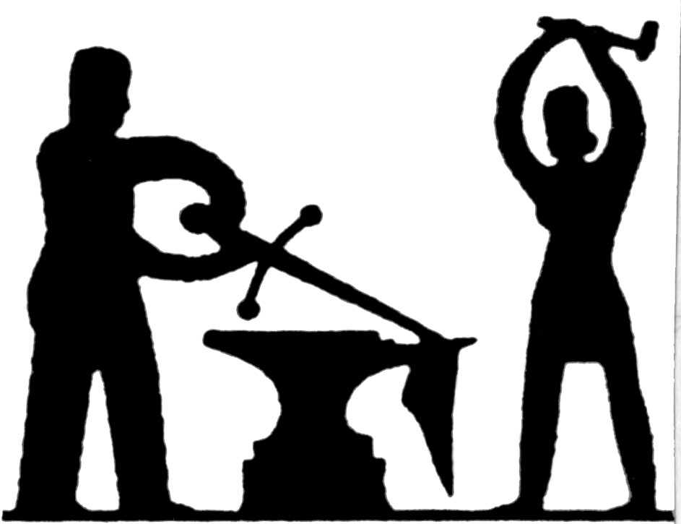
Peacemakers
Matt 5:9 – “Blessed are the peacemakers, for they shall be called sons of God”
Those promoting harmony and unity amongst citizens of the kingdom
Those striving to bring unbelievers to the peace of Jesus Christ
Examples: Isa 2:4; John 14:27
Conclusion: No other people could truly be called the children of the God of peace (Rom 15:33)
Notes:
One of the biggest reasons Jesus came down here and died for our sins is so that we could find peace through reconciliation w/God. Putting on Christ means we are no longer subject to the wrath of God. Therefore, desiring to be like God, we are to be a people who strive for unity and harmony amongst our brethren as well as introducing the unbelieving to the peace they can have with Jesus Christ.
Regarding peace w/one another, Isa 2:4cde – “they will hammer their swords into plowshares and their spears into pruning hooks. Nation will not lift up sword against nation, and never again will they learn war.” In other word, all the carnal strength that wages war prior to becoming a Christianity will go towards fighting spiritual battlers. All our abilities we used to get ahead in the rat race will go toward serving one another.
Regarding teaching peace to others, John 14:27 – “Peace I leave with you; My peace I give to you; not as the world gives do I give to you. Do not let your heart be troubled, nor let it be fearful.” People need to be reminded that out there, there is no peace, only conflict after conflict. But Jesus came to bring a peace that surpasses understanding so that despite external circumstances, as long as we know we’re headed to be with Him in heaven, nothing down here can shake us. That’s a peace the world cannot teach, and we need to take that message of peace to every ear that will hear.
Given God’s peace-bringing nature, no one could more aptly be called sons of God than the peacemakers among us. In Rom 15:33, He is called “the God of peace” and Rom 12:18 – “If possible, so far as it depends on you, be at peace with all men.”

Slide 10
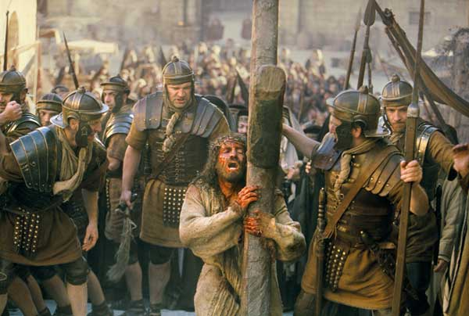
Persecuted For Righteousness
Matt 5:10-12 – “Blessed are those who have been persecuted for the sake of righteousness, for theirs is the kingdom of heaven. Blessed are you when people insult you and persecute you, and falsely say all kinds of evil against you because of Me. Rejoice and be glad, for your reward in heaven is great; for in the same way they persecuted the prophets who were before you.”
Such people are painful reminders to a world choosing to live in darkness – John 3:19-20
Examples: John 1:10-11; 15:18-19
Conclusion: Reward in heaven is great
Notes:
This is interesting, because you would think that people who lived like this would be the most admired, most praised people in the entire world. Everyone should admire a person with these qualities – these are the best of people. So why those Jesus follow this up w/assuring us that we will be persecuted? Because people of this quality of character become living reminders to a world that chooses to pitch its tent in the darkness that they could make the same choices, but they chose otherwise. And so rather than respecting the choice of others who do choose this way of life, they resent them – John 3:19-20 – “This is the judgment, that the Light has come into the world, and men loved the darkness rather than the Light, for their deeds were evil. For everyone who does evil hates the Light, and does not come to the Light for fear that his deeds will be exposed.”
Think about Jesus, the greatest man who ever lived – John 1:10-11 – “He was in the world, and the world was made through Him, and the world did not know Him. He came to His own, and those who were His own did not receive Him.” If the greatest man who ever lived could not avoid persecution, neither can His followers – John 15:18-19 – “If the world hates you, you know that it has hated Me before it hated you. If you were of the world, the world would love its own; but because you are not of the world, but I chose you out of the world, because of this the world hates you.” There is no escape from persecution for those who desire to live godly in this world because there was no escape for Jesus.
And so, if the thought of slander, rejection, and hardship in this world is just too much to handle, you’re not going to make it in the kingdom. You’ll at first begin to compromise, but eventually you’ll fold completely. That is why it is so important to develop a healthy sense of self-worth in Christ early, because if we don’t, we’re going to care too much about what man thinks and we’ll miss out on that great reward in heaven that is promised us.
We need to press through knowing that what doesn’t kill us makes us stronger and more resolved, filling up what is lacking in Christ’s affliction (Col 1:24).

Slide 11
Notes:
There may be no better description of what it means to be a transformed creature than what we find in the Beatitudes.

