Slide 1
Notes:
The Sermon on the Mount was arguably the greatest sermon ever preached. The OT had taught these principles, and everything taught in this sermon can be summarized into the two greatest commandments of loving the Lord our God with everything we’ve got and loving our neighbor as ourselves. But it was unique teaching to 1st-century ears because it countered everything they’d been taught by the so-called religious elite. And though Jesus knew this ran against the grain of popular convention, He preached it anyway, striking at the very heart of what true citizenship in God’s kingdom is really about.
The Beatitudes set the tone. We are blessed when we have a deep sense of our spiritual poverty, when we mourn over our sin, when we portray meekness in spite of the rights and liberties that being citizens of this nation allow us, and when we hunger and thirst for a right relationship with God. People worthy of the kingdom are merciful towards others because of the abundant mercy God has shown towards them, desiring pureness of heart, and the peace and harmony that comes with being part of a spiritual family. And you’d think that people with this quality of character would be the most honored people in all the world. Yet Jesus concludes the Beatitudes by affirming that rather than being honored, this kind of person will provoke reviling, slander, and persecution. Why? Because becoming this blessed people is a choice, and many choose to pitch their tents in darkness, and so they resent those who choose to strive in the light because being a true disciple of Christ is a perpetual reminder of their sin. And if this suffering and difficulty was all that we had to look forward to in our life, assuming no promise of heaven at the end of our journey, it would certainly be a valid question to ask if it were truly worth it.

Slide 2
Notes:
But there is indeed a reward waiting for us, and Jesus continues this sermon of sermons by explaining how strong and attractive our influence can be when we take on these attitudes, how powerful a force we can be for those who, though dwelling in darkness, have good and honest heart – Matt 5:13 – “You are the salt of the earth; but if the salt has become tasteless, how can it be made salty again? It is no longer good for anything, except to be thrown out and trampled underfoot by men.”
One of the reasons why Jesus’ teaching was so attractive to the masses was because He used illustrations like this one that every single person in the audience of that particular time and culture could have understood. It can be harder for us because we’re 2000 years removed. We’re not an eastern culture or an agrarian society as they once were. But these people were well acquainted with salt and its characteristics, and Jesus saying “You are the salt of the Earth” would have immediately gotten them thinking about what characteristics of salt Jesus was actually comparing them to.

Slide 3
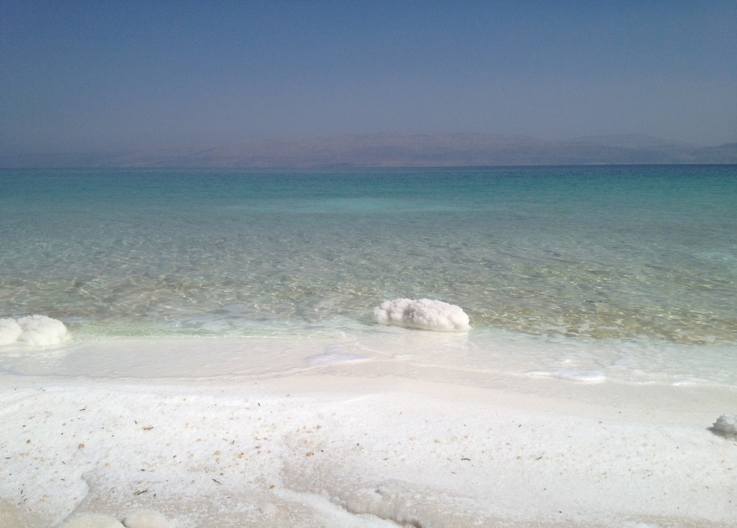
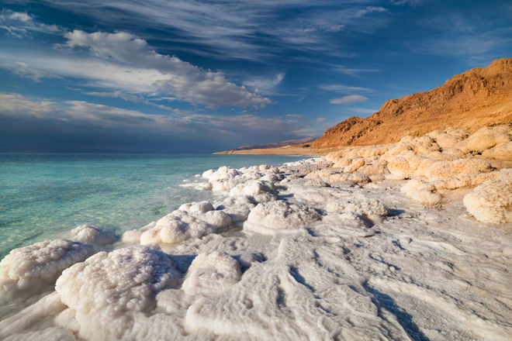
The Salt Of The Earth
Matt 5:13 – “You are the salt of the earth; but if the salt has become tasteless, how can it be made salty again? It is no longer good for anything, except to be thrown out and trampled under foot by men.”
God Can Purify Us
Notes:
(Eph 2) Now, at that time, salt was available in abundance because so much of it washed ashore at the Dead Sea. But what they gathered from shore would have been very impure and mostly useless. It would’ve needed to be processed in order to remove the impurities and actually make it useful. Brethren, that’s us. I mean, think about who we were before God gathered us into His kingdom – Eph 2:1 – “And you were dead in your trespasses and sins”. But when God saves us and gathers us into His kingdom, we come to Him, as we so often sing, “just as I am”, with all our impurities and our sin. And what does He do to us? – Eph 2:5 – “made us alive with Christ, even when we were dead in our trespasses…”. And so God takes us in our deadness and he makes us alive. Then He disciplines us, He prunes us, taking what was once without value and makes us invaluable, and pure, and full of worth, all because of His wonderful grace.
See, despite how impure salt was at it lay on the shores of the Dead Sea, when it was purified, it was actually very expensive monetarily, much more expensive at that time than what we find in our grocery stores today. In that day, Roman soldiers were often paid with salt for their labor, which is where our word “salary” comes from, the root word for “salt”. The expression “He is not worth his salt” originates from the ancient Greek practice where salt was traded for slaves. No matter how sinful we have been in our past, no matter what we’ve done, if we have obeyed the gospel of Jesus Christ, we belong to God and we have value. God wants you, He can use you. We are invaluable to God.
So it is true that no matter how impure of a life you may live that you can come to God just as you are. But you can’t stay that way. No, we are the salt of the earth and that means God has a purpose for His new creation and that purpose is that we’ll be a powerful influence in this lost world.

Slide 4
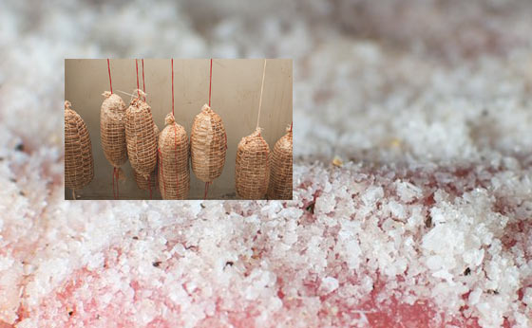
The Salt Of The Earth
Matt 5:13 – “You are the salt of the earth; but if the salt has become tasteless, how can it be made salty again? It is no longer good for anything, except to be thrown out and trampled under foot by men.”
Christians Preserve/Save Mankind
Notes:
Now, there were two primary purposes for salt in the 1st century: to prevent decay and to act as an antiseptic, to preserve as well as to prevent infection of disease.
First, before electricity was invented, people did not have the luxury of storing their fish and other perishable meats in refrigerators – they packed it in salt. They packed it in salt because salt is a natural preservative, and that is one of the things Jesus is telling us in this verse that we are. We are the salt of the earth because we are a preservative to this earth, a saving force in this world in the same sense that salt is a preserver and saving force to perishable meat. By way of influence, our natural function as Christians should be to prevent the moral decay of sin that is infecting our world.
(Rom 10) As disciples, and we’ve been given the responsibility to carry the gospel, as a saving force, to this lost world. That is our job. God has no hands but our hands. And unless we do this, the world will be doomed because a world without disciples carrying the message of the gospel is a world condemned for lack of the truth of things truly are – Rom 10:14-15 – “How then will they call on Him in whom they have not believed? How will they believe in Him whom they have not heard? And how will they hear without a preacher? How will they preach unless they are sent? Just as it is written, ‘How beautiful are the feet of those who bring good news of good things!’”. Now we generally think of preaching as what we see on Sunday mornings, a formal presentation by someone with the responsibility to stand up and talk about religious things. But it’s so much more than that. To “preach” is to “advocate”. To “advocate” is “to plead in favor of, to support or to urge by means of some argument”. When Jesus told the Apostles in Mark 16:15 to “Go into all the world and preach the gospel to every creature…”, he’s not telling them to make sure they stand up on a regular basis and give a formal presentation about spiritual things. Certainly that is included, but the way the bible uses the word “preach” is much like how your kid uses the word when they say, “I wish you’d quit preaching to me”. Because when we “preach” to someone, we’re teaching with passion. We’re dispensing information that is born out of urgency because of the importance of the information. If your child walked out in the middle of a highway without looking both ways, you wouldn’t say, “Now be careful or you’re going to get hit by a car”. No, you would go to great lengths to impress upon their mind how dangerous it is what they’re doing. Jesus is telling us, “You are the salt of the Earth, you are the preserving power by which lost men and women can hear the good news that I have delivered them”. And if we don’t do this, men and women of this world are going to be condemned.

Slide 5
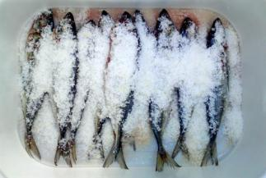
The Salt Of The Earth
Matt 5:13 – “You are the salt of the earth; but if the salt has become tasteless, how can it be made salty again? It is no longer good for anything, except to be thrown out and trampled under foot by men.”
Christians Preserve/Save Mankind
Notes:
Now in order for us to fulfill our responsibility as the salt of the earth, as a preserving and saving power to this world, we’ve got to do what salt does. Salt can only preserve that which is perishable by getting in close contact with the object that it is trying to preserve. You can’t just place a bucket of salt in the same room with the meat you’re trying to preserve can you? That won’t work. It has to make close contact. This means we can’t isolate ourselves from people. We have a God-given responsibility to teach them not just by word, but by the influence that comes from our good example. The ancient monks didn’t understand this. When they observed wickedness in their communities they thought the best thing to do was to seclude themselves from the world by living in caves and such; then as time went on they relished in this seclusion and it turned into religious pride. And I understand that we’re to guard ourselves from the world and to limit our association in one extent, but there is a balance we need to strive for. Because we can’t reach a lost world and avoid any and everyone who offends our delicate sensibilities. We can’t reach a lost world by limiting our discipleship to Sun and Wed church attendance and studying the bible on our own. We’ve got to go out and “rescue the perishing”, making contact w/people, because that’s what salt does. People in this world won’t stand a chance come judgment day without the preserving power that Christians can bring them by being the salt God created us to be. Because the word “salary” is not the only word to come from the root word for salt. It’s also where we derive our word “salvation”. Salt is a preserving power.

Slide 6
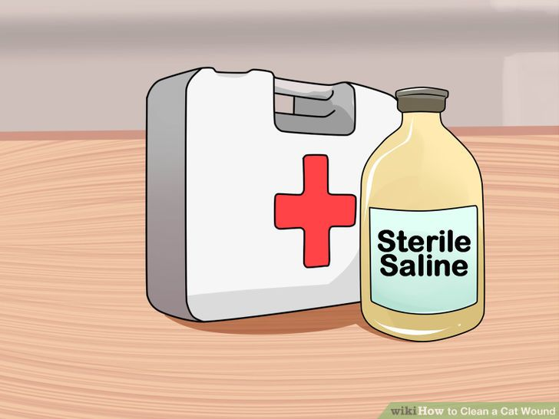
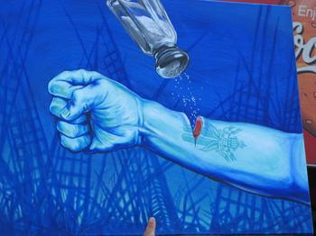
The Salt Of The Earth
Matt 5:13 – “You are the salt of the earth; but if the salt has become tasteless, how can it be made salty again? It is no longer good for anything, except to be thrown out and trampled under foot by men.”
Salt Stings, Yet Heals
Notes:
But it’s also an antiseptic, isn’t it? You can take salt and rub it on a blister or an open wound, and it’ll weaken the bacteria and prevent it from causing an infection. But it doesn’t feel good does it? It helps! It heals! But it irritates, doesn’t it? Salt doesn’t irritate everything though. If I were to take some salt and pour it on my arm, I would feel no irritation, no pain whatsoever. But take that same salt and pour it on an open wound, it’s going to hurt! It’s going to irritate and sting and burn and I’m going to want to rinse it off as soon as possible. But the salt didn’t cause the wound, did it? No, all it did was emphasize the fact that a wound is there and it is trying to help heal the wound.
Is there a more fitting metaphor for gospel preaching? The very presence of believers in this dying world stings the consciences of the ungodly and their worldly sensibilities. And so when you say something, when you warn, when you advise, when you love, a lot of people will resent you, scoff at you, hate you. The truth of God’s word, when rubbed into this diseased and decaying world, will sting. And they won’t blame their wounds, they’ll blame the salt. And that’s why a lot of us don’t bother to talk to anybody about the gospel, and it’s why so many people prefer a non-irritating brand of the gospel. Because the truth hurts. Mark 9:49 – “For everyone will be salted with fire.” No one is exempt from this. If we think we’re going to make it to heaven without anyway ever correcting our behavior, we’re living in a dream world. When someone has allowed sin to completely encapsulate him, and a disciple comes along and tries to draw him out of the darkness, it often takes that person getting a little irritated before he can begin to properly heal.

Slide 7
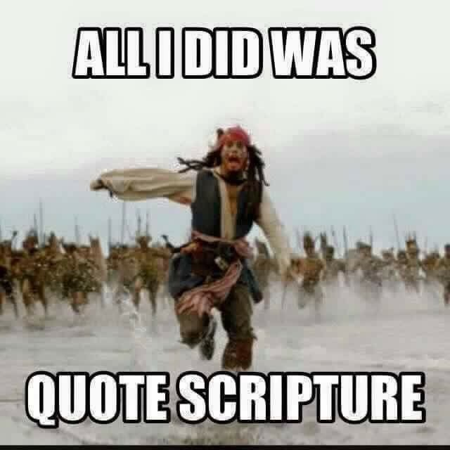
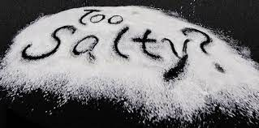
The Salt Of The Earth
Matt 5:13 – “You are the salt of the earth; but if the salt has become tasteless, how can it be made salty again? It is no longer good for anything, except to be thrown out and trampled under foot by men.”
Salt Stings, Yet Heals
Notes:
Illustration: before my conversion, I got angry at the person who taught me the gospel. He didn’t cause the wound. No, like salt, he helped me to see that a wound was there, and he tried to help me heal it.
If someone says something scriptural, or makes an application from scripture that is true, and that irritates you or gets on your nerves, perhaps what you need to do is look deep down inside of yourself and ask whether not your anger and irritation is misdirected. If God’s word irritates you and burns you, I guarantee you it’s not the word of God that’s the problem. The word is just showing you that you’ve got a wound that needs healing. And that’s how God’s word works – Heb 4:12 – “For the word of God is living and active and sharper than any two-edged sword, and piercing as far as the division of soul and spirit, of both joints and marrow, and able to judge the thoughts and intentions of the heart.”
Christians, by what they teach and the way they live, are going to irritate other people. I know this is true because they would not be persecuted if they were not an irritating factor in their society. But again, Christians are not the true cause of the irritation, but like salt, simply emphasize that a wound is already there. Christians, through preaching and being living epistles, emphasize the fact that a change must be made. Jesus didn’t say, “You are the sugar of the world”. He didn’t say, “You’re the honey of the world so you just go out and be sweet”. We’re to be gracious and compassionate, remembering where we once were, but if our teaching consists of too much sugar and honey and not enough salt, we’re likely just being a Band-Aid solution rather than healing the sickness within.

Slide 8
The Salt Of The Earth
Matt 5:13 – “You are the salt of the earth; but if the salt has become tasteless, how can it be made salty again? It is no longer good for anything, except to be thrown out and trampled under foot by men.”
Salt Makes You Thirsty
Notes:
You know, we may think that people don’t want what we have to offer through the Lord, but even just a little bit of salt makes people thirsty doesn’t it? Ever been to a restaurant and there are saltine crackers or salted nuts on the table and you start eating them before the waiter brings you a drink? You’re thirsty. Salt makes you thirsty! And it doesn’t take a lot of salt does it? Just a pinch, just a few grains here and there and we’re famished and need water. You can’t think about anything else. It’s near the forefront of your thoughts. You begin to notice everything that has any connotation to water: cups, rain, pictures of water. Like a man wandering in the desert dehydrated, you’re so fixated on water that you even start imagining it in everything you see. And the greater the thirst, the more earnest the search. And you don’t want other liquids. When I’ve been playing tennis for two hours straight and haven’t had enough to drink, I don’t think, “Boy I’d sure love a cold glass of coca cola about now.” No, I want the one and only thing that can quench my thirst: water, that simple, tasteless H2O
Brethren, we’re immersed in a world that is thirsting for direction And people in the world hardly know it, but they’re thirsting for something more, something lasting, something eternal. But they’re looking for it in all the wrong places. They’re overindulging in everything they can, from entertainment, to sports, sexuality, money, anything and everything other than what will truly nurture the soul. And then comes the Christian, with just a little bit of that salt, just a pinch, showing the grace and love of Jesus Christ…that feeds hope to an undernourished world. It salts their palette. Suddenly, they’re acutely aware of just how thirsty they are and how there is something of eternal significance missing in their life that is uniquely satisfying. Christians by their very lives, bring evidence of joy, satisfaction, and contentment that nothing here of material sustenance can bring. The happiness manifested as a result of the forgiveness of sins we’ve received, the sense of belonging, of being in a family environment as a result of the love and goodwill that naturally exists between brethren, the peace of mind that they see in us as we go through our lives not worrying about a thing. People with good and honest hearts see this and it causes them to look up from their hectic, empty lives and say, “That’s what I want”. Because only a Christian could ever have the right perspective on trouble, hardship, and difficulty as well as prosperity. It makes people thirsty for the fountain of life that never runs dry.

Slide 9
The Salt Of The Earth
Matt 5:13 – “You are the salt of the earth; but if the salt has become tasteless, how can it be made salty again? It is no longer good for anything, except to be thrown out and trampled under foot by men.”
Salt Makes You Thirsty
Notes:
1 Pet 3:1-4 – “In the same way, you wives, be submissive to your own husbands so that even if any of them are disobedient to the word, they may be won without a word by the behavior of their wives, as they observe your chaste and respectful behavior. Your adornment must not be merely external—braiding the hair, and wearing gold jewelry, or putting on dresses; but let it be the hidden person of the heart, with the imperishable quality of a gentle and quiet spirit, which is precious in the sight of God.”
Example - A certain man, whose wife was a member of the church, would take the car, the only one they had, and drive off somewhere just before the time of services. His wife would walk to services, a very long distance, sometimes when it was raining or snowing. Over time, His heart was softened. He started attending services with her. He is now a preacher of the gospel. She was a wise woman. She could have demanded her rights, but it probably would have driven him further away. Instead, in her perseverance, in her salt, she caused this man to long for something he didn’t even know he was thirsty for.

Slide 10
The Salt Of The Earth
Matt 5:13 – “You are the salt of the earth; but if the salt has become tasteless, how can it be made salty again? It is no longer good for anything, except to be thrown out and trampled under foot by men.”
Salt Flavors
Notes:
Most foods taste pretty bland/dry without salt. What this tells us is that salt is missed when it is not present. Job 6:6 – “Can something tasteless be eaten without salt, or is there any taste in the white of an egg?” So what this suggest is that the presence of conscientiously godly people in society will have the natural effect of arousing an appetite for God and a thirst for that righteousness Jesus alluded to in the Beatitudes. As the salt of the earth, we are agents of flavoring. Our purpose is to bring the taste of heaven to earth wherever we go and toward whomever we come in contact with. Many people are living bland, flavorless lives which is why they’re striving to find some kind of high, some kind of thrill, and they’re looking for it in materialism and entertainment, which simply boils down to a distraction for meaningless lives. Brethren, everything about us should resonate with attractiveness, virtue, as well as the holiness of our Lord. Because salt brings out the best in food. So too does Christ bring out the best in us as others experience the flavor of Christ through us.
Illustration: Man who walked in Flint Hill in the middle of singing.
Here’s the point: isn’t it amazing what a pinch of salt can do to bring out the true flavor to an otherwise bland and seemingly meaningless life? Just a pinch of salt to one’s life by way of godly influence can turn another person’s life around, and cause them to praise God as David did in Psa 119:103 – “How sweet are Your words to my taste! Yes, sweeter than honey to my mouth!”

Slide 11
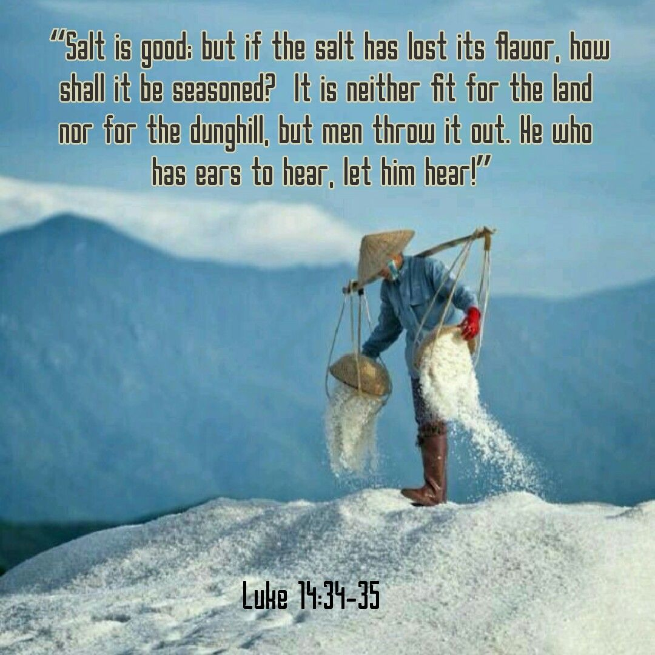
The Salt Of The Earth
Matt 5:13 – “You are the salt of the earth; but if the salt has become tasteless, how can it be made salty again? It is no longer good for anything, except to be thrown out and trampled under foot by men.”
Salt Flavors
Notes:
What if the salt loses its flavor? – “It is no longer good for anything, except to be thrown out and trampled under foot by men.”
How does salt lose its flavor? Through the influx of other substances. And when those substances overpower it, salt loses its ability to perform as God designed it to. Just as weeds suck away all the nutrients of the soil, allowing impurities into our life will rob us of our ability to be the salt God created us to be. In the 1st century, salt that lost its flavor were put on pathways. It couldn’t be put in gardens or fields because that would damage the soil. They added it to pathways where it would absorb moisture and make the roads harder, good for only being trampled under foot.
Brethren, when we become tainted by bitterness, unrepentant sin, our hearts become hardened and we lose our saltiness. And we become trampled upon. By whom? Satan. He walks all over us, uses us for his agenda, to bring suffering to others. He manipulates us and makes a mess of our life because we’re letting him until at last we find ourselves in torment right alongside him.

Slide 12
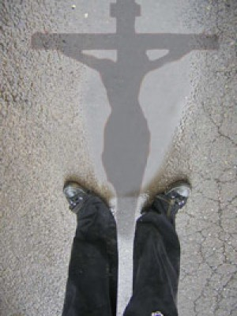
The Light Of The World
Matt 5:14-16 – “You are the light of the world. A city set on a hill cannot be hidden; nor does anyone light a lamp and put it under a basket, but on the lampstand, and it gives light to all who are in the house. Let your light shine before men in such a way that they may see your good works, and glorify your Father who is in heaven.”
Let People See Jesus In You
Notes:
Matt 5:14-16 – “You are the light of the world. A city set on a hill cannot be hidden; nor does anyone light a lamp and put it under a basket, but on the lampstand, and it gives light to all who are in the house. Let your light shine before men in such a way that they may see your good works, and glorify your Father who is in heaven.”
Like salt, the idea behind being light is that we’re pointing people toward Jesus. We’re lighting the path. And by them seeing our good works, they see God. And this is the tricky part about this. Because by virtue of kingdom living, we’re going to stand out, we’re going to be admired. People are going to look up to us and complement us. What is the key to ensuring that by what we do they glorify God rather than glorifying us?
Answer: always give God the glory. When Joseph stood before Pharaoh, he gave God the glory so much, it left no room for Pharaoh to heap praise on Joseph. When Daniel stood before Nebuchadnezzar, he constantly gave God the glory. This is in turn caused the wicked Nebuchadnezzar to give God the glory on numerous occasions. On the flip side, in Acts 12 after the people of Tyre and Sidon praised Herod as speaking with the voice of God, God afflicted w/a painful mortal wound in the intestines and the text specifically tells us it was because he didn’t give God the glory.
Our mission is to point others to how great we are – we’re not. Our mission is to point them to Jesus. One of the keys to projecting the right image is ensuring we are giving glory to God in our speech. In this way, we can properly channel others’ praise toward the right Object and be not ourselves guilty of receiving honor where it is not due.

Slide 13
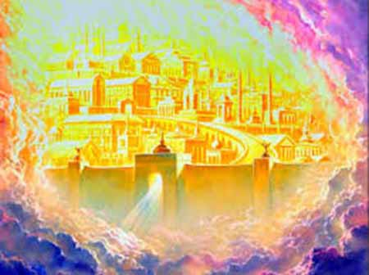
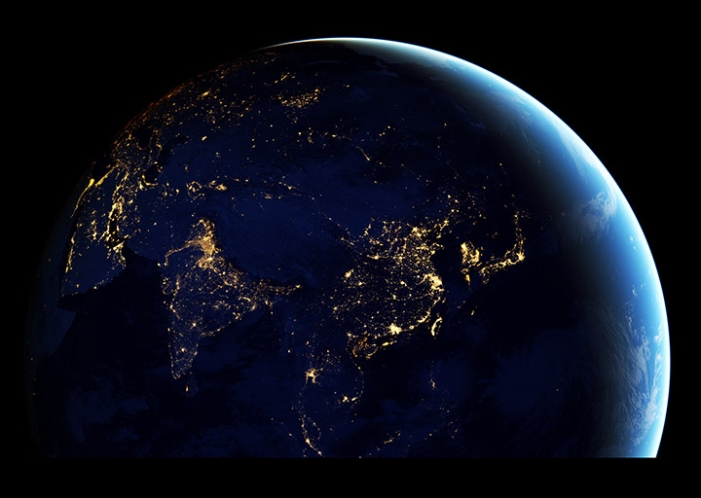
The Light Of The World
Matt 5:14-16 – “You are the light of the world. A city set on a hill cannot be hidden; nor does anyone light a lamp and put it under a basket, but on the lampstand, and it gives light to all who are in the house. Let your light shine before men in such a way that they may see your good works, and glorify your Father who is in heaven.”
Collective Power of Light
Notes:
There is also collective power in light – Isa 2:2 – “Now it will come about that in the last days the mountain of the house of the Lord will be established as the chief of the mountains, and will be raised above the hills; and all the nations will stream to it.” This is looking forward to the Messianic age when God’s people cannot help but be seen by the world when they fully embrace the cause of Christ - “A city set on a hill cannot be hidden”. And when we combine our influence through the pooling together of our resources, our money, our talent, we create this synergy that cannot be achieved individually. Just as large cities w/their collectives lights can be seen from the darkness of space itself, combining our influence will make us visible from great distances.
We are God’s temple, a holy establishment kept free from the defilements of the world where Divinity Himself dwells. This structure, when stable and providing support to one another, will stand above all other mountains and cities in existence and draw men to her.

Slide 14
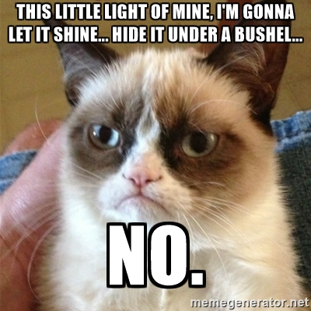
The Light Of The World
Matt 5:14-16 – “You are the light of the world. A city set on a hill cannot be hidden; nor does anyone light a lamp and put it under a basket, but on the lampstand, and it gives light to all who are in the house. Let your light shine before men in such a way that they may see your good works, and glorify your Father who is in heaven.”
Don’t Hide Your Light
Notes:
And then Jesus uses humor as a teaching tool in this verse when He says no one lights a lamp and puts it under a bushel. That would defeat its purpose and therefore be a waste of the fuel provided that keeps the fire going. In the tabernacle and later Solomon’s temple, the golden lampstand was to give off its light perpetually. Christians must likewise always shine their light in conscious awareness of every situation we find ourselves in to make maximum impact on those in the world around us.
Mark 4:21 – “And He was saying to them, ‘A lamp is not brought to be put under a basket, is it, or under a bed? Is it not brought to be put on the lampstand?’” How does hidden light become revealed? In Judges 7, Gideon and his 300 men put torches in pitchers and went to the Midianite outpost where they blew the trumpets and broke their pitchers. The Midianites were so confused, they killed each other. This battle was won w/o Gideon and his 300 men having to raise their swords. We too, when we remove the bushel, can win many battles in this world.

