Slide 1
Notes:
As we begin chapters 7 – 12, we are entering a section of Isaiah that is referred to by many as “The Book of Immanuel”. And as we progress through these chapters, it won’t be difficult to see why it is called this. These chapters introduce us to a war between the Southern Kingdom of Judah and a coalition of her northern neighbors, and it is the result of Judah’s refusal to join that coalition to fight against the powerful nation of Assyria. There are going to be choices made during this war that will lead to the downfall of every nation involved as well as the captivity and deportation for much of the nation of Judah. As we studied chapters 1 – 5, we noticed a pendulum effect occurring wherein we found a mixture of rebukes, judgments, and promises. This same pendulum swing is in full effect in these chapters as well.

Slide 2
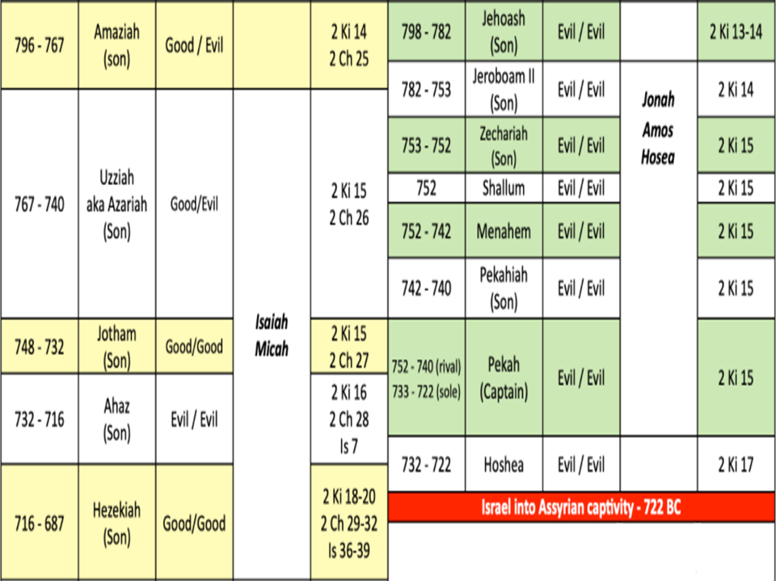
Notes:
Let’s first look at some background to set the stage. During the days of Uzziah of Judah and Jeroboam II of Israel, both nations were prospering economically. In fact, while they were doing great, the nation of Assyria, who had been steadily climbing, was starting to wane, and that was when God sent the prophet Jonah to preach repentance to them, and they responded positively to it. But Israel was not responding to the warnings of Amos and Hosea and Judah was not responding to Micah and Isaiah. And so, God starts to allow Assyrian to recover over a very short period of time and under it’s king, Tiglath-Pileser IIl, it began to conquer most of the nations in Mesopotamia, rendering them either Assyrian provinces or vassal states.
During this period of time, Jeroboam II dies and according to 2 Kings 15, the throne passed to passed to 5 different kings within a very short period of time. Jeroboam II’s son, Zechariah, only reigned for 6 months because he was killed by Shallum, but Shallum only lasted 1 month and he was murdered by Menahem. Menahem managed to keep the usurpers at bay for all 11 years of his reign, but by this time Assyria had become a juggernaut again, and 2 Kings 15:19 tells us that Tiglath-Pileser III (Pul) came up against the land and Menahem paid him off to make him leave. But when Menahem died and his son Pekahiah became king, he only lasted 2 years before being killed by one of his officers, a man named Pekah, and Pekah would reign for 20 years..
Pekah went the opposite route of Menahem by denying tribute to Assyria. But he knew Israel was no match for Tiglath-Pileser’s army, and so he decided to form a coalition with the nation of Syria and its king Rezin. But even they knew that together, their countries did not have the military capability to successfully withstand the Assyrian army – and they were right. And so, they thought that forming more and more coalitions was the answer. And nearly all of the nations in the area sympathized with Syria and Israel’s views, since they too felt the yoke of Assyrian oppression. Philistia and Edom both joined their effort. Judah was the one essential nation that they felt they needed, and what had Uzziah and his son Jotham been doing for much of their reign? 2 Chron 26 says they were building towers and fortresses and building up the army and constructing war engines and strengthening the walls. And while the Lord was w/Uzziah and Jotham because they were godly men, the people of Judah as a whole, as we saw in Isa 1 – 5, were corrupt. So, after Uzziah died and Jotham became king, toward the end of his reign, we read the following in 2 Kings 15:37 – “In those days the Lord began to send Rezin king of Aram and Pekah the son of Remaliah against Judah.” And what Pekah and Rezin were doing was trying to intimidate King Jotham to join their coalition against Assyria, and Jotham refused to do so. But before the issue could be resolved, Jotham died, and his son Ahaz became king. And when Ahaz became king, he likewise refused to join their cause, and this forms the background to Isa 7.

Slide 3
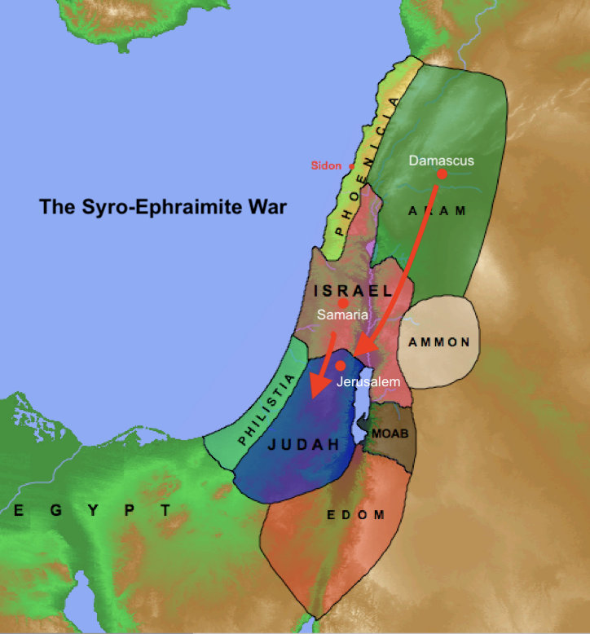
Syro-Ephraimite War
Isa 7:1-2 – “¹Now it came about in the days of Ahaz, the son of Jotham, the son of Uzziah, king of Judah, that Rezin the king of Aram and Pekah the son of Remaliah, king of Israel, went up to Jerusalem to wage war against it, but could not conquer it. ²When it was reported to the house of David, saying, ‘The Arameans have camped in Ephraim,’ his heart and the hearts of his people shook as the trees of the forest shake with the wind.”
Notes:
Isa 7:1 – This text sets the stage for what is referred to as the Syro-Ephraimite War, a war which primarily involved four nations. You have the southern kingdom of Judah w/its king Ahaz who is refusing to join the confederacy. To its north, the northern kingdom of Israel whose capital is Samaria, ruled by Pekah. The nation of Syria to its north, which is sometimes called Aram, has its capital in Damascus, and it is ruled by a man named Rezin. And then there is the nation of Assyria w/its capital Nineveh, well northeast of them, and it is ruled by Tiglath-Pileser III who by this time has conquered most of Mesopotamia. Assyria is the reason Israel and Syria have formed the confederacy, and Judah’s refusal to join is the reason why before going to war w/Assyria, they’re going to try to take down Judah first. Now why did the Lord allow this? (2 Chron 28) Why would he allow a wicked Israelite king and a pagan nation like Syria to afflict Jerusalem? Assyria’s rise to power was God’s doing, so it would seem like Ahaz is making the right choice not siding w/Israel and Syria against Assyria.

Slide 4
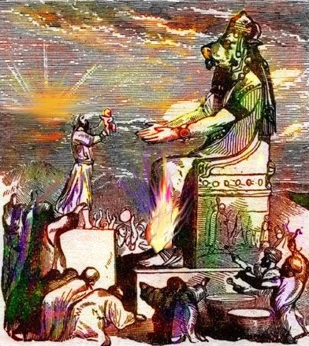
2 Chron 28:1-4 – “¹Ahaz was twenty years old when he became king, and he reigned sixteen years in Jerusalem; and he did not do right in the sight of the Lord as David his father had done. ²But he walked in the ways of the kings of Israel; he also made molten images for the Baals. ³Moreover, he burned incense in the valley of Ben-Hinnom and burned his sons in fire, according to the abominations of the nations whom the Lord had driven out before the sons of Israel. ⁴ He sacrificed and burned incense on the high places, on the hills and under every green tree.”
Ahaz
Idolatrous
Brought Judah Low
Completely faithless
Notes:
Because Ahaz was an exceptionally wicked man. 2 Chron 28:1-4 – And God brought Judah very low because of Ahaz. If you go on reading in 2 Chron 28, we’re told that Syria took many Judeans captive to Damascus. Israel, led by Pekah, slew 120,000 Judeans in one day and carried into captivity 200,000 more until a prophet of the Lord made Israel return them to Judah. And because Edom and Philistia had joined the coalition, they also attacked Judah and were just decimating the land, and even settling in some of its cities. See, when Ahaz started his reign, Judah had experienced incredible prosperity due to Uzziah and Jotham’s reigns. Isaiah described the land in Isa 2 as “full of silver and gold” and “full of horses”. But by the time Ahaz’s 16-year reign ended, everything had changed. Why? Because despite Uzziah and Jotham’s military reforms, God was bringing Judah very low because of Ahaz and the people’s sins. This is the context behind Isa 7:1. Israel and Syria were afflicting Judah badly, but they couldn’t take it the first time they attacked.

Slide 5
Syro-Ephraimite War
Isa 7:1-2 – “¹Now it came about in the days of Ahaz, the son of Jotham, the son of Uzziah, king of Judah, that Rezin the king of Aram and Pekah the son of Remaliah, king of Israel, went up to Jerusalem to wage war against it, but could not conquer it. ²When it was reported to the house of David, saying, ‘The Arameans have camped in Ephraim,’ his heart and the hearts of his people shook as the trees of the forest shake with the wind.”
Notes:
So now in Isa 7:2, the coalition of Syria and Israel are marching on Jerusalem once again, intent on besieging it and taking it down for good. And now that we know who the players are in this war and we know the reason, let’s look at the reaction of the house of David.
Isa 7:2 – This would have never been said of the man David. The apple has truly fallen far from the tree. We mentioned last week that in chapters 1 – 5, God refers to sinful Judah as “My people”, but in chapter 6 he calls them “this people”. Now, they are truly “Ahaz’s people”. Why is this happening? Their lack of faith – Lev 26:36 – “As for those of you who may be left, I will also bring weakness into their hearts in the lands of their enemies. And the sound of a driven leaf will chase them, and even when no one is pursuing they will flee as though from the sword, and they will fall.” Under Ahaz’s wicked rule, Judah is experiencing this reality.

Slide 6
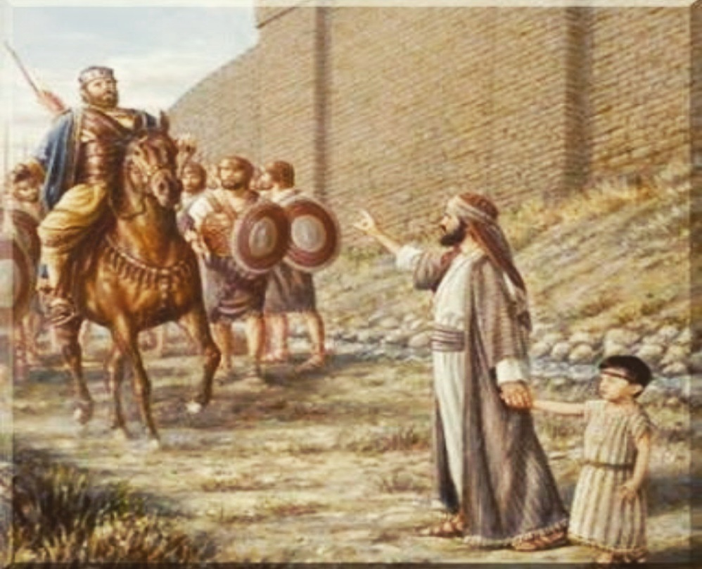
Isaiah’s encouragement
Isa 7:3-6 – “³Then the Lord said to Isaiah, ‘Go out now to meet Ahaz, you and your son Shear-jashub, at the end of the conduit of the upper pool, on the highway to the fuller’s field, ⁴and say to him, “Take care and be calm, have no fear and do not be fainthearted because of these two stubs of smoldering firebrands, on account of the fierce anger of Rezin and Aram and the son of Remaliah. ⁵Because Aram, with Ephraim and the son of Remaliah, has planned evil against you, saying, ‘Let us go up against Judah and terrorize it, and make for ourselves a breach in its walls and set up the son of Tabeel as king in the midst of it.’”’”
Shear-jashub
Preparation for siege
Isaiah’s message
Syro-ephraimite intentions
Notes:
And so, God sends Isaiah to Ahaz to actually give this ungodly man a message of encouragement – Isa 7:3-6.
1) Isaiah and his son Shear-jashub are both sent in order to be signs of God’s promise to ultimately protect Judah. Isaiah’s name means “God is salvation”, implying Ahaz needed to place his trust in God to save him from this calamity, and not put his trust elsewhere. Only God could save him from this situation. Shear-jashub’s name means “a remnant shall return”. It is a name of promise, implying that destruction in Judah was inevitable, but the people would not utterly perish – Isa 1:9 – “Unless the Lord of hosts had left us a few survivors, we would be like Sodom, we would be like Gomorrah.”. And Ahaz has to decide whether he would be part of this remnant. Would he believe or would he continue in his evil ways? And so, Shear-jashub was a visual aid to bring home the word of God that much clearer. One might even say that “the word became flesh” (hint).
2) Where are they to meet him? Ahaz is “at the end of the conduit of the upper pool, on the highway to the fuller’s field”, which is very close to his palace. Now, when Hezekiah becomes king, he would eventually divert this water through an underground channel into the Pool of Siloam, which today you can actually walk. But in Ahaz’s day, Jerusalem’s water supply was still above ground, making them vulnerable in the event of a siege. So, Ahaz is no doubt checking his resources. But Ahaz doesn’t need to trust in his resources, he needs to trust in God.
3) What is the message? “Take care, be calm, have no fear”. Ahaz was under pressure to align himself w/Assyria against the Syrians and Israelites. Isaiah informs him Israel and Syria are not the supreme threat he thinks they are, rather “two stubs of smoldering firebrands”, about to be burnt out, smoke w/no fire, and so nothing to be afraid of. The issue is not one of politics, but of faith. The issue is, will Ahaz keep calm and trust God, or will he trust in his resources and trust in man by making alliances?
4) What are Israel and Syria really up to? Well, when Ahaz refused to join their coalition, Pekah and Rezin didn’t go against Judah to destroy it, but to replace Ahaz with a more cooperative king favorable to their cause – the son of Tabeel. And so confident were they, they’re already dividing the spoil before they conqueror Judah. But so disdained are these men, Isaiah acts as if he can’t even recall their names, “son of Remaliah” and “son of Tabeel”. In other words, “Who are these jokers?”

Slide 7
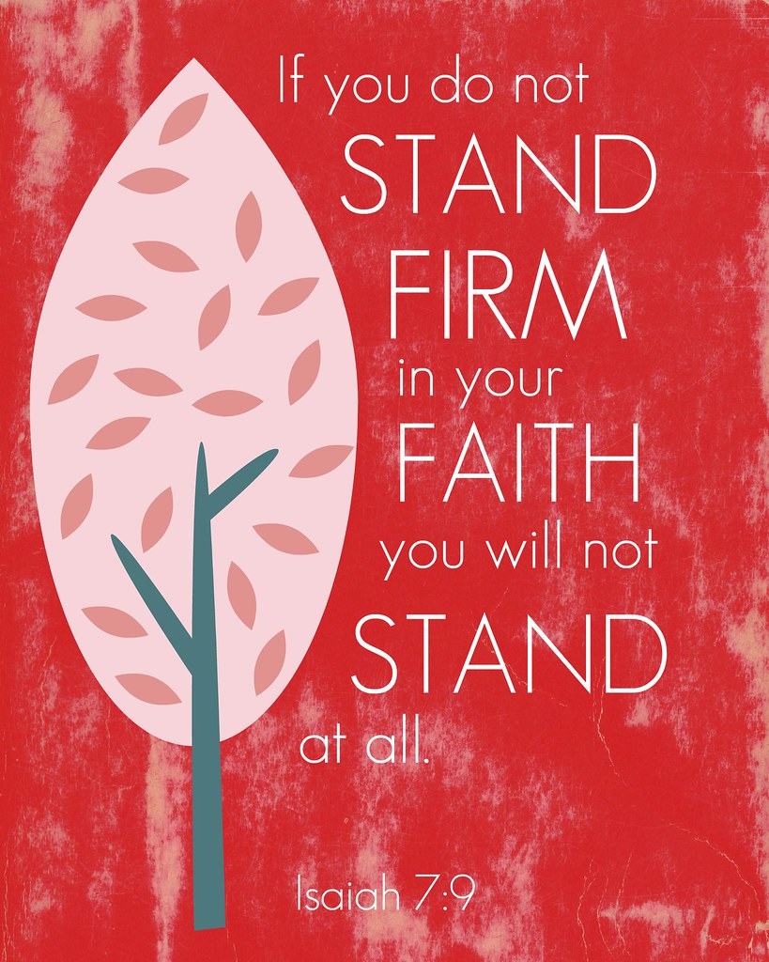
Isaiah’s encouragement
Isa 7:7-9 – “⁷thus says the Lord God: ‘It shall not stand nor shall it come to pass. ⁸For the head of Aram is Damascus and the head of Damascus is Rezin (now within another 65 years Ephraim will be shattered, so that it is no longer a people), ⁹and the head of Ephraim is Samaria and the head of Samaria is the son of Remaliah. If you will not believe, you surely shall not last.’”’”
God is in control
Israel & Syria going down
Ahaz’s ultimatum: trust
Notes:
Isa 7:7 – In other words, God is in control, not human armies. And even though Ahaz was a coward, he still represents the house of David, and so whatever Israel/Syria had planned was irrelevant. God has His own plans. Prov 19:21 – “Many plans are in a man’s heart, but the counsel of the Lord will stand.”
Isa 7:8-9a – Meaning, Rezin’s authority will not go past Damascus, and Israel’s authority will not go past Samaria. In fact, by the time God is done w/them, neither will even be able to keep their own land let alone conqueror Judah. Why? Acts 17:26 – “[God has determined] their appointed times and the boundaries of their habitation”. Syria fell pretty quickly after this event in 732BC and most of Israel would follow, other than Samaria, but the 65 years looks beyond when Esarhaddon brought in foreigners, and they intermarried w/Israel and became the Samaritans.
But what about Ahaz? – Isa 7:9b – In other words, while it’s true that a remnant would return, in order for Ahaz to be a part of that would require him to trust God. This is the major theme of Isaiah’s preaching. The crisis facing God’s people was not the threat of surrounding nations and world powers. The critical issue was faith, and as we’ll see further in chapter 8, either God will be their fear and their dread, or He’ll be a rock to stumble over. Isaiah was sent to encourage Ahaz, but to also give him an ultimatum.

Slide 8
Ahaz Offered a Sign
Isa 7:10-12 – “¹⁰Then the Lord spoke again to Ahaz, saying, ‘¹¹Ask a sign for yourself from the Lord your God; make it as deep as Sheol or high as heaven.’ ¹²But Ahaz said, ‘I will not ask, nor will I test the Lord!’”
2 Kings 16:5,7 – “Then Rezin king of Aram and Pekah son of Remaliah, king of Israel, came up to Jerusalem to wage war; and they besieged Ahaz, but could not overcome him…So Ahaz sent messengers to Tiglath-pileser king of Assyria, saying, ‘I am your servant and your son; come up and deliver me from the hand of the king of Aram and from the hand of the king of Israel, who are rising up against me.’”
Notes:
In an incredible display of grace, God offers to wretched Ahaz a basis for believing in God that even most believers are not able to experience – Isa 7:10-11 – What grace! God is willing to condescend Himself even to wicked people, offering to prove what He is saying just to motivate Ahaz toward faith. “As deep as Sheol or high as heaven” is an idiom meaning that God is ready to stop at nothing to move Ahaz toward faith, that there is no limit to what he can ask for. The God of this universe is actually offering to put Himself at Ahaz’s command. But this puts wicked Ahaz in a pickle; because if he agrees to the sign, he’d be submitting to God and would have no choice but to believe. If he refuses the sign, it will prove he was an unbeliever. And so, seeing that he is trapped, he uses his skill at diplomacy and quick thinking to display false piety – Isa 7:12 – But how are you testing the Lord by doing what the Lord asks? Even atheists claim, “If God shows Himself, then I’ll believe”. So how insulting is it to say to God, “I won’t believe you even if you show me a miracle”?
Most suspect that the reason he is not willing to give God the time to prove Himself is because of what we read in 2 Kings 16:5,7 – Why did he reject God’s help? Because he’s already made up his mind to get help from Tiglath-Pileser. And if you go on reading, he paid Tiglath-Pileser off w/silver and gold from God’s temple. How deaf, dumb, and blind can you be?
As deaf, dumb, and blind as the Lord had already told Isaiah he would experience from his preaching – Isa 6:9 – God told Isaiah that his message would be rejected and so chapter 7 is the beginning of Isaiah experiencing this in a very real sense – deaf ears, blind eyes, and an insensitive heart in King Ahaz himself.

Slide 9
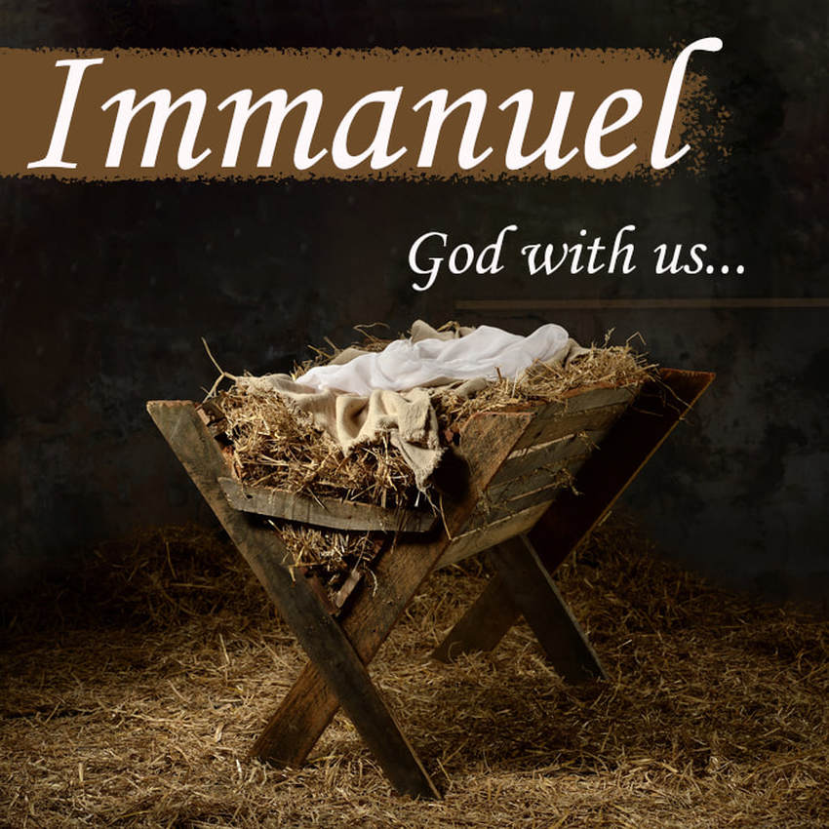
God gives an incarnate sign
Isa 7:13-17 – “¹³Then he said, ‘Listen now, O house of David! Is it too slight a thing for you to try the patience of men, that you will try the patience of my God as well? ¹⁴Therefore the Lord Himself will give you a sign: Behold, a virgin will be with child and bear a son, and she will call His name Immanuel. ¹⁵He will eat curds and honey at the time He knows enough to refuse evil and choose good. ¹⁶For before the boy will know enough to refuse evil and choose good, the land whose two kings you dread will be forsaken. ¹⁷The Lord will bring on you, on your people, and on your father’s house such days as have never come since the day that Ephraim separated from Judah, the king of Assyria.”
2 Chron 28:20-21 – “²⁰So Tilgath-pileser king of Assyria came against him and afflicted him instead of strengthening him. ²¹Although Ahaz took a portion out of the house of the Lord and out of the palace of the king and of the princes, and gave it to the king of Assyria, it did not help him.”
Notes:
And so, God rescinds the offer completely and changes course w/Ahaz – Isa 7:13 – Notice when talking to Ahaz in vs. 9, He calls Him “your God”. But in this verse, Isaiah “my God”. The phrase “try the patience” means God is wearied of Ahaz, and not just him but the entirety of the house of David. None of them have lived up to God’s holy standard. Human beings are just too inadequate to be what God needs them to be in and of themselves. And so, God is now taking the matter out of Ahaz’s hand completely and he’s going to give him a sign anyway.
Isa 7:14-16 – This is not a random prophecy. God is done w/Ahaz the man; His patience w/him is exhausted. But by virtue of former promises, God must be w/the house of David, and Immanuel is the proof of this; God’s miraculous provision. Volumes have been written on the subject of Immanuel, and my purpose is not to get into the controversy surrounding it. I’d only ask how this could truly be a sign of the caliber offered Ahaz if this were an ordinary child with an ordinary birth? It is best to let the NT interpret the meaning for us. Matt 1:23 applies it to Jesus and his virgin birth, and the birth of a child who is both God and man would by necessity require a special entrance into this world. Anything beyond this child being Jesus Himself is pure speculation. Vs. 15 reveals that as a child, He will not partake of the food of royalty, and this can be confusing because of “the land of milk and honey”. But it’s actually the food of scarcity, a diet due to hard times, and vs. 22 will make that clearer, and we know that Jesus was indeed raised in such circumstances. And vs. 16 gives us a further basis for the sign, that before this child would be old enough to know the difference between good and evil, Samaria and Damascus and the kings who rule them will be no more.
But because of Ahaz’s unfaithfulness… - Isa 7:17 – God tells Ahaz in essence, “You want Assyria? You got him!” Only its not going to go as well as he thinks. Despite the fact he paid him off, Assyria would become a worse threat to Judah than what Ahaz thought Rezin and Pekah would do – 2 Chron 28:20-21. This further proves that when we give into ungodly fear at the expense of faith, we tend to reap the very thing we feared in ways we could not have imagined.

Slide 10
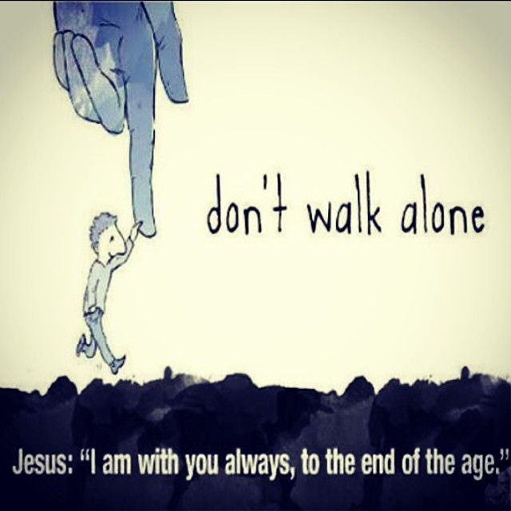
Notes:
But “Immanuel” has a two-fold meaning, one which looks backwards and another which looks forward. For us, we look backwards to the history as we’re currently doing and observing how God was w/them then through thick and thin, and it gives us confidence that, as Jesus told the Apostles in Matt 28:20, “I am with you always.” But for the people of Isaiah’s time, they had to look forward to this fulfillment based on the seed promise that was yet to be fulfilled. And so, while Immanuel was definitely a promise of the coming Messiah, it meant even more to them than that. Combined the w/the first sign Shear-jashub, it meant that no matter how much God judged Judah, that judgment could not be the last word. A remnant must survive for the seed promise to be fulfilled. And this meant that God must be with them. Immanuel is a living, incarnate sign that God has kept His promise. Pay attention to this theme throughout the rest of this section to the end of chapter 12 as it represents the dominant theme of these chapters, and these incarnate signs are intended to cultivate trust in them.

Slide 11
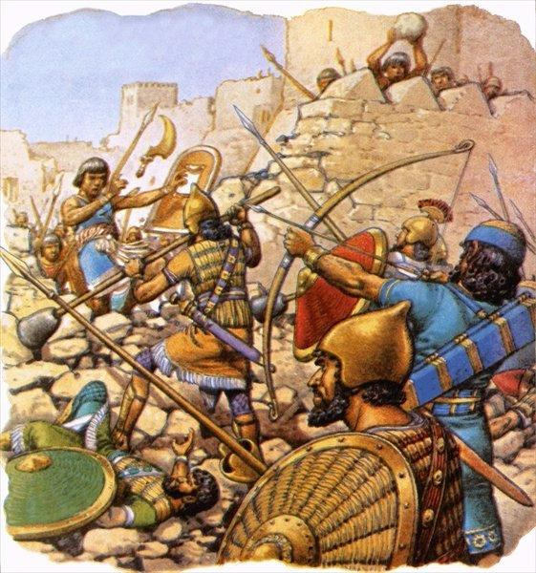
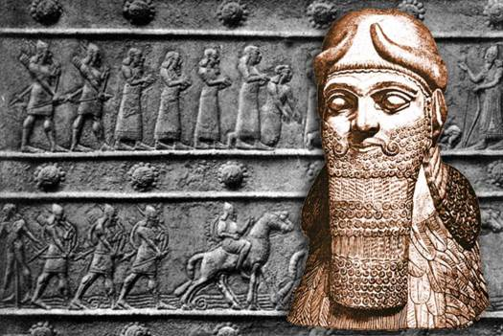
Judah’s 4-fold judgment
Isa 7:18-20 – “¹⁸In that day the Lord will whistle for the fly that is in the remotest part of the rivers of Egypt and for the bee that is in the land of Assyria. ¹⁹They will all come and settle on the steep ravines, on the ledges of the cliffs, on all the thorn bushes and on all the watering places. ²⁰In that day the Lord will shave with a razor, hired from regions beyond the Euphrates (that is, with the king of Assyria), the head and the hair of the legs; and it will also remove the beard.”
Notes:
The remainder of the chapter spells out the veiled threat of vs. 17, answering the question, “How will the coming days be worse than when our kingdom divided?”
There is an inclusio in this section, seen in four repeated phrases of “In that day”:
1) Isa 7:18-19 – The flooding of the Nile brought a swarm of flies and the hills of Assyria were well known for their bees. He’s using this alliteration to give the imagery of a land blanketed by a dreadful swarm of their enemies, Egypt in the south and Assyria in the north. In other words, Judah would become a staging ground for a power struggle between Egypt and Assyria, and it will devastate the land. And they will be everywhere, even in those inaccessible places where the Jews would have wanted to hide from them. God will purpose this. Another example that giving into our fears often brings about the very things we fear, and in ways we could not possibly have imagined.
2) Isa 7:20 – So not only will no part of the land be spared, but no part of the person. Again, who will cause this? The Lord; this is an important point lest the people believe that Assyria defeated Judah because its gods were stronger than Jehovah. Not so; God is causing this to happen to punish them. So remember in 5:26, we were told that God would whistle for a nation to come and devastate the land. Now He specifies which nations they will be – He is using the nation of Assyria as his instrument of judgment. And Assyria was known for its cruelty in humiliating captives. They often shaved them bare from head to toe before carrying them into slavery w/no clothing and no dignity. Because for Assyrians, the beard was a sign of manliness and power, akin to the lion’s mane, which may allude to why they are referred to as a lion in 5:29. So while the Egyptians shunned hair, as evidence from their sphinxes, the Assyrian’s embraced it, as you can see in this rendering of Tiglath-pileser III.

Slide 12
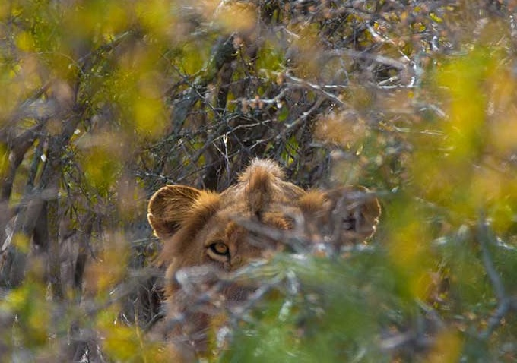
Judah’s 4-fold judgment
Isa 7:21-25 – “²¹Now in that day a man may keep alive a heifer and a pair of sheep; ²²and because of the abundance of the milk produced he will eat curds, for everyone that is left within the land will eat curds and honey. ²³ And it will come about in that day, that every place where there used to be a thousand vines, valued at a thousand shekels of silver, will become briars and thorns. ²⁴People will come there with bows and arrows because all the land will be briars and thorns. ²⁵As for all the hills which used to be cultivated with the hoe, you will not go there for fear of briars and thorns; but they will become a place for pasturing oxen and for sheep to trample.”
Notes:
3) Isa 7:21-22 – On the surface, this sounds delightful. Jennifer and I have been to Tillamook in Oregon and eaten their cheese curds and they are fantastic. And who doesn’t like honey? But this is not the food of wealth, but of scarcity. This is the result of a depopulation of the land, in which it has reverted from a crop-growing to a herding region in which there will be so few people that a minimum of animals will produce more than enough food. Because if you’re fortunate enough to even have this, you won’t kill them for food. Rather, you’ll rely on them for staple products. Honey will also be available, but food supplies will otherwise be scarce.
Isa 7:23-25 – This is reminiscent of 5:5-6 when God judges the vineyard, and both speak of an unprofitable, hostile landscape. The finest, most beautiful vineyards, once so prized by Judah and carefully worked, will become briars and thorns. Places where men once tread and beasts were excluded are now overrun by beasts and men must go armed, not knowing what might be lurking in the thickets. And so, the farmland will only be suitable for hunting. The land will return to a primitive state unknown by everyone. Oxen and sheep may go to these places, but not men.
In short, Ahaz had a chance to trust in God, and God gave him incentive for doing so that even most believers are not given. But because he chose to put his trust elsewhere, the object of Ahaz’s trust will now become an instrument of the very devastation he dreaded. What’s the point of Isaiah’s message? “Trust God.”

