Slide 1
Notes:
Isaiah chapters 7 – 12 are referred to as the book of Immanuel, because the theme “God is with us” is scattered throughout the chapters. No matter how ungodly Judah had become and what judgment they merited, God had made a promise that through Abraham’s seed, all nations of the earth would be blessed, that through David’s seed He would establish the throne of His kingdom forever. And so, despite allowing the Assyrian flood to get up to its neck, they would be ultimately protected – God is with us. And that was the theme of chapters 7 – 8.
Then in chapter 9, we saw God’s plans to liberate them from the darkness they had plunged themselves into by bringing them a great light, the same child Immanuel, who would usher in a kingdom and government that would endure forever, established by justice and righteousness. Even the scattered of the Northern Kingdom of Israel would experience this, btu before they can, they too must be purged of their filth, God’s hand stretched out against them.
As we get into chapter 10, the focus is going to shift to Assyria, both God’s purpose behind using them as well as His long-term plans for them. But lets first look at some history.

Slide 2
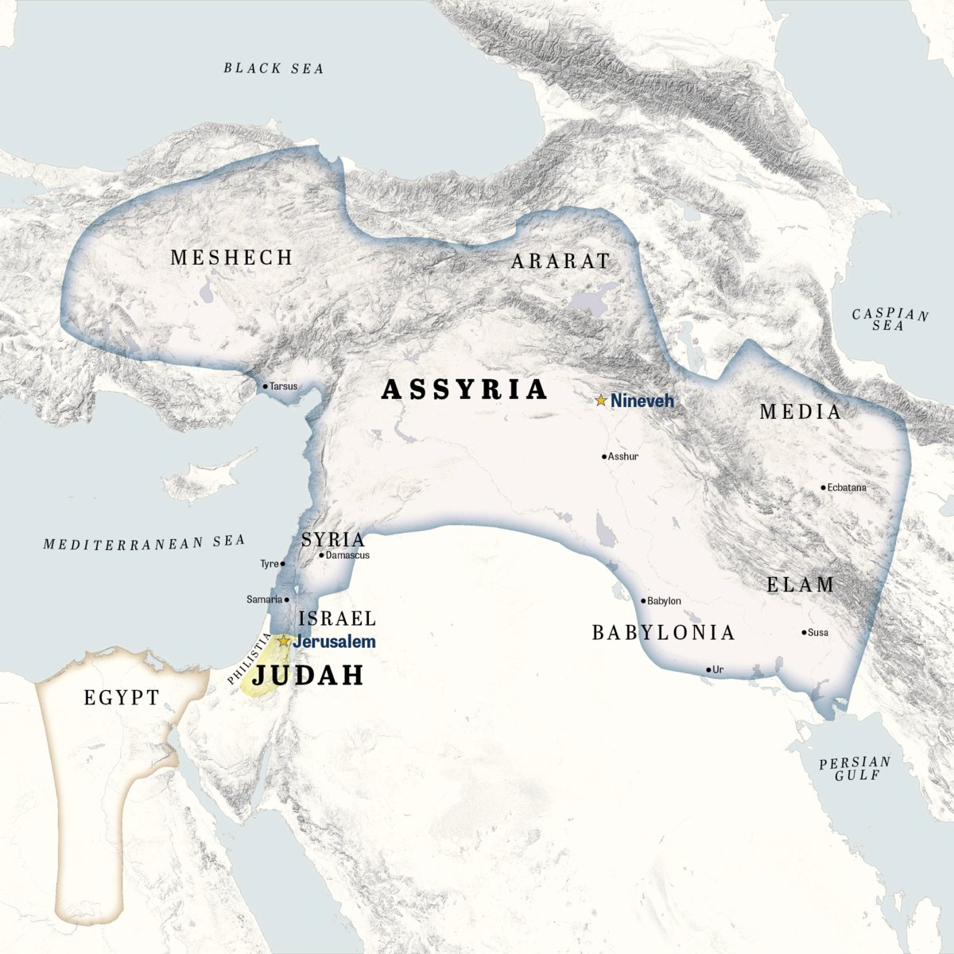
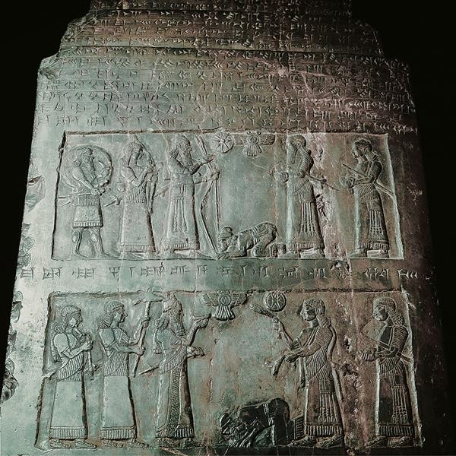
Notes:
The Assyrians had been a minor power in the ancient east since the 12th century BC when it was founded by the original Tiglath-pileser. But they waxed and waned in power for several hundres years, only getting involved w/God’s people on a handful of occasions. We know from Assyrian annals that King Ahab of the Northern Kingdom of Israel joined a coalition w/other nations to fight against Assyria in what is called the battle of Qarqar, led by Assyrian’s king Shalmaneser III, and Assyria won.
The picture on the right is of one of the most famous of Assyrian artifacts, called the Black Obelisk, and is housed in the British Museum. It shows 5 reliefs of kings bowing down to Shalmaneser III and offering tribute. The most famous king it shows, though, is King Jehu of the Northern Kingdom of Israel. The relief reads in Akkadian – “The tribute of Jehu, son of Omri: I received from him silver, gold, a golden bowl, a golden vase with pointed bottom, golden tumblers, golden buckets, tin, a staff for a king [and] spears.” This is a significant archeological find from the 19th century because it displays the earliest ancient depiction of a biblical figure. But not long after Jehu, God begins to allow the Northern Kingdom of Israel to gain back a lot of its lost territory, reaching its peak during the reign of Jehu’s great grandson Jeroboam II. And at the same time, Assyria was waning in power and really struggling to keep its grip as a nation, and God takes advantage of their decline to try and get Assyria to repent by sending the prophet Jonah, who was not to pleased to go. But Nineveh did repent, and they begin to regain a lot of their power under the reign of who would inevitably become one of its most dominant kings: Tiglath-pileser III. And it’s Tiglath-pileser III who sacks Syria, sacks most of the Northern Kingdom of Israel, and is severely afflicting Judah who, as we read in chapter 8, is “up to its neck” in Assyria.

Slide 3
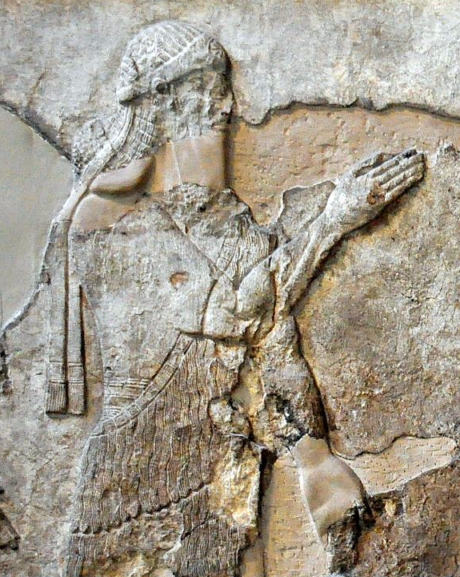
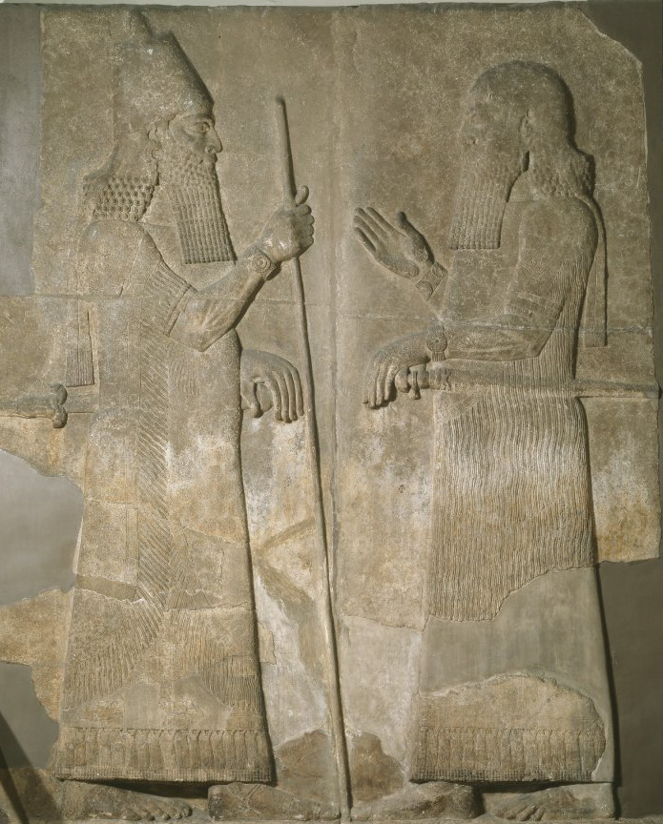
2 Kings 17:1-6 – “¹In the twelfth year of Ahaz king of Judah, Hoshea the son of Elah became king over Israel in Samaria, and reigned nine years. ²He did evil in the sight of the Lord, only not as the kings of Israel who were before him. ³Shalmaneser king of Assyria came up against him, and Hoshea became his servant and paid him tribute. ⁴But the king of Assyria found conspiracy in Hoshea, who had sent messengers to So king of Egypt and had offered no tribute to the king of Assyria, as he had done year by year; so the king of Assyria shut him up and bound him in prison. ⁵Then the king of Assyria invaded the whole land and went up to Samaria and besieged it three years. ⁶In the ninth year of Hoshea, the king of Assyria captured Samaria and carried Israel away into exile to Assyria, and settled them in Halah and Habor, on the river of Gozan, and in the cities of the Medes.”
Annals of Sargon II – “At the beginning of my royal rule, I…the town of the Samarians I besieged, conquered (2 Lines destroyed) [for the god…] who let me achieve this my triumph… I led away as prisoners [27,290 inhabitants of it (and) equipped from among them (soldiers to man)] 50 chariots for my royal corps… The town I rebuilt better than it was before and settled therein people from countries which I had conquered. I placed an officer of mine as governor over them and imposed upon them tribute as is customary for Assyrian citizens.”
Notes:
Now, as we read in 9:8 – 10:4, Assyria would finish the job of taking down the Northern Kingdom of Israel. How did this happen? The details are in 2 Kings 17. When Tiglath-Pileser III took out the northern part of the Northern Kingdom of Israel, all that practically remained was Samaria. An Israelite named Hoshea killed King Pekah and Tiglath-pileser III installed Hoshea as king under the condition he continue to pay tribute. This pretty much ended the Syro-Ephraimite War.
But 4/5 years into Hoshea’s reign, Tiglath-pileser III died in 727BC. His son reigned in his place and took on the name Shalmaneser V, depicted in the relief in the upper right. Typically, when an Assyrian king died, this caused the nations they had previously subjugated to rebel. Well, we read in 2 Kings 17 that Hoshea paid his tribute at first. But then he stopped, and Shalmaneser V uncovered the fact that Hoshea had been secretly corresponding w/Egypt. And so, Shalmaneser V throws Hoshea in prison and began a siege of Samaria that would last for 3 years, but he died shortly before taking it.
The details are sketchy, but it appears Shalmaneser V was deposed, and the Assyrian throne was taken by a man named Sargon II, depicted in the relief in the lower right (guy on left). And in 722BC, Sargon II completed the siege of Samaria and deported its inhabitants. The Northern Kingdom of Israel is no more.
In the Assyrian annals, Shalmaneser indicates that he deported 27,290 people from Samaria. This number only includes the inhabitants of the city, and that number could be extrapolated to 200,000 when you consider the people who were deported from the countryside. Sargon II then rebuilt Samaria and filled it w/deported people from other areas: “At the begi[nning of my royal rule, I . . . the town of the Sama]rians [I besieged, conquered] [for the god... who le]t me achieve (this) my triumph . . . . I led away as prisoners 27,290 inhabitants of it (and) [equipped] from among [them (soldiers to man)] 50 chariots for my royal corps . . . . [The town I] re[built] better than (it was) before and [settled] therein people from countries which [I} myself [had con]quered. I placed an officer of mine an governor over them and imposed upon them tribute as (is customary) for Assyrian citizens.”

Slide 4
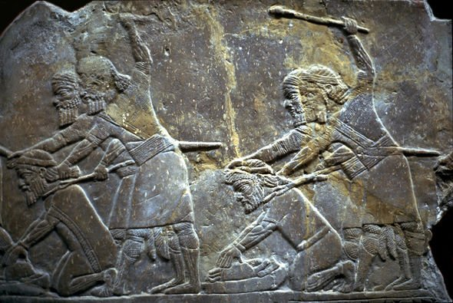
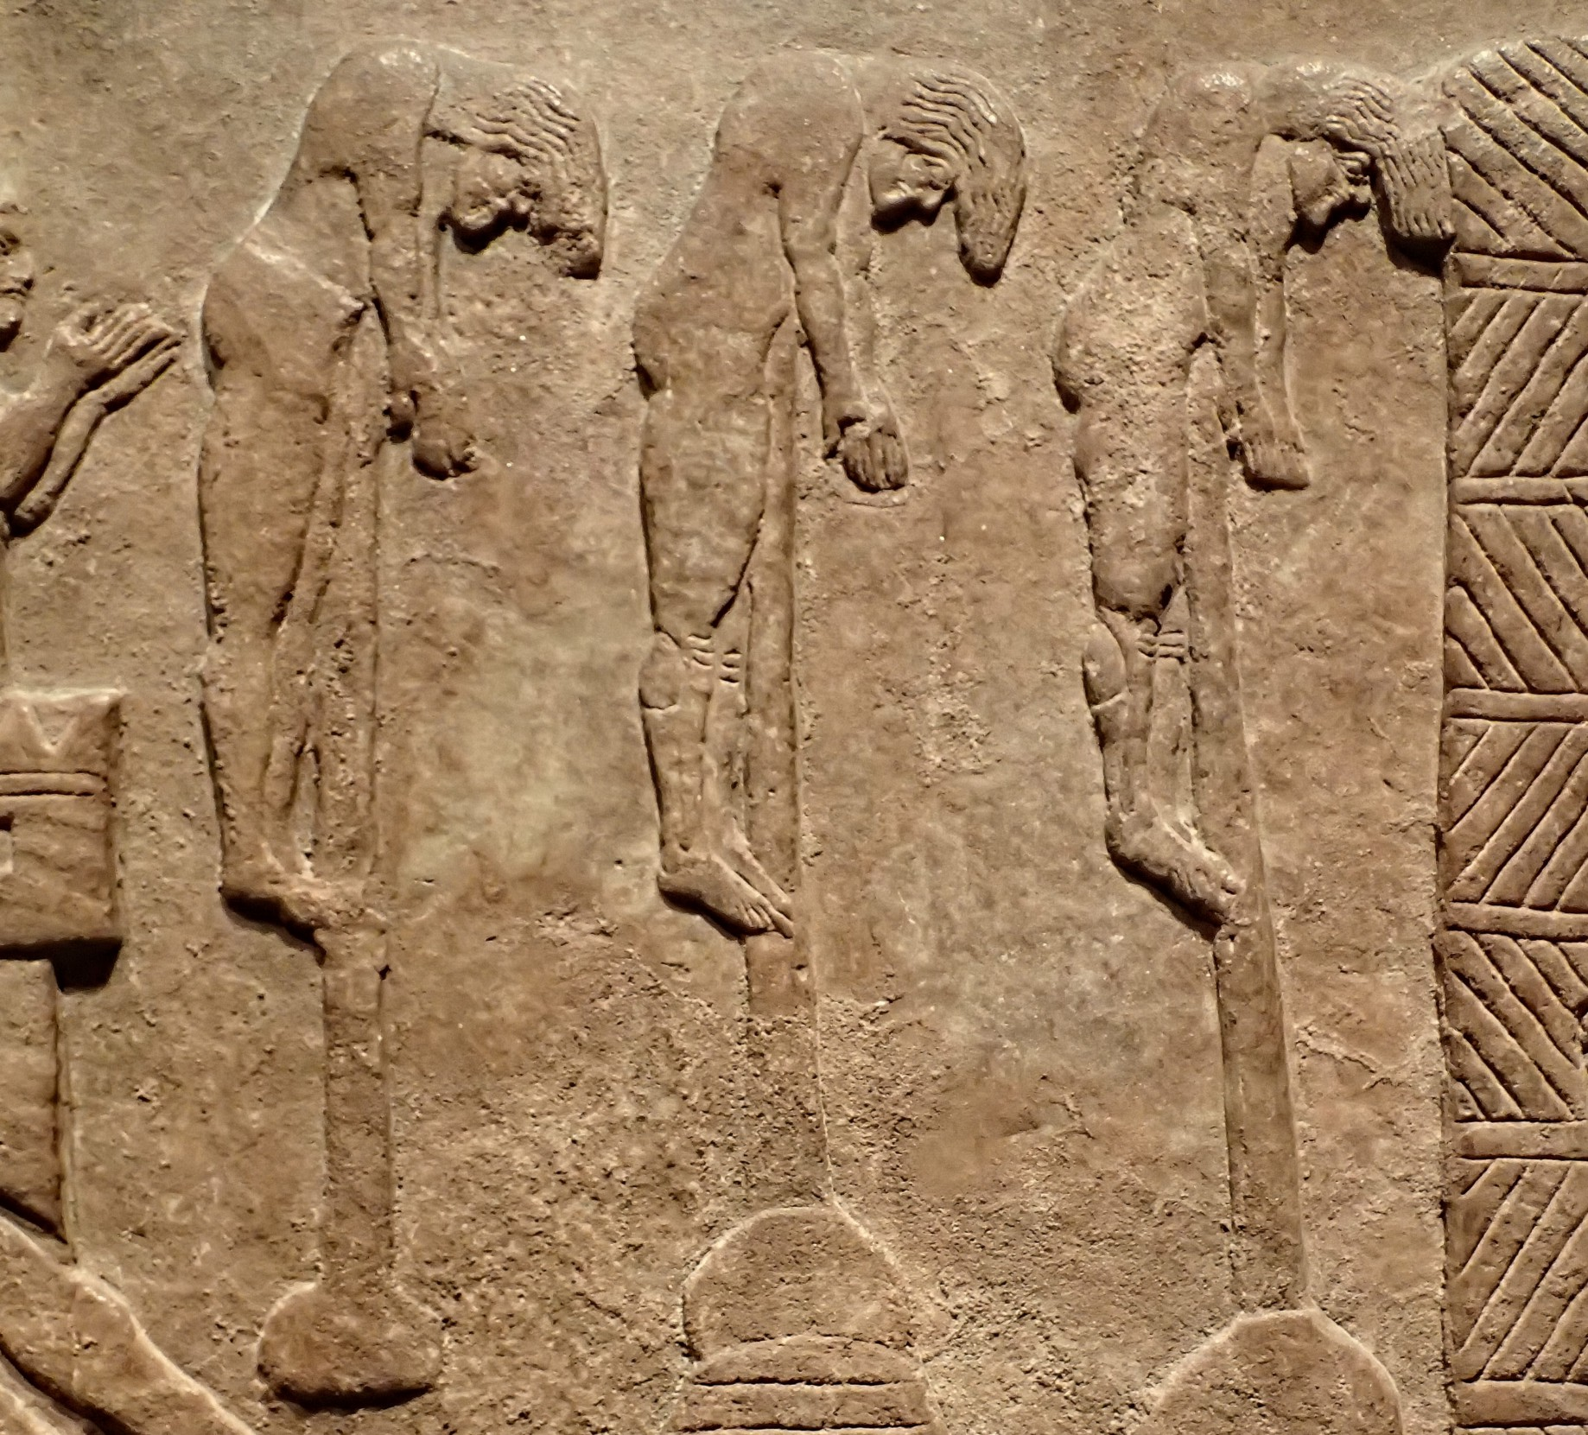
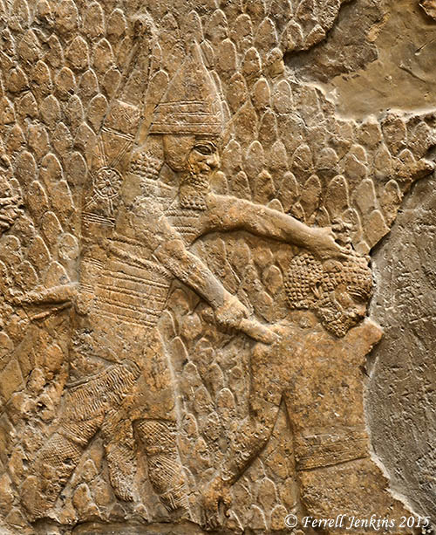
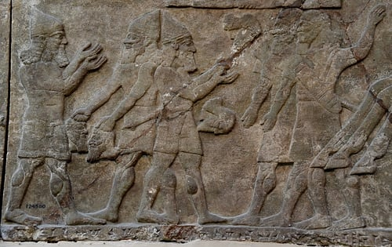
The Rod of God’s Anger
Isa 10:5-6 – “⁵Woe to Assyria, the rod of My anger and the staff in whose hands is My indignation, ⁶I send it against a godless nation and commission it against the people of My fury to capture booty and to seize plunder, and to trample them down like mud in the streets.”
Notes:
So, here’s a question: Israel and Judah are not following God’s law. But why would God allow a pagan nation, who is so cruel, to overcome His chosen people? Just look at some of the reliefs that have been uncovered in Ashurbanipal’s Library. The torture, beheadings, flaying the skin of its victims. Why would God allow them to hurt His people? Isaiah reveals God’s reason in Isa 10.
Isa 10:5-6 – So, in chapter 9 and 10, we saw phrase repeated 4 times that formed an inclusio – “In spite of all this, His anger does not turn away and His hand is still stretched out.” What was in God’s hand to punish His people? A rod called Assyria. The rod and staff was used by shepherds to correct and direct their sheep respectively, and that is what God raised up Assyria to do to His people. Assyria was simply God’s instrument of judgment.
And notice the irony in vs. 6, that God is sending Assyria against a godless nation. Anyone living in Israel or Judah would look at Assyria and think, “We’re not doing right, but surely we’re godlier than them.” But keep in mind that Judah and Israel had the light of God’s word. And because they rejected that light, it makes their fall much worse. And w/all the advantages we Christians have living in the United States, we need to heed this.
That phrase “to capture booty and to seize plunder” is almost identical in the Hebrew to Maher-shalal-hash-baz, indicating the ongoing fulfillment of the word which became flesh in Isaiah’s son. So, this was God’s purpose for raising up Assyria – judgment against His people.
Yet what does that first word “woe” imply? Well, judgment begins w/the household of God, which is why Judah and Israel have been the focus so far, but after God uses Assyria, they too would be judged. “Well, that’s not fair. You’re the one who raised us up, we’re doing as we’re told.”

Slide 5
Assyria’s Reasonings
Isa 10:7-11 – “⁷Yet it does not so intend, nor does it plan so in its heart, but rather it is its purpose to destroy and to cut off many nations. ⁸For it says, ‘Are not my princes all kings? ⁹Is not Calno like Carchemish, or Hamath like Arpad, or Samaria like Damascus? ¹⁰As my hand has reached to the kingdoms of the idols, whose graven images were greater than those of Jerusalem and Samaria, ¹¹shall I not do to Jerusalem and her images just as I have done to Samaria and her idols?’”
Different motive
Grounds for confidence
Pagan mentality
Saw Jehovah as just another idol
Notes:
The issue wasn’t purpose, it was motive – Isa 10:7 – In other words, though God and Assyria shared the same purpose (conquest), their motives for doing so were entirely different. Despite the work Jonah had done among them, Assyria wasn’t seeking God’s glory for its rise to power; its goal was selfish ambition, to bring destruction to everyone it met. The arrogant “heart” is the same word used to describe Israel’s arrogance in 9:9.
What are the grounds for its confidence? – Isa 10:8-9 – You can almost understand their confidence. Their military leaders had conquered kings, and so why not think themselves as kings? The 6 cities named in vs. 9 are in pairs, the first of each pair being further south. The idea is, “I took this city, I can take that one as well.” To Assyria, none were any more unique than the other, just cities to be checked off a list. In Hebrew poetry, whenever you see a list of cities, always look for patterns and repetitions.
Isa 10:10 – Wait, “my hand”? No, whose hand was it? God’s hand. But pagan monarchs of the day connected their victories and defeats to the strengths and weaknesses of the nation’s gods. His boast that the idols of the nation was “greater” than Judah’s has to do w/the fact that idol construction was moral exquisite looking than what God set up in the temple. God’s altar was very basic looking compared to some of the pagan altars. Even Ahaz thought the image in Damascus was greater than what was at the temple. Assyria’ problem in vs. 10 is they are seeing the future in light of the past. “I did this, I’ll surely do this too” This is why it’s important we add to our plans “if it’s the Lord’s will” (Jas 4:13-16).
Isa 10:10-11 – So clearly Assyria didn’t view Jehovah as any different than the other gods, and that is blasphemy. It characterizes God as just another pagan idol that couldn’t stop Assyria. This would turn out to be Assyria’s biggest mistake, and it keys us in on what their real problem was – arrogance.

Slide 6
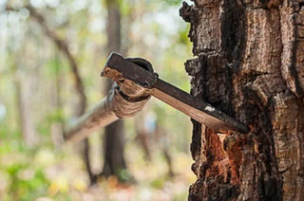
Assyria’s Arrogance
Isa 10:12-15 – “¹²So it will be that when the Lord has completed all His work on Mount Zion and on Jerusalem, He will say, ‘I will punish the fruit of the arrogant heart of the king of Assyria and the pomp of his haughtiness.’ ¹³For he has said, ‘By the power of my hand and by my wisdom I did this, for I have understanding; and I removed the boundaries of the peoples and plundered their treasures, and like a mighty man I brought down their inhabitants, ¹⁴and my hand reached to the riches of the peoples like a nest, and as one gathers abandoned eggs, I gathered all the earth; and there was not one that flapped its wing or opened its beak or chirped.’ ¹⁵Is the axe to boast itself over the one who chops with it? Is the saw to exalt itself over the one who wields it? That would be like a club wielding those who lift it, or like a rod lifting him who is not wood.”
Notes:
Isa 10:12 – What Assyria did conformed to God’s will. Why they did it did not. Their sin of arrogance matched that of Judah and Israel, and they would be judged for it. But not yet. God still has work for them to do toward Jerusalem. And as we read the next 2 verses, look at how many times the words “I”, “my”, and the phrase “my hand” appears.
Isa 10:13-14 – sounds an awful lot like a Barack Obama speech! The king is listing his achievements, and ancient Assyrian docs actually collaborate this arrogance. Like most bullies, they exaggerated their power. It’s not a sin to have ability and to recognize it; it’s a sin when we don’t recognize those abilities as coming from any origin other than God. They are gracious gifts given for a purpose and we dare not use them to devalue others and look at them as inferior.
Isaiah compares it humorously to the following – Isa 10:15 – The axe is nothing w/o the forester, and the saw is nothing w/o the carpenter. So here is the main point we need to get from this chapter: God’s sovereignty. This is a significant theme throughout the book of Isaiah. The God who is “with us” is the Sovereign “God with us”. Assyria comes at God’s command, but because it will not bow to the same moral law incumbent on all God’s creation, they too will be judged. And chapter 11 shows us that in her place will rise a kingdom w/true power.

Slide 7
Assyria’s Judgment
Isa 10:16-19 – “¹⁶Therefore the Lord, the God of hosts, will send a wasting disease among his stout warriors; and under his glory a fire will be kindled like a burning flame. ¹⁷And the light of Israel will become a fire and his Holy One a flame, and it will burn and devour his thorns and his briars in a single day. ¹⁸And He will destroy the glory of his forest and of his fruitful garden, both soul and body, and it will be as when a sick man wastes away. ¹⁹And the rest of the trees of his forest will be so small in number that a child could write them down.”
Fire& sickness
Darkness overcome
Assyria’s worthless vineyard
Child takes a census
Notes:
And since Assyria has a lax understanding of divine to human sovereignty, they’re in for a world of hurt.
Isa 10:16 – What does this occasion sound like? When God sends the angel in 37:36 to kill 185,000 Assyrian troops overnight. And when this happens, Assyria’s king Sennacherib should have then figured out that there is a difference between idols and “the Lord, the God of hosts.” But we know from the end of chapter 37 that he did not. Upon whom did this combination of fire and sickness come on? Their “stout warriors” – their physical prowess didn’t keep them from God’s judgment.
Isa 10:17 – In other words, Assyria marching on Jerusalem would be like they are jumping into a fire. There is a contrast between this verse and chapter 5:30 which describes Assyria’s judgment against Judah – “If one looks to the land, behold, darkness and distress; even the light is darkened by its clouds.” And that is true. But once Assyria’s purpose was fulfilled and they try to take down Zion, that darkness is going to meet a light it wasn’t prepared for, and Assyria will be like briars and thorns before Him. How quickly will it happen? “in a single day” – Assyria’s judgment would come suddenly.
Isa 10:18 – Just as God destroyed Judah’s vineyard for yielding worthless grapes, Assyria’s vineyard would be no different. So, notice that God is showing no partiality in His judgment against human sin other than the fact He made a promise to be on Judah’s side no matter how unworthy. Sin is sin, but for Judah, “God is with us”.
Isa 10:19 – Notice the reference to a child, a prominent theme in chapters 7 – 12. They would become so diminished in number, a child could easily take a census of their remaining soldiers.

Slide 8
A Remnant Will Return
Isa 10:20-23 – “²⁰Now in that day the remnant of Israel, and those of the house of Jacob who have escaped, will never again rely on the one who struck them, but will truly rely on the Lord, the Holy One of Israel. ²¹A remnant will return, the remnant of Jacob, to the mighty God. ²²For though your people, O Israel, may be like the sand of the sea, only a remnant within them will return; a destruction is determined, overflowing with righteousness. ²³ For a complete destruction, one that is decreed, the Lord God of hosts will execute in the midst of the whole land.”
Notes:
The focus now changes abruptly from Assyria to Israel. And speaking of children, notice what pops up again – Isa 10:20-22a – what theme pops up that we saw in chapter 7?
Shear-jashub – “a remnant shall return”. Since they are truly under God’s protection, the destruction won’t be total, but a part of God’s larger purpose, that they’d no longer lean on pagan empires for help, something had hurt them so often in the past. Israel had been at war with Syria for over a century but aligns w/them against Judah. Judah had been at war against Assyria before but chose to pay them off for help. None relied on God, and so He judges them to teach them trust. That vs. 21 says “Mighty God” is no accident. It is the same phrase for the child in 9:6. It’s almost as if God wants them to see where true power is found, not in the so-called power of Assyria, that mighty Euphrates, but in the gentle waters of Shiloah, that of a child who would be born in this world of a virgin and whose might would be displayed through condescension and submission. This is a theme that will be developed further in chapters 49 – 55.
Isa 10:22b-23 – Notice how this judgment is referred to as “righteous”. We don’t particularly enjoy the judgment aspects we’re studying – it’s uneasy reading. And yet God’s judgments are righteous – Psa 19:9b – “The judgments of the Lord are true; they are righteous altogether.” It’s an outworking of His holiness, His fairness. Yes, God told Abraham in Gen 22:17 that His descendants would be as numerous as the stars and the sand. But being a physical descendant of Abraham was never to usurp the righteous conduct of Abraham, as Jesus repeatedly told the Jews. Abraham’s true descendants are those who have the faith of Abraham (Rom 4:16). And to get there, there must first be judgment, which will be “overflowing”, pointing back to the Assyrian flood of chapter 8, which the Lord Himself will decree.

Slide 9
Assyria Destroyed
Isa 10:24-27 – “²⁴Therefore thus says the Lord God of hosts, ‘O My people who dwell in Zion, do not fear the Assyrian who strikes you with the rod and lifts up his staff against you, the way Egypt did. ²⁵For in a very little while My indignation against you will be spent and My anger will be directed to their destruction.’ ²⁶The Lord of hosts will arouse a scourge against him like the slaughter of Midian at the rock of Oreb; and His staff will be over the sea and He will lift it up the way He did in Egypt. ²⁷So it will be in that day, that his burden will be removed from your shoulders and his yoke from your neck, and the yoke will be broken because of fatness.”
My people | Isa 1:3
You people | Isa 1:10
Your people | Isa 2:6
My people | Isa 3:12
His people | Isa 3:14
My people | Isa 3:15
His people | Isa 5:13
His people | Isa 5:25
This people | Isa 6:9-10
[Ahaz’s] people | Isa 7:2,17
These people | Isa 8:6
This people | Isa 8:11-12
This people | Isa 9:16
My people | Isa 10:2
My people | Isa 10:24
His people | Isa 11:11,16
69
Notes:
Isa 10:24 – The discipline will hurt, but it won’t last. God is in charge. It’s comparative to Egypt’s affliction upon them, which though terrible, ended in a great redemption victory.
And then He refers to them again as “My people”. Notice the pendulum affect in chapters 1 – 12, going from being “His” people or “My people” or “Your” people to “You” people, “This” people, “These” people. What is this about? Have you ever had a child, who you raised w/godly principles, do something so completely out of character, that you briefly wonder whose child he is? You may even refer to him as “your” to your spouse. But then when the anger passes, you realize no matter what he’s done, he is still your child. I wonder if that isn’t what is happening here.
Isa 10:25 – Remember the inclusio from chapters 9 and 10 – “His anger does not turn away, and His hand is still stretched out”. His anger hasn’t subsided because there is still sin to be dealt with. It’s just that when He has purged the filth from Zion and the remnant returns w/greater faith, His anger will be redirected toward Assyria and their sin.
How complete will Assyria’s defeat be? – Isa 10:26 – The slaughter of Midian refers back to Judg 7, where Gideon and his 300 men defeated 135,000 Midianites, an allusion to chapter 37 when Assyria would finally be defeated at Jerusalem. The Rock of Oreb was named after the Midiantite prince who escaped death from battle but was killed when he fled. This is very similar to what we will see happen to Sennacherib at the end of Isa 37, so stay tuned. What does the 2nd half of vs. 26 remind us of? How God provided an escape against Egypt through the Red Sea by lifting his staff over it. He’s giving them precedence for their rescue – God has rescued them before, He’ll do it again. Notice the contrast between that idea vs. 24. Though Assyria brings its staff, God has a staff of His own. Hebrew poetry is great.
Isa 10:27 – Instead of the word “fat”, some of your versions will say “oil” and some “anointing”. Hebrew poetry can be allusive. It is difficult to know what the word should be. But if “fat” is correct, the image is of an ox who has eaten so well and been worked so little, the very fat of its neck breaks the yoke away. That’s how the yoke of Assyria would be removed from them.

Slide 10
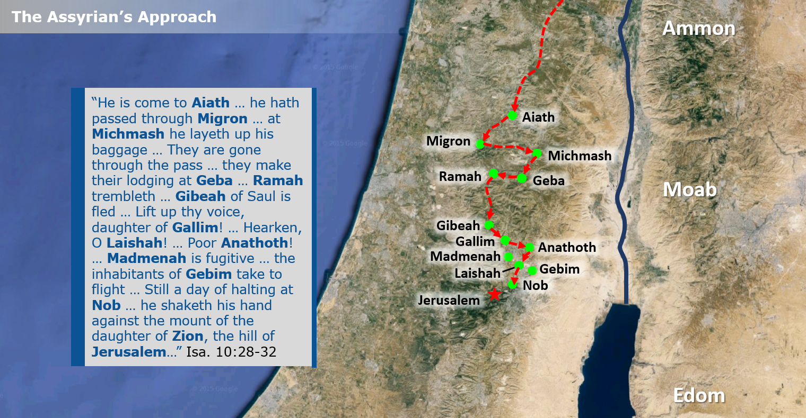
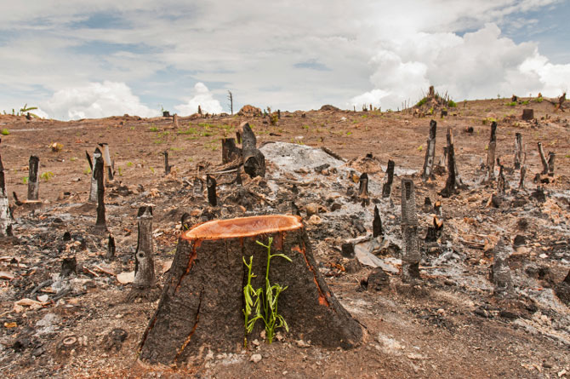
Assyria Destroyed
Isa 10:28-34 – “²⁸He has come against Aiath, he has passed through Migron; at Michmash he deposited his baggage. ²⁹They have gone through the pass, saying, ‘Geba will be our lodging place.’ Ramah is terrified, and Gibeah of Saul has fled away. ³⁰Cry aloud with your voice, O daughter of Gallim! Pay attention, Laishah and wretched Anathoth! ³¹Madmenah has fled. The inhabitants of Gebim have sought refuge. ³²Yet today he will halt at Nob; he shakes his fist at the mountain of the daughter of Zion, the hill of Jerusalem. ³³Behold, the Lord, the God of hosts, will lop off the boughs with a terrible crash; those also who are tall in stature will be cut down and those who are lofty will be abased. ³⁴He will cut down the thickets of the forest with an iron axe, and Lebanon will fall by the Mighty One.”
Notes:
So, if you remember back in chapter 8, Assyria was described as an overflowing flood that would sweep into Israel and cover all its banks and channels, and it would sweep into Judah, but would only reach to the neck. Isa now described a bit more of how this will work.
Isa 10:28-32 – Just as in 10:9, there is a pattern to the listing of these 12 cities – they are all names from north to south in order to show the flow of Assyria’s invasion. Aiath is probably Ai of Joshua’s day. Migron and Michmash were notable cities in Benjamin’s day, and it sounds as if Assyria deposits their baggage in Michmash in order to go through some “pass” unencumbered. Having done so, they occupy Geba, and this terrifies Ramah and Gibeah and so they flee away, which is notable because these were fortress cities, but they see the inevitable. And the more obstacles Assyria overcame to get to Jerusalem, the more inevitable it was that the enemy was coming. And so, the cities of Laishah, Gallim, ad Anathoth are encouraged to take note of this. The desperation is evident. Everyone in the towns on the outskirts of Jerusalem are now fleeing, including Madmenah and Gebim. Nob is a priestly city, just one mile from Jerusalem, right on the outskirts. This is where Assyria will plan its attack, but it’s as far as they will ever get, marking the zenith of Assyria’s power. From here on out, they will be objects of God’s judgment. Now the destroyer will be destroyed.
Isa 10:33-34 – This is a repeat of the language from chapter 2, to show that all the prideful will be abased – Judah, Israel, and now Assyria. Because there is only one who is truly lofty and exalted – the holy, holy, holy One of Israel.

Slide 11
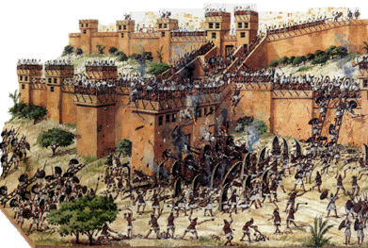
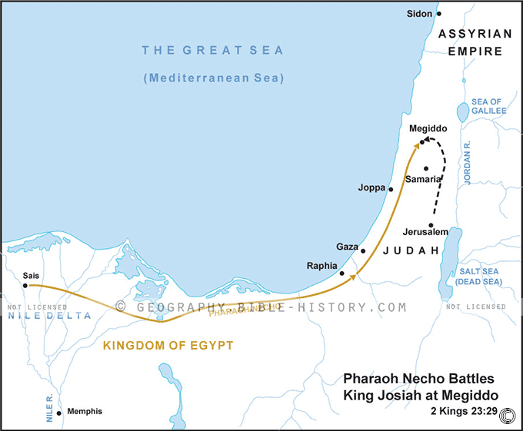
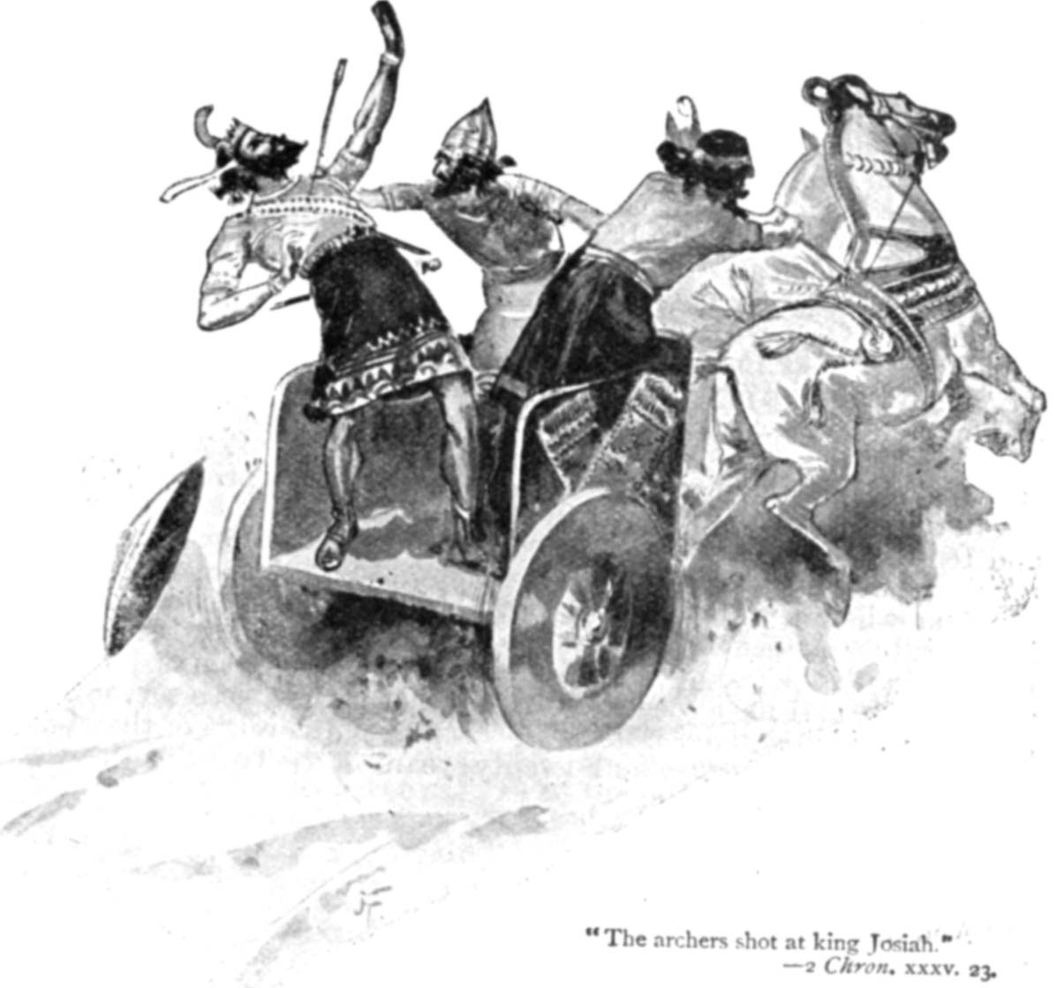
The Fall of Assyria
Notes:
How did Assyria finally go down? Most of us are aware of their climactic defeat in Isa 37, but this did not spell the end of the empire; that would come ~100 years later. During that time, Assyria found it very difficult to keep all the nations it had conquered in check. Rebellions broke out all over the place and it was taxing Assyria financially and militarily. Another nation, which had been a thorn in Assyria’s side for a long time, is now starting to make its presence felt, and that is the Babylonian Empire.
In 612 BC, Babylon joined up w/the Medes and conquered the Assyrian capital of Nineveh. Nineveh is no more, just as the prophet Nahum had prophesied. This was also the pivotal point in history where Babylon established itself as the dominant empire, and would be so for the next 73 years.
But Assyria wasn’t done. 3 years later in 609BC, Pharaoh Necho of Egypt agreed to join forces with the remnant of the Assyrian Empire at the Euphrates River in Carchemish in an attempt to hold off invasion by the Babylonians. Josiah seemed to prefer the Babylonians being in power vs. Assyria and Egypt, and so he met Necho’s army in battle while they are traveling north – the Battle of Megiddo.
This mistake in judgment led to Judah’s army being defeated and Josiah losing his life. Josiah’s death is one of the darkest days in Judah’s history.
4 years later in 605BC, the great battle of Carchemish takes place. It’s Egypt and Assyria vs. Babylon. Babylon wins handily and Assyria is annihilated and is never again an empire. The Egyptian forces flee back to Egypt pursed by their general, Nebuchadnezzar, who while chasing the Egyptians hears that his father Nabopolassar has died, and he has to turn around and rush back to Babylon to secure the throne, stopping in Jerusalem along the way to back them a vassal state.

