Slide 1
Jesus Said Few Will Be Saved
Knowing Jesus
Luke 13:22-30

Slide 3
Jesus Said Few Will Be Saved
Don’t despair and give up!
There is hope!
You can be among the few!
And those who heard it said,
"Who then can be saved?"
But He said,
"The things which are impossible with men are possible with God."
Luke 18:26-27; NKJV

Slide 4
Jesus Said Few Will Be Saved
The Savior
The Saved
Not because of
Unwillingness
Inability
Lack of
Willingness
Faith
Confession
Repentance
Baptism
Striving

Slide 5
Strive
agonizomai – agonize
Strong’s
To struggle
Lit. to complete for a prize
Fig. to contend with an adversary
To endeavor to accomplish something
Thayer’s
To endeavor with strenuous zeal
Vine’s
To contend, to strive
Luke 13:24
1 Corinthians 9:25
Colossians 4:12
1 Timothy 6:12
2 Timothy 4:7

Slide 6
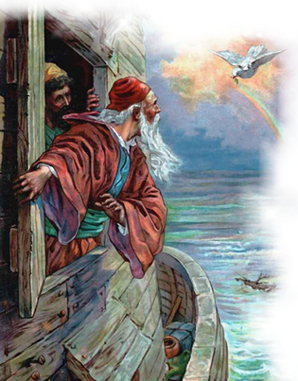
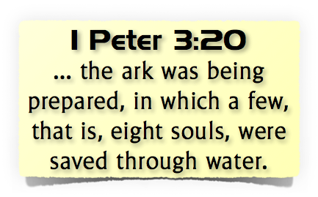
Jesus Said Few Will Be Saved

