Slide 1
Notes:
As the threat of Sennacherib’s invasion heats up, it was putting the Jews under a lot of political and spiritual pressure. The temptation politically was to form an alliance w/Egypt, despite the fact they had already proven themselves to be full of hot air. The temptation spiritually was to not look at God has the sovereign Lord of history who is more than able to keep His promises despite how bleak the outlook. Chapter 29 contains oracles #2 and #3 in which God gives a general overview of how He will both judge them and rescue them, how He will take their self-imposed blindness and increase it even more so as to destroy their worldly wisdom, and how He will reverse roles between the ruthless leadership and those who are afflicted. Keep in mind that these first 3 “woes” are dealing w/the principle of the issue whereas the following chapters will make these principles applicable historically and eschatlogically.

Slide 2
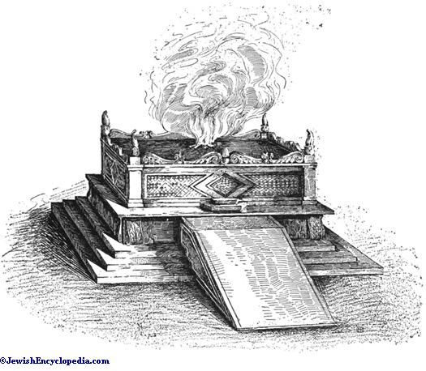
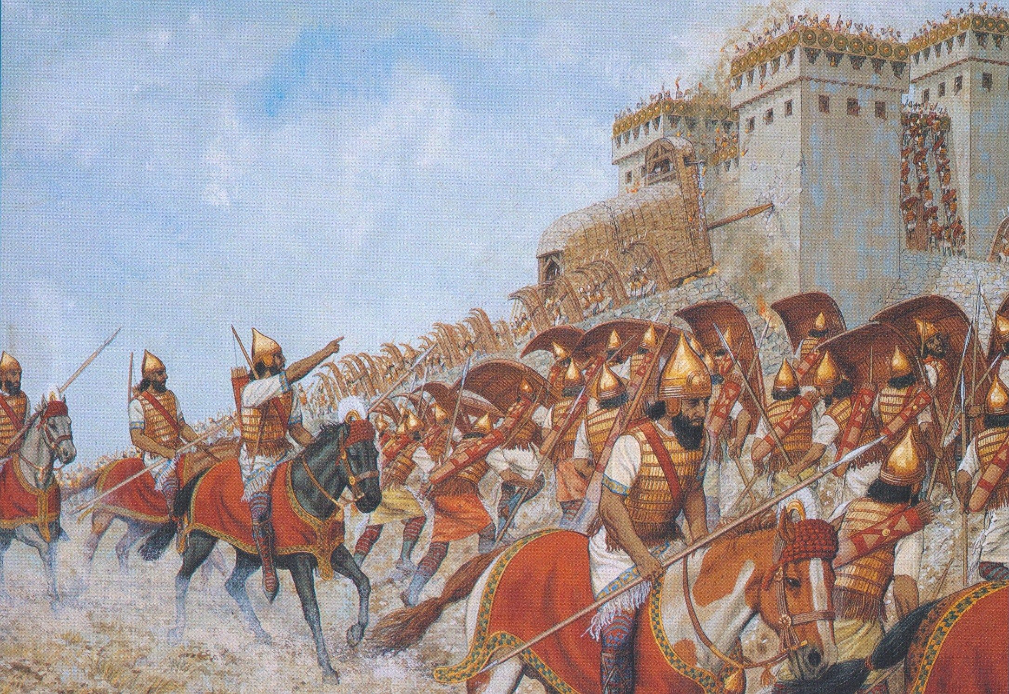
Blindness & Illumination
City reduced to dust
Isa 29:1-4 – “¹Woe, O Ariel, Ariel the city where David once camped! Add year to year, observe your feasts on schedule. ²I will bring distress to Ariel, and she will be a city of lamenting and mourning; and she will be like an Ariel to me. ³I will camp against you encircling you, and I will set siegeworks against you, and I will raise up battle towers against you. ⁴Then you will be brought low; from the earth you will speak, and from the dust where you are prostrate your words will come. Your voice will also be like that of a spirit from the ground, and your speech will whisper from the dust.”
Notes:
Isa 29:1-4 – The historical setting: Sennacherib’s invasion of Judah in 701BC. The city David once conquered (2 Sam 5:7-9) is in danger of itself being conquered. Why would Jerusalem be referred to as Ariel? The word “Ariel” is very similar to a Hebrew word in Ezek 43:15, “hearth of God”, which, much like the cross, would be the place where both God’s wrath and favor are found (31:9). But though they were keeping their annual religious feasts, it would not prevent God’s judgment because their hearts weren’t changing (1:11-15). Point: they’re relying on their association w/David and their religious rituals, but not on God.
And so, in place of religious festivity, there will be sorrow and mourning. They’ll be like a veritable “Ariel” from which God’s wrath will be extinguished, purging the city of David of its moral filth. Treating God’s sacrifices lightly will cause us to be the sacrifice.
David once camped against the city in 2 Sam 5:7-9, but now God will “camp against it”, using secondary forces such as Assyria and its engines of war. David had camped against it to establish the true Jerusalem; God now camps against it for the same purpose.
The purpose? To bring their loud, lofty boasts as low as a whisper. This denotes a Jerusalem on the brink of destruction, crying out to God from the ground w/a weak voice just before death. The latter whispers refer to the mediums who claim to consult w/the dead. The people once sought them instead of God (8:19). Their futility will now be made known in the most humbling way.

Slide 3
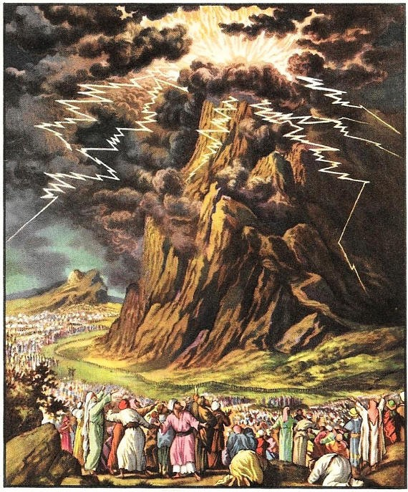
Blindness & Illumination
11th hour rescue
Isa 29:5-8 – “⁵But the multitude of your enemies will become like fine dust, and the multitude of the ruthless ones like the chaff which blows away; and it will happen instantly, suddenly. ⁶From the Lord of hosts you will be punished with thunder and earthquake and loud noise, with whirlwind and tempest and the flame of a consuming fire. ⁷And the multitude of all the nations who wage war against Ariel, even all who wage war against her and her stronghold, and who distress her, will be like a dream, a vision of the night. ⁸It will be as when a hungry man dreams—and behold, he is eating; but when he awakens, his hunger is not satisfied, or as when a thirsty man dreams—and behold, he is drinking, but when he awakens, behold, he is faint and his thirst is not quenched. Thus the multitude of all the nations will be who wage war against Mount Zion.”
Notes:
The tone now shifts from judgment against Jerusalem to its redemption.
Isa 29:5 – So while Judah would be humbled to the dust, her enemies will be scattered like fine dust (37:36-38). Chaff is used metaphorically for that which is weak and helpless and inconsequential. Also, this judgment on Ariel’s enemies will be sudden (17:14). Such is the awesome ease of which God demonstrates His divine action. This should be a lesson for us that when we allow our fear of humanity to overcome us, God’s power becomes less and less significant to us.
Isa 29:6 – This language is similar to the theophany, and these types of violent metaphors describe the coming visitation of God for judgment, and serve as the beginning source of future apocalyptic language in scripture. All the forces of nature that are awesome and beyond our control are at His complete disposal and He utilizes them for His divine purposes w/ease.
Isa 29:7 – In other words, because of how quickly God disposes of Judah’s enemies, it will seem to them as just a bad nightmare that quickly vanishes away w/the coming day. Dreams can seem so frighteningly real and it’s a relief to wake up and figure out that’s all it was. In fact, some of Jerusalem’s inhabitants likely woke up one morning w/the dread of having to face the Assyrian threats/taunts for yet another day only to realize Sennacherib was headed back home, leaving his decimated camp behind.
But now it’s the dreaming of the enemy under consideration – Isa 29:8 – Meaning, those who undertake to thwart God’s purposes by destroying His people can dream about the spoils all they want, but it will be like a dream that is unfulfilled when he awakens. Isaiah is drawing a picture of a defeated and disillusioned enemy, who finds out the bitterness of wanting something that he can’t have. It is an endless frustration to the benefit of God’s people, as He will ultimately protect Mt. Zion despite the sin of His people.

Slide 4
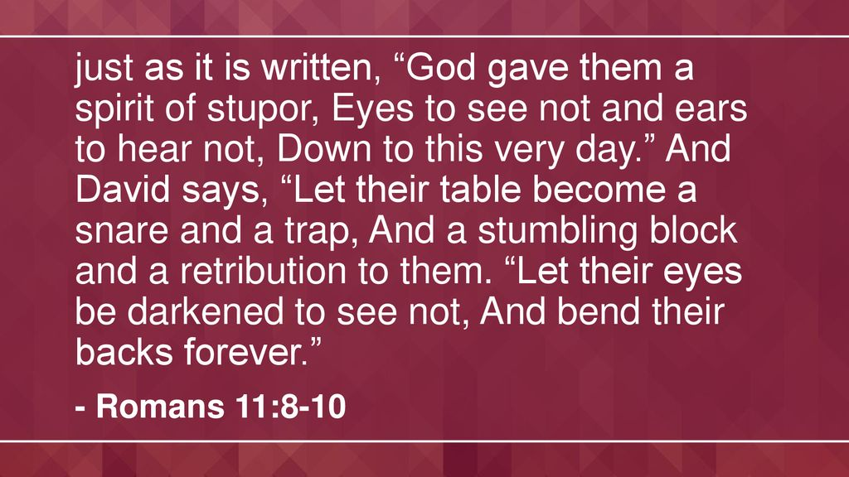
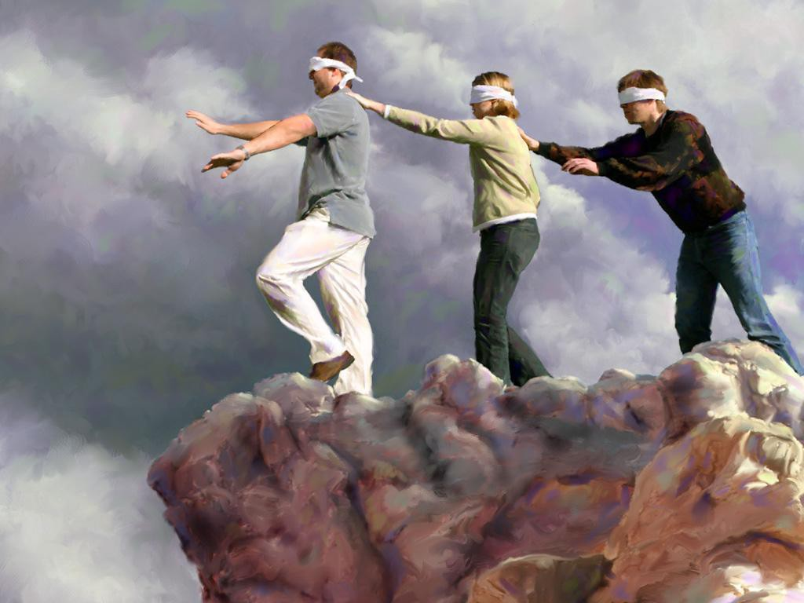
Blindness & Illumination
God blinds those choosing blindness
Isa 29:9-12 – “⁹Be delayed and wait, blind yourselves and be blind; they become drunk, but not with wine, they stagger, but not with strong drink. ¹⁰For the Lord has poured over you a spirit of deep sleep, He has shut your eyes, the prophets; and He has covered your heads, the seers. ¹¹The entire vision will be to you like the words of a sealed book, which when they give it to the one who is literate, saying, ‘Please read this,’ he will say, ‘I cannot, for it is sealed.’ ¹²Then the book will be given to the one who is illiterate, saying, ‘Please read this.’ And he will say, ‘I cannot read.’”
Notes:
Isaiah is now going to revisit an earlier theme from his call to the prophetic office in chapter 6, the blindness of the people.
Isa 29:9 – As Isaiah was told in 6:9, those who resist the word can only be won by the word, but the word will harden them past the point of no return. By “delay”, he likely means “hesitation”, which can indicate willful blindness. Willfully refusing to see induces blindness. This is a figurative, spiritual drunkenness, describing people who are undiscerning of the times.
But now notice the balance between free will and divine sovereignty – Isa 29:10 – It’s a cyclical effect. We blind ourselves, which causes God to have to blind us even more, as He did w/Pharaoh in Exodus. Spiritual insensitivity leads to spiritual paralysis. The idea is that God will cause these “drunks” to “sleep it off”. All that this “altar hearth” is good for at the moment is to be “poured over” as w/a drink offering to complete the sacrifice. This verse is quoted in Rom 11:8 as the reason why Israel had such a hard time accepting Jesus as their Messiah.
What will the blindness for the seers and prophets be like? – Isa 29:11-12 – Covers those who can, but don’t want to be bothered (indolence) as well as those who can’t, and do not care (indifferent). The illiterate had to depend on those who could read to reveal. But those who had the ability to understand lacked the spiritual insight. And so, both the learned and unlearned are brought under condemnation (9:14-17). Many today read the bible like a man “reads” the newspaper, picking out a few words here and there while the true content escapes them. Many in the pews can read, but for them the bible is still “sealed”.

Slide 5
Blindness & Illumination
Destroys “wisdom” to restore them
Isa 29:13-14 – “¹³Then the Lord said, ‘Because this people draw near with their words and honor Me with their lip service, but they remove their hearts far from Me, and their reverence for Me consists of tradition learned by rote, ¹⁴therefore behold, I will once again deal marvelously with this people, wondrously marvelous; and the wisdom of their wise men will perish, and the discernment of their discerning men will be concealed.”
Notes:
Why would the Lord allow the people to go on being blind?
Isa 29:13 – This is another NT quote; Jesus used this to describe the hypocritical worship of the Jews in Matt 15:7 and Mark 7:6. So while Samaria’s idolatry might have been open and glaring, Jerusalem’s was hidden under the cloak of hypocrisy. They could talk the spiritual talk, but lived another. But observance and ritual w/o personal relationship are an abomination to God. Whatever reverence they had was due to fear toward man, what they would think and the traditions they taught, rather than a desire to honor God. God doesn’t separate from people until they separate their hearts from Him.
But this is not arbitrary on God’s part; there is a purpose to letting them come to the full extent of their blindness – Isa 29:14 – Here’s the idea: the people had a worldly wisdom about them that kept them from fully seeing God and His work. This so-called “wisdom” led to the very prideful blindness they were facing. And while it is true that human wisdom that omits God and His ways needs exposing, by God demonstrating Himself in the way he plans to at the end of 37, it will in turn destroy man’s confidence in human wisdom, demonstrating it to be foolish, which will turn the nation back to God who is the source of all wisdom. This verse is quoted by the Apostle Paul in 1 Cor 1:19 as a way to show how the cross of Christ worked much the same, destroying the so-called wisdom of man by its seeming “foolishness”.

Slide 6
Notes:
The 2nd woe calls for the need for there to be a radical spiritual overhaul, and something dramatic is going to have to occur to achieve that. As we look at the 3rd woe, we’re not yet told what that dramatic event needs to be, but we are told its certainty as well as the transformation. No matter what the leaders are contriving behind the scenes, God will expose it, and when He does, there will be a transformation in which the ruthless leadership will be removed and those they afflicted exalted.

Slide 7
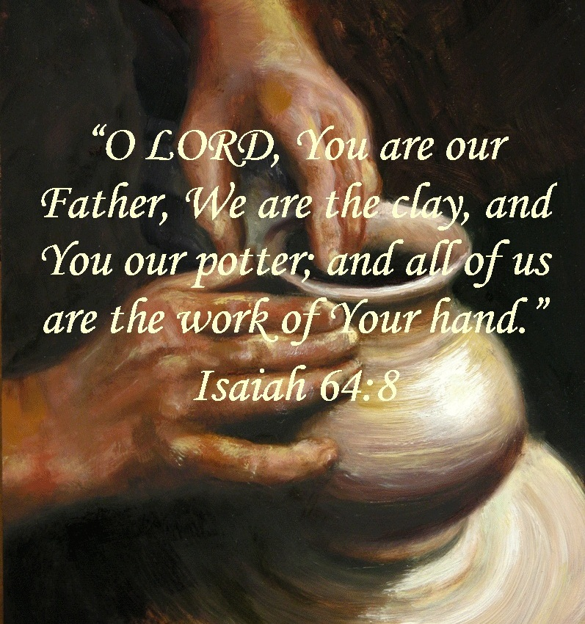
Contrivance & Transformation
Subverting of reason
Isa 29:15-16 – “¹⁵Woe to those who deeply hide their plans from the Lord, and whose deeds are done in a dark place, and they say, ‘Who sees us?’ or ‘Who knows us?’ ¹⁶You turn things around! Shall the potter be considered as equal with the clay, that what is made would say to its maker, ‘He did not make me’; or what is formed say to him who formed it, ‘He has no understanding’?”
Deny His distinctiveness
Undermine His sovereignty
Underestimate His wisdom
Notes:
Isa 29:15 – This is how blind the world is: they think they can hide their sinful plans from God (Ezek 8). It is a stubborn denial of God’s physical presence, hiding as Adam and Eve attempted to do in the garden (Gen 3:8). We’re still establishing principle in these first 3 woes, but this likely refers to their plan to politically align themselves w/Egypt. Why would God’s people endeavor to ensure its freedom w/a nation He proved his power and sovereignty over in the beginning of their history?
Isa 29:16 – This verse is quoted in Rom 9:20, the point being that they’ve got it backwards. Now, as you can see from Isa 64:8, by the time God works out all their issues through the Messiah, His people will have this figured back out. But until then, there are 3 issues:
1) They’re denying His distinctiveness (potter vs. clay). 2) They’re undermine His sovereignty (He did not make me). 3) They’re underestimating His wisdom (He has no understanding). In short, they sound like modern-day evolutionists who attempt to rule God out of the picture altogether!

Slide 8
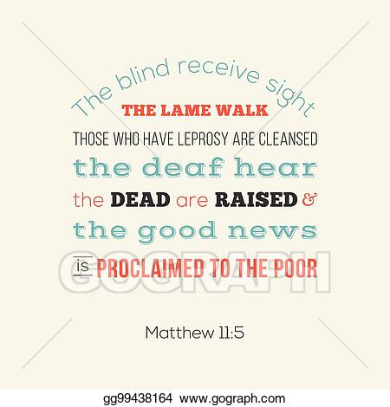
Contrivance & Transformation
Reversal of fortunes
Isa 29:17-21 – “¹⁷Is it not yet just a little while before Lebanon will be turned into a fertile field, and the fertile field will be considered as a forest? ¹⁸On that day the deaf will hear words of a book, and out of their gloom and darkness the eyes of the blind will see. ¹⁹The afflicted also will increase their gladness in the Lord, and the needy of mankind will rejoice in the Holy One of Israel. ²⁰For the ruthless will come to an end and the scorner will be finished, indeed all who are intent on doing evil will be cut off; ²¹who cause a person to be indicted by a word, and ensnare him who adjudicates at the gate, and defraud the one in the right with meaningless arguments.”
Notes:
Here is the reciprocal change described in detail:
Isa 29:17 – Isaiah loves using the tree motif, and he can mean different things by it depending on the context. Here, it likely alludes to national Israel and its corrupt leaders becoming an uncultivated field while spiritual Israel will become a productive field, and the next verses seem to indicate such.
Isa 29:18-19 – This verse is quoted in Matt 11:5 and Luke 7:22. This is the contrast we saw in the previous woe in which Isaiah’s message was a closed book for the current people, but there would come a new people w/new faculties and appetites for God’s word. Part of the “cultivation” from vs. 17 was removing physical distractions that were blinding them to spiritual realties. Once removed, there will be an enhanced joy for the afflicted and needy who were used to being pushed around by stronger people. But all the pent-up feelings of fear and anxiety throughout the years will be released. It doesn’t matter whether the affliction/need is spiritual or physical in nature, as coming to Jesus brings renewed joy in both circumstances.
Isa 29:20-21 – So in addition to restoring, God brings justice upon the wicked. Those unsparing in their misuse of power, the immoral, and those who are determined to do evil will be gone. Their selfish interests are served by a breakdown of law and order and so God will not allow them to continue to oppress those who He has determined to save. Vs. 21 explains what occurs in a corrupt judicial process. False testimony, tampering w/witnesses, and using verbosity to confuse the issue to make the innocent look guilty. This can be done through cross-examinations, technicalities, triviality, and having a corrupt judge or lawyer in the proceedings.

Slide 9
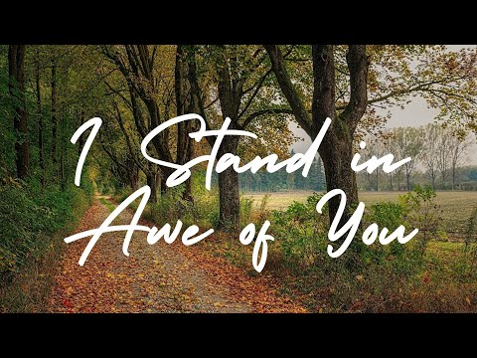
Contrivance & Transformation
Jacob’s changed fortunes
Isa 29:22-24 – “²²Therefore thus says the Lord, who redeemed Abraham, concerning the house of Jacob: ‘Jacob shall not now be ashamed, nor shall his face now turn pale; ²³But when he sees his children, the work of My hands, in his midst, they will sanctify My name; indeed, they will sanctify the Holy One of Jacob and will stand in awe of the God of Israel. ²⁴Those who err in mind will know the truth, and those who criticize will accept instruction.”
Notes:
This will lead to Jacob’s changed fortunes:
Isa 29:22-23 – Isaiah is painting the picture of Jacob witnessing the bad path that his descendants have taken, probably anxious over whether their behavior will forfeit the promises. God says this will not be the case, not because of them, but in spite of them. The great work God began in Abraham, He is going to complete it. Though they were Jacob’s children, and were as stubborn as he was, they became better as a result of God working on them, just as God had worked on Jacob to change him into Israel. This will cause them to cast away idolatry and at last recognize the one true God of Israel as a central part of their lives, revering Him in the strongest possible sense.
The result? – Isa 29:24 – This contrasts what we saw in 29:9-12,14. The order of events is significant – deliverance is followed by praise which results in understanding. David experienced something similar – Psa 51:13-15. Who then becomes the source of our spiritual blessings in God? Him and Him alone.

Slide 10
Isaiah 29 In The NT
Effect: God stupefies – Isa 29:10 = Rom 11:8
God’s doing, for progressing His plan to save man
A stupor that comes as a result of a blow: the gospel
Temporary hardening for the Jews caused hardening
Point: though disobedient, He shows mercy – Isa 29:14; Rom 11:32
Cause: Self-stupefication – Isa 29:13 = Matt 15:8; Mark 7:6-7
Outward religion required, but moot w/o inward devotion
Like Pharaoh’s self-hardening, led to God hardening more
Point: traded trust in God for trust in what man says/thinks
Means: True/False wisdom revealed – Isa 29:14 = 1 Cor 1:19
By letting false witness run its course, man sees its ineffectiveness
Pharaoh’s wise men no match for God
God reveals His wisdom in ways not to be misunderstood
Point: sometimes school of hard knocks only thing that sticks
Root Sin: Lacked knowledge of God – Isa 29:16 = Rom 9:20
Denied His distinctiveness, sovereignty, and wisdom
10 plagues designed to broadcast God’s name – Rom 9:17; Ex 9:16; 12:12
Point: Idolatry as much mental as physical
Remedy: Jesus Christ – Isa 29:18 = Matt 11:5; Luke 7:22
Like Pharaoh, John the Baptist saw confirmation from God
Like Pharaoh, John the Baptist needed to be reminded
Blindness, leprosy, and death used to be punishments
Point: in Christ, the marginalized become most receptive
Notes:
Many Christians couldn’t tell you about Isaiah 29 let alone quote a verse from it. But did you know that there are 5 well-known verses in this 24-verse chapter that are quoted in the NT? And interestingly, they all form a theme:
1) Isa 29:10 talks about God’s need to further stupefy an already stupefied nation, because doing so will progress His plan for saving man. In Rom 11:8, the Apostle Paul quotes the same verse in regard to the Jews and the gospel. The Jews could not “obtain” Christ because of their hardened hearts, and so God had to harden them further because, in His wisdom, He saw that by making them jealous through the conversion of the Gentiles, more Jews could be saved (Rom 11:11). And so, its marvelous as this sounds to our ears, God was able to use their own disobedience to show mercy – Isa 29:14; Rom 11:32.
2) Isa 29:13 relays that the cause for God hardening their hearts was their own self-hardening. Though outward religion was required, it was a moot point w/o the inward devotion it was intended to create. This was very similar to how He dealt w/Pharaoh. At first, Pharaoh was the one hardening his own heart until he continued to do so and God had to harden it further. Jesus quotes this verse in Matt 15:8 and Mark 7:6-7, applying it to the scribes and Pharisees and their hypocrisy. Like the Jews of Isaiah’s day, the scribes and Pharisees placed their trust in what man said rather than God, and expected their followers to do the same. In this way, they hardened their hearts toward anything God’s word said that contradicted their traditions.
3) Isa 29:14 relays how God will use this hardening process to destroy their wisdom and exalt His own. By letting false witness run its course, man will see its ineffectiveness. We saw this in Exodus when Pharoah’s own wise men were found to be no match for God. And so, God would reveal His wisdom in such a way as it could not be misunderstood by those who truly had a heart for God. The Apostle Paul quotes this same verse in 1 Cor 1:19 to describe the effects of the cross of Christ. The cross was foolishness to those who were perishing, but the power of God to those being saved. It was the ultimate marvelous act of God that determined those who would be saved and lost.
4) Isa 29:16 shows us how the Jews of Isaiah’s day denied God’s distinctiveness, sovereignty, and wisdom. Pharaoh did the same in Exodus, requiring God to manifest Himself through the 10 plagues. The Apostle Paul quoted this in Rom 9:20, and elaborates on its purpose in Exodus in Rom 9:17. The point is the same in both passages – idolatry is as much mental as it is physical.
5) Isa 29:18 is partially quoted in Matt 11:5 and Luke 7:22 to John the Baptist. Like Pharaoh, John the Baptist saw confirmation from God and like Pharoah needed a reminder when he was in prison. But just as Isaiah uses this verse to show the transformation that the marginalized will undergo to become blessed, Jesus would heal people of these physical infirmities to show that once healed, they become the most receptive of all the people. This is in keeping w/Jesus teaching that He did not come to call the righteous, but sinners to repentance.

