Slide 1
Notes:
On Sunday, we began studying Isa 49, and I made the point that there are many similarities between Isa 49 and Isa 40, the most significant being the complaints raised by the people. In 40:27, the complaint was that God had abandoned them to physical captivity, and in 49:14 we see a similar complaint – Isa 49:14 – “The Lord has forsaken me, and the Lord has forgotten me.” But this doesn’t appear to be a complaint about their physical captivity, but their spiritual captivity, that lingering issue that keeps causing God to have to continue visiting judgment upon them. Is God able to fix the greater problem of sin? And the answer from chapter 49 is the 2nd Servant Song, an expansion of the 1st Servant Song of chapter 42, in which God will send a Deliverer who will be the ideal Israel. And since spiritual captivity is not just a Jewish problem but also a human problem, He’ll be given the double task of delivering both. He’ll experience frustration and difficulty and even persecution doing so, but ultimately God will resolve all things in a favorable time. God cannot forget His people anymore than a mother could forget her nursing children. And not only will He rescue humanity, He will also bless their posterity beyond their comprehension to perceive.

Slide 2
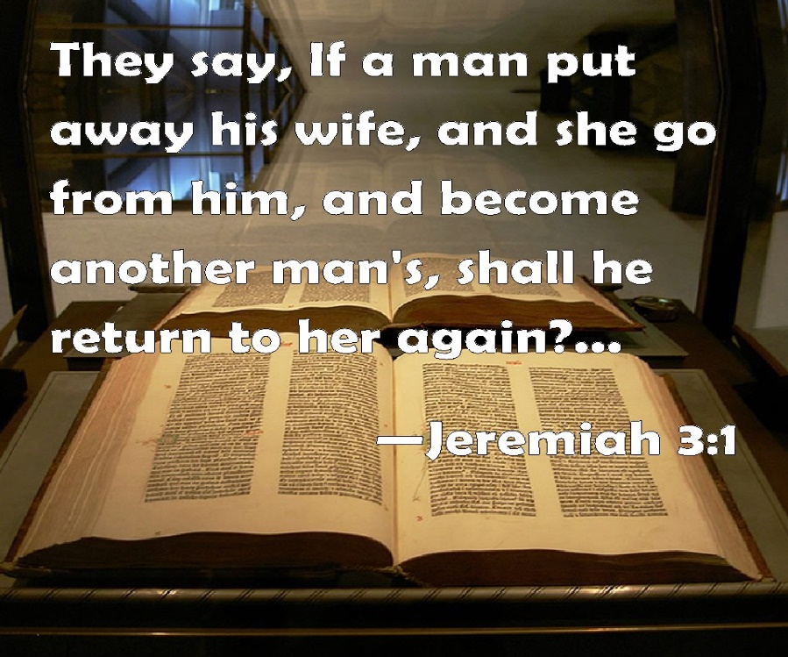
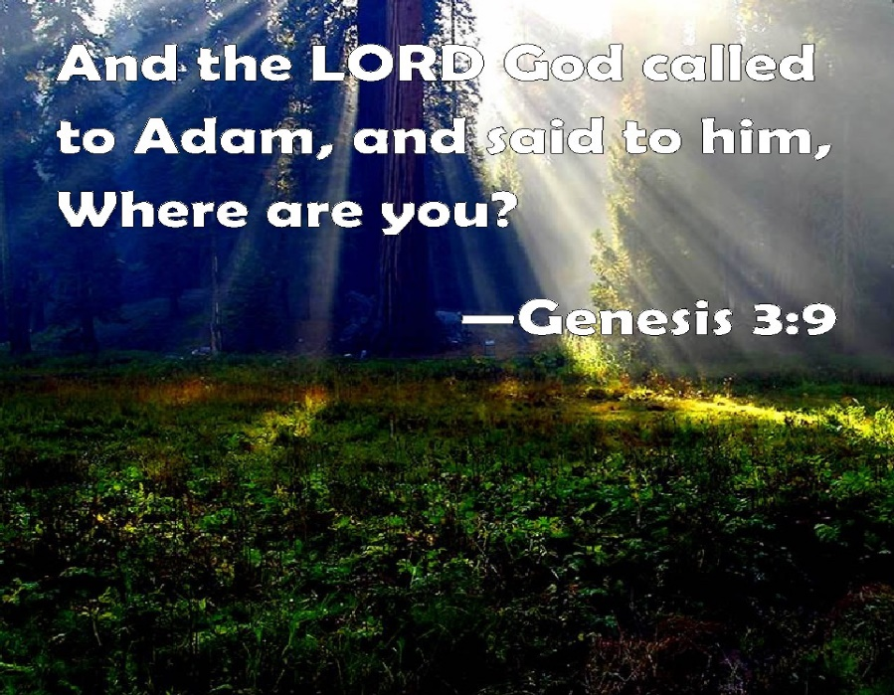
Zion Not Forgotten
God redeems
Isa 50:1-3 – “¹Thus says the Lord, ‘Where is the certificate of divorce by which I have sent your mother away? Or to whom of My creditors did I sell you? Behold, you were sold for your iniquities, and for your transgressions your mother was sent away. ²Why was there no man when I came? When I called, why was there none to answer? Is My hand so short that it cannot ransom? Or have I no power to deliver? Behold, I dry up the sea with My rebuke, I make the rivers a wilderness; their fish stink for lack of water and die of thirst. ³I clothe the heavens with blackness and make sackcloth their covering.’”
Notes:
As we begin chapter 50, Isaiah continues making the argument that God has not forgotten Zion, and He turns their complaint around and places the responsibility where it belongs – when God called, no one responded. What happened to them was due to their own rebellion. But that is not the nail in the coffin:
Isa 50:1a – God is asking if something irretrievable has occurred. The Law of Moses does teach that divorce can lead to a series of events that make reconciliation impossible. But an absence of a certificate of divorce would leave the door open. In the same manner, a creditor could forcibly sell one’s children into slavery if the debtor defaulted, and while that could leave the debtor w/o rights, the law of the kinsman redeemer still left the door open for a remedy. In other words, as if answering their charge from 49:14, “Where is your evidence that I sold you into permanent slavery or I sent you away in divorce?”
But while He makes that case, notice how He quickly shifts toward reminding them, “You know, you’re the reason this happened.” – Isa 50:1b-2a – Why were they in this situation to begin with? Because they sinned. The issue wasn’t that God had forsaken them; they forsook God. God has been calling sinful man since the garden, hasn’t He? Why don’t we answer? Because, like Adam and Eve, we’re afraid of exposing the nakedness of our sin, too.
But the main thrust of this section of scripture passage is not hopelessness; it’s reconciliation – Isa 50:2b-3 – Meaning, they’re treating God as if He doesn’t have the reach to squash the enemy. Do you see the Exodus imagery? They want to see something like that hand that Moses raised over and over again that brought the dramatic changes in Creation such as the drying of the Red Sea, turning the Nile into blood, and bringing darkness to Egypt while giving His people light. Well, as we’re going to see in Isa 53, the Lord’s arm will be revealed, and it will pay a ransom, but in a surprising way. Stay tuned.

Slide 3
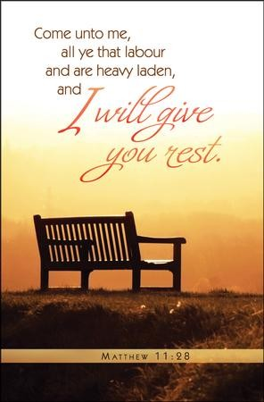
Zion Not Forgotten
Servant Song #3
Isa 50:4-6 – “⁴The Lord God has given Me the tongue of disciples, that I may know how to sustain the weary one with a word. He awakens Me morning by morning, He awakens My ear to listen as a disciple. ⁵The Lord God has opened My ear; and I was not disobedient nor did I turn back. ⁶I gave My back to those who strike Me, and My cheeks to those who pluck out the beard; I did not cover My face from humiliation and spitting.”
Notes:
So, they’re complaining, “God, you’re being unresponsive.” But God says, “No, you are the unresponsive one. I’ve called, you haven’t listened.” And so, in order to show them the length at which His arm will go, God is going to send someone to show them what responsiveness actually looks like. Here is the 3rd Servant Song:
Isa 50:4-5 – So the, nation of Israel was unresponsive, right? What about this coming Servant who will be the ideal Israel? He listens to the Father, ready to receive the word daily, and unlike the 1st Adam, He was unashamed when called. What He heard, He then obeyed. That word “opened” can sometimes mean “carved”, and so it is suggested that what Jesus did in spirit is what God allowed slaves to do in the Law of Moses as a way to express their desire to serve them permanently. In Ex 21:6, the servant would pierce his ear against the doorpost. Some suggest this could be an allusion to that practice. His tongue/words was also a theme in the first 2 Servant Songs, to stress that one of His main works would be revealing God’s word, words designed to comfort those who are weary and need rest. This description of the Servant Israel stands in stark contrast to the nation Israel, doesn’t it? Even the greatest of Israel’s prophets struggled listening to God – Moses, Jonah, Jeremiah, etc. There is only one man that could ever fit this description, and He is Jesus the Christ.
Now, when we were talking about the Servant Song #2 from Isa 49, we made the point that each Servant Song shows increasing opposition and suffering, climaxing in the 4th Song – Isa 50:6 – This Servant is not some symbolic personification of Israel; He is a man who felt pain. Not due to wrongdoing, but perfect right-doing. Because in order to obey God perfectly requires confronting godless behavior, and that is seldom well-received. But notice that men did not take Him; He gave His back – John 10:17-18 – “For this reason the Father loves Me, because I lay down My life so that I may take it again. No one has taken it away from Me, but I lay it down on My own initiative. I have authority to lay it down, and I have authority to take it up again.” He was always in complete control. Jesus willingly offered Himself to redeem man.

Slide 4
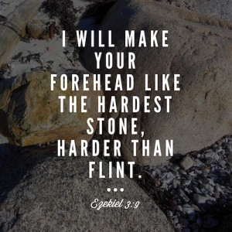
Zion Not Forgotten
Servant Song #3
Isa 50:7-9 – “⁷For the Lord God helps Me, therefore, I am not disgraced; therefore, I have set My face like flint, and I know that I will not be ashamed. ⁸He who vindicates Me is near; who will contend with Me? Let us stand up to each other; who has a case against Me? Let him draw near to Me. ⁹Behold, the Lord God helps Me; who is he who condemns Me? Behold, they will all wear out like a garment; the moth will eat them.”
Notes:
We mentioned back when we studied Isa 6 that after Isaiah said, “Here I am, send Me!” that when God gave Him that very hard commission, he then asked, “How long Lord?” as if the reality of the commission really put a damper on his enthusiasm. But what about the Servant? What’s His mentality given what He will suffer to deliver people?
Isa 50:7 – You cannot read the gospels w/o coming away impressed by Jesus’ unshakable confidence that the Father was w/Him. So certain of this, He was certain of the outcome. So certain of the outcome, and stubbornness He saw in man was matched 10-fold, unashamedly. When we try to help people who are in the wrong, we are going to encounter stubbornness. The temptation is to back off and let them have their way. No, our job, just as Jesus, is to be stubborn for the truth, and in doing so we can have the same assurance as Jesus.
Isa 50:8-9 – One can’t help but think of John 8:46a – “Which of you convicts Me of sin?” I’ll tell you who: an unjust group of judges who had to break their own trial laws to find Him guilty. But Jesus had the perfect defense attorney in heaven, and He’s also the Judge who condemns the mortal, subject to rot/decay, from vs. 9. Why this emphasis? Because if Jesus’ suffering had been deserved, it could not be on behalf of anyone else. The fact He triumphed in unjustified suffering means He can be our substitute.

Slide 5
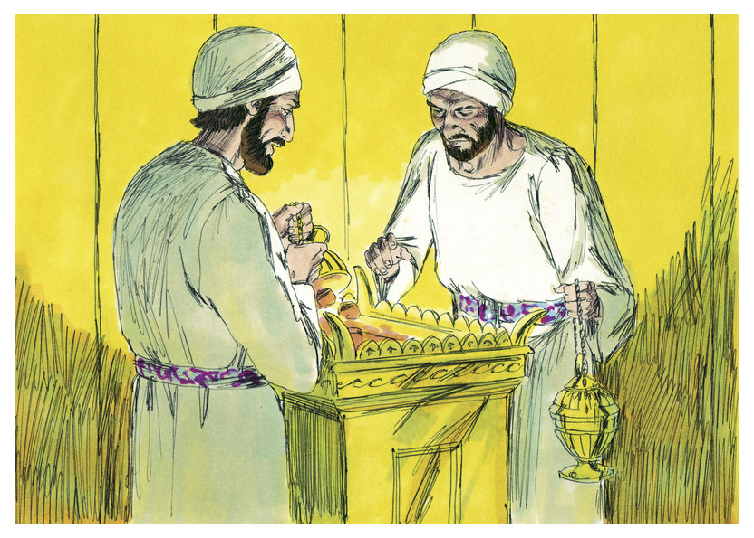
Zion Not Forgotten
Exhortation
Isa 50:10-11 – “¹⁰Who is among you that fears the Lord, that obeys the voice of His servant, that walks in darkness and has no light? Let him trust in the name of the Lord and rely on his God. ¹¹Behold, all you who kindle a fire, who encircle yourselves with firebrands, walk in the light of your fire and among the brands you have set ablaze. This you will have from My hand: you will lie down in torment.”
Notes:
This short chapter ends w/an exhortation to respond to the Servant, contrasting 2 ways of life:
Isa 50:10 – Notice the contrast: reverential fear is a mark of the remnant, but darkness is a mark of the rebellious. Even the remnant may temporarily find themselves in the darkness of frustration, injustice, and humiliation. But so did the Servant, and by trusting the Father implicitly, none of that frustration was permanent.
But those who attempt to make their own light, who like Nadab and Abihu feel the need for nothing they can’t generate themselves? They’re doomed – Isa 50:11 – The irony is staggering – those who live by their own light plunge themselves to eternal darkness.

Slide 6
Notes:
He’s successfully answered their complaint from 49:14, which is the lynchpin of these first 2 sections. He’s promised deliverance through this new Servant and He has assured them why He has not forgotten them at all. But their incessant complaining seems to have sunk them into despair, and God has something extremely exciting and important to tell them, so they need to be woken up.
When your kid is asleep, and you’re having trouble getting him to wake up, what do you do? You call his name, probably more than once. And what have we noted that Isaiah will sometimes do in order to emphasize something? He’ll repeat a word/phrase. In Isa 51:1 – 52:12, we find 8 oracles, and each one contains repeated concepts and words that are all designed for the same purpose: “Israel! Israel! WAKE UP!”

Slide 7
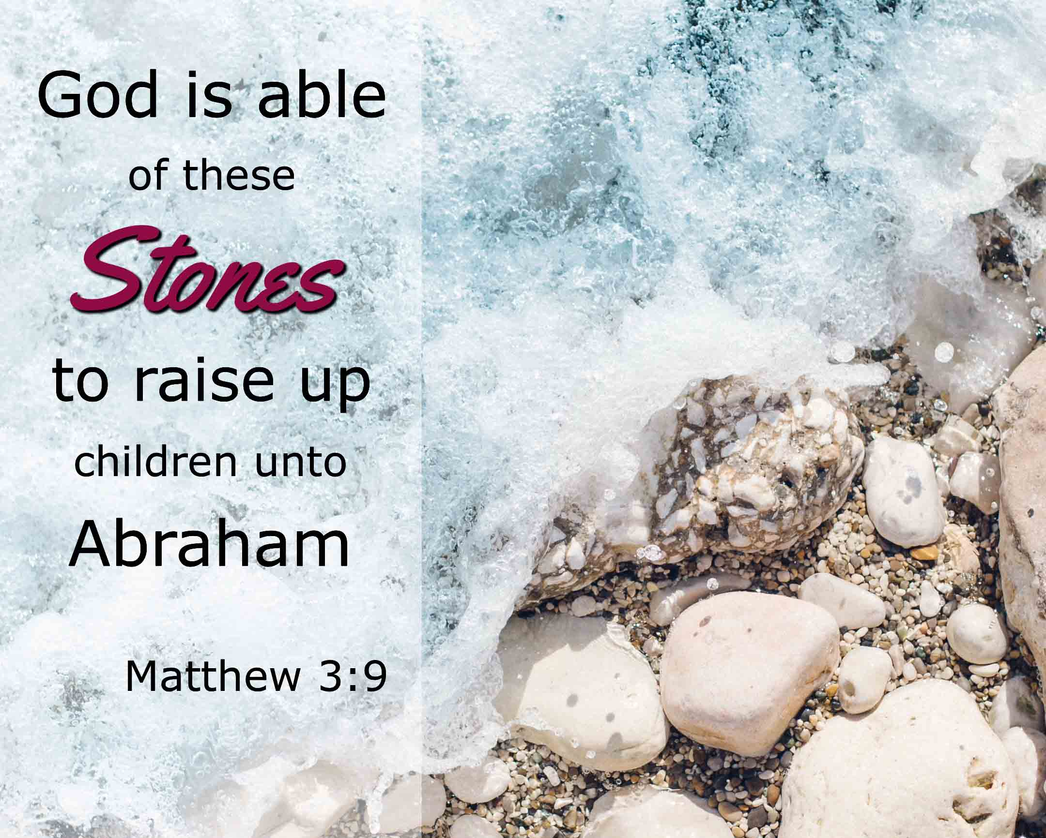
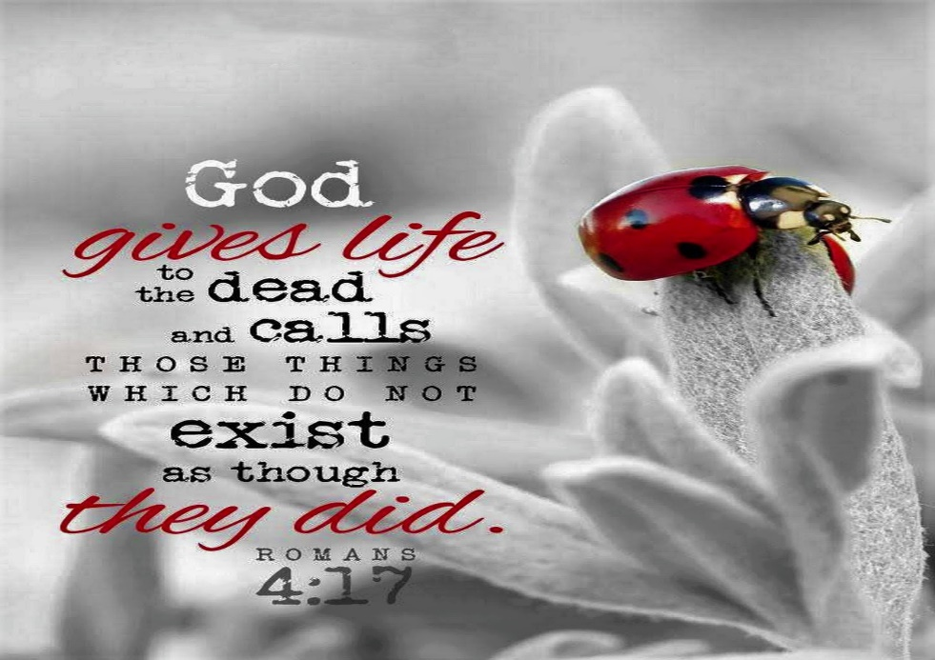
Rousing Zion to New Life
Listen To Me
Isa 51:1-3 – “¹‘Listen to me, you who pursue righteousness, who seek the Lord: look to the rock from which you were hewn and to the quarry from which you were dug. ²Look to Abraham your father and to Sarah who gave birth to you in pain; when he was but one I called him, then I blessed him and multiplied him.’ ³Indeed, the Lord will comfort Zion; He will comfort all her waste places. And her wilderness He will make like Eden, and her desert like the garden of the Lord; joy and gladness will be found in her, thanksgiving and sound of a melody.”
Notes:
Those who are actively pursuing righteousness are invited to seek the Lord by looking back at their past and considering their origin.
Isa 51:1-2 – So, not just “listen”, but “look, look”, the same verb used in Gen 15:5 when He told Abraham to “look toward the heavens and count the stars”. Abraham is referred as the “rock/query”. Why? Because in exile, most had land, businesses, and family. Returning to Jerusalem meant starting over in a land that had been left uncultivated for decades. You’d be trading something seemingly alive for something seemingly dead, kind of like Sarah’s womb, which Paul said in Rom 4:19 was as good as dead. But God can take “one” who is powerless and transform him and “multiply” him from just one stone. Abraham left everything behind in the Ur of Chaldee, and his descendants are now being called to leave the same place. And while this would take real conviction to return to Canaan, think how much conviction it takes for a sinner to return to God spiritually? Giving up land and title is one thing, but giving up self? That’s another ballgame. Yet, God blessed Abraham beyond measure. How much more us?
Look, hope deferred is a hard trial – Isa 51:3 – Abraham/Sarah’s barrenness match Zion’s ruins. The same divine power that blessed Abraham and Sarah will ensure Zion’s future. Remember from 49:16 – “your walls are continually before Me” – not your ruins, not your sin, but your walls. God is thinking not of the mess from where we came from, but what He can do for us going forward. And He wants to take our wilderness and make it a paradise, where the curse of sin no longer reigns. He wants to take away the thorns and thistles we’ve merited and replace it w/a fruitful harvest that will evoke joy, gladness, thanksgiving, and melody.

Slide 8
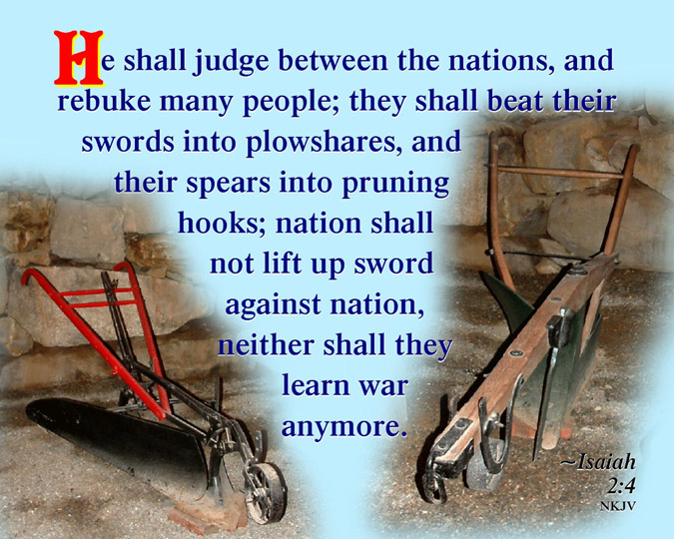
Rousing Zion to New Life
Pay Attention To Me
Isa 51:4-6 – “⁴Pay attention to Me, O My people, and give ear to Me, O My nation; for a law will go forth from Me, and I will set My justice for a light of the peoples. ⁵My righteousness is near, My salvation has gone forth, and My arms will judge the peoples; the coastlands will wait for Me, and for My arm they will wait expectantly. ⁶Lift up your eyes to the sky, then look to the earth beneath; for the sky will vanish like smoke, and the earth will wear out like a garment and its inhabitants will die in like manner; but My salvation will be forever, and My righteousness will not wane.”
Notes:
That’s oracle #1, here is oracle #2:
Isa 51:4-5 – Because it is their “walls” which are continually before Him, and not their “ruins”, they are “My people” – no matter the sins of the past, if they truly seek God, they are His. This is the same law that goes forth from Zion that we learned about in 2:3 and the same justice brought forth to the nations we learned about 42:1. Notice the 2 distinct phrases to describe the people He will deliver – “My people” and “the peoples” – this is the Servant’s double mission from the 2nd Servant Song, to deliver both Jews and Gentile. There is such a strong emphasis on the personal pronouns “My” and “I” – we couldn’t save ourselves, so God had to act. Our sins once drove Him away, but now He is near, and what was formerly a unique privilege of Israel is now for the world, all who “wait expectantly”, meaning every nation where there are people, like Cornelius, w/a deep spiritual hunger for something better.
He then turns to salvation’s eternal nature – Isa 51:6 – Babylon used astrology to look to the heavens for guidance, but we are called to look at its transience. And yet, what is so disconcerting is that we too live in this transient Creation, no more permanent than they. So, what/who are we putting our trust in? Those tied to earth vanish away; nature does not give, it takes away. But God’s righteousness and His salvation are the gifts that keep on giving, and no external force will destroy what the Lord will do.

Slide 9
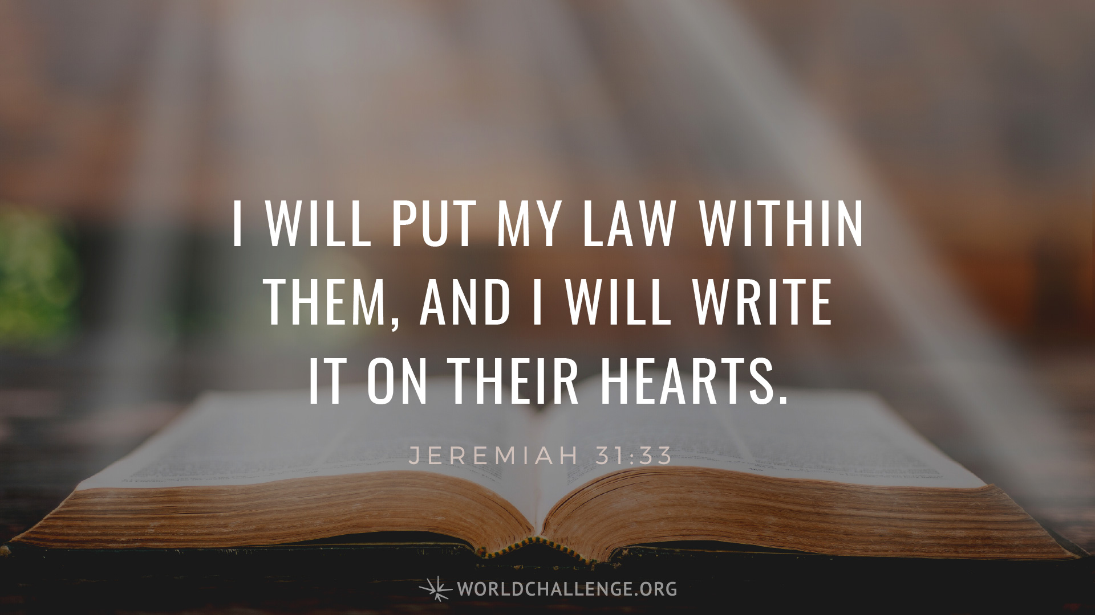
Rousing Zion to New Life
Listen To Me
Isa 51:7-8 – “⁷Listen to Me, you who know righteousness, a people in whose heart is My law; do not fear the reproach of man, nor be dismayed at their revilings. ⁸For the moth will eat them like a garment, and the grub will eat them like wool. But My righteousness will be forever, and My salvation to all generations.””
Notes:
Here is oracle #3:
Isa 51:7-8 – Back in 46:12, He said they were “far from righteousness”. Now, the ones from vs. 1 who “pursue righteousness” will “know righteousness”. This is an intimate union of the heart and a sharing in the Servant’s hostile experience at the hands of men. And, again, it’s not what we do that invites hostility, it’s who we are. But because they are man, they are transient, and therefore we are not to fear or be dismayed. When we face hostile people, all we need to do is remember God’s faithfulness in history (vs. 1-3) whose salvation will outlast the cosmos (vs. 4-6), because that will remind us that those who reproach us are doomed to the same destruction as those who oppose the Servant. So why not to put our trust in the eternal nature of God’s righteousness and salvation rather than the material things which moth and rust destroy?

Slide 10
Rousing Zion to New Life
Awake, awake
Isa 51:9-11 – “⁹Awake, awake, put on strength, O arm of the Lord; awake as in the days of old, the generations of long ago. Was it not You who cut Rahab in pieces, who pierced the dragon? ¹⁰Was it not You who dried up the sea, the waters of the great deep; Who made the depths of the sea a pathway for the redeemed to cross over? ¹¹So the ransomed of the Lord will return and come with joyful shouting to Zion, and everlasting joy will be on their heads. They will obtain gladness and joy, and sorrow and sighing will flee away.”
Notes:
Now, we’re going to conclude w/looking at just the first part of oracle #4, in which as God is trying to rouse them awake, Israel still thinks it is God who is asleep.
Isa 51:9-10 – It’s like they’re saying, “Exciting news, but we want to see God’s arm now! Or has He really forgotten us?” (49:14). Well, God’s arm went w/Moses (63:12), strengthened David (Psa 89:20-21), and it knocked out Egypt pretty good, which is who “Rahab” is referring to (30:7; Psa 87:4), the “dragon” being Pharaoh (Ezek 29:3). Everything that ever threatened to block God’s plans for a time proved to always be under His sovereign control, just as when the barrier of the Red Sea became an escape route for the redeemed. And if the “depths of the sea” can be made passable, the arm of the Lord is truly powerful. And they want to see that arm now! “Wake up, Lord, let us see that arm like we saw it in the days of the Exodus!” They’re going to see it, but in an entirely different an unexpected way. Stay tuned.
Isa 51:11 – This verse is virtually identical to 35:9d-10. They’ll wear joy on their head as a wreath of flowers. “Everlasting” an oft used word to describe the new age.

