Slide 1
Notes:
After hearing words of “comfort” in Isa 40, seeing the great victory of the Servant in Isa 53 followed, and then the response of those who identify w/Him, reading these next chapters where God is reprimanding Israel for their sins is like a splash of cold water in the face. But as we’re making our way toward the center of these last 9 chapters, we’re going to see Jerusalem presented as this shining city attracting all nations. And if they’re going to be the holy city that attracts the hungry and thirsty and poor, they’re going to have to be holy.
But what is the relationship to the prior chapters? Well, we’ve been introduced to this “Highway of Holiness” and how that “way” needs to be cleared. Remember that one of the things we often say got fixed when Israel returned from captivity was idolatry. This is not entirely true. While the evidence is strong that they ceased worshipping wooden images, idolatry came in another form. The evidence is strong that the religion of Judaism became the next idol they focused on. We see this during Jeremiah’s day by how much precedence they placed on having God’s temple in their presence. We see this coming about in their offerings in Malachi. Then 400 years later, when the Servant finally arrives, the Jewish elite of that day are firmly entrenched in outward shows of conformity. Remember that paganism’s purpose was to pressure the god into doing what they wanted, and this is how the Jews began treating the Mosaic Law, and like all the idolatry of the past, it kept them from coming to Jesus. This was an “obstacle” that needed to be removed from the “Highway”, and this is the subject of the first part of this section.
Chapter 58 is a call for people to recognize this particular sin and rebellion. We made the point back in chapter 1 that idolatry and social injustice are linked – they’re twin sins. The superficiality they brought to their formal religion made no difference in human relationships This will be exposed in chapter 58, elaborated on in the first 1/3 of chapter 59, and then we’re going to the people’s repentance for this in the 2nd 1/3 of chapter 59.

Slide 2
Who God Doesn’t See
Superficial Religion
Isa 58:1 – “¹Cry loudly, do not hold back; raise your voice like a trumpet, and declare to My people their transgression and to the house of Jacob their sins.”
Notes:
Chapter 58 opens w/a request for God’s prophet to convict His people of sin.
Isa 58:1 – The purpose of the trumpet at Mt. Sinai was to stop all activity and pay attention to the Law that was about to be given. That’s what Isaiah’s rebuke is to be like – not relayed to people quietly or privately, he is to shout their transgression from the proverbial rooftop.

Slide 3
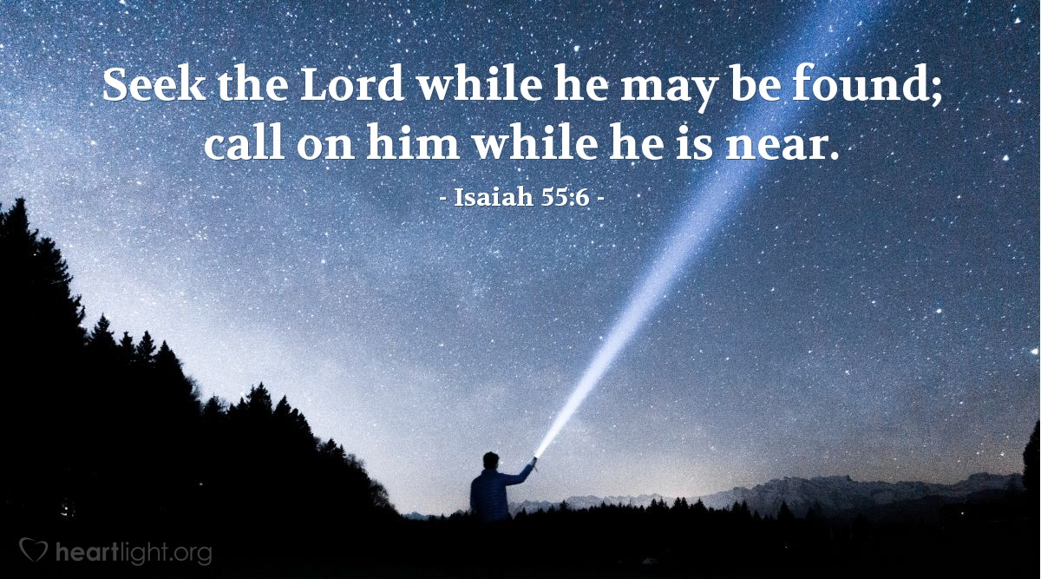
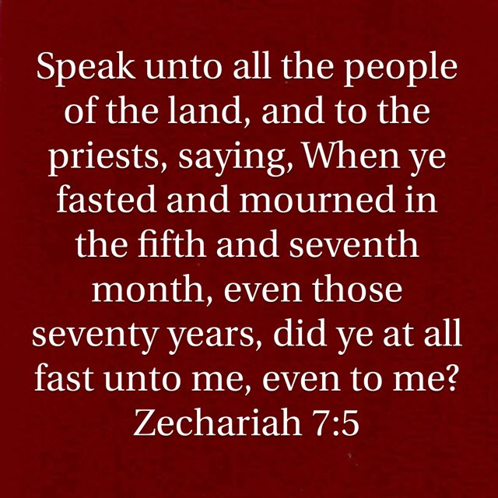
Who God Doesn’t See
Superficial Religion
Isa 58:2-3 – “‘²Yet they seek Me day by day and delight to know My ways, as a nation that has done righteousness and has not forsaken the ordinance of their God. They ask Me for just decisions, they delight in the nearness of God. ³‘Why have we fasted and You do not see? Why have we humbled ourselves and You do not notice?’”
Notes:
This chapter talks about “religious” people who desire a response from God but they’re not getting it.
Isa 58:2 – Notice the seemingly praiseworthy things: they “seek Me”, which is what God said they should do back in 55:5-9. So, there is some form of commitment and devotion to what they’re doing. And there is a frequency that suggests persistence – “day by day”. They seemingly “delight” in it and want to “know” His ways. They “look” like a righteous nation! But Isaiah is using sarcasm. Appearing as a “nation that has done righteousness” and being one are different. There are good ways to draw near to God and bad ways to draw near, and what we’re going to see is although they were zealous for the “form” of His way, they weren’t zealous for what those forms meant to convey. Who does this remind us of from Jesus’ day? The Pharisees (Matt 23:23; Luke 20:47).
Notice the extreme means they will go to get a response from God – Isa 58:3a – “What do you mean we’re sinful people? Can’t you see how we’re drawing near to You through fasting?” That’s some pretty radical self-denial on their part. But it’s interesting that the only fast the Law of Moses required was on the Day of Atonement (Lev 16), so it’s like they’re putting all their eggs in this one basket called “fasting” and using it as an attempt to manipulate God into securing His favor and getting what they wanted. This was idolatry at its core, a “cause and effect” religion, the Pharisee spirit that confused the outward merit of religious exercise w/true trust. To be fair, fasting is a legitimate means to humble ourselves (Ezra 8:21; Psa 35:13), but the form alone is not what achieves the result.

Slide 4
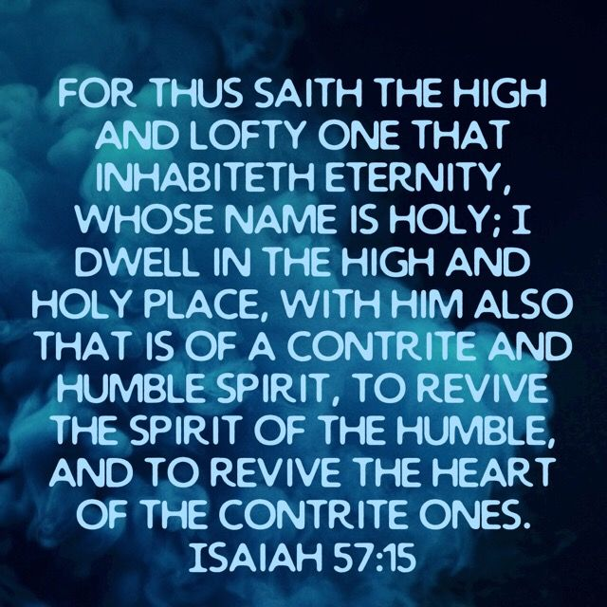
Who God Doesn’t See
Superficial Religion
Isa 58:3-5 – “Behold, on the day of your fast you find your desire, and drive hard all your workers. ⁴‘Behold, you fast for contention and strife and to strike with a wicked fist. You do not fast like you do today to make your voice heard on high. ⁵Is it a fast like this which I choose, a day for a man to humble himself? Is it for bowing one’s head like a reed and for spreading out sackcloth and ashes as a bed? Will you call this a fast, even an acceptable day to the Lord?’”
Notes:
What’s the real issue?
Isa 58:3b-4 – The problem was that what was a “delight” on one side became a means to oppress other people. They were employers who exploited their workers, becoming the very taskmasters God saved them from in Egypt. Whether this was because they were “hangry” from fasting or wanting people to know just how difficult their self-denial was, their mistreatment of others eclipsed their worship to God. It didn’t achieve holiness. It afflicted their bodies but not their souls, and as we saw in 57:15, God only dwells w/the contrite and lowly; this behavior does not fit that description. And so, it’s possible to do something to glorify God while at the same time glorifying self and afflicting others, and it can be the same act where the only difference is the intent behind it.
Isa 58:5 – Humility was tied to fasting in Lev 23:27,29, but these people had ritualized it into outward displays of bowing, sackcloth, and ashes, as automatic and uncomprehending as a reed before the wind. This was the mock humility of the Pharisees. Bodily postures and clothing are no substitute for changed attitudes and behaviors. God is asking, “Is this what you call a fast?” And the answer wasn’t to necessarily stop fasting, but to get right w/God so their fasting could actually mean something. The Law only required fasting on one occasion during the year. Compare that to how many times the Law required a person to treat others w/justice and love. All the religious rituals in the world are a moot point if we’re treating people badly.

Slide 5
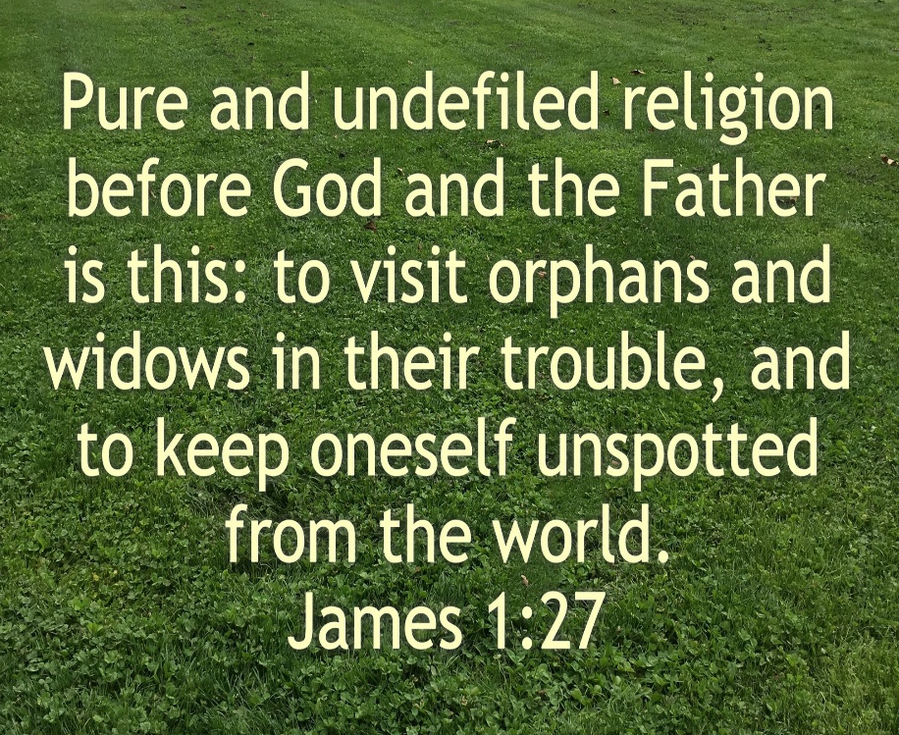
Who God Doesn’t See
True Religion
Isa 58:6-9a – “⁶‘Is this not the fast which I choose, to loosen the bonds of wickedness, to undo the bands of the yoke, and to let the oppressed go free and break every yoke? ⁷Is it not to divide your bread with the hungry and bring the homeless poor into the house; when you see the naked, to cover him; and not to hide yourself from your own flesh? ⁸Then your light will break out like the dawn, and your recovery will speedily spring forth; and your righteousness will go before you; the glory of the Lord will be your rear guard. ⁹Then you will call, and the Lord will answer; you will cry, and He will say, “Here I am.”’”
Notes:
And so, God goes even further, basically saying, “If you really want to practice self-denial, let me tell you the kind that really gets My attention.”
Isa 58:6-7 – This is Jas 1:27 to the core, keeping ourselves undefiled and helping those who can’t help themselves. See, fasting is only used in this text as a framework for describing superficial religion. What good is it to deny oneself food when there are those around us starving? A real deprival of self that gets God’s attention is doing it for the oppressed, needy, and helpless, not just our own religiosity. Stand up against the wrong-doer; stand up for justice; stop treating people like animals; be a blessing to those who life have broken. Instead of bondage and brokenness, freedom from injustice, inhumanity, and inequality. After all, the Servant set us free – what are we doing w/that freedom?
Notice how vs. 8 begins w/the word “then” – Isa 58:8-9a – Four blessings: 1) “light”, as opposed to darkness, something that will be expanded on in chapter 60. 2) “recovery”, used in the sense of new skin spread over a wound. 3) “security“, because the Lord will guard us, and 4), the blessing of His “fellowship”, so that when we DO call, He’s not just listening, but says “here I am” w/the same enthusiasm Isaiah did in chapter 6. And that is the solution to their complaint from vs. 2-3.

Slide 6
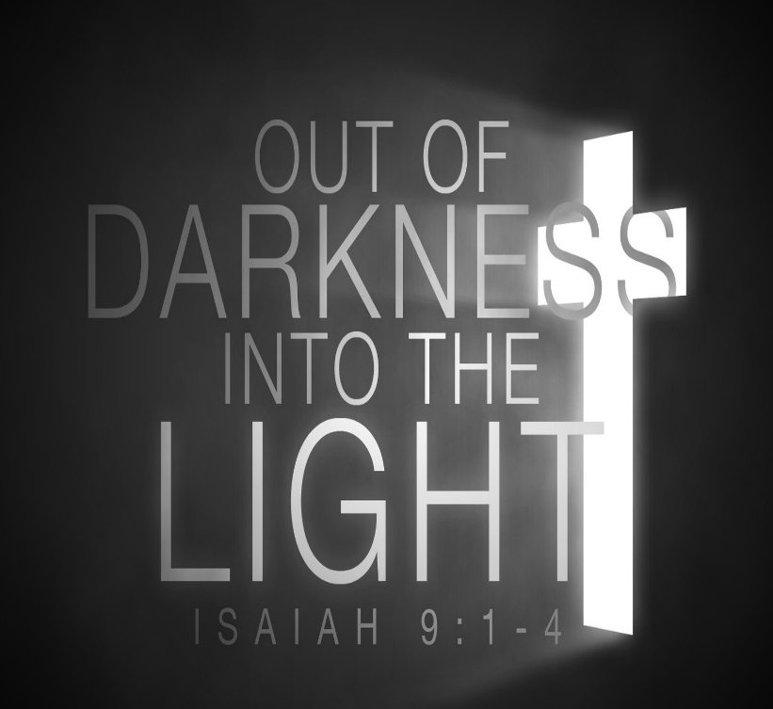
Who God Doesn’t See
True Religion
Isa 58:9b-12 – “If you remove the yoke from your midst, the pointing of the finger and speaking wickedness, ¹⁰and if you give yourself to the hungry and satisfy the desire of the afflicted, then your light will rise in darkness and your gloom will become like midday. ¹¹And the Lord will continually guide you, and satisfy your desire in scorched places, and give strength to your bones; and you will be like a watered garden, and like a spring of water whose waters do not fail. ¹²Those from among you will rebuild the ancient ruins; you will raise up the age-old foundations; and you will be called the repairer of the breach, the restorer of the streets in which to dwell.”
Notes:
Isaiah now returns to the proper use of the fast day, honing in on personal behavior.
Isa 58:9b-10b – In other words, REMOVE all these bad things like the yoke, pointing fingers, speaking wickedness, and this will not cease until we see learn to see people w/worth rather than objects of scorn and contempt. We then ADD things like giving yourself to the hungry, satisfying the desire of the afflicted, etc. I have preached for years that the hardest command in scripture is “denying self”. I don’t think that goes far enough, because even the Pharisees “denied self” in their fasting. What’s even harder than “denying self” is “denying self for someone else.” God’s concern is that focus of self is eliminated and transferred to caring for others. There is no genuine relationship w/God that does not have good relations w/His brother.
Isa 58:10c-11 – Corresponds to vs. 8-9b. Who is the light of the world? Jesus. How do others see Jesus in us? By shining the very light He has entrenched us with (theme alert for chapter 60). That’s how we recover the “barren wasteland lives” sin creates in us. That’s when the true “desire” of vs. 3 is realized.
And here is the theme verse of the chapter – Isa 58:12 – We live in a broken world where there are broken hearts, broken homes, and where things once sacred have become waste places. And at the core is a breach in man’s relationship w/God; our sin has destroyed everything it touches. That is what is cutting the lines of our communication w/heaven. But the wonderful thing about God’s plan is that not only is God stronger than our sin, He can also cause what we have destroyed w/our own stupidity to be restored. And what’s more, He gives us the dignity of being involved in putting back together what we’ve broken. Look, we cannot do it apart from Him; but He also won’t do it apart from us.

Slide 7
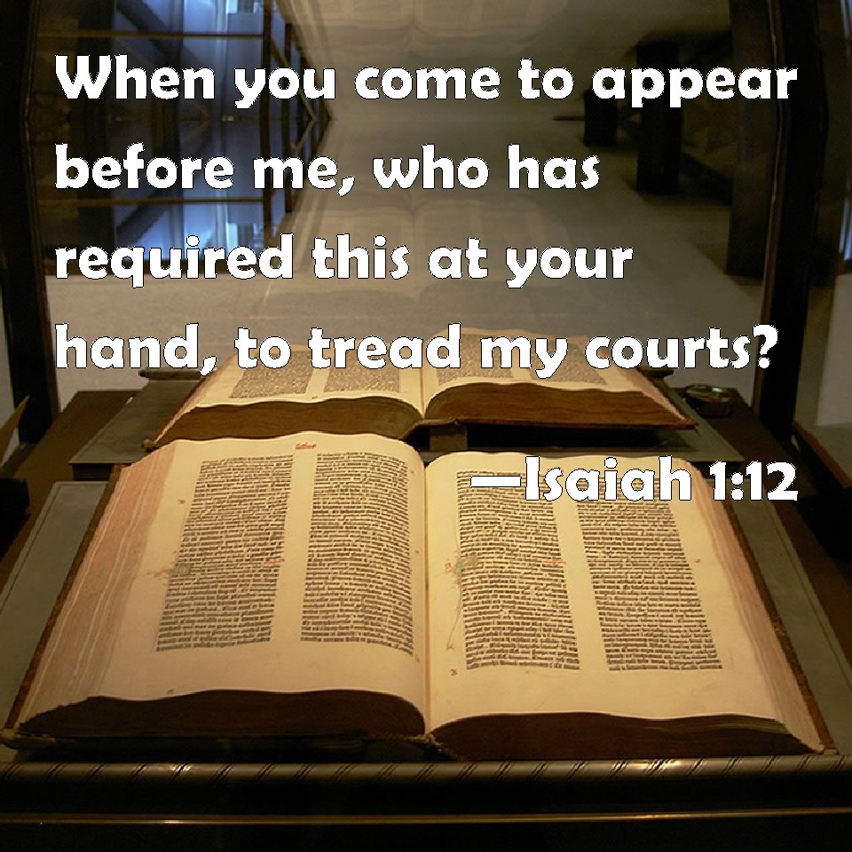
Who God Doesn’t See
True Religion
Isa 58:13-14 – “¹³‘If because of the sabbath, you turn your foot from doing your own pleasure on My holy day, and call the sabbath a delight, the holy day of the Lord honorable, and honor it, desisting from your own ways, from seeking your own pleasure and speaking your own word, ¹⁴then you will take delight in the Lord, and I will make you ride on the heights of the earth; and I will feed you with the heritage of Jacob your father, for the mouth of the Lord has spoken.’”
Notes:
He now changes from fasting to the Sabbath, both which were greatly misused in the first century:
Isa 58:13 – The issue is not just fasting, but religion that actually pleases God. It is a real test of genuine religion to give an entire day to God w/delight, to set aside that day w/joy because of a heart so taken by God. The Sabbath was not a fast, but a feast; not a burden, but a delight; and He is more interested in enjoyment of it than deprivation. Remember the manna: God said he’d give twice as much the day before the sabbath. The recurrence of the words “delight/desire/pleasure” in vs. 2,3,13,14 seems to be for the purpose of causing us to ask whether our religion is for our pleasure or for God’s?
Isa 58:14 – So, in vs. 1, the mouth of the Lord speaks of the sin of Jacob, but now it speaks of the blessing Jacob would enjoy. Those who relinquish their throne will receive a crown. That phrase “ride on the heights of the earth” = confidence, enjoyment of God’s blessings. If they would but surrender their desires to Him, allowing their ceremonial behavior to align w/a heart that seeks true self-denial, they will find Him. Point of chapter: both fasting and Sabbath keeping isn’t just about “doing things” or “not doing things”, but a heart aligned w/God.

Slide 8
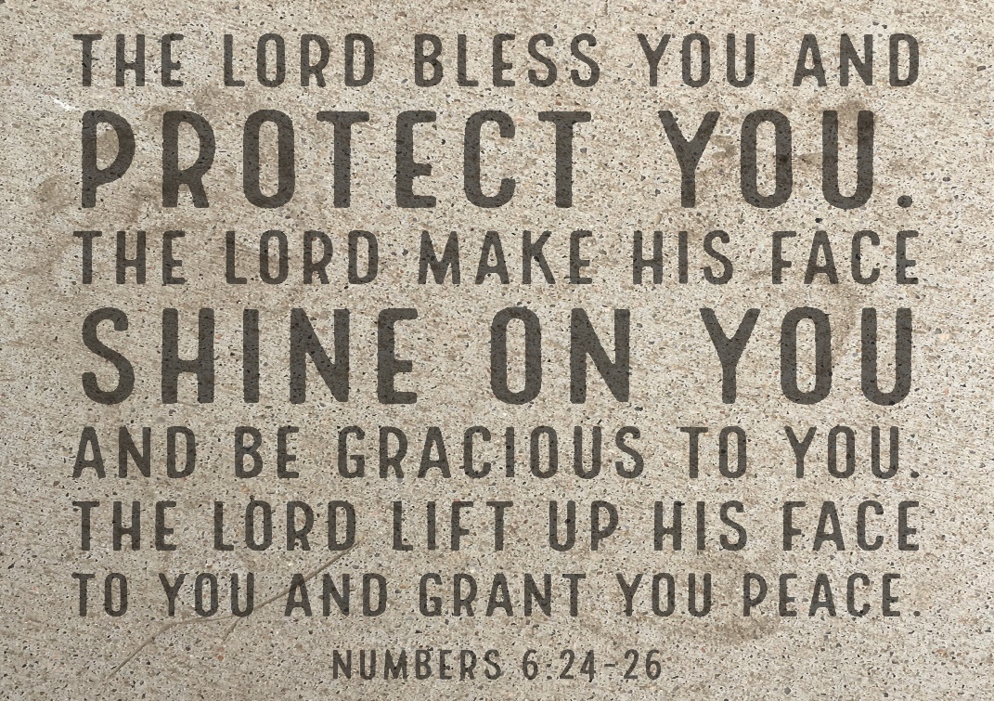
They Called, God Didn’t Listen
Singular charge (you)
Isa 59:1-4a – “¹Behold, the Lord’s hand is not so short that it cannot save; nor is His ear so dull that it cannot hear. ²But your iniquities have made a separation between you and your God, and your sins have hidden His face from you so that He does not hear. ³For your hands are defiled with blood and your fingers with iniquity; your lips have spoken falsehood, your tongue mutters wickedness. ⁴No one sues righteously and no one pleads honestly.”
Notes:
Now, the purpose of 58 was to expose sin. Chapter 59 elaborates on and applies chapter 58. Their complaint of 58:3 was not an issue of God’s ability to hear them, but His unwillingness to hear them because of their sin.
Isa 59:1 – God’s “hand” has been a frequent term used throughout Isaiah, an expression of God’s personal action. A shortened hand wouldn’t be able to reach the object for which it stretches. But it’s not that the Lord heard but lacks ability or strength to respond; He can hear just fine. It’s not that He lacks knowledge or interest in our problem. The issue is not on His end; it’s on our end.
Isa 59:2-4a – God is not powerless and He’s not insensitive. The cause was their sin; that’s what creates the gulf. It makes Him have to “hide face”, which is divine alienation. He’s holy, and we can’t have a relationship w/Him while in sin. Responding to their prayers or their worship is ruled out until the sin barrier is removed. What specific sins? These parts of the body which have become the agents of sin: our hands, fingers, lips, and tongue. Rather than using those faculties to bring blessing to others, we use them for self-serving purposes. We take advantage of the legal process for selfish means, not sharing God’s heart for what is fair and good, but what is for our good. The Lord’s hand is not the problem. It’s “our” hand. The Lord’s ear is not the problem. It’s that our lying tongue/lips will never reach His ears.

Slide 9
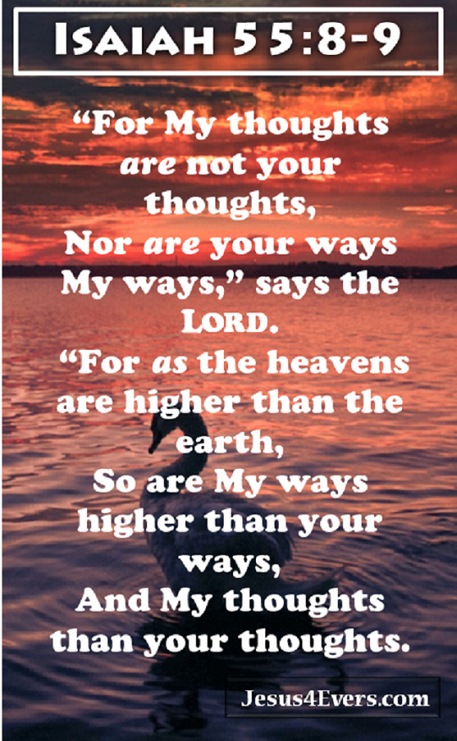
They Called, God Didn’t Listen
Plural charge (they)
Isa 59:4b-8 – “They trust in confusion and speak lies; they conceive mischief and bring forth iniquity. ⁵They hatch adders’ eggs and weave the spider’s web; he who eats of their eggs dies, and from that which is crushed a snake breaks forth. ⁶Their webs will not become clothing, nor will they cover themselves with their works; their works are works of iniquity, and an act of violence is in their hands. ⁷Their feet run to evil, and they hasten to shed innocent blood; their thoughts are thoughts of iniquity, devastation and destruction are in their highways. ⁸They do not know the way of peace, and there is no justice in their tracks; they have made their paths crooked, whoever treads on them does not know peace.”
Notes:
Now, in the prior verses, the pronoun “you” was used. Notice how the pronouns now change to “they”:
Isa 59:4b-6 – All throughout the book, we’ve pointed out the dominate theme is “Trust God”. But their lack of trust is not because they trusted in nothing. Everyone trusts in something. Here, what they trusted in was their ability to contrive mischief and hatch schemes. One way they did this was by taking advantage of the legal system to their own purposes. Notice the imagery: eggs are typically a source of life, nutritious and productive – but not these eggs. Whether eaten or crushed, the results equally produce death. If eaten, it kills you. If crushed, it produces another snake equally destructive. What is being described are the corrupt works of man that produce no good fruit. A spider weaves a web to lay a snare for the “flies” and feed on them. Likewise, wicked man seeks to entangle people in intricacies and perplexities. The web glimmers in the sun and promises something great, but as soon as the fly touches it, its whole life is taken. The world “lays traps” like this for people under the guise of things like technicalities, politics, and legal maneuvering and then think that those schemes provide an adequate covering before God for their wickedness, and it is not. Likewise, society promises much, but gives little. It doesn’t promote life, it takes it. Devouring self-interest.
Isa 59:7-8 – Notice the use of “hands”, “feet”, and “thoughts” – this is the person involvement of the sinner to hurt others. All restraints have been removed. Plans and schemes are carefully mulled over and developed until ready to hatch. Notice the phrases “destruction in their highway” and “no justice in their tracks” – this is why the Highway of Holiness has to be cleared. This lifestyle cannot bring peace because the roads they’re traveling will not take them there. Paul quotes these verses in Rom 3:15-17 to describe the universal sin-condition of his day. They had rejected God’s “high” way, going their own way.

Slide 10
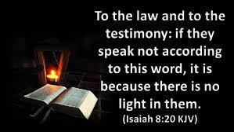
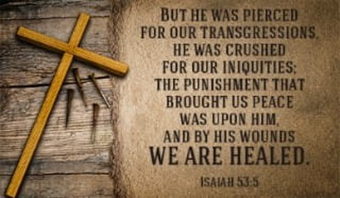
God’s Mercy Undeserved
Personal confession (we/us)
Isa 59:9-11 – “⁹Therefore justice is far from us, and righteousness does not overtake us; we hope for light, but behold, darkness, for brightness, but we walk in gloom. ¹⁰We grope along the wall like blind men, we grope like those who have no eyes; we stumble at midday as in the twilight, among those who are vigorous we are like dead men. ¹¹All of us growl like bears, and moan sadly like doves; we hope for justice, but there is none, for salvation, but it is far from us.”
Notes:
And now, the pronouns switches to 1st person, changing to “we/us”. Having charged them w/sin and their inability to treat one another w/righteousness, we now find a confession of guilt and helplessness.
Isa 59:9 – “therefore” = “because of what I just said, we’re in a tragic position.” It indicates that God’s salvation has not yet occurred for them. This is important, because the victory we’re going to starting in vs. 15b is impossible w/o their repentance. They want the Lord’s light, but their sin is keeping them on perpetual darkness.
Isa 59:10-11 – This shows that darkness is a metaphor for blindness. The external circumstances of midday and twilight won’t matter because the issue is in us. In the presence of the stronger, we are weak because sin debilitates us into utter hopelessness. And so, we growl like bears and moan like doves, frustrated over the helplessness that sin brings. We hope for things to get better, but God seems so far away.

Slide 11
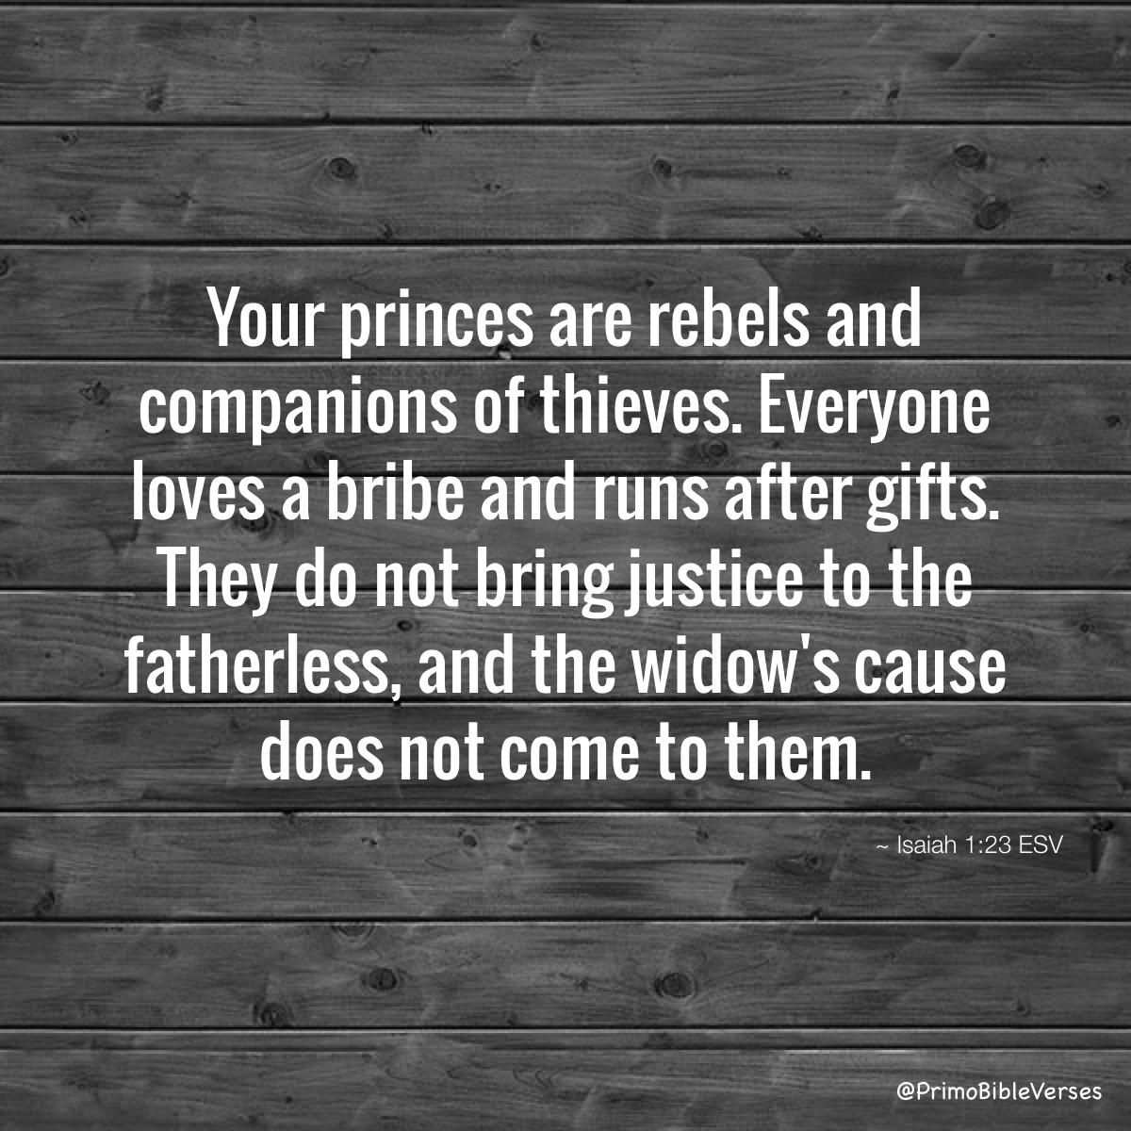
God’s Mercy Undeserved
Personal confession (we/us)
Isa 59:12-15b – “¹²For our transgressions are multiplied before You, and our sins testify against us; for our transgressions are with us, and we know our iniquities:¹³Transgressing and denying the Lord, and turning away from our God, speaking oppression and revolt, conceiving in and uttering from the heart lying words. ¹⁴Justice is turned back, and righteousness stands far away; for truth has stumbled in the street, and uprightness cannot enter. ¹⁵Yes, truth is lacking; and he who turns aside from evil makes himself a prey.”
Notes:
And now, the pronouns change again. Vs. 12 begins w/the word “for”, meaning, “We have no defense because the accusations are true.”
Isa 59:12-13 – The idea seems to be that people will rise out of this muck no longer blaming God’s “short hand” or “dull ear”. They’ll readily admit fault. They’ll finally come to terms w/the fact that God cannot be “with us” when our sins remain “with us”. As long as we remain ignorant of our sins or try to explain or blame them away, we cannot change. God can only heal us when we agree w/God’s assessment of our situation. Whenever we live the lie that we can be fully human w/o dependence on God, we create a false reality, which gives rise to injustice and unrighteousness.
Now they’re testifying, “Here is the reason why our sins testify so effectively.” – Isa 59:14-15b – Meaning, they’re witnessing for themselves that moral absolutes have disappeared, social morality has collapsed, and individual moral character is under threat. Justice is shown as knocking at the gate, but it’s turned away. Righteousness stands far away beyond reach, almost as if shaking its head in disgust, and does not even try to enter. In the central square, where business transactions are made, truth has fallen down like a wounded soldier. And in such an environment, the one w/courage to try and do right is targeted as prey.
What a drumbeat of condemnation. Wasn’t 40 - 66 supposed to be mostly positive? Yes. This is not where the story ends. Judah has committed gross sin and they are unable to save themselves, but God is going to intercede on their behalf. There are some things we can do to get ready for the Lord. And then there are those things only the Servant can do. And perhaps the extreme negativity of this chapter is what makes the next few verses so uplifting.

