Slide 2
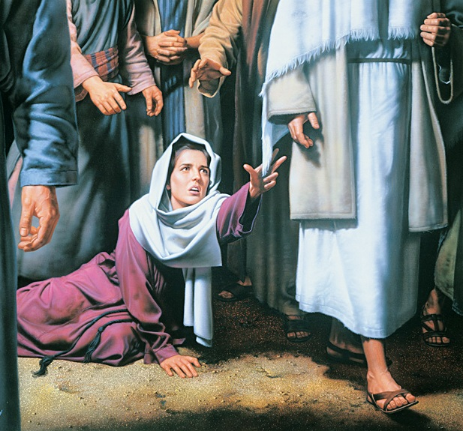

Slide 3
Her Burdens
Physical
Mark 5:26c
Financial
Mark 5:26b
Religious
Lev 15:25
Social
Lev 15:19-24

Slide 5
Application
Was Jesus unclean?
Isa 53:4a; John 2:18-21
Mustard seed faith
Matt 17:20
Heals the “nobody”
Mark 3:31-35
Faith In The Fringe
Num 15:38-40

Slide 6
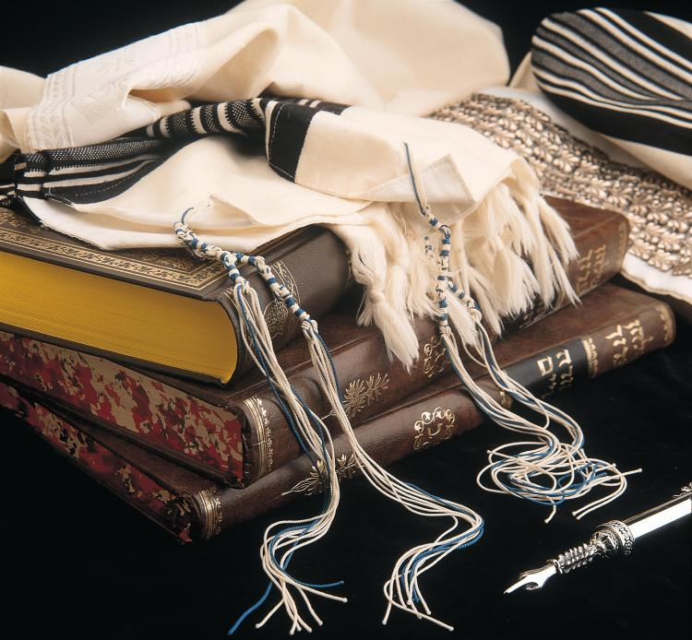

Slide 7
Application
Was Jesus unclean?
Isa 53:4a; John 2:18-21
Mustard seed faith
Matt 17:20
Heals the “nobody”
Mark 3:31-35
Faith In The Fringe
Num 15:38-40;
Mal 4:2

