Slide 1
Notes:
In chapters 58 – 59, God revealed our helpless state in sin. In fact, the Apostle Paul quotes several verses in Romans 3 to make the same point that Isaiah did in these chapters, that “there is none righteous, not even one”. And as we saw from Isa 59, the people actually admitted this. But they also knew that God had interceded in the past to help them when things got out of hand. Well, God did see mankind’s greatest need, and when He didn’t see anyone else who could help them, 59:16 tells us “His own arm brought salvation”. The result is Isa 60, that we are to “arise and shine” because our light has come. And while we are not the ultimate source of this light, it will be alluring enough to draw all nations to Zion and we need to shine that light.
As we begin chapter 61, we are now going to see the source of this Light in an announcement by the Messiah Himself. We may not be able to procure righteousness for ourselves, but we can achieve it through what the Messiah does for us. And we need His righteousness because while the message in Isa 53 was primarily about salvation, the message in Isa 61 is primarily about our transformation through Him. He conquers and delivers so that we will be righteous and embrace our role as God’s transformed people.

Slide 2
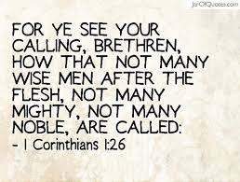
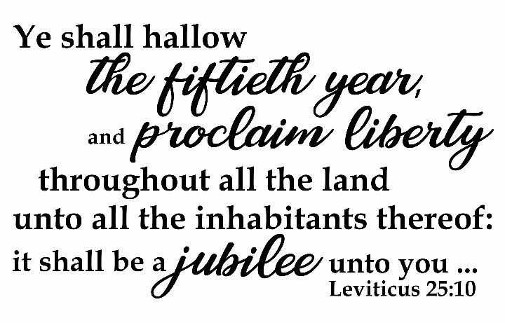
Anointed Conqueror
The transforming Lord
Isa 61:1-2 – “¹The Spirit of the Lord God is upon me, because the Lord has anointed me to bring good news to the afflicted; He has sent me to bind up the brokenhearted, to proclaim liberty to captives and freedom to prisoners; ²To proclaim the favorable year of the Lord and the day of vengeance of our God; to comfort all who mourn,”
Notes:
And so, he goes from chapter 60 in talking about the city that reflects His light, Zion’s outer magnificence, to the Light Himself, Zion’s inner magnificence. The Servant reappears, speaking in the first person, to announce His role in all this – Isa 61:1-2.
“The Spirit of the Lord God is upon Me” – this word “Lord” is the word “Yahweh”, how God introduced Himself to Moses at the burning bush. The idea is He is announcing His intention to deliver His people once again. He began the 10 commandments this way – “I am the Lord God, who brought you out of the land of Egypt, out of the house of slavery”. In other words, “Are you listening now?”
“because the Lord has anointed Me” – This is one of the places where we get the word “Messiah”, which means “Anointed One”. He is endowed by the Spirit Himself.
“to bring good news to the afflicted” – some translations say “poor”. These are the downtrodden, disadvantaged, those held back from progress by circumstances or people. It will not be “good news” to those who are “comfortable”, but…
“He has sent me to bind up the brokenhearted” – Those who are crushed by sin w/no heart left in them are going to be the ones to experience personal renewal and restoration. He will “bind up”, expressing personal attention to the damage sin has done.
“to proclaim liberty to captives and freedom to prisoners” – the first liberty mentioned is an Exodus type of liberty in which the afflicted, brokenhearted, and prisoners are set free. The 2nd kind of liberty is…
“to proclaim the favorable year of the Lord” – The word liberty, in this context is only used for 4 times, and it refers to the Year of Jubilee of Lev 25. The Jubilee year, the 50th year, released everything. Debts were canceled. Inherited lands that were sold because of hardship were given back. If you sold yourself as a slave just to eat and have a roof over your head, you’re free. It was a redo, a reset, in which you could start fresh. Part of the Messiah coming and rescuing us from the debts we’ve accumulated, the slavery we’ve sold ourselves in, is that we’d experience a reset, being born again. But our Jubilee doesn’t last a year, it lasts forever. Peter calls it an “inheritance undefiled that will not fade away”.
“and the day of vengeance of our God.” – Now, Jesus specifically read from this passage at the start of His ministry in Luke 4:16-22, confirming its Messianic intent. But He stopped at “favorable year of the Lord”. He stopped before mentioning the “day of vengeance”, closing the book, giving it back to the attendant, sitting down, and then saying, “Today this Scripture has been fulfilled in your hearing.” Why? Because He understood His purpose while on earth was to save and not to condemn. His coming marked the Jubilee, a “year of grace” so to speak that has extended for 2000 years. It is His 2nd coming that will mark the inauguration of the “day of vengeance”. So, these texts combine the 1st and 2nd coming. Notice that it is a “year” of favor, but a “day” of vengeance. His 1st coming is one of “patience”, his 2nd coming will be “quick”. “day of vengeance” sounds very negative, but it will be a comfort to the oppressed that one day the source of oppression will get what it deserves, their power broken.
“to comfort all who mourn” – all the sadness sin brings? The desolation of Zion? Just as Jesus said in the SOTM, they shall be comforted.

Slide 3
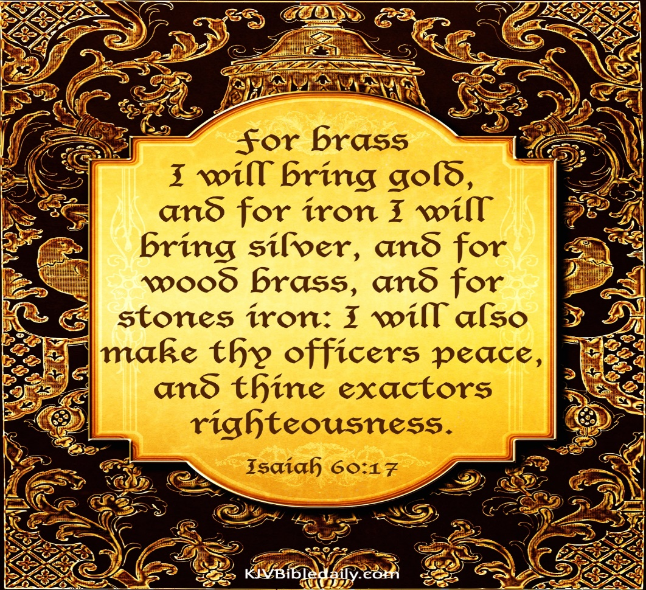
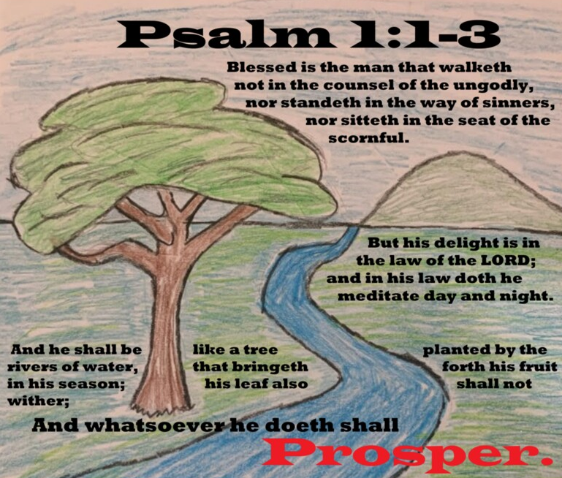
Anointed Conqueror
The transforming Lord
Isa 61:3 – “³To grant those who mourn in Zion, giving them a garland instead of ashes, the oil of gladness instead of mourning, the mantle of praise instead of a spirit of fainting. So they will be called oaks of righteousness, the planting of the Lord, that He may be glorified.”
Notes:
What’s involved in this comforting? Vs. 3 expands vs. 2:
Isa 61:3a – The idea is that w/repentance comes a transformation of attitude. Just as we saw in 60:17 where they were promised the “best” for “better”, here we are promised the “best” instead of the “worst”. Ashes, mourning, and fainting will be relaced w/a garland, oil, and praise. All the hurt that causes us to mourn will be remedied. This new life replaces mourning w/responsive praise.
Isa 61:3b – All the way back in 1:29-30, he said they would be like oaks whose leaf fades away because they were worshipping idols under the oaks. Now they will be oaks of righteousness, symbolizing stability, permanence, and abundance. The idea is that though we fail to be righteous in and of ourselves, through the Light of this Anointed Conqueror, we will proclaim and champion His righteousness. He’s transforming us so that we demonstrate the beauty of God. All throughout this latter part of Isaiah, we’ve learned that whatever the Servant does, His offspring will do.

Slide 4
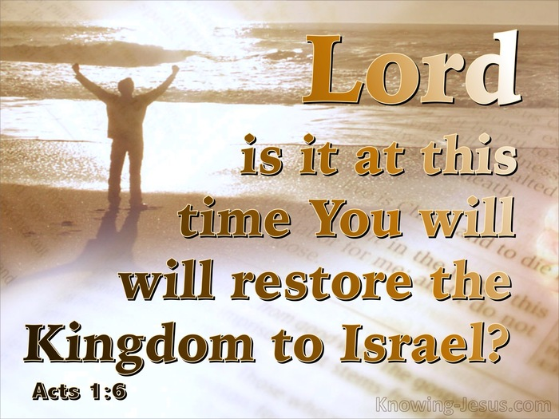
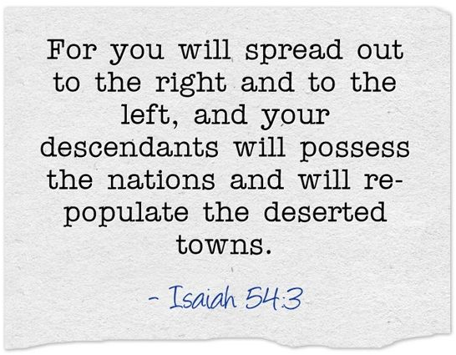
Anointed Conqueror
The transformed people
Isa 61:4-6 – “⁴Then they will rebuild the ancient ruins, they will raise up the former devastations; and they will repair the ruined cities, the desolations of many generations. ⁵Strangers will stand and pasture your flocks, and foreigners will be your farmers and your vinedressers. ⁶But you will be called the priests of the Lord; you will be spoken of as ministers of our God. You will eat the wealth of nations, and in their riches you will boast.”
Notes:
The text now shifts from the work and person of the Messiah to the promises of Zion. Having been transformed, the focus is now on restoration:
Isa 61:4 – The Jews would initially remember the devastation brought on by the likes of Assyria and Babylon. But this isn’t talking about a physical rebuilding. You read Ezra and Nehemiah and that last part of Daniel which talks about what the 400 years of silence would be like and it doesn’t exude a picture of the wonderful restoration we’re seeing here. Rather, it is what the Apostles asked in Acts 1:6 – “Lord, is it at this time you are restoring the kingdom to Israel?” And then in Acts 3:21, Peter taught the crowds that heaven must receive Jesus until “the restoration of all things”. This is what we are doing. We are in the process of building and restoring God’s kingdom to be what it is supposed to be. The return from Babylon is a motif of a greater return and recovery into God’s kingdom, where all the ravages of past sin things that were unable to be mended are now mended. Through the Anointed One, all this long-standing and inherited brokenness will be restored. As Christians, our calling is not just to avoid the bad things, but to build good things, to bear fruit.
Isa 61:5-6 – Remember all the nations that used to dominate and plunder Israel, from Judges onward, who wanted to destroy them and take everything they had? These same people will voluntarily come in order to cooperate in this grand restoration of the kingdom. They are not 2nd-class citizens, but former “aliens” joyfully cooperating. They will “pasture/shepherd” their flocks. Who are shepherds in the church, the ones who meet the highest qualifications God has given a person in any role in the church? They come from the nations, as well as those who provide sustenance as farmers and vinedressers would. And Israel would teach them as priests do, and while they are doing so, they’ll be provided for by the nations just as the Levites were supported through the tithes of the tribes. Priests represent God to the people and the people to God. As Christ brought us to God, through Christ, we’re bringing the world to God.

Slide 5
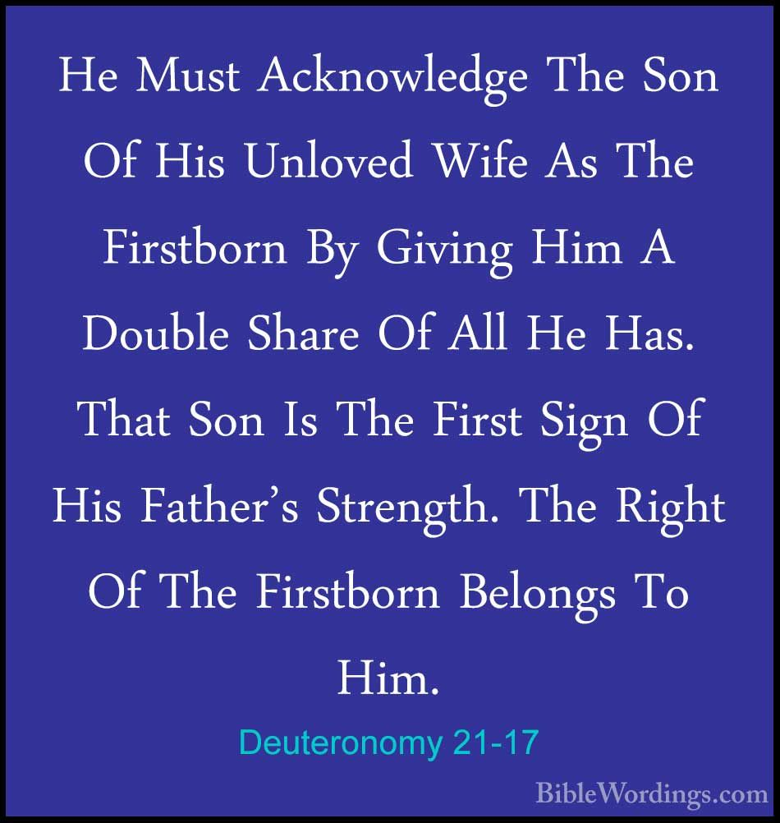
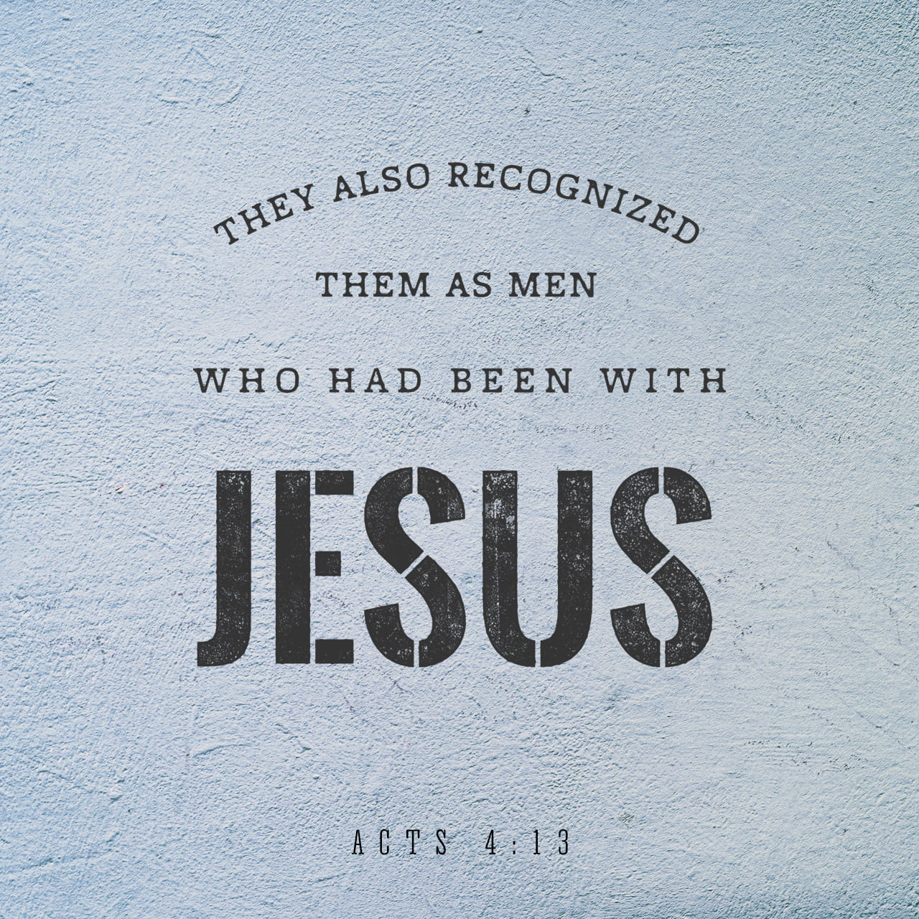
Anointed Conqueror
The transformed people
Isa 61:7-9 – “⁷Instead of your shame you will have a double portion, and instead of humiliation they will shout for joy over their portion. Therefore they will possess a double portion in their land, everlasting joy will be theirs. ⁸For I, the Lord, love justice, I hate robbery in the burnt offering; and I will faithfully give them their recompense and make an everlasting covenant with them. ⁹Then their offspring will be known among the nations, and their descendants in the midst of the peoples. All who see them will recognize them because they are the offspring whom the Lord has blessed.”
Notes:
Remember all the figurative “instead ofs” of vs. 3?
Isa 61:7 – When we first began chapter 40, I mentioned that I believed all 3 9-chapter sections could be summarized in 40:2. “call out to her that her warfare has ended” = 40 – 48. “that her iniquity has been forgiven” = 49 – 57. And “she has received of the Lord’s hand double for all her sins” = 58 – 66. Remember it was the eldest child that received the double portion of the estate. Other times it was the more favored son, as was the case w/Joseph. The idea now is that instead of dispossession due to sin, we will receive “possession x 2”! And who would not shout for joy over such an undeserving portion from the Lord?
Why such a change of heart toward the people by God? Why will everlasting joy be theirs? – Isa 61:8-9 – The 3 chapters leading up to this showed their inability to be righteous in and of themselves. But because of the Anointed Conqueror, we have been transformed into oaks of righteousness, meaning we “stand” for righteousness. So transformed will the Lord’s people be, they will be easily discerned as distinct and peculiar in the world. In this way, they’ll be a witness to the world, that perhaps some of the world would join in this blessing. This image began in 53:10 in which we learned that the Servant will “see His offspring”. Now we see His offspring producing even more descendants. This is who God desires to make an everlasting covenant with.

Slide 6
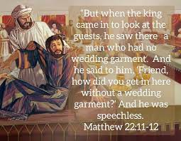
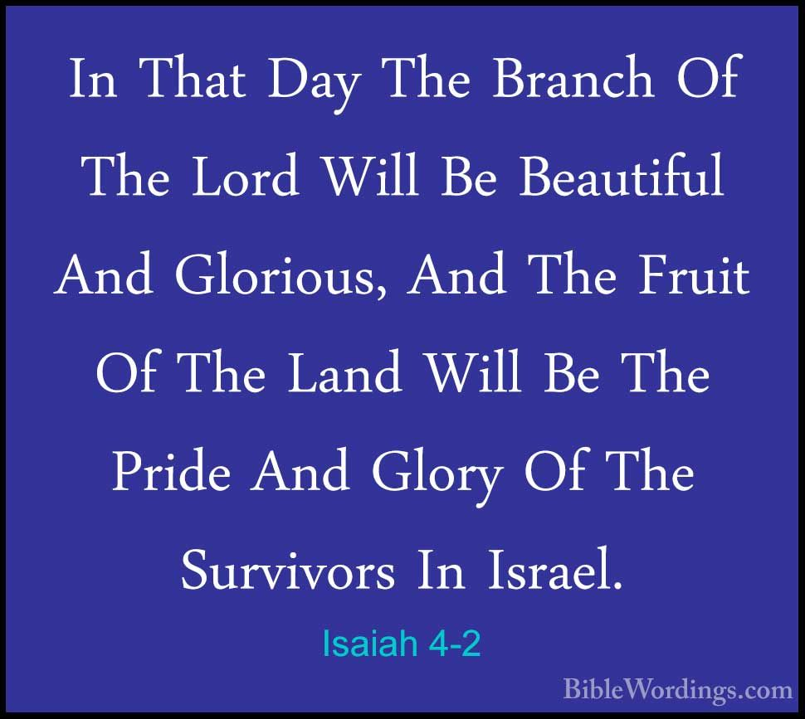
Anointed Conqueror
The transformation song
Isa 61:10-11 – “¹⁰I will rejoice greatly in the Lord, My soul will exult in my God; for He has clothed me with garments of salvation, He has wrapped me with a robe of righteousness, as a bridegroom decks himself with a garland, and as a bride adorns herself with her jewels. ¹¹For as the earth brings forth its sprouts, and as a garden causes the things sown in it to spring up, so the Lord God will cause righteousness and praise to spring up before all the nations.”
Notes:
And now we come to a transformation song, a statement of praise just like we saw at the end of the servant songs. When Jesus read 61:1-3, He was kicking things off. But now, all of us become part of the process. This is a Great Commission passage.
Isa 61:10 – We saw in 59:17-18 how the Messiah put on garments to do this very thing. Now we, His bride, are given garments too, in reflection of Him. We adorn salvation and righteousness just as much as a bride would a garland and jewels. Clothes reveal character and these things enhance our character. In the same careful way someone dresses for their wedding, this is how Zion carries herself. The song “The Sands of Time” = “The bride eyes not her garment, but her dear bridegroom’s face.” The gladness is not so much in the clothes, but over why we’re dressed up in the first place.
Isa 61:11 – When we plant and water, we expect nature to cooperate. How much more will God cause to spring up what He plants? If he has put in all this work through the Servant, sending His Spirit, will not righteousness and praise spring up? God’s blessings grow. Praise is the logical response of this saving work, a testimony of such a liberated life. When in the midst of affliction, conflict, and distress, we are still singing the songs of victory, that is the most alluring advertisement of the gospel that there is.

Slide 7
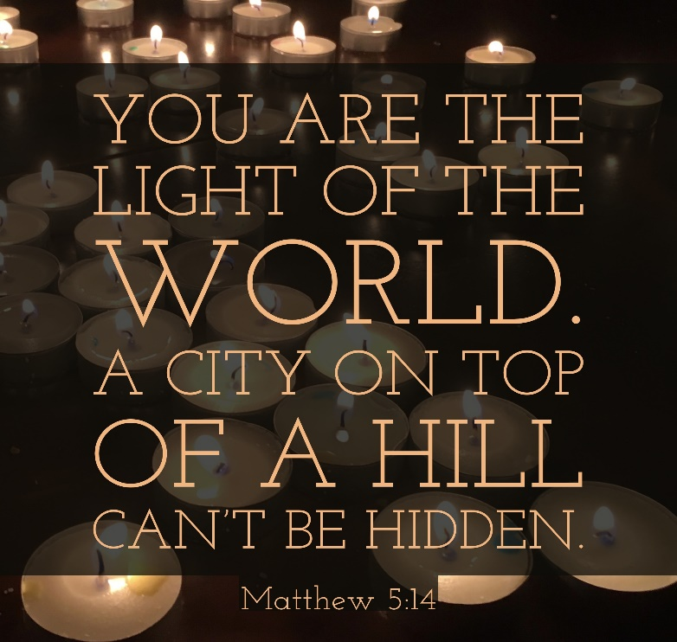
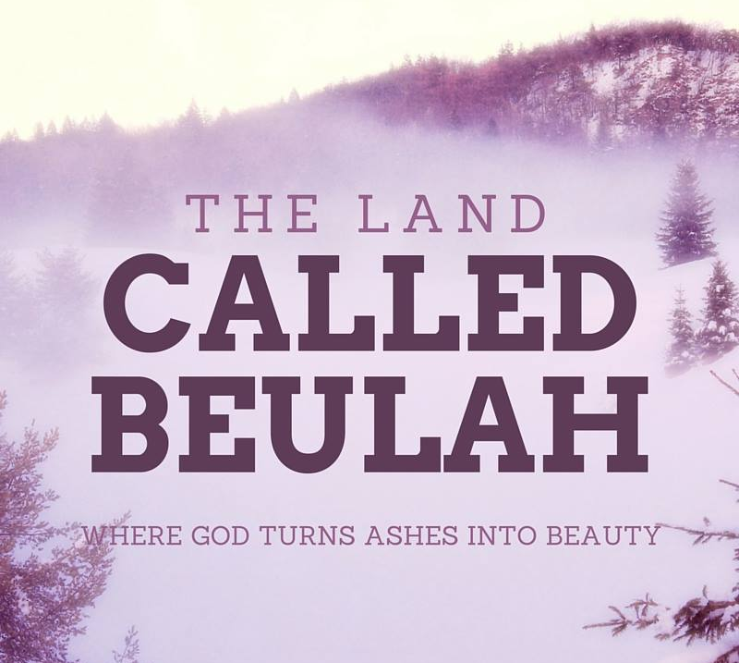
Zion’s Transforming Light
Forsakenness replaced w/light
Isa 62:1-5 – “¹For Zion’s sake I will not keep silent, and for Jerusalem’s sake I will not keep quiet, until her righteousness goes forth like brightness, and her salvation like a torch that is burning. ²The nations will see your righteousness, and all kings your glory; and you will be called by a new name which the mouth of the Lord will designate. ³You will also be a crown of beauty in the hand of the Lord, and a royal diadem in the hand of your God. ⁴It will no longer be said to you, ‘Forsaken,’ Nor to your land will it any longer be said, ‘Desolate’; but you will be called, ‘My delight is in her,’ and your land, ‘Married’; for the Lord delights in you, and to Him your land will be married. ⁵For as a young man marries a virgin, so your sons will marry you; and as the bridegroom rejoices over the bride, so your God will rejoice over you.”
Notes:
Isa 62 is a continuation of the Messiah’s proclamation of 61:1-3 in which He is going to respond to the peoples’ frequent charge that He’d been silent concerning them.
Isa 62:1-2a – What we’re witnessing in this text is a restlessness by God to fulfill what He has planned through the Messiah for the sake of Zion. He’s saying, “I’m not going to stop until my people are what I want them to be.” This verse really shows us the personality and emotions of our God. And what He wants is for us to be so full of righteousness and salvation, that it shines like a torch that is burning so that it’s plan for all to see and that the nations will be drawn to us. What about the present glory of nations? Mere candles compared to the sun when compared to Zion.
And look at what He’s going to do to Zion that is going to be so attractive – Isa 62:2b-3 – “name” in Hebrew is always associated w/character. We’ve already seen this about the Messiah in this book. He would be called the Branch, Immanuel, Wonderful Counselor, Mighty God, Prince of Peace. And further back than that, God changed Abram’s name to Abraham, Sarai’s name to Sarah, Jacob’s name to Israel. God would name His people according to their transformation, what they’ve become, Himself picking out the name that expresses them. It’s a new relationship just as when a woman marries and changes her name – she’s in a new relationship in which God “shows her off” like a crown/diadem in the hand, a prized possession. And so, He will guard us and protect us. The idea is that the kings of the earth will see who is truly kingly.
New name explained – Isa 62:4-5 – The old names of “Forsaken” and “Desolate” were due to her former sins, As we saw in 59:1-2, we were in a desperate situation. But God will no longer remember us that way. The past is gone. Now we are known as “Married” and “My delight is in her”, covering both the marriage and the honeymoon. “Married” = “Beulah”. Because we are so acquainted w/our sins, we tend to think God is barely tolerating us. No, He rejoices over us just as we rejoiced over our brides on the day of our wedding, men. Then He says, “so your sons will marry you”. Is the language making you uncomfortable yet? Us marrying God, our sons marrying us? This is highly figurative, using earthly experiences to express divine realities. “sons will marry you” simply means we’ll possess the nations, that we’ll likewise be committed to one another by virtue of the commitment we all have w/God.

Slide 8
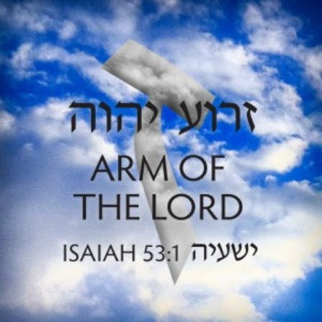
Zion’s Transforming Light
Foreigners turn to praise
Isa 62:6-9 – “⁶On your walls, O Jerusalem, I have appointed watchmen; all day and all night they will never keep silent. You who remind the Lord, take no rest for yourselves; ⁷and give Him no rest until He establishes and makes Jerusalem a praise in the earth. ⁸The Lord has sworn by His right hand and by His strong arm, ‘I will never again give your grain as food for your enemies; nor will foreigners drink your new wine for which you have labored.’ ⁹But those who garner it will eat it and praise the Lord; and those who gather it will drink it in the courts of My sanctuary.”
Notes:
And it’s not just the Lord who will be restless for Zion:
Isa 62:6-7 – The idea is, “I’m not going to rest until Zion is what I intend it to be, and neither should you rest.” He’s describing prayer warriors, those who ceaselessly pray and “never keep silent”. Remember Anna from Luke 2:37b-38? – “She never left the temple, serving night and day with fastings and prayers. At that very moment she came up and began giving thanks to God, and continued to speak of Him to all those who were looking for the redemption of Jerusalem”. And while we typically thinking of watchmen as guardians who make the people aware of approaching dangers, these “watch and pray” as Jesus told the Apostles to do in the Garden of Gethsemane. This is a fascinating idea because we know God does not forget, yet somehow our prayers are a vital ingredient in the implementing of His promises, if not in building trusting faith in the one who prayers. He wants Jerusalem to be a praise in the earth, and He’s calling on His people to be just as restless in wanting it as He is restless to perform it.
Isa 62:8-9 – You’ll remember from the Law of Moses that God’s original intention for Israel is that they dwell in the land in safety and protection from all its enemies so they could enjoy the fruit of their labors, but their sins removed that protection. The curses of covenant-breaking are over. As we saw earlier, foreigners will supply for them what they once stole. And in a reminder that they would serve as priests to the foreigners, as we saw in 61:6, they will eat and drink in God’s sanctuary just as the Levitical priests did. But this is not physical sustenance, it’s spiritual sustenance – John 6:27 – “Do not work for the food which perishes, but for the food which endures to eternal life, which the Son of Man will give to you…”. And how we can we be sure of this? I stopped early in John 6:27…the rest says, “for on Him (Jesus), God, has set His seal.” And here, God swears by His own right hand as if He were raising it in a court of law.

Slide 9
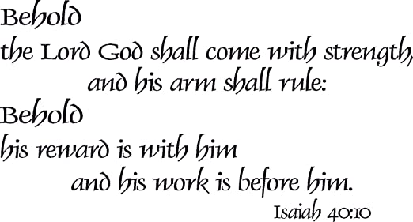
Zion’s Transforming Light
Pilgrimage
Isa 62:10-12 – “¹⁰Go through, go through the gates, clear the way for the people; build up, build up the highway, remove the stones, lift up a standard over the peoples. ¹¹Behold, the Lord has proclaimed to the end of the earth, say to the daughter of Zion, ‘Lo, your salvation comes; behold His reward is with Him, and His recompense before Him.” ¹²And they will call them, ‘The holy people, the redeemed of the Lord’; and you will be called, ‘Sought out, a city not forsaken.’”
Notes:
God goes from being restless Himself to encouraging restlessness among the people, and now He calls out to all the nations:
Isa 62:10 – We’ve seen the highway imagery before, such as in chapter 40, understanding that the role of John the Baptist was to “clear the way” for Jesus by encouraging man to remove the obstacles of sin and unrighteousness. Zion having done so, our job is now to also perform that’s same function. Zion is called on to bring others into the city. But though they themselves are the attraction by which they come, the Zion cannot just sit in passivity, but must pave the way for other people to join them.
Isa 62:11-12 – What is the Messiah’s reward? The people He has redeemed. And once again, He names them, describing what their character as become – “the holy people, the redeemed of the Lord” and “Sought out, a city not forsaken”. Meaning, we live as a holy, redeemed people who can rightly boast that the Lord has sought us out and not forsaken us. God was not running from the Jews, but toward the Jews. And when men look at the church, do they see holiness, or an institution?

