Slide 2
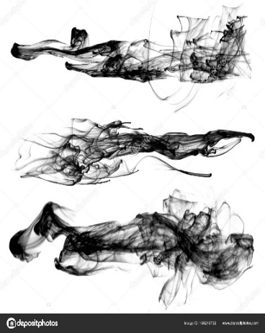
What Is “Unbecomingly”?
Greek =“aschémoneó”
“shapeless, unfitting, deformed, unpresentable, uncomely, lacking respect, indecent”
Latin = “rudis”
“rough, raw, wild, untilled”
1 Cor 12:23 – “and those members of the body which we deem less honorable, on these we bestow more abundant honor, and our less presentable members become much more presentable”
Rom 1:27 – “and in the same way also the men abandoned the natural function of the woman and burned in their desire toward one another, men with men committing indecent acts and receiving in their own persons the due penalty of their error.”
Rev 16:15 – “Behold, I am coming like a thief. Blessed is the one who stays awake and keeps his clothes, so that he will not walk about naked and men will not see his shame”
Jude 13 – “wild waves of the sea, casting up their own shame like foam; wandering stars, for whom the black darkness has been reserved forever.”

Slide 3
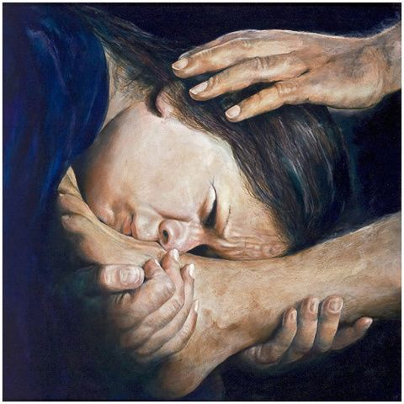

Slide 5
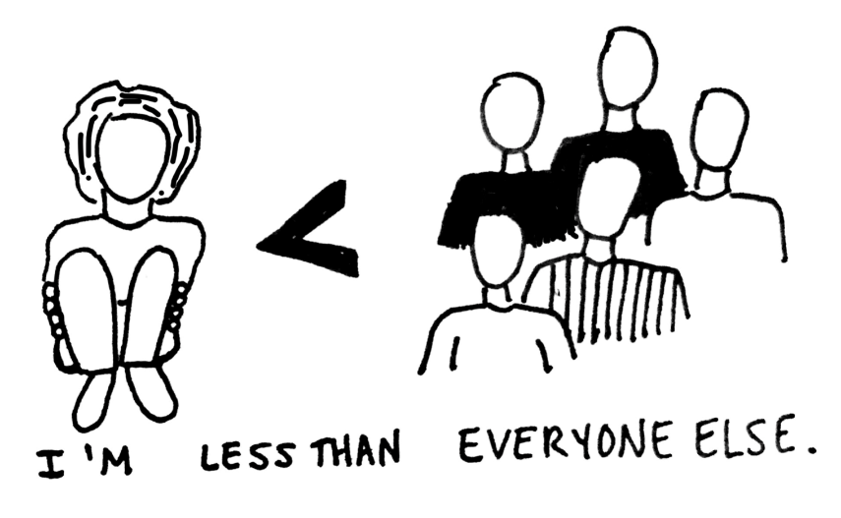
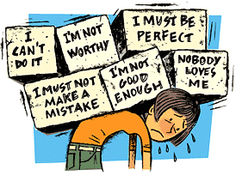

Slide 7
Love Does Not Act Unbecomingly
Love’s symmetry
1 Cor 14:33, 40

Slide 9
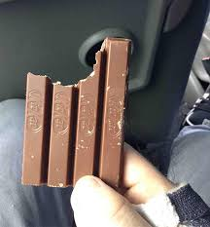

Slide 10
Love Does Not Act Unbecomingly
Love’s symmetry
1 Cor 14:33, 40; Eph 4:29

Slide 11
Love Does Not Act Unbecomingly
Love’s symmetry
1 Cor 14:33, 40; Eph 4:29
Love’s simplicity
1 Cor 13:1-3 vs. Acts 9:36-39

Slide 12
Love Does Not Act Unbecomingly
Love’s symmetry
1 Cor 14:33, 40; Eph 4:29
Love’s simplicity
1 Cor 13:1-3 vs. Acts 9:36-39
Love’s sensitivity
Matt 11:29

