Slide 2
CURRICULUM
Apr 6 – Introduction
Apr 13 – Its Nature
Apr 20 – Its Standard of Authority
Apr 27 – False Standards of Authority
May 4 – Applying the Standard (1)
May 11 – Applying the Standard (2)
May 18 – Local Organization
May 25 – Local Organization Apostasy
Jun 1 – Nature of Worship
Jun 8 – Elements of Worship
Jun 15 – Its Work of Edification
Jun 22 – Its Work of Evangelism
Jun 29 – Its Work of Benevolence
Notes:
As we study the local church’s work of evangelism, we’re going to observe how God would have this work to be accomplished. We will then spend the 2nd half of the class looking at things churches have done wrong in the past. As we do so, let’s keep in mind Eph 4:1-3 – “Therefore I, the prisoner of the Lord, implore you to walk in a manner worthy of the calling with which you have been called, with all humility and gentleness, with patience, showing tolerance for one another in love, being diligent to preserve the unity of the Spirit in the bond of peace.”
There will likely be some differences of opinion on some of the topics discussed. If you disagree doctrinally w/any of the points made and there needs to be further study, do not hesitate to let me know.

Slide 3
Work of Evangelism
M
Individual
1 Pet 2:9 – “But you are a chosen race, a royal priesthood, a holy nation, a people for God’s own possession, so that you may proclaim the excellencies of Him who has called you out of darkness into His marvelous light”
2 Cor 2:14-16 – “¹⁴But thanks be to God, who always leads us in triumph in Christ, and manifests through us the sweet aroma of the knowledge of Him in every place. ¹⁵For we are a fragrance of Christ to God among those who are being saved and among those who are perishing; ¹⁶to the one an aroma from death to death, to the other an aroma from life to life. And who is adequate for these things?”
Notes:
Evangelism can be done individually (CLICK) – 1 Pet 2:9 – Any person who is of the “called out”, that is the universal body of believers, has an obligation to proclaim the excellencies of Jesus Christ.
2 Cor 2:14 – As individual Christians, we engage in the dissemination of truths of the gospel throughout our communities and beyond. And notice it is regardless of their response (CLICK) – 2 Cor 2:15-16 – What does this mean? It means that if someone responds to the gospel, fantastic! We’ll facilitate it, baptize them, and encourage them in their faithfulness to Christ for as long as we’re given opportunity and who gets the glory in this? God. If a person does not choose to obey the gospel, we’ll continue to encourage them to do so, but that’s not on us, it’s on them. And God has still received glory because we’ve manifested the knowledge of Him in every place. In other words, our work in evangelism begins and ends simply with teaching people what they must do to be saved.

Slide 4
Work of Evangelism
M
Individual
Collective
1 Thes 1:8 – “For the word of the Lord has sounded forth from you, not only in Macedonia and Achaia, but also in every place your faith toward God has gone forth, so that we have no need to say anything.”
Notes:
But our primary concern this morning is the evangelistic work of the local church, meaning that “collective” work which is unique for local churches. In fact, Paul commended the local church of Thessalonica for this very thing, saying – 1 Thes 1:8.
So, the work of teaching the gospel was not just done individually, but collectively. Let’s observe what the pattern of the NT reveals as to the ways in which local churches do this collectively.

Slide 5
Work of Evangelism
M
Individual
Collective
Local Evangelists
Eph 4:11-12 – “And He gave some as apostles, and some as prophets, and some as evangelists, and some as pastors and teachers, for the equipping of the saints for the work of service, to the building up of the body of Christ”
1 Thes 3:2 – “and we sent Timothy, our brother and God’s fellow worker in the gospel of Christ, to strengthen and encourage you as to your faith”
1 Tim 1:3 – “As I urged you upon my departure for Macedonia, remain on at Ephesus so that you may instruct certain men not to teach strange doctrines”
2 Tim 2:2 – “The things which you have heard from me in the presence of many witnesses, entrust these to faithful men who will be able to teach others also.”
Notes:
Recall from a prior study that churches were given roles by which its work was to be accomplished (CLICK) – Eph 4:11-12. Evangelists perform specific functions relative to equipping saints for service and to building up the body, in both teaching and training in evangelism.
(CLICK) 1 Thes 3:2 – This involves general edification of strengthening and building faith in one another, but it also includes training others to preach the gospel.
(CLICK) 1 Tim 1:3 – The work Timothy was doing at the time of this letter appears to be confined to the area of Ephesus, working with the church in that location on how to make the proper distinction between sound and unsound doctrine as well as warning those who were crossing doctrinal lines. And so, it is today that we have local preachers for the same reason, to help churches make distinctions between sound teaching and unsound teaching, and to help protect them from false teaching and its leavening affect, and even to identify when individuals are getting off course.
(CLICK) 2 Tim 2:2 – This is an important aspect of the work of local preachers because if all the work of evangelism is placed on the shoulders of the local preacher, evangelism simply won’t get done. Brethren in local churches have connections that the local preacher(s) do not. There are people who trust you but will put their guard up around us when they find out we are preachers. And if preachers are not busy training others to be evangelistic, what will happen to evangelism when we’re all gone? Evangelists in local churches help to strengthen faith, build up, train in evangelism, and warn the brethren against unsound teaching.

Slide 6
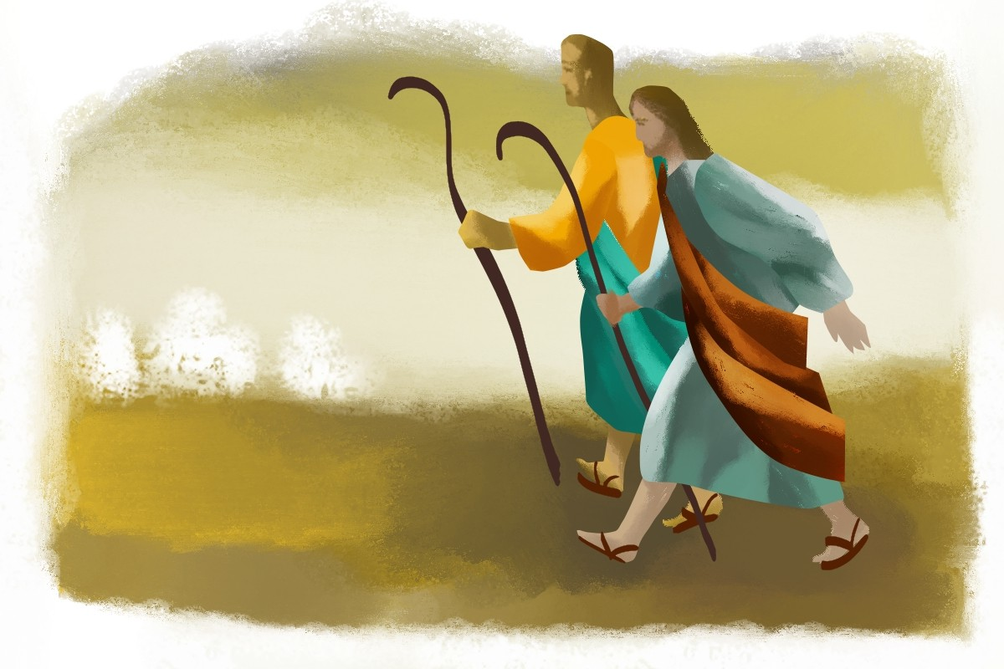
Work of Evangelism
M
Individual
Collective
Local Preachers
Send Out Preachers
Acts 11:20-24 – “But there were some of them, men of Cyprus and Cyrene, who came to Antioch and began speaking to the Greeks also, preaching the Lord Jesus. And the hand of the Lord was with them, and a large number who believed turned to the Lord. The news about them reached the ears of the church at Jerusalem, and they sent Barnabas off to Antioch. Then when he arrived and witnessed the grace of God, he rejoiced and began to encourage them all with resolute heart to remain true to the Lord; for he was a good man, and full of the Holy Spirit and of faith. And considerable numbers were brought to the Lord.”
Acts 13:2-3 – “While they were ministering to the Lord and fasting, the Holy Spirit said, ‘Set apart for Me Barnabas and Saul for the work to which I have called them.’ Then, when they had fasted and prayed and laid their hands on them, they sent them away.”
Notes:
Churches sent out preachers to other places.
(CLICK) Acts 11:20-24 – Noticed what happened: an open door was presented in a specific area, a local church in another area saw the open door, then they send someone there to teach and edify the brethren. The result? A considerable number were brought to the Lord. Every now and then, we might hear of areas either locally or internationally that need help and we might send men there. And when the local church is developing and training able-minded men to preach the gospel and the desire is present to do it, we should be sending them to these areas to lend a hand.
(CLICK) Acts 13:2-3 – Who is “they”? The church in Antioch. Local churches edify disciples (last week’s lesson), and then when a need shows itself and a desire amongst one or more disciples is present, local churches should send them wherever a need may exist. This might be a temporary need, say a gospel meeting, lectureship, mission trip, or it might be that a permanent opportunity opens up to start a church in another area, domestically or internationally, requiring a longer-term commitment. The reasons are abundant, but we know from the NT pattern that local churches not only equipped the saints for the work of evangelism, but also sent them out to where the work needed to be done.

Slide 7
Work of Evangelism
M
Individual
Collective
Local Preachers
Send Out Preachers
Support Preachers
2 Cor 11:8 – “I robbed other churches by taking wages from them to serve you.”
Phil 4:15-16 – “You yourselves also know, Philippians, that at the first preaching of the gospel, after I left Macedonia, no church shared with me in the matter of giving and receiving but you alone; for even in Thessalonica you sent a gift more than once for my needs.”
1 Cor 9:14 – “So also the Lord directed those who proclaim the gospel to get their living from the gospel.”
Gal 6:6 – “The one who is taught the word is to share all good things with the one who teaches him”
Notes:
Which leads us to this: local churches also support those who preach the gospel.
(CLICK) 2 Cor 11:8 – And what he meant by that was he didn’t want to burden the Corinthians with the needs he had, so other churches sent support to him.
(CLICK) Phil 4:15-16 – The local church sent this. And we ought to do the same. And we do support gospel preachers, entering into that labor as we have fellowship with them. We support those who go on temporary missions, as the church here has done has done several time here. We support those who are indefinitely located in other areas of the country and the world. And the local church here supports its own in this community.
This is a monetary support (CLICK) – 1 Cor 9:14.
But it is also a spiritual support (CLICK) – Gal 6:6 – Certainly that involves monetary support, but “all good things” shouldn’t just be limited to that which is material. Evangelists have a hard job. We teach and preach not just to those who want to hear, but those who don’t. Difficulty arises from this. Evangelists need spiritual support and encouragement from its members. We need friends. We need your prayers for our individual works, we need your forbearance and your patience in our personal faults and weaknesses as we try to grow to be the men that God desires us to be. We need your “amen” when we have to say hard things. And we need your patience when we say wrong things. Please continue to share all good things with us. Local churches who support and stand by their evangelists are local churches that grow.

Slide 8
Notes:
Evangelism is such an important work of the local church. In fact, what so often pushes a local church to want to be more evangelistic is understanding what it really means to be lost. And here are my friends, my family, my neighbors, my school mates, and if we can’t persuade them to become Christians, they will spend an eternity in torment. I read a statistic once that every minute, 156 people die without knowing Christ. Doesn’t that tug at your heart strings? It is a tragedy that people are lost. Doesn’t that make you want to be more evangelistic?
That emotional response can become so front and center in our mind, we can be so moved by the tragedy of lost souls, that it is possible for us as a local church to step outside of biblical boundaries in regards to evangelism. We can be so moved by the tragedy of lost souls, that it overwhelm our emotions to the extent that we begin reasoning wrongly concerning the work of evangelism. And this has caused some local churches to veer outside of the pattern of scripture concerning this important work.
As we get into these “innovations”, keep in mind study #8 from this series when we talked about “local organization apostasy”, that the first great apostasy of the local church began w/a small tweak in local church organization and how over several hundred years it led to the formation of the Roman Catholic Church. The point in addressing these innovations is not just a matter of respecting God’s authority (that is of foremost importance), but also to show the slippery-slope consequences of what happens when we step even a little bit outside the NT pattern, which is very typical when we allow emotion to prevail over proper, biblical discernment.

Slide 9
“Innovations”
1 Pet 5:1-2 – “¹Therefore, I exhort the elders among you, as your fellow elder and witness of the sufferings of Christ, and a partaker also of the glory that is to be revealed, ²shepherd the flock of God among you, exercising oversight not under compulsion, but voluntarily, according to the will of God; and not for sordid gain, but with eagerness;”
Notes:
Passion for evangelism has caused some local churches of the past to stray outside organizational boundaries. We learn from the NT that local churches are independent, autonomous bodies of believers due to the fact we are to have elders who oversee the flock among them – 1 Pet 5:1-2a. Shepherding what? “The flock of God among you.” Elders have no oversight whatsoever of those who make up another local church and the work of that church. They have no oversight of anything beyond their group. It's the oversight of the flock among you.
But something interesting happened in the late 1940s, early 1950s. Right at the end of WWII, there was a lot of concentration expended towards preaching the gospel within the countries that were defeated in WWII, such as Germany and Japan (CLICK). And so, a local church in Texas came up w/the idea of evangelizing Germany (CLICK). But the way they wanted to do the work was by having other churches send them money so they could oversee the work. So, they sent out a bunch of letters to other local churches and that’s what happened (CLICK). The big church in Texas handled the work of evangelism, exercising oversight over it, making all the decisions of who went where, the financial decisions, and other churches simply sent them money so they could take care of the work. (CLICK)

Slide 10
“Innovations”
1 Pet 5:1-2 – “¹Therefore, I exhort the elders among you, as your fellow elder and witness of the sufferings of Christ, and a partaker also of the glory that is to be revealed, ²shepherd the flock of God among you, exercising oversight not under compulsion, but voluntarily, according to the will of God; and not for sordid gain, but with eagerness;”
Sponsoring
Church
Japan
Notes:
Around that same time, another church in Tennessee decided they wanted to handle the work of evangelism in Japan (CLICK), and they followed the same pattern as the church in Texas. They sent out letters saying, “Send us your money, and the elders here will take on the oversight of evangelizing Japan” And so that’s what happened.
What’s the issue? The issue in both of these cases is that you had one local eldership overseeing the work of many churches. There’s no authority in scripture for that, no precedence in scripture for that, and it goes against the independent autonomy God designed for local churches. The elders overseeing one local congregation became the “sponsor” of an area of evangelistic effort abroad as other congregations agreed to help provide financial support for these endeavors by sending the money to them so they could distribute it as they saw fit.
Now an eldership of a local church has every right to encourage and promote evangelistic endeavors in their local areas and to provide sufficient funding for them; they also have the right to directly support evangelists working in other areas. But if a local church gives money to another church to do those things, they have given up all control over the resources, acceded their autonomy to a degree, and therefore have abrogated their responsibilities before God in so doing. God has not commanded local churches to give to other local churches to fund their evangelistic work, but for them to do the work and the support of the work themselves. This places the decision-making and judgment calls for the work in the hands of the elders of our local church.

Slide 11
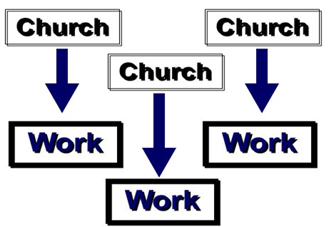
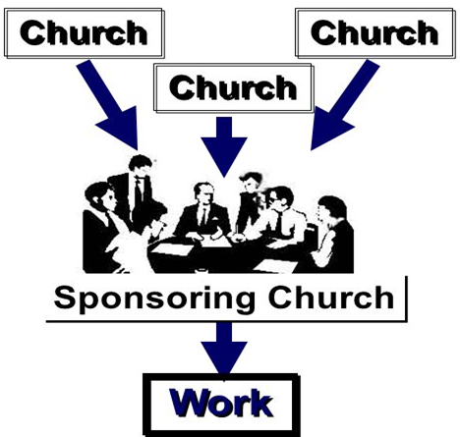
“Innovations”
1 Pet 5:1-2 – “Therefore, I exhort the elders among you, as your fellow elder and witness of the sufferings of Christ, and a partaker also of the glory that is to be revealed, ²shepherd the flock of God among you, exercising oversight not under compulsion, but voluntarily, according to the will of God; and not for sordid gain, but with eagerness;”
This
Not This
Notes:
And so, this is the pattern we see in scripture: local churches sending directly to the need and not through a middleman organization. By sending money to a sponsoring church, we are activating the universal church, undermining local church autonomy, and taking the first step toward denominationalizing the church of Christ.

Slide 12
“Innovations”
Notes:
But there’s another consequence that comes out of this, what we call the issue of “centralized influence”. Another church out in Texas got the idea to take oversight of a radio/TV program. There is nothing against a local church using its resources for a TV/radio program to preach the gospel, as this would fall under general authority to “teach”. But this church didn’t want to use its own resources, but also the resources of other churches. And so, a bunch of churches did indeed start sending money so they could broadcast gospel teaching all over the country, bringing us right around to the same problem we discussed previously – a sponsoring church arrangement.
But another issue was introduced. For a while, the Herald of Truth was preaching sound teaching – restoring NT Christianity, the plan of salvation, good first principles lessons that the denominational world really needed to hear. And brethren all over the place were tuning in and being influenced by it. But over time, the teaching started to become watered-down, shifting into how to develop a strong self-image, how find inner peace, etc. It got to be that you’d rarely hear any good doctrinal preaching. There were a lot of preachers who tuned into this program and were influenced by it and so they started altering their message in the pulpits the Herald of Truth’s teaching. And so, the Herald of Truth became an “entity” of “centralized influence” that had a leavening affect in a lot of local churches, so that when it softened its teaching, a lot of churches connected to it began following suit.
Whenever a secular entity is created w/spiritual precepts in mind, and local churches become connected to that entity, the same problem can occur. Not just radio or TV programs, but magazines, bible colleges, camps, etc. – all doing good things, but once they explode in popularity and influence and many churches/churches become connected, will inevitably follow the same path as what happened w/the Herald of Truth. Part of God’s teaching on the organization of the local church was to prevent the spread of apostasy. By introducing outside nonchurch entities and becoming too connected to them, we are increasing the odds of apostasy.

Slide 13
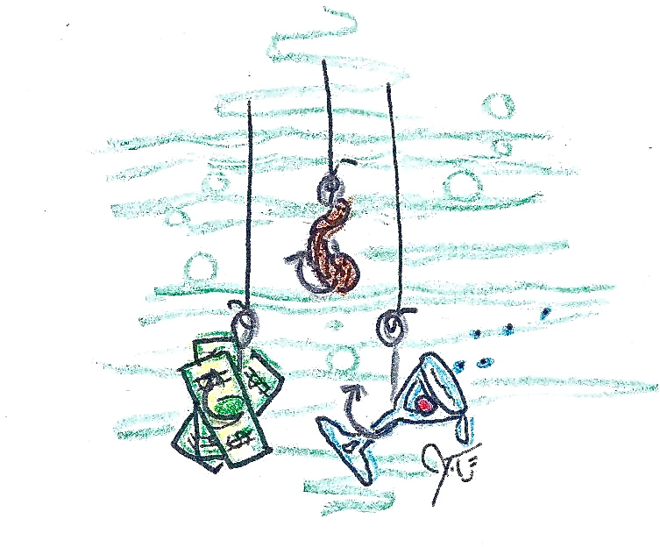
“Innovations”
1 Cor 1:22-23 – “²²For indeed Jews ask for signs and Greeks search for wisdom; ²³but we preach Christ crucified, to Jews a stumbling block and to Gentiles foolishness”
1 Cor 2:1-2 – “¹And when I came to you, brethren, I did not come with superiority of speech or of wisdom, proclaiming to you the testimony of God. ²For I determined to know nothing among you except Jesus Christ, and Him crucified.”
Notes:
And then there is the Social Gospel. The Social Gospel comes from the mentality that people just won’t listen to the gospel unless you appease their social, physical, and recreational needs first. It is the philosophy that people simply won’t listen to the gospel unless we appeal to their carnal needs. And so, to get the numbers to sustain ourselves, we must attract them in other ways by building basketball gymnasiums, massive eating halls, entertainment facilities, and provide things like exercise classes, day cares, etc.
“What’s wrong w/that?” (CLICK) – 1 Cor 1:22-23 – In other words, many in the 1st century who wanted nothing to do with the cross. The Jews wanted more than a crucified Savior to save them from their sins and the Greeks were so addicted to the sophistication of their own thinking – the idea of a crucified king to them was a bunch of baloney. So what did Paul do about this? What did he do to make the message of the cross more interesting for those to whom it didn’t appeal?
1 Cor 2:1-2 (CLICK) – What did he do to make the cross more attractive? He did nothing. He preached Christ crucified, and he let that message be its own drawing power, because God designed the gospel message, in its purity/simplicity, to be the natural divider between those who want the truth and those who do not. And anything that I do that may obscure that is going to hinder the plans and purposes of the gospel.

Slide 14
“Innovations”
1 Cor 1:14-17 – “¹⁴I thank God that I baptized none of you except Crispus and Gaius, ¹⁵so that no one would say you were baptized in my name. ¹⁶Now I did baptize also the household of Stephanas; beyond that, I do not know whether I baptized any other. ¹⁷For Christ did not send me to baptize, but to preach the gospel, not in cleverness of speech, so that the cross of Christ would not be made void.”
Notes:
How far did he take this? – 1 Cor 1:4-17 – Paul was so intent on making sure nothing in his preaching distracted from the cross, we learn in 1 Cor 1 that he stopped baptizing people. He didn’t stop baptizing people because he didn’t believe it was necessary for salvation, but because the Corinthian church had developed a case of “preacheritus”. And so, he reasoned, “If by me personally baptizing somebody is going to distract them from total loyalty to Christ, someone else can do the baptizing.” It’s not an issue of whether baptism is necessary – it is. What Paul was doing was trying to be careful that nothing at all infringed on the truth about Jesus Christ and the role that He played in the salvation of mankind through the cross, because that is what mankind needs the most.
There is no biblical precedence for the social gospel, and there are also practical consequences to it. If a person simply will not obey the gospel because they want forgiveness of their sins, eternal life in the God’s presence, and seek the moral values that identify us with Jesus in a family of likeminded people desiring the same thing, imagine the kind of people will be drawn by Wednesday night spaghetti dinners and church movie nights? It won’t be spiritually-inclined people who want to make the sacrifices incumbent of the cause of Christ that drives the work of this local church. It will be people who are self-indulgent w/an attitude not of “what I can contribute to the cause of Christ”, rather “what will you give me?”

Slide 15
CURRICULUM
Apr 6 – Introduction
Apr 13 – Its Nature
Apr 20 – Its Standard of Authority
Apr 27 – False Standards of Authority
May 4 – Applying the Standard (1)
May 11 – Applying the Standard (2)
May 18 – Local Organization
May 25 – Local Organization Apostasy
Jun 1 – Nature of Worship
Jun 8 – Elements of Worship
Jun 15 – Its Work of Edification
Jun 22 – Its Work of Evangelism
Jun 29 – Its Work of Benevolence
Notes:
Let’s maintain our evangelistic passion. Let’s be united in our motivations. But let’s be careful to stay within the boundaries that scripture provides for us, because within these boundaries we find God’s wisdom for how to best achieve evangelism within the local church. And though we may not always be able to see in the present time why a particular innovation is problematic, if we’ll simply trust in the pattern that God has provided and determine to stay within that pattern, not deviating to the left or the right, we’ll never have to worry about the consequences that often come about as a result of these “innovations”. And it will also show that our trust and faith is in God and His plan, as simple as that plan may seem to be.

