Slide 1
No Greater Joy
Shaping young hearts through proactive parenting

Slide 2
The Goal.
We want them to learn meekness.
We want them to learn self-control.

Slide 3
Who is wise and understanding among you? By his good conduct let him show his works in the meekness of wisdom.
James 3:13

Slide 4
…the glutton will come to poverty…
Proverbs 23:21
Drink water from your own cistern, flowing water from your own well.
Proverbs 5:15
…the borrower is slave to the lender…
Proverbs 22:7

Slide 5
Wine is a mocker, strong drink a brawler, and whoever is led astray by it is not wise.
Proverbs 20:1
Do not toil to acquire wealth, be discerning enough to desist.
Proverbs 23:4
A fool gives full vent to his spirit, but a wise man quietly holds it back.
Proverbs 29:11

Slide 6
The Problem.
They are foolish.
They are simple.

Slide 7
The fear of the Lord is the beginning of knowledge; fools despise wisdom and instruction. Prov 1:7
Do not reprove a scoffer, or he will hate you; reprove a wise man, and he will love you. Prov 9:8

Slide 8
The way of a fool is right in his own eyes, but a wise man listens to advice. Prov 12:15
A fool despises his father’s instruction, but whoever heeds reproof is prudent. Prov 15:5

Slide 9
The simple believes everything, but the prudent gives thought to his steps. Prov 14:15
The prudent sees danger and hides himself, but the simple go on and suffer for it. Prov 22:3

Slide 10
“How long, O simple ones, will you love being simple? How long will scoffers delight in their scoffing and fools hate knowledge?” Prov 1:22
For the simple are killed by their turning away, and the complacency of fools destroys them… Prov 1:32

Slide 11
For at the window of my house I have looked through my lattice, and I have seen among the simple, I have perceived among the youths, a young man lacking sense, passing along the street near her corner… Prov 7:6

Slide 12
The Solution.
Discipline.
Instruction.

Slide 13
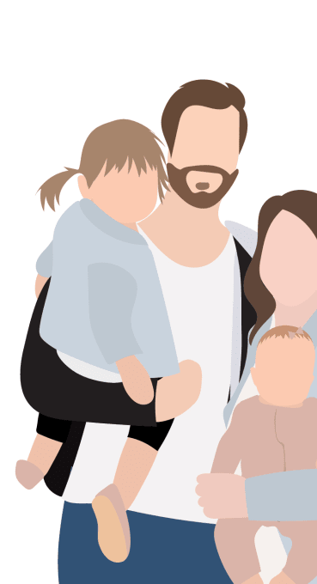
Fathers, do not provoke your children to anger, but bring them up in the discipline and instruction of the Lord.
Ephesians 6:4

Slide 14
“Bring them up”
Ek-trepho – to bring up, promote health and strength, educate

Slide 15
“Discipline”
Paideia – “To train a child… the discipline that regulates character” (Vine’s)

Slide 16
“Instruction”
Nouthesia – “calling attention to… mild rebuke or warning – admonition” (Strong’s)

Slide 17
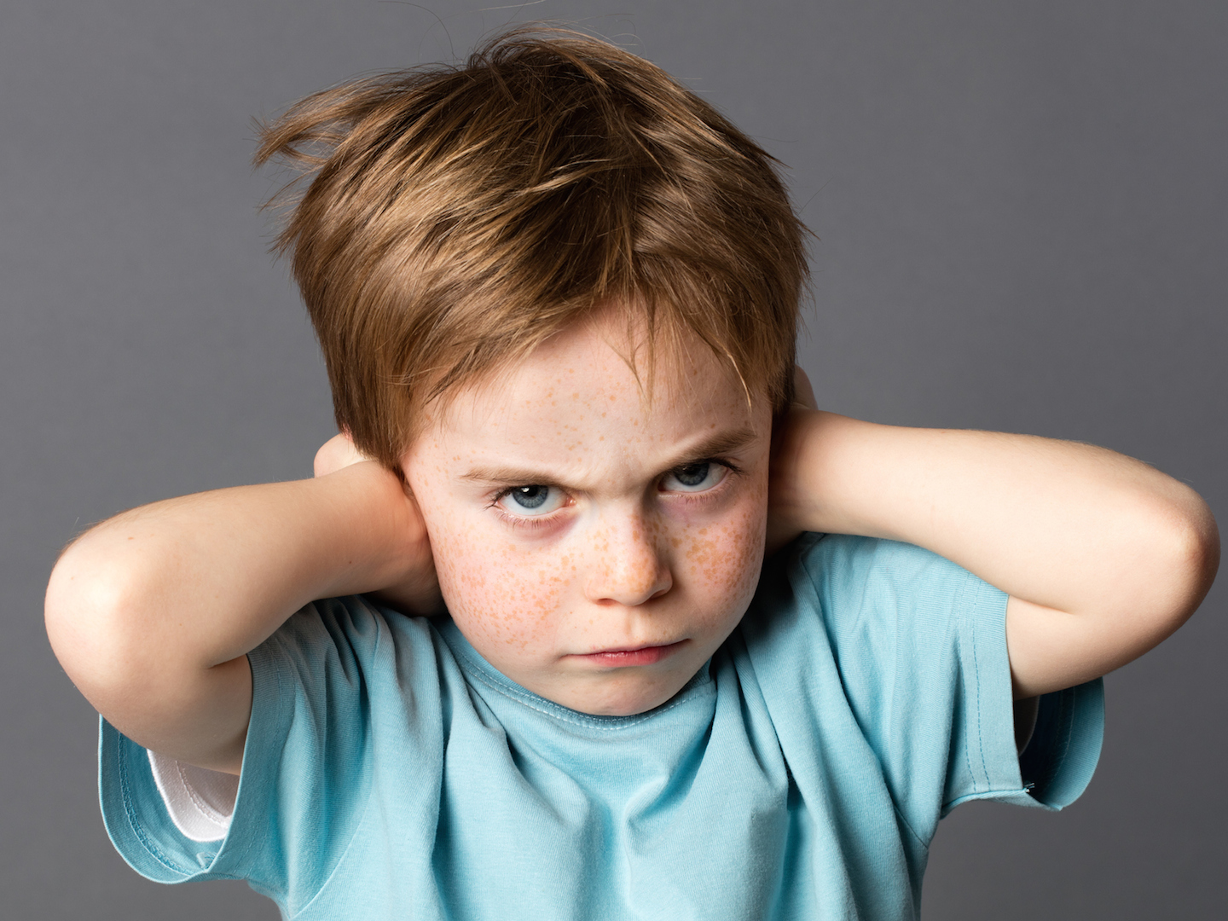
Folly is bound up in the heart of a child, but the rod of discipline drives it far from him. Prov 22:15
The rod and reproof give wisdom, but a child left to himself brings shame to his mother. Prov 29:15

Slide 18
Do not withhold discipline from a child; if you strike him with a rod, he will not die. If you strike him with a rod, you will save his soul from Sheol. Prov 23:13-14
Whoever spares the rod hates his son, but he who loves him is diligent to discipline him. Prov 13:24

Slide 19
Discipline your son, for there is hope; do not set your heart on putting him to death. Prov 19:18

Slide 20
The law of the LORD is perfect, reviving the soul; the testimony of the LORD is sure, making wise the simple. Psa 19:7
The unfolding of your words gives light; it imparts understanding to the simple. Psa 119:130

Slide 21
Setting rules beforehand
Evaluating the infraction
Interlude—set an example of self-control
Prelude to punishment
Conclusion & resolution

