Slide 5
Apostle Paul: a Fleshly Man?
Didn’t talk like a fleshly man
Flawless former life in Judaism
Preaches what he formerly condemned
Limited interaction w/Apostles
Contended against Judaizers
Called out a hypocritical apostle

Slide 6
Gal 2:16 – “nevertheless knowing that a man is not justified by the works of the Law but through faith in Christ Jesus, even we have believed in Christ Jesus, so that we may be justified by faith in Christ and not by the works of the Law; since by the works of the Law no flesh will be justified.”

Slide 8
LAW
Requires perfect human performance
Places us under a curse
Make us villains, not heroes
Given 430 after the Promise (Gen 12:3)
Drives us toward an awareness of sin
Puts us in bondage
Adapted for slaves
GOSPEL
Requires Jesus perfect life
Jesus redeemed us from the curse
Jesus, the hero, died for the villains
Fulfills the Law and the Promise
Drives us toward an awareness of Jesus
Adopts us into God’s family
Adapted for children

Slide 15
THEM

Slide 16
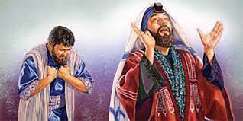
ME

