Slide 1
What Jesus Knows
About This Church
UNIVERSITY CHURCH OF CHRIST
08.21.22

Slide 2
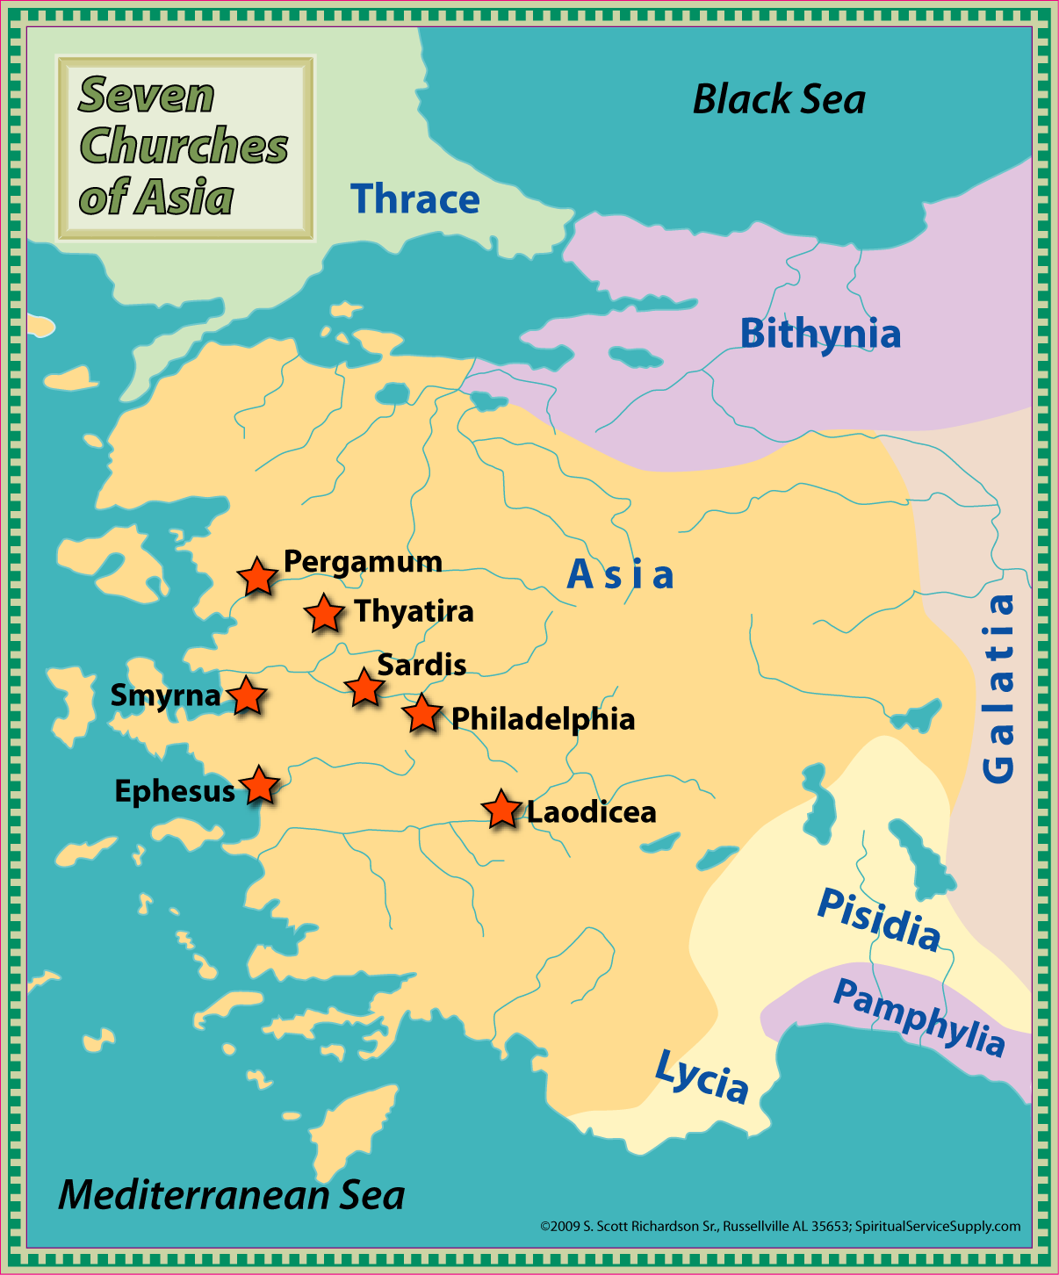
“To the angel of the church in _______, write: The words of (Jesus)...”
“I know…”

Slide 3
The 7 Churches in Asia
#1 | Ephesus | mirrors | #4 | Thyatira
#2 | Smyrna | mirrors | #5 | Sardis
#3 | Pergamum | mirrors | #6 | Philadelphia
#7 | Laodicea

Slide 4
Jesus Knows Your…
Tolerance & Love (2:2-3 vs. 2:20; 2:4-5 vs. 2:19)
Reputation & Reality (2:9 vs. 3:1b)
Obstacles & Opportunities (2:13 vs. 3:8)
Fervor & Zeal (3:15-19)

Slide 5
“He who has an ear, let him hear what the Spirit says to the churches.”
(Rev. 2:7; 2:11; 2:17; 2:29; 3:6; 3:13; 3:22)

