Slide 1
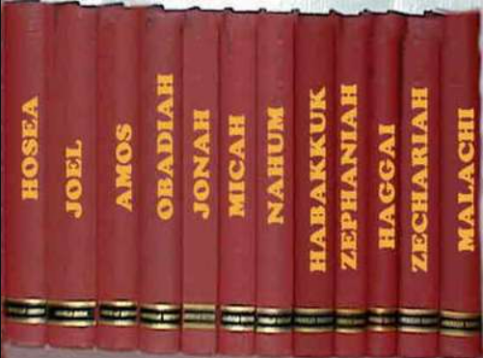
Minor Prophets
Lesson 1 – Overview of the Minor Prophets
Hebrews 1:1-2a, “Long ago, at many times and in many ways, God spoke to our fathers by the prophets, but in these last days He has spoken to us by His Son…”
“In times of spiritual and moral repression and decay, God raised up men (prophets) in whose mouth He put His word and whom He sent to the people in an effort to turn them back to Himself. –Homer Hailey

Slide 2
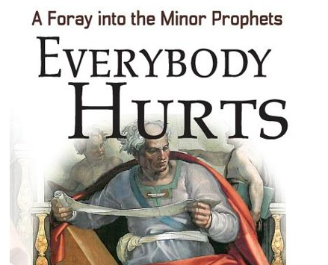
Minor Prophets
Books of Prophecy cover roughly 25% of the Bible, about as much as the entire New Testament.
Different men, different personalities with varying messages and delivery methods.
Why are these often the least studied books?

Slide 3
Why We Should Study the Prophets
I Peter 1:10 – 12, “Concerning this salvation, the prophets who prophesied about the grace that was to be yours searched and inquired carefully, inquiring what person or time the Spirit of Christ in them was indicating when he predicted the sufferings of Christ and the subsequent glories. It was revealed to them that they were serving not themselves but you, in the things that have now been announced to you through those who preached the good news to you by the Holy Spirit sent from heaven, things into which angels long to look.”
Romans 15:4, “For whatever was written in former days was written for our instruction, that through endurance and through the encouragement of the Scriptures we might have hope.”
We should learn from the mistakes of God’s people who came before us.
We God’s view of His people appeasing and joining “The Nations”
Strengthen our faith by understanding God’s plan and seeing fulfilled prophecy.
We see God’s control of ALL nations on the face of the earth.
The New Testament quotes the Old Testament (Matt 67, Rom 60, Heb 59 – Rev zero by hundreds)

Slide 4
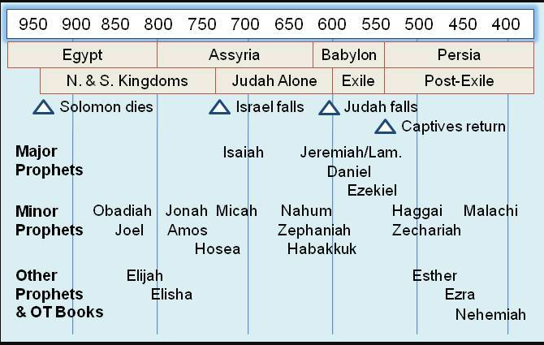
Minor Prophets Timeline

Slide 5
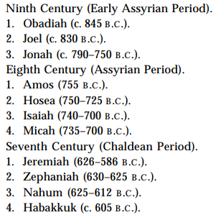
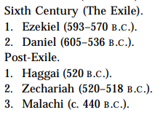
Minor Prophets Timeline

Slide 6
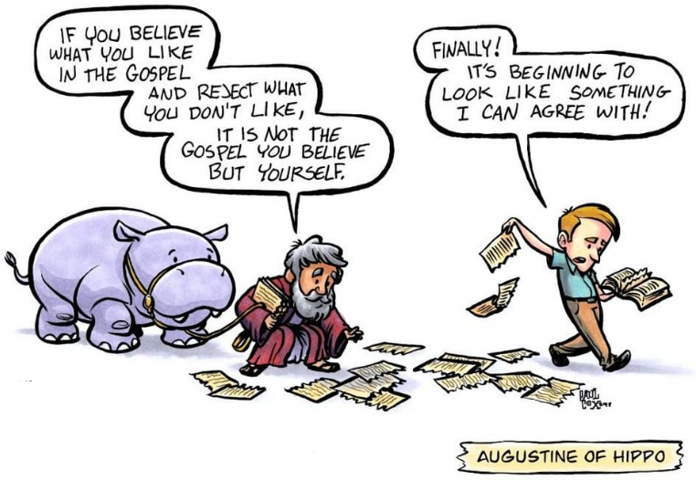
Who were the “Minor” Prophets?
In extra-Biblical \ apocryphal writings by 190 BC
Twelve Prophets or Book of the Twelve by the Jews and “the twelve” by many early church writings
“Minor” wasn’t introduced until 375-425 AD
Augustine of Hippo credited with the naming

Slide 7
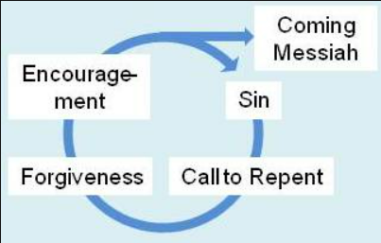
Major Themes
The Terrible Nature of Sin
Repentance & Righteousness
God’s Holiness & Mercy
Encouragement to Trust God
Coming Messiah \ Kingdom
The worship due to God

Slide 8
Types of Prophets \ Teachers
Moses “Lawgiver, friend of God” – his own type
Wise men & women
Priests – teachers of the Law, dutiful servants
Prophets – spokesman for God
Psalmists
False Prophets

Slide 9
How does this apply to me?
Amos 3:7 “For the Lord God does nothing without revealing his secret to his servants the prophets.”
Hosea 4:6 “My people are destroyed for lack of knowledge; because you have rejected knowledge, I reject you from being a priest to me. And since you have forgotten the law of your God, I also will forget your children.”
Hebrews 1:1-2 “Long ago, at many times and in many ways, God spoke to our fathers by the prophets, 2 but in these last days he has spoken to us by his Son, whom he appointed the heir of all things, through whom also he created the world.”
Hebrews 2:1-4 “Therefore we must pay much closer attention to what we have heard, lest we drift away from it. For since the message declared by angels proved to be reliable, and every transgression or disobedience received a just retribution, how shall we escape if we neglect such a great salvation? It was declared at first by the Lord, and it was attested to us by those who heard, while God also bore witness by signs and wonders and various miracles and by gifts of the Holy Spirit distributed according to his will.”

