Slide 1
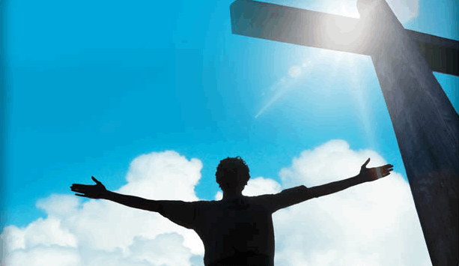

Notes:
What is the big picture of the bible? Sometimes we get so caught up in “doctrinal” things that we forget the big picture. It’s at that point we need to step back remember what it’s all about. And the way we do that is by piecing together the bible story, bringing together each piece so that it makes a big picture.
Illustration: Trying to put together a jigsaw puzzle without knowing what the picture looks like.

Slide 2





The Incredible Book
66 Books: 39 OT + 27 NT
Written over 1500 years
(1450 BC – AD 100)
40 different authors
From 3 different continents, different nations, and varying cultures
Contains 3 different languages (Hebrew, Aramaic, Greek)
HEBREW
ARAMAIC
GREEK
Notes:
The bible truly is incredible. There are 66 different books written over 1500 years by 40 different authors from 3 different continents comprised of a variety of nations and cultures and languages.

Slide 3

40 Authors…
6 Major Empires…
1500 Years…
66 Books…
3 Continents…
3 Languages…
1
One Theme!
amazing
God’s Plan of Redemption
Notes:
But despite all of these differences, the bible reflects just one theme. And that theme is God’s Plan of Redemption – His plan to save all of mankind from their sins. To uncover this theme, this big picture of the bible, the best place to begin is on a hilltop in Galilee.

Slide 4

An Urgent and Important Command
THE GREAT COMMISSION
“Go into all the world and
preach the gospel
to all creation.”
Mark 16:15
Notes:
Imagine that you had only a few minutes with your loved ones before you would never see them again. The last words you speak to them would the things that are dearest to your heart. Jesus’ last words on earth to His followers, before His ascension to heaven, were for them to go into all the world and preach the gospel to all creation. This tells us how important the gospel is to Jesus.

Slide 5
The Gospel –
The Power of God
“I am not ashamed of the gospel
for it is the
power of God
for salvation...”
Romans 1:16
Notes:
Rom 1:16 further tells us of the importance of the gospel when the Apostle Paul tells us it is the power of God to salvation to those who believe. In other words, the gospel is God’s power to convert and save people. God could have chosen to save people in a variety of ways. He could have forced them into obedience, He could have told us to convert people by the edge of the sword – and some religions do this.

Slide 6


THE GOSPEL –
A Message of Salvation
The gospel is a MESSAGE that is to be PREACHED to every person - a message of SALVATION.
The Gospel is Objective Truth!
Notes:
But God chose the gospel to be a message, a spoken message to stand between man and his salvation, a message about how we can be saved. This is an objective truth designed to convince and convict the mind, not to force it into submission. And this is exciting news as it pertains to the gospel.

Slide 7

The Gospel…Must be Obeyed
“...when the Lord Jesus will be revealed from heaven with His mighty angels in flaming fire, dealing out retribution to those who do not know God and to those who do not obey the gospel of our Lord Jesus. These will pay the penalty of eternal destruction, away from the presence of the Lord and from the glory of His power...”
2 Thessalonians 1:7-9
Notes:
But there’s also a very frightening aspect connected with this gospel message – 2 Thes 1:7b-8 – What we find here is that Christ is going to deal out retribution to 2 groups of people: those who do not know God (which tells us why we should be teaching the gospel) and also to those who do not obey the gospel – in other words, those who have heard the gospel message but decide to reject it. This tells us how scary this can get.

Slide 8

A Serious Warning…To Christians
“I am amazed that you are so quickly deserting Him who called you by the grace of Christ, for a different gospel; which is really not another; only there are some who are disturbing you and want to distort the gospel of Christ.
But even if we or an angel from heaven should preach a gospel other than
the one we preached to you,
let him be eternally condemned!”
Galatians 1:6-12 (see also Acts 20:28)
Notes:
But perhaps the scariest passage as it pertains to the gospel is found in Gal 1. The Galatians were changing the gospel and teaching another message of salvation. Some people in the religious world today say that it doesn’t what you believe or do as long as you believe in Jesus. But Paul tells the Galatians that if even an apostle or angel from heaven should preach another gospel, they would be condemned. This is not politically correct in our world, but it is the reason we have so many different churches today - because there are so many different gospels. In fact, if you were to stop 10 people on the street and ask them how one might be saved, you will get 10 different answers.

Slide 9
The ONE Gospel
1
“I am amazed that you are so quickly deserting Him who called you by the grace of Christ, for a different gospel; which is really not another; only there are some who are disturbing you and want to distort the gospel of Christ.
But even if we or an angel from heaven should preach a gospel other than the one we preached to you, let him be eternally condemned!”
Galatians 1:6-12
How can I be certain?
Where would we start?
GOSPEL
Notes:
Ok, so what is the gospel? (Purpose of this lesson). Well, in one sense, it’s the entire bible. The gospel is that good news which the entire bible teaches. But the way the apostles used it in most cases in which it is referred is the message of salvation that would put an individual into Christ, into a relationship with Christ.
So the question is, if there is only one gospel, how do I know what that gospel is? Where do I begin in trying to understand that one gospel Paul tells us we must know and obey?

Slide 10
Galatians 3:24
Also: Rom. 15:4
For whatever things were written before were written for our learning, that we through the patience and comfort of the Scriptures might have hope.
1 Cor. 10:11
Now these things happened to them as an example, and they were written for our instruction
(see also 2 Tim 3:14-15)
OLD LAW
SCHOOLMASTER
GUARDIAN
TUTOR/TEACHER
TO BRING US TO CHRIST
JUSTIFIED BY FAITH
Notes:
The OT is actually a good place to begin. Paul tells us in Gal 3:24 that the purpose of the old law was to be a tutor to bring us to Christ so that we might be justified by faith. In other words, the OT was that training period for mankind to teach us the fundamentals, the ABCs, to bring us to Jesus Christ.

Slide 11
The Eternal Plan
Ephesians 1:3-6
Blessed be the God and Father of our Lord Jesus Christ, who has blessed us with every spiritual blessing in the heavenly places in Christ, just as He chose us in Him
before the foundation of the world,
that we would be holy and blameless before Him. In love He predestined us to adoption as sons through Jesus Christ to Himself, according to the kind intention of His will, to the praise of the glory of His grace, which He freely bestowed on us in the Beloved.
before the foundation of the world,
FREE WILL
Notes:
We know from Eph 1 that this was God’s plan before He even created the world. God is a spirit, and He created us as spirits to love Him. We are placed in these earthly vessels for a short time to prove that we are willing to put Him first in our life no matter what happens. Every parent wants their child to love them because they choose to love them, not because they have to. In the same way, God created us with free will because He desires our love and respect as a result of our own choosing.

Slide 12



Which God?
OT
NT
Notes:
But now which God are we talking about? Some people believe that there are two Gods in the bible because of the different behavior God exhibits from OT to NT. But the God of the OT is the same God of the NT. The difference in behavior can be explained by the difference in how our parents behave toward us as children and when we are grown. When we are children, we are being trained and disciplined in order to learn the fundamentals of life. But once we have grown, the training period is over and the relationship changes. This is why God disciplined them so much in the OT.

Slide 13





GOD IS HOLY
Notes:
The most important thing God would have us to understand from the OT is that He is holy. This means He is good, He loves His creation, and He always acts in our best interests. There are many people in this world with great qualities of kindness, love, intelligence, and power; but none of these things cause us to worship them. But we worship God because He is holy and because we want to serve Him and be with Him forever.

Slide 14
Ps 33:4-5
“For the word of the LORD is upright, And all His work is done in faithfulness. He loves righteousness and justice; The earth is full of the lovingkindness of the LORD.”
JUSTICE
LOVE
God’s holiness is demonstrated in His justice and love toward His creation.
Notes:
Psa 33 tells us that there are two sides to God’s holiness – His justice and His love. And every interaction we have with God is due to one of these qualities of His holiness. That He is a God of justice means that He is fair and always means what He says. That He is a God of love means that He cares deeply for us and will always act in our best interest, according to His will.

Slide 15

“Thus you are to be holy to Me, for I the LORD am holy; and I have set you apart from the peoples to be Mine.” Lev. 20:26
God demands moral uprightness in His creatures because He is Holy!
Notes:
This is important to understand because since He is holy, His desire is for us to be holy. God demands that His creation be morally upright and it is only on this basis that He can have a relationship with our spirit.

Slide 16


A DESIRED RELATIONSHIP:
SPIRITUAL FELLOWSHIP
WITH A HOLY GOD
Notes:
God’s desire is to have spirit beings in heaven that love Him and worship Him out of their free will. And our life here is a test to see if we will put Him first regardless of the temptations and trials thrown our way. Heaven is not a place for the lucky or the superstitious. Heaven is prepared for spirits that have proven themselves in this life. And our spirit can only have fellowship with a holy God if we are holy. And that is precisely the problem…

Slide 17

God exhibits an attitude of abhorrence
and hatred to all that is wrong
“You are of purer eyes than to behold evil,
and cannot look upon wickedness.” Hab 1:13
Sin Separates us from God
“Your iniquities have separated you from your God; and your sins have hidden his face from you.” Is 59:2
Notes:
Often, we sin by breaking God’s law and that makes us unholy. Because God is holy, sin is revulsion to Him and prevents Him from having fellowship with us. The prophet Habakkuk states it perfectly when He tells us that God’s eyes are too pure to behold evil and that He cannot look upon wickedness. Isaiah says that our iniquities have separated us from Him. This is the most serious problem a person can have – to have their spirit separated from a holy God.

Slide 18




SPIRITUAL
DEATH
“you were dead in your trespasses and sins” Eph 2:1
Notes:
It is so serious, the bible gives it a serious label – spiritual death. It’s not called a spiritual complex or a spiritual time-out. The bible gives it the worst possible label because death is what we typically fear the most in life. So, the fact spiritual death is used to describe our spiritual condition reflects the seriousness of the offense.

Slide 19
Romans 3:23
...for all have sinned and fall short of the glory of God
Romans 6:23
...for the wages of sin is death
SIN
DEATH
Notes:
The book of Romans tells us that the wages of sin is death. Spiritual death is the result of sin. But perhaps the most distressing thing about sin is that Rom 3:23 tells us that we’ve all done it. All have sinned and fallen short of the glory of God. And so, spiritual death is the first terrible consequence of sin.

Slide 20
The CONSEQUENCES of Sin
SPIRITUAL
DEATH
MORTAL
“For out of the dust you were taken; for dust you are, and to the dust you shall return.”
Genesis 3:19
Notes:
The second consequence of sin is what we might call mortal death. Because of Adam and Eve’s first sin, our bodies will die a mortal death. God told Adam, “for dust you are, and to dust you shall return.”

Slide 21
The PRICE for SIN
LIFE
DEATH
“without the shedding of blood there can be
no remission of sins.”
Heb. 9:22
no remission of sins
Romans 3:23
...for all have sinned and fall short of the glory of God
Notes:
And the third consequence concerns the price for sin, and it is truly a punishment that fits the crime. Just as courts declare a price to be paid for the breaking of the laws of the land, God also declares a price to be paid for sin – this price for sin is the death of the offender. After all, who deserves to die for my sins? I do. I am the offender. It is my life that should be forfeit for my sins.

Slide 22


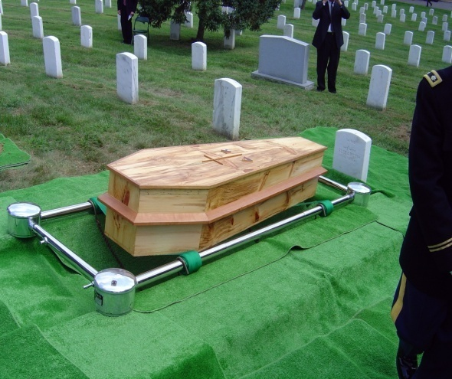

Three Deaths
SPIRITUAL
MORTAL
JUDICIAL
Separation
From God
Death of our bodies
Life payment
for sin
Result of individual sin
Result of Adam and Eve’s first sin
Required of every sinner
“The wages of sin
is death”
Romans 6:23
“for dust you are, and to the dust you shall return.”
Genesis 3:19
“without the shedding of blood there can be no forgiveness of sin”
Hebrews 9:22
Notes:
So, to sum it up, all three of these deaths are a result of God’s justice. The consequences of sin are spiritual death, mortal death, and judicial death. And what is God trying to teach us by this? That sin is bad, it’s really bad. It’s so bad that when we commit sin, we deserve the worst possible punishment imaginable.

Slide 23
God’s Justice Demands
Death as Payment for Sin
We find ourselves in a very desperate situation:
We have broken the laws of the God of the universe, this has separated us from a Holy God, and the price of death hangs over our head by a just God! We cannot pay the price ourselves and still live!
Notes:
And this places us in a terrible and desperate predicament. And if the only side of God’s holiness we had to contend with was His justice, we would be in a hopeless situation because we would be lost for eternity with no price to be paid for our sin but our own personal life.

Slide 24
God’s Love Provides a Way to Pay the Price
LIFE!
GRACE
God gives
what is not deserved
(Romans 3:23-26; 5:6-11)
God does not give
what is deserved
(Romans 1:18)
DEATH!
MERCY
Notes:
But there is another side to God’s holiness and that is His love. God loves us and wants a relationship with us. But He cannot just wink at sin because He is also a God of justice and therefore demands the proper punishment be paid. And so, through His love, He provides both grace and mercy. Grace is when God gives us something we don’t deserve (which is life), and mercy is when He doesn’t give us what we do deserve (which is death).

Slide 25
MERCY
BLOOD
Notes:
And in the OT, we see God’s love for us demonstrated through the blood of animals. Animals are innocent creatures and do not sin. And so, in the OT, animals were sacrificed on the alter to represent the death of the sinner making the offering. In other words, the animal paid the price owed by the sinner, which is life.

Slide 26

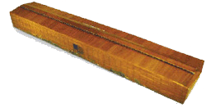
Atonement
Kaphar: to cover, purge, make an atonement, make reconciliation, cover over with pitch
Notes:
This is where we get the idea of atonement. Atonement means to “cover”. When Noah covered the ark with pitch, it is from the same root word as atonement. Atonement allows for reconciliation because when the animal was sacrificed, sins were covered and removed.

Slide 27
Atonement
“...for it is on this day that atonement shall be made for you to cleanse you; you will be clean from all your sins before the LORD” Lev 16:30
SANCTIFICATION
RECONCILIATION
Notes:
This leads to “sanctification”. Once sins were removed by the blood of the innocent animal, that person was made holy or sanctified. And when they were made holy, their relationship with God was restored which is what we call “reconciliation”. The animal took the place of the sinner and atonement was made.

Slide 28
Atonement
Leviticus 17:11
'For the life of the flesh is in the blood, and I have given it to you on the altar to make atonement for your souls; for it is the blood by reason of the life that makes atonement.'
Notes:
This is where we get the term “blood atonement”. It is really life atonement because Lev 17:11 tells us that the life of the flesh is in the blood. And so when animal blood was shed, it was by means of life.

Slide 29
Payment
REPRESENTS
BLOOD
LIFE
ATONES FOR
Innocent LIFE
SINNER
REPRESENTS
Guilty LIFE
Innocent LIFE
Heb 9:22 …without the shedding of blood there can be no forgiveness
Notes:
So, let’s review the payment of sin: blood represents life, that is innocent life, which then atones for the sinner. And so, what happened in animal sacrifice is the animal’s blood represents the guilty life.

Slide 30
BLOOD ATONEMENT
(Judicial Death)
RESULTS IN
SANCTIFICATION
(Sins Removed – Made Holy)
RESULTS IN
JUSTIFICATION
(Penalty Removed)
RESULTS IN
RECONCILIATION
(Spiritual Relationship with a Holy God Restored)
Notes:
Here is the whole process: in the OT, blood atonement produced sanctification which then results in justification, which then results in reconciliation with God.

Slide 31

Animal Sacrifice
SINS
(FIGURATIVE)
JUSTICE
JUDICIAL
DEATH
MERCY
REPRESENTATIVE DEATH
INNOCENT SACRIFICE
SINNER
SANCTIFIED
DEATH
Notes:
Here’s a visual of how this worked in animal sacrifice: we have a sinner who is spiritually dead and separated from God. The animal is then killed in his place on the alter, paying the price for sin. The animal’s death represents the sinner’s death, so it is as if the sinner has died himself. As a result of the sinner’s representative death, his sins are removed, and he is sanctified or made holy and therefore reconciled again to God. Animal sacrifices in the OT represented God’s justice because the price for sin was paid. But it also represented God’s love through His mercy because He allowed the sinner to live and have his relationship with God restored. This was an incredible plan in the OT that could not have been dreamed up by mankind.

Slide 32

What Made Animal Sacrifice Work?
FAITH
Notes:
Let us dig deeper. What made animal sacrifice work? Let me give two illustrations. Imagine a person living under the OT needed to offer an animal sacrifice but it was raining outside and he lived far away from the alter. Could this person merely believe in animal sacrifice w/o actually offering the animal and therefore receive atonement for his sins? No, this person had to also obey. And so faith w/o obedience would not provide atonement.
But what if a person did offer animal sacrifices according to the OT law, but the reason he did it was because all of his ancestors before him did it, but he didn’t understand why he had to do it? Would the obedience w/o faith save this man? No, this person had to have faith as well as obey. What made animal sacrifice work was faith and obedience together. It’s like going to the doctor. If we believe the doctor when he tells us we are sick, we’ll also take the medicine prescribed. We don’t just look at the medicine and believe it has healing power. Likewise, in the OT, when the sinner understood what God instructed him, he believed what God instructed and then obeyed what God had instructed.

Slide 33
By Faith…
Abel
Noah
Abraham
Abraham
Sarah
Abraham
Isaac
Israelites
Walls of Jericho
OFFERED
PREPARED
OBEYED
LIVED
CONCEIVED
OFFERED
BLESSED
PASSED THROUGH
ENCIRCLED
ROM. 10:17
Genuine FAITH requires
Belief-based ACTION
Notes:
This is evident all throughout the OT has it pertains to faith. Heb 11 offers many examples of individuals who, by faith, obeyed. By faith, Abel offered a more acceptable sacrifice than Cain. By faith, Noah prepared an ark for the salvation of his household. By faith, Abraham obeyed God by going to a place he was to receive for an inheritance. All of these individuals had in common that God instructed them, they believed, and then they acted upon that belief.

Slide 34
Genuine Faith – Hebrews 11:6
But without faith it is impossible to please Him, for he who comes to God
must believe that He is, and that He is a rewarder of those who diligently seek Him.
without faith it is impossible
must believe
diligently seek Him.
Genuine FAITH requires
Belief-Based Action!
Notes:
Heb 11:6 is a good definition of faith. We are told that w/o faith it is impossible to please God and that those who come to God must believe that He is and that He is a rewarder of those who diligently seek Him. Notice the two components of saving faith – belief and action. Actually, true bible faith is belief-based action.

Slide 35
What is Saving Faith?
WORKS ALONE
(Obedience)
HEBREWS 11
BELIEF
ALONE
(Heart)
Action, Based upon Belief
(Obedience, From the Heart)
“What good is it, my brothers, if a man claims to have faith but has no deeds?
Can such faith save him?”
James 2:14
Notes:
We see these two components of faith illustrated very well in the book of James. James was the first NT book to be circulated among all the churches and it dealt with a misconception some Christians had that they were saved by faith alone. Jas 2:14 asks if a man claims to have faith but has no works, can that faith save him? And the answer to this rhetorical question is “no”. True faith requires both the heart and obedience.

Slide 36
BELIEF ALONE? (James 2:14-26)
(v14) Can that type of faith save a man?
(v17) Faith without action is dead
(v18) Faith is shown by action
(v20) Faith without action is “useless”
(v21-23) Abraham’s faith was perfected by belief working with his actions
(v24) Justified by action, not “faith alone”
(v26) Faith without action is dead
(v19) Devils are believers!
THERE ARE BELIEVERS IN HELL!
Notes:
This is really illustrated all throughout Jas 2. Vs. 19 even reveals to us that the demons also believe. When one acts by faith, he is not earning anything anymore than the person who offered the animal sacrifice in the OT earned his salvation. This was a plan comprised by God and solely due to His grace and mercy and therefore man could not claim any merit whatsoever.

Slide 37
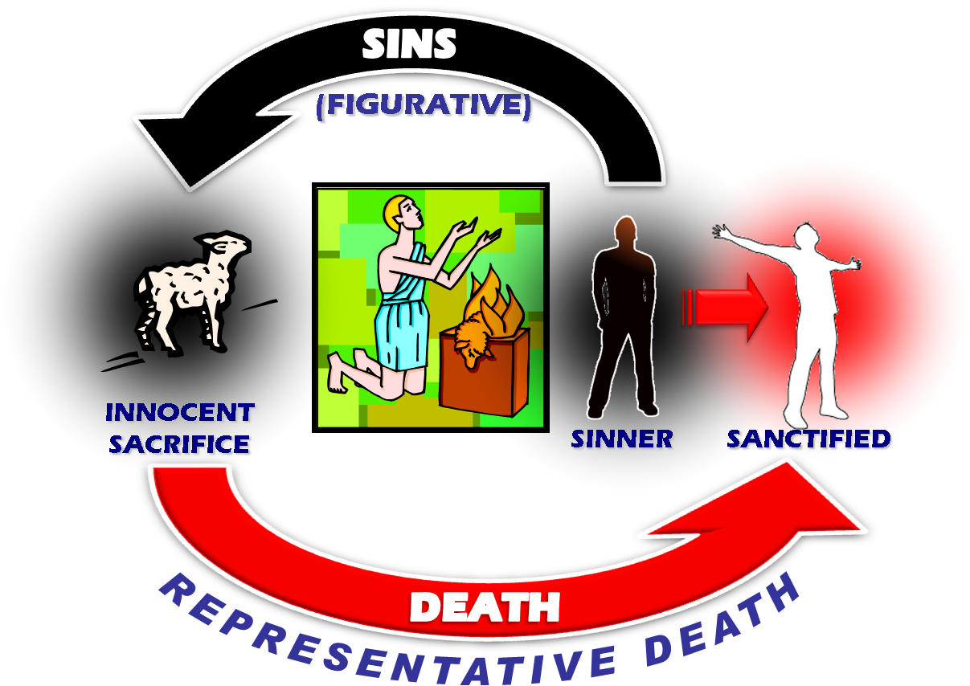
The OT “Teacher”
SACRIFICE
SIN
HOLINESS
GRACE
FAITH
TEACHER
Gal 3:24
ATONEMENT
JUSTICE
MERCY
REDEMPTION
RECONCILIATION
BLOOD
REPRESENTATIVE
DEATH
SANCTIFICATION
Notes:
And so, to summarize the fundamentals that the OT teaches, we learn that God is holy and through this holiness He demonstrates His justice and His love. Our sin prevents us from having fellowship with God and therefore He introduced animal sacrifice solely as an instrument of his grace and mercy. The blood of the animal was a representative death that provided atonement so that they might be sanctified, redeemed, and then reconciled back to God. And what made animal sacrifice work was faith. This system lasted for over a thousand years and millions of animals were killed under this sacrificial system. But it was a temporary system that could not ultimately take care of the problem of sin.

Slide 38
“Behold the
LAMB OF GOD
that
takes away the sin of the world”
Notes:
And so the time arrived where God would send someone to earth to ultimately accomplish God’s full purpose. John the Baptist sees Jesus Christ approaching and announces Him publicly for the first time in John 1:29. “Behold the Lamb of God that takes away the sin of the world.” Jesus was God’s ultimate sacrifice to take care of sin once and for all. Jesus did not die an accidental death as some claim; it was His purpose to come to earth and to die. This also tells us why Jesus never sinned. If He had committed even one sin, He couldn’t have been the Lamb of God because He would have had the same price on His head as you and I. But because He was sinless, He was qualified to be the Lamb of God.

Slide 39

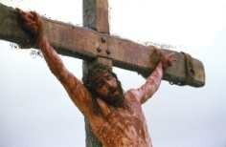
Christ’s Blood in Prophecy
Isaiah 53
1400 BC
750 BC
0 AD
30 AD
First five books of Bible written
Jesus’ Birth
Jesus’ Death
Isaiah’s Prophecy written
750 years before Christ!
Notes:
1

Slide 40
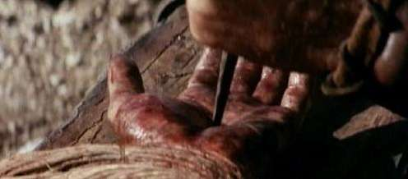
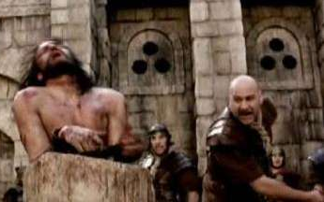

Christ’s Blood in Prophecy
Isaiah 53 – 750 years before Christ!
5 He was pierced through for our transgressions, He was crushed for our iniquities; The chastening for our well-being fell upon Him, And by His scourging we are healed.
All of us like sheep have gone astray, Each of us has turned to his own way; But the LORD has caused the iniquity of us all To fall on Him.
8 He was cut off out of the land of the living For the transgression of my people, to whom the stroke was due
10 But the LORD was pleased To crush Him, putting Him to grief; the Righteous One, My Servant, will justify the many, As He will bear their iniquities.
12 He poured out Himself to death, And was numbered with the transgressors; Yet He Himself bore the sin of many, And interceded for the transgressors.
Notes:
1

Slide 41
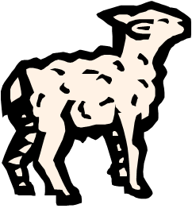
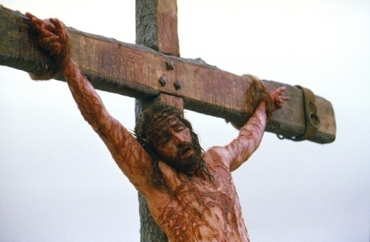
The Lamb of God - Ransomed
Mt. 20:28
the Son of Man did not come to be served, but to serve, and to give His life a ransom for many
Mt. 26:28
for this is My blood of the covenant, which is poured out for many for forgiveness of sins.
1 John 3:5
But you know that he appeared so that he might take away our sins. And in him is no sin.

Slide 42


Christ’s Sacrifice – OT Fulfillment
1 Peter 1:18-19
you were redeemed with precious blood, as of a lamb unblemished and spotless, the blood of Christ.
Matthew 5:17
"Do not think that I came to abolish the Law or the Prophets; I did not come to abolish but to fulfill.
Heb 9:22 …without the shedding of blood there is no remission.

Slide 43
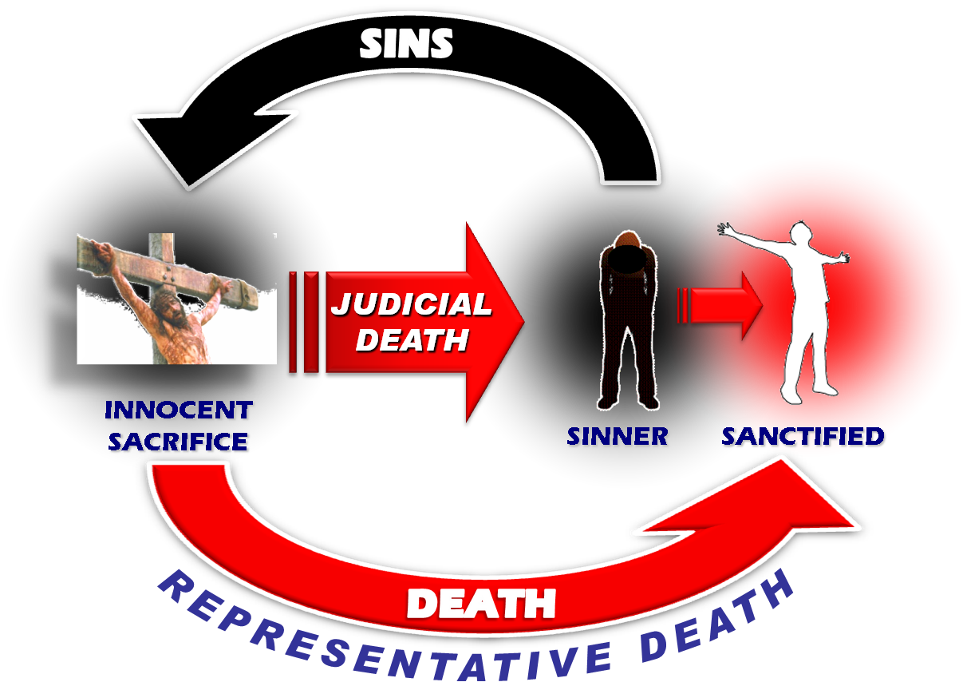
Christ’s Sacrifice – A Judicial Death
1 Peter 2:24
He Himself
bore our sins
in His body
on the cross,
that we might die to sin.
Heb 9:22 …without the shedding of blood there can be no forgiveness

Slide 44
Christ’s Sacrifice – Removes Sin
Romans 6:6
Our old self was crucified with Him,
That our body of sin might be done away with.
Heb 9:22 …without the shedding of blood there can be no forgiveness

Slide 45
Christ’s Sacrifice - Reconciliation
Colossians 1:22
But now he has reconciled you by Christ's physical body through death to present you holy in his sight, without blemish and free from accusation
Also
Hebrews 13:12
Hebrews 10:10
Heb 9:22 …without the shedding of blood there can be no forgiveness

Slide 46
Propitiation – By Faith
Romans 3:23-25
for all have sinned, and fall short of the glory of God; being justified freely by his grace through the redemption that is in Christ Jesus: whom God set forth to be a propitiation, through faith, in his blood...
Heb 9:22 …without the shedding of blood there can be no forgiveness
Notes:
<TR> Who died?

Slide 47
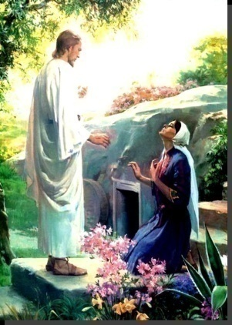
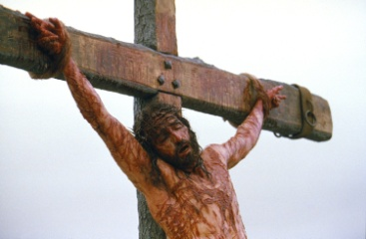
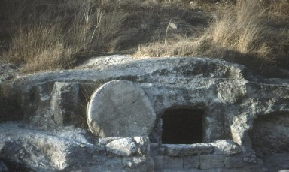
RESURRECTION!
“…who [Christ],
was declared the Son of God
with power by the resurrection
from the dead…” Romans 1:4
RESURRECTION
DEATH & BURIAL
& APPEARANCES!

Slide 48
Christ’s Sacrifice – Who Died?
1 Peter 2:24
He Himself bore our sins in His body on the cross, that we might die to sin.
1 Peter 1:18-19
you were redeemed with precious blood, as of a lamb unblemished and spotless, the blood of Christ.
Romans 6:6
Our old self was crucified with Him,
That our body of sin might be done away with.
Jesus Died
literally on the cross to pay the judicial price for our sin.
The Sinner Died
representatively through Jesus, thus paying our judicial price for sin.
Heb 9:22 …without the shedding of blood there can be no forgiveness

Slide 49
The Death of the Believer
2 Tim 2:11 “If we died with him, we will also live with him”
Gal 2:20 “I have been crucified with Christ…”
2 Cor 5:14 “one died for all, therefore all died.”
Christ’s death represents the death of the believer!
Heb 9:22 …without the shedding of blood there can be no forgiveness
Notes:
Notice these are things written by Christians referring to a point in time in the past where they died with Christ (past tense)

Slide 50
Our sins can not and will not be forgiven
UNLESS:
We have died with Christ
We have been united with Christ in His death
We have been crucified with Christ
We have died to sin
This is according to the plan of redemption for “without the shedding of blood there is no forgiveness of sins.”
Notes:
Whew all this death – the death of the believer!

Slide 51
The fundamental question of the gospel is:
When?
Or How?
At what point in my faith . . .
do I die to sin ?
do I die with Christ ?
When does God view me as . . .
uniting with Christ in his death?
crucified with Christ ?
Notes:
Now if you ask this to people today you get a lot of different answers. Why? Different gospels. Believe? (James says No) Pray?
Do you suppose that God would put in place the scheme of redemption and have millions of animals killed over thousands of years just to prepare the way for His son (the Lamb of God) and then have Christ go through the anguish, suffering, and cruel death on the cross – to die in my place – and then leave us in confusion as to where Christ’s death became mine! Can you believe it.
The confusion doesn’t come from God. It comes from man.
We need a Bible answer, not an answer based on human reasoning, tradition, or human emotion. We want God to answer the question and we want to accept His answer.
<TR> Let’s go to the book

Slide 52
We must have a Bible answer to our four questions!
ROMANS 6
“What shall we say, then? Shall we go on sinning so that grace may increase? By no means!
We died to sin;
How can we live in it any longer?
V 1-2
We died to sin.
“We died to sin.” …. How?/When?

Slide 53
v3 Or don’t you know
that all of us who have been
baptized into Christ Jesus
baptized into His death?
have been
INTO CHRIST
INTO HIS DEATH

Slide 54
v4 Therefore we have been buried with Him through baptism into death, in order that as Christ was raised from the dead through the glory of the Father, so we too might walk in newness of life.
INTO DEATH
NEW LIFE
NEW BIRTH
NEW CREATION
Jn. 3:5
2 Cor. 5:17

Slide 55
5 For if we have become
united with Him
in the likeness of His death, certainly we shall be also in the likeness of His resurrection,
INTO DEATH
NEW LIFE
United with
Christ’s Death

Slide 56
6 knowing this, that our
old self was crucified with Him, that our body of sin
might be done away with,
that we should no longer be slaves to sin;
INTO DEATH
NEW LIFE
United with
Christ’s Death

Slide 57
7 for he who has died is
freed from sin
JUDICIAL
DEATH
INTO DEATH
NEW LIFE
United with
Christ’s Death

Slide 58
8 Now if we have
died with Christ,
we believe that we shall also
live with Him…
INTO DEATH
NEW LIFE
United with
Christ’s Death

Slide 59
10 For the death that He died,
He died to sin, once for all; but the life that He lives, He lives to God.
INTO DEATH
NEW LIFE
JUDICIAL
DEATH
United with
Christ’s Death

Slide 60
10 For the death that He died,
He died to sin, once for all; but the life that He lives, He lives to God.
11 In the same way count yourselves to be dead to sin,
but alive to God in Christ Jesus
INTO DEATH
NEW LIFE
JUDICIAL
DEATH
United with
Christ’s Death
1 Pet. 2:24

Slide 61
12 Therefore do not let sin reign in your mortal body that you should obey its lusts,….
INTO DEATH
REPENTANCE
NEW LIFE
United with
Christ’s Death
Notes:
You’ve just been cleaned up. Don’t go out and get dirty again!
Jay Reynolds, old navy man trying to quit smoking. Tried money, behavioral conditioning, gum, nicotine patches, you name it. Nothing worked. One day he goes to the doctor for a checkup. He lingers outside and has a smoke. Goes in and the doctor forund a spot on his lungs. He walked out and never touched another cigarette. He changed his mind immediately, dramaticaly. That spot on his lung changed him. What does your spirit look like? Has it been washed in the blood of the lamb and made spotless or is like that lung that is the product of years of smoking? We can do whatever we set our minds to do.

Slide 62
17 But thanks be to God that though you were slaves of sin, you became
obedient from the heart
to that form of teaching to
which you were committed,
INTO DEATH
NEW LIFE
FAITH
United with
Christ’s Death

Slide 63
22 But now having been freed from sin and enslaved to God, you derive your benefit, resulting in sanctification, and the outcome, eternal life.
INTO DEATH
NEW LIFE
HOLY
United with
Christ’s Death

Slide 64
23 For the wages of sin is death, but the free gift of God is eternal life in Christ Jesus our Lord..
INTO DEATH
GIFT
NEW LIFE
United with
Christ’s Death

Slide 65

ROMANS 6
JUDICIAL DEATH
v2 “We died to sin…”
HEB. 9:22
v3 “baptized into Christ…baptized into his death”
MERCY
v4 “buried with him through baptism into death…a new life.”
REPRESENTATIVE DEATH
v5 “united with Him in the likeness of His death”
JUDICIAL DEATH
v6 “crucified with Him…sin…done away with.”
JUDICIAL DEATH
v7 “he who has died is freed from sin.”
JUDICIAL DEATH
v8 “if we have died with Christ…we shall also live with Him.”
JUDICIAL DEATH
V10-11 “He died to sin… consider yourselves to be dead to sin…”
REPENTANCE
V12 ”Therefore do not let sin reign in your mortal body”
FAITH
v17 “you became obedient from the heart”
HOLY
v22 “you derive your benefit, resulting in sanctification...”
GIFT
v23 “the free gift of God is eternal life in Christ..”

Slide 66


but you were washed,
you were sanctified,
you were justified
in the name of the Lord Jesus Christ
and in the Spirit of our God. 1 Cor. 6:11
BAPTIZED INTO CHRIST
BAPTIZED INTO HIS DEATH
DEAD MAN
RECONCILIATION (Relationship with a Holy God restored)
United with
Christ’s Death –
Died with Christ
CRUCIFIED
WITH CHRIST
(Buried with Christ INTO
His death)
JUSTIFICATION (Penalty removed)
SANCTIFICATION (Sins removed –
made Holy and righteous)

Slide 67
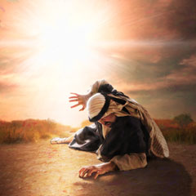
Paul’s Conversion
A Powerful Example of New Testament Conversion
Saul on the road to Damascus–
Already a God fearing man
Believed -
“What shall I do,...”
Confessed -
“What shall I do, Lord?”
Obeyed –
“Get up and go into Damascus”
Fasted –
“three days… and neither ate nor drank”
Prayed –
“for he is praying” (definitely a “sinner’s prayer”)
Notes:
Baptism is not the gospel – it is part of the gospel because it is the rsponse to the gospel
Man began to treat baptism as gospel – I came to preach gospel not to baptize

Slide 68
Paul’s Conversion
Repented for 3 Days
After all of these acts of repentance
Paul was commanded:
Now why do you delay? Get up and
be baptized, and wash away your sins, calling on His name.'
Acts 22:16
be baptized, and wash away your sins,
Notes:
Baptism is not the gospel – it is part of the gospel because it is the rsponse to the gospel
Man began to treat baptism as gospel – I came to preach gospel not to baptize

Slide 69
The Power of Jesus’ Last Command
What Jesus Taught
The Great Commission –
“Go into all the world and
preach the gospel to all creation.
He who believes and is baptized shall be saved;
but he who has not believed
shall be condemned.
Mark 16:15-16
Notes:
Let’s complete the command of Christ…
This is exactly what we see the apostles carrying out in Acts

Slide 70
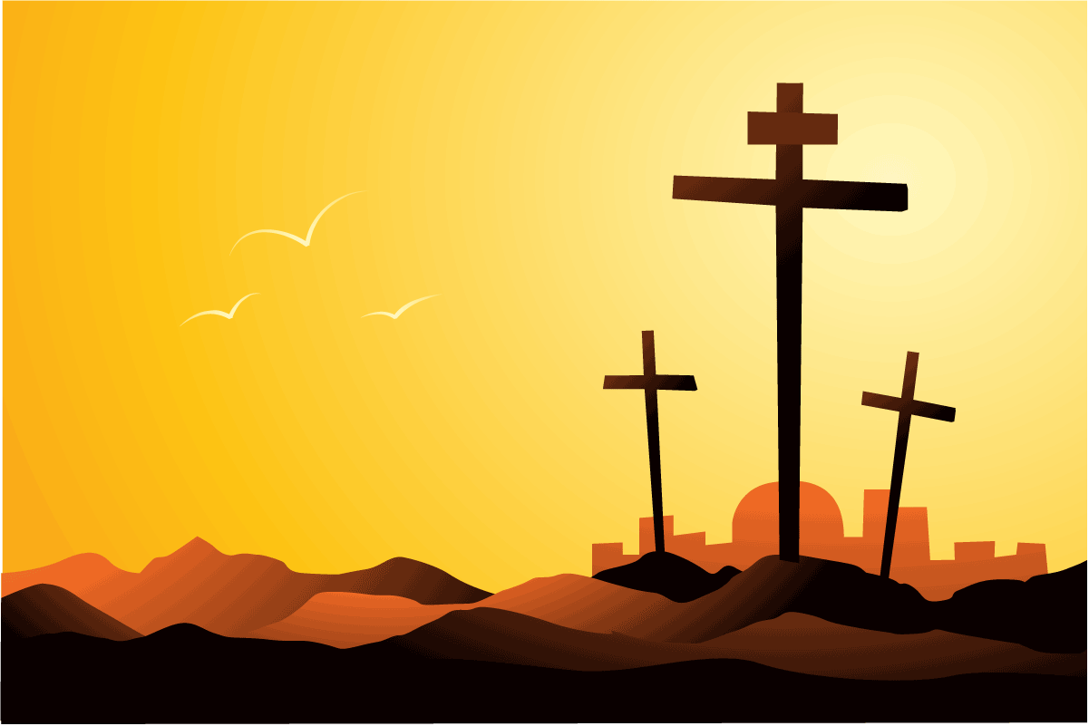
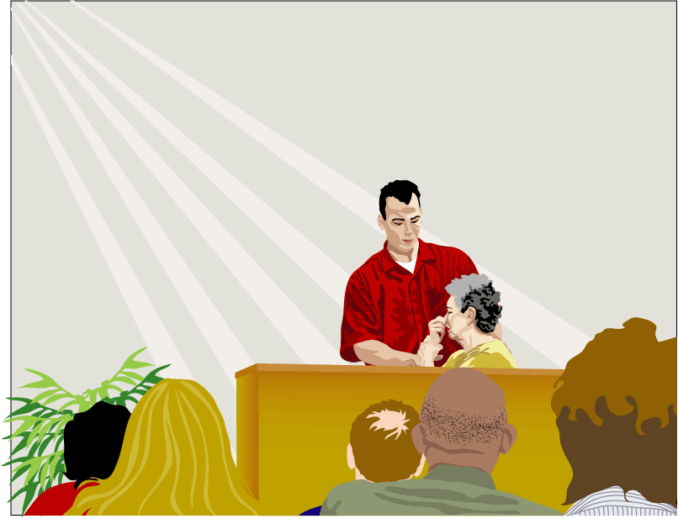
Have you died with Christ?
Notes:
Won’t you accept the promise and gift of God’s son today? And be baptized for the remission of your sins by faith in the blood of Christ.
If you believe in Christ and have faith in His blood, and are willing to repent of your sins and confess His name… then you are ready to die with Him and have your sins removed, and enter His kingdom and live a life of faithful loving obedience to Christ as king and have every confidence that you will spend eternity in heaven.
But if you reject this gift there will be no hope for you… there is no other basis on which God will forgive sin…nothing but the blood of Jesus.
In the Seychelles a couple of years ago a young man responded to the gospel message and as we were about to immerse him in the Indian Ocean he looked up at me and said, “It is a good day to die.” He got the message. Did you?

Slide 71
University church of Christ
449 North Gay Street
Auburn, AL 36830
http://www.auchurch.com
Evangelists:
Ryan Hasty
ryan.h.hasty@gmail.com
205-249-9041
Larry Rouse
larryrouse@aubeacon.com
334-734-2133

Slide 73

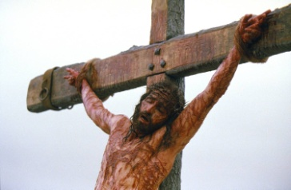
OLD TESTAMENT PERIOD
NEW TESTAMENT PERIOD
PATRIARCHAL
CHRISTIAN
MOSAIC
CREATION
DAY OF JUDGEMENT

Slide 74
Great Commission
Matthew 28:19-20
“Therefore go and make disciples of all the nations
baptizing them
baptizing them in the name of the Father and the Son and the Holy Spirit,
HOW?
teaching them
teaching them to observe all that I commanded you; and surely I am with you always, even to the end of the age."
The basis for following Apostolic authority for all work and worship in the kingdom

Slide 75
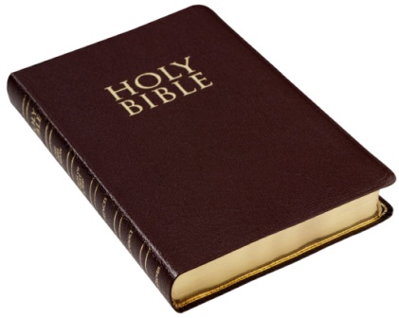
What the Apostles Taught:
The testimony of the epistles
Gal. 3:22-27 Justified by faith…How/When?
Col. 2:1-12 Raised up with Christ…How/When?
Through what?
1 Pet. 3:21 Baptism saves…How?
Eph. 5:25-27 Church is sanctified…How/When?
Eph. 4:3-6 Why is baptism on this list?...
How many baptisms are there?

Slide 76
What the Apostles Actually Practiced:
The power of actual historical examples
Acts 2:36-37 What should we do?
Acts 8:35-39 Preaching the gospel of Jesus
Acts 8:5-13 Preaching Christ in Samaria
Acts 9 & 22 The conversion of Saul

Slide 77
What the Early Church Taught and Practiced:
The teachings and practice of those often trained and taught either directly by the apostles or their followers
Epistle of Barnabas (70 ad)
“Blessed are they who, placing their trust in the cross, have gone down in the water…We indeed descend into the water full of sins and defilement. However, we come up, bearing fruit in our heart, having the fear of God and the trust of Jesus in our spirit.”
The Epistle of Barnabas, Chapter 11, Roberts-Donaldson

Slide 78
What Jesus Taught:
The power of Jesus’ own words
“And Jesus came up and spoke to them, saying, "All authority has been given to Me in heaven and on earth. Go therefore and make disciples of all the nations, baptizing them in the name of the Father and the Son and the Holy Spirit, teaching them to observe all that I commanded you; and lo, I am with you always, even to the end of the age.“
Mt. 28:19-20
See also:
John 3:3-5 Must be born again…How?
Mt. 28:19-20 Make disciples…How?
believes and is baptized

Slide 79
OLD TESTAMENT PERIOD
NEW TESTAMENT PERIOD
PATRIARCHAL
CHRISTIAN
MOSAIC
CREATION
DAY OF JUDGEMENT

