Slide 2
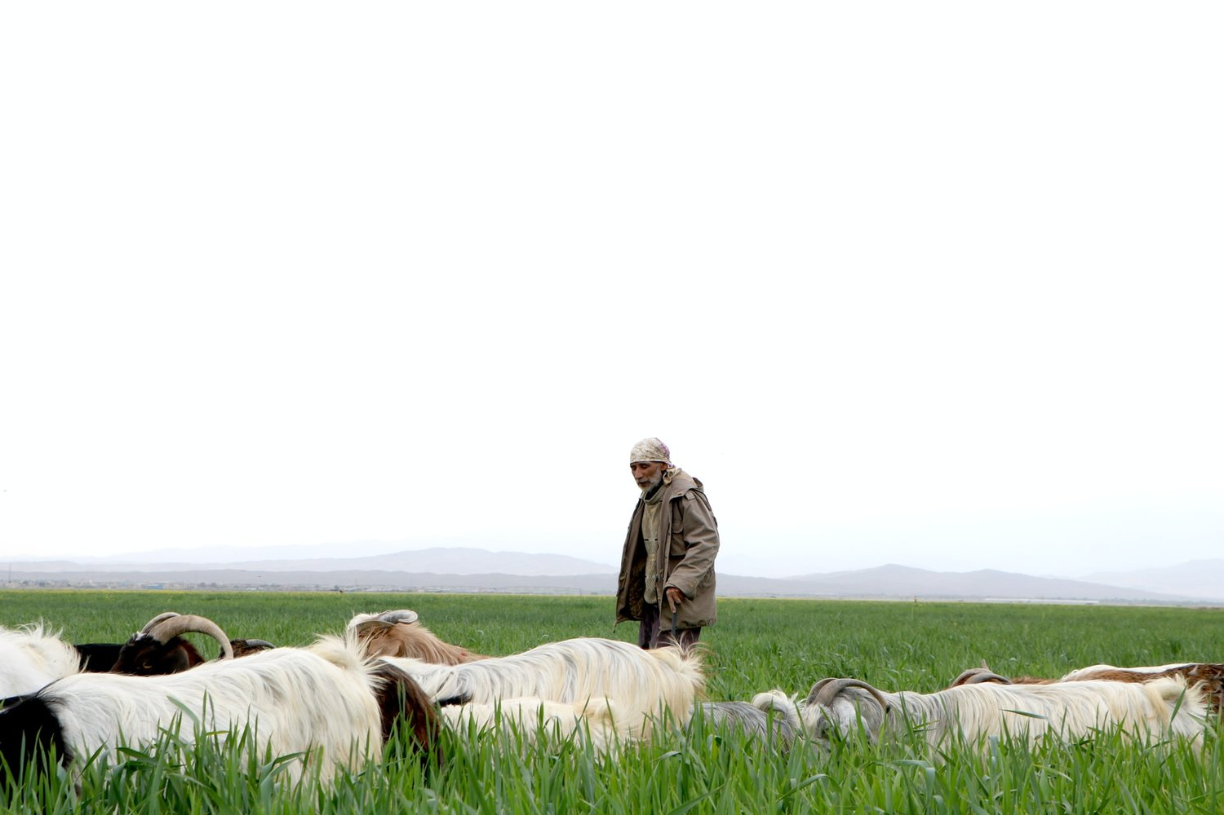
The Work of Elders

Slide 3
Feed the flock
Ezek 34:1-3; Acts 20:28; 1 Tim 3:2; 5:17-18
Guard & Protect
Acts 20:29-31; Tit 1:9b; Ezek 34:4a; Jude 22-23
An Example
Matt 5:14-16; 20:25-26; 1 Pet 5:3;Ezek 34:4b
Watch Our For Souls
Ezek 34:4b-6; Heb 13:17

