Slide 1
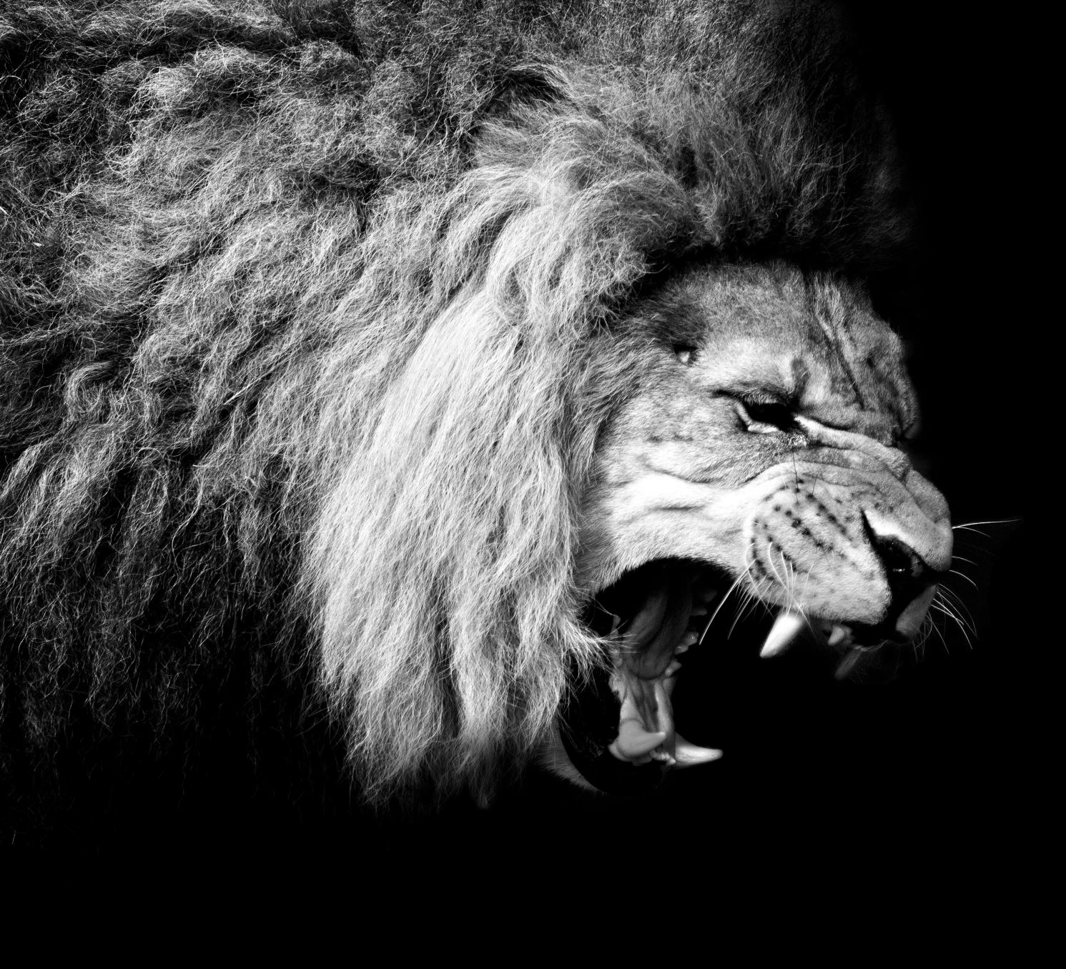
The Kings of Judah

Slide 2
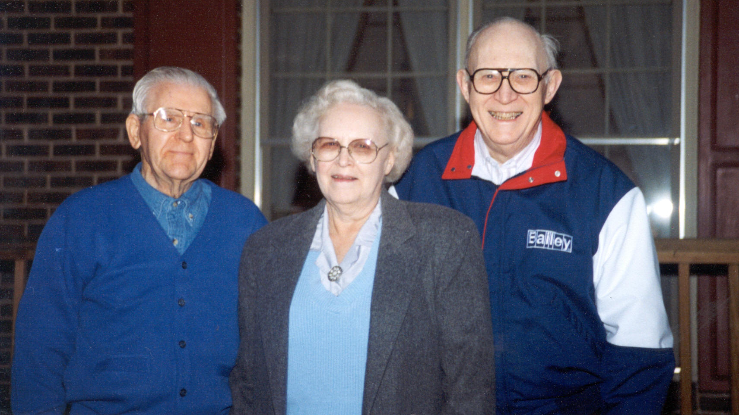

Slide 3
joash
MAKING YOUR FAITH YOUR OWN

Slide 4
The power of a godly mentor
Joash was seven years old when he began to reign, and he reigned forty years in Jerusalem. His mother's name was Zibiah of Beersheba. 24:1
And Joash did what was right in the eyes of the Lord all the days of Jehoiada the priest. 24:2
After this Joash decided to restore the house of the Lord. 24:4

Slide 5
The power of a godly mentor
And he gathered the priests and the Levites and said to them, “Go out to the cities of Judah and gather from all Israel money to repair the house of your God from year to year, and see that you act quickly.” 24:5
And all the princes and all the people rejoiced and brought their tax and dropped it into the chest until they had finished. 24:10

Slide 6
The power of a godly mentor
So those who were engaged in the work labored, and the repairing went forward in their hands, and they restored the house of God to its proper condition and strengthened it. 24:13

Slide 7
The impact of ungodly influences
Now after the death of Jehoiada the princes of Judah came and paid homage to the king. Then the king listened to them. 24:17
And they abandoned the house of the Lord, the God of their fathers, and served the Asherim and the idols. And wrath came upon Judah and Jerusalem for this guilt of theirs. 24:18
Yet he sent prophets among them to bring them back to the Lord. These testified against them, but they would not pay attention. 24:19

Slide 8
The impact of ungodly influences
But they conspired against him, and by command of the king they stoned him with stones in the court of the house of the Lord. Thus Joash the king did not remember the kindness that Jehoiada, Zechariah's father, had shown him, but killed his son. And when he was dying, he said, “May the Lord see and avenge!” 24:21-22

Slide 9
The impact of ungodly influences
Though the army of the Syrians had come with few men, the Lord delivered into their hand a very great army, because Judah had forsaken the Lord, the God of their fathers. Thus they executed judgment on Joash. 24:24

Slide 10
The impact of ungodly influences
When they had departed from him, leaving him severely wounded, his servants conspired against him because of the blood of the son of Jehoiada the priest, and killed him on his bed. 24:25
So he died, and they buried him in the city of David, but they did not bury him in the tombs of the kings. 24:25

Slide 11
application
Give thanks for godly influences
Practice obedience in isolation
Pray for a pure heart
Identify driving influences
Gauge level of sincerity

