Slide 1
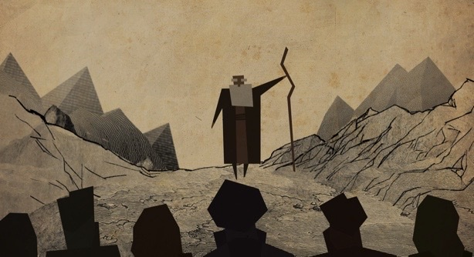
Heroes of Faith: Moses
Hebrews 11:23-28

Slide 2
Life of Moses
Moses in a basket. Exodus 2:3-10
Death of an Egyptian. Exodus 2:11-22
Burning bush. Exodus 3:1-3
Slaves agree to follow Moses. Exodus 7:8-13
Parting of the Res Sea. Exodus 14:1-31
Water for the thirsting Hebrews. Exodus 17:1-7
Communing with God and receiving the Ten Commandments. Exodus 19-20
Stone tablets were destroyed, and God's anger was revealed. Exodus 32:1-35

Slide 3
Exodus 32:9-14
9 And the Lord said to Moses, “I have seen this people, and behold, it is a stiff-necked people.
10 Now therefore let me alone, that my wrath may burn hot against them and I may consume them, in order that I may make a great nation of you.”
11 But Moses implored the Lord his God and said, “O Lord, why does your wrath burn hot against your people, whom you have brought out of the land of Egypt with great power and with a mighty hand?
12 Why should the Egyptians say, ‘With evil intent did he bring them out, to kill them in the mountains and to consume them from the face of the earth’? Turn from your burning anger and relent from this disaster against your people.
13 Remember Abraham, Isaac, and Israel, your servants, to whom you swore by your own self, and said to them, ‘I will multiply your offspring as the stars of heaven, and all this land that I have promised I will give to your offspring, and they shall inherit it forever.’”
14 And the Lord relented from the disaster that he had spoken of bringing on his people.

Slide 4
Life of Moses continued...
Moses receives the Ten Commandments anew. Exodus 34:1-35
Ark of the Covenant instructions. Exodus 25:10-22 and 37:1-9
Tabernacle was completed. Exodus 39:32-43
Moses and the people were wondering because of their disbelief. Numbers 13:1-33; Numbers 14:33-34

Slide 5
Numbers 20:10-12
10 Then Moses and Aaron gathered the assembly together before the rock, and he said to them, “Hear now, you rebels: shall we bring water for you out of this rock?”
11 And Moses lifted up his hand and struck the rock with his staff twice, and water came out abundantly, and the congregation drank, and their livestock.
12 And the Lord said to Moses and Aaron, “Because you did not believe in me, to uphold me as holy in the eyes of the people of Israel, therefore you shall not bring this assembly into the land that I have given them.”

Slide 6
Life of Moses continued...
Healing the snake bitten. Numbers 21:4-9
Promise Land. Deuteronomy 32:49–52
Death of Moses. Deuteronomy 34:1-12

Slide 7
Hebrews 11:23-28
23 By faith Moses, when he was born, was hidden for three months by his parents, because they saw that the child was beautiful, and they were not afraid of the king's edict. 24 By faith Moses, when he was grown up, refused to be called the son of Pharaoh's daughter,25 choosing rather to be mistreated with the people of God than to enjoy the fleeting pleasures of sin. 26 He considered the reproach of Christ greater wealth than the treasures of Egypt, for he was looking to the reward. 27 By faith he left Egypt, not being afraid of the anger of the king, for he endured as seeing him who is invisible.28 By faith he kept the Passover and sprinkled the blood, so that the Destroyer of the firstborn might not touch them.

Slide 8
By Faith Moses...
11:23
Was Hidden.

Slide 9
By Faith Moses...
11:23
Was Hidden.
11:23-25
Refused.

Slide 10
By Faith Moses...
11:23
Was Hidden.
11:23-25
Refused.
11:27
Left Egypt.

Slide 11
By Faith Moses...
11:23
Was Hidden.
11:23-25
Refused.
11:27
Left Egypt.
Kept the Passover.
11:28

