Slide 1
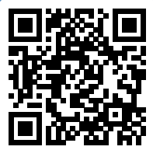
Please take a moment to complete this week’s survey.
For we are his workmanship, created in Christ Jesus for good works, which God prepared beforehand, that we should walk in them.
Ephesians 2:10

Slide 2
Good Works
Class 3 – Redeeming the Time
“…The Good Portion…”

Slide 3
38 Now as they went on their way, Jesus entered a village. And a woman named Martha welcomed him into her house. 39 And she had a sister called Mary, who sat at the Lord's feet and listened to his teaching.
Luke 10:38-39

Slide 4
40 But Martha was distracted with much serving. And she went up to him and said, “Lord, do you not care that my sister has left me to serve alone? Tell her then to help me.” 41 But the Lord answered her, “Martha, Martha, you are anxious and troubled about many things, 42 but one thing is necessary. Mary has chosen the good portion, which will not be taken away from her.”
Luke 10:40-42

Slide 5
15 See then that you walk circumspectly, not as fools but as wise, 16 redeeming the time, because the days are evil. (NKJV)
Ephesians 5:15–16

Slide 6
15 Look carefully then how you walk, not as unwise but as wise, 16 making the best use of the time, because the days are evil. (ESV)
Ephesians 5:15–16

Slide 7
“Are you a wondering generality,
Or a meaningful specific?”
- Zig Ziglar

Slide 8
Show me how you spend your day,
And I will show you your priorities.
Or lack of them…

Slide 9
Intentional

Slide 10
According to DigitalMarking.org,
people spend almost
2 and ½ hours
each day on Social Media

Slide 11
Time Spent on Social Media by Age
Age Group | Average Time Spent on Social Media per Day (2022)
16-24 | 5 hours and 49 minutes
25-34 | 5 hours and 31 minutes
35-44 | 4 hours and 49 minutes
45-54 | 3 hours and 57 minutes
55+ | 3 hours and 3 minutes
Source: techjury.net

Slide 12
Source: broadbandsearch.net

Slide 13
Too much time on your phone?
For adults, it’s really the wrong question
Content matters, e.g. bible reading, bible study, checking on and encouraging others via text

Slide 14
I have only just a minute, only 60 seconds in it;
forced upon me; can't refuse it;
didn't seek it, didn't chose it.
But it's up to me just how I use it.
I must suffer if I lose it, give account if I abuse it.
Just a tiny little minute, but eternity is in it.
-Unknown

Slide 15
What’s the best use of your time?
Listen to God (reading the bible)
Talk to God (praying to God)
Surround yourself with good influences
Serve others

Slide 16
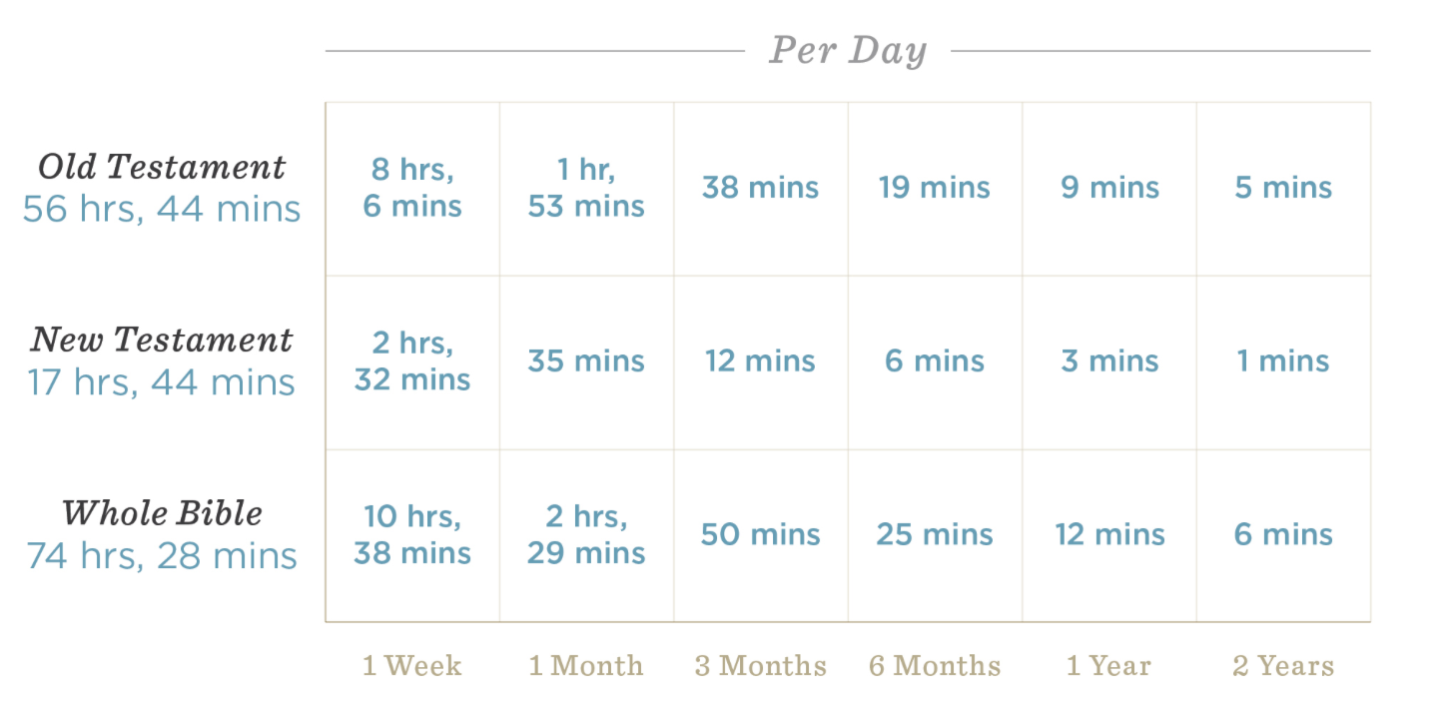
How much time would it take…?

Slide 17
How much time would it take…?

Slide 18
47And if thine eye causes thee to sin, pluck it out. It is better for you to enter the kingdom of God with one eye, rather than having two eyes, to be cast into hell fire
Mark 9:47

Slide 19
47And if thine phone app causes thee to sin, delete it. It is better for you to enter the kingdom of God with no apps, rather than having all the social media apps, to be cast into hell fire
Mark (&Josh) 5-21-2023

Slide 20
Breaking Bad Habits
Journal how you spend your time each week (write it down)
Know your app usage
Delete apps
Time constrain apps with accountability

Slide 21
24 “When an impure spirit comes out of a person, it goes through arid places seeking rest and does not find it. Then it says, ‘I will return to the house I left.’ 25When it arrives, it finds the house swept clean and put in order. 26Then it goes and takes seven other spirits more wicked than itself, and they go in and live there. And the final condition of that person is worse than the first.”
Luke 11:24-26

Slide 22
This week’s challenge 1:
Open your phone and go to Screen Time
Snap a screen shot of your most-used apps and the time spent on them
Let’s try to cut the number of minutes spent on all social media in half.
Conversely, let’s double the amount of time spent in the bible app

Slide 23
This week’s challenge 2:
Take a friend or two to lunch
Give them uninterrupted attention (no phones)

Slide 24
This week’s challenge 3:
Spend one evening with your family, screen-free (a minimum of 3 hours)
Read the bible out loud
Play games
Play bible trivia

Slide 25
Class 3
ⓘ Start presenting to display the poll results on this slide.

Slide 26
Survey Results

