Slide 2
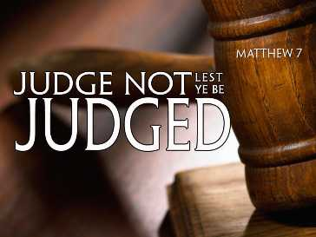

Slide 3
Most Misinterpreted Scripture
Matt 7:1-2 – “Judge not, that ye be not judged. For with what judgment ye judge, ye shall be judged: and with what measure ye mete, it shall be measured unto you.”
Those most ignorant of scripture know this verse
Twisted by many to justify doing whatever they want w/o criticism
All bible verses can be twisted out of context if that is where our heart is inclined – Matt 4:5-6

Slide 5
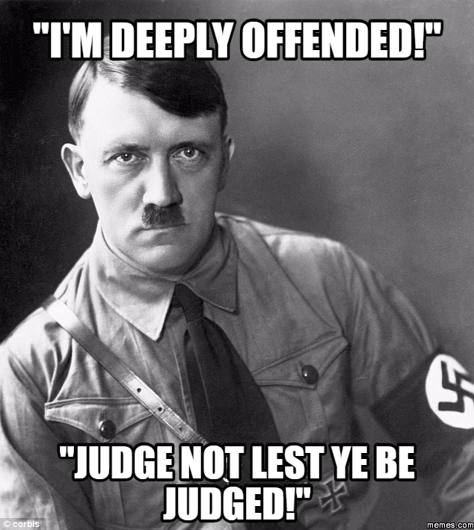
What It Does Not Mean
Does not mean all judgment is forbidden:
Can children say this to parents?
Can students say this to teachers?
Can cadets say this to drill sergeants?
Can athletes say this to coaches?
The hypocrisy: many who misuse this verse are quick to “judge”
“Intolerant”
“Hate Speech”
“Narrow-minded”
“Legalistic”

Slide 6
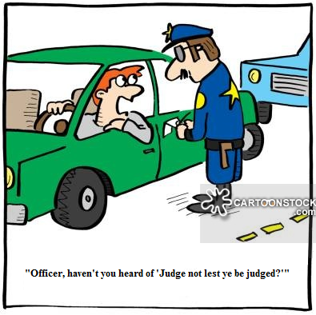
What It Does Not Mean
Does not mean judgment by civil government is wrong
Would you tell a police officer not to judge you for speeding? – Rom 13:1-4
Many, however, will protest up and down the streets against government law for judging their lifestyle as uncivil and judgmental
Government has the right to judge in matter of civil law because it’s been ordained by God that they do so

Slide 7
What It Does Not Mean
Does not mean we cannot judge those within the church
Church Discipline: 1 Cor 5:9-13 – “⁹I wrote you in my letter not to associate with immoral people; ¹⁰I did not at all mean with the immoral people of this world, or with the covetous and swindlers, or with idolaters, for then you would have to go out of the world. ¹¹But actually, I wrote to you not to associate with any so-called brother if he is an immoral person, or covetous, or an idolater, or a reviler, or a drunkard, or a swindler—not even to eat with such a one. ¹²For what have I to do with judging outsiders? Do you not judge those who are within the church? ¹³But those who are outside, God judges. Remove the wicked man from among yourselves.”
Conflict resolution: 1 Cor 6:5 – “ I say this to your shame. Is it so, that there is not among you one wise man who will be able to decide between his brethren”

Slide 8
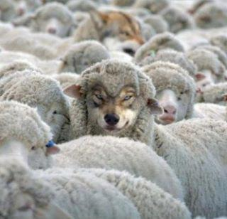
What It Does Not Mean
Does not mean we cannot judge who is teaching false doctrine
Matt 7:15 – “Beware of the false prophets, who come to you in sheep’s clothing, but inwardly are ravenous wolves.”
1 John 4:1 – “Beloved, do not believe every spirit, but test the spirits to see whether they are from God, because many false prophets have gone out into the world.”
How can we do this unless we take what is told and judge it against what the bible teaches?

Slide 9
What It Does Not Mean
Does not mean we cannot judge those who sin against us
Jesus makes it clear that when a brother sins against you, steps must be taken – Matt 18:15-17
Judgements involved:
Did he sin against me?
If so, did he listen to me and repent?
If not, did he listen to the 2 or 3 witnesses?
If not, did he listen to the church?
If not, should we withdraw from him?

Slide 11
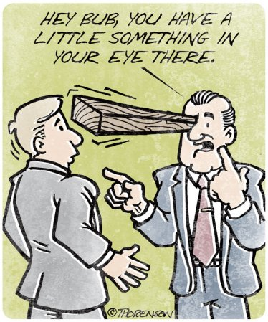
What It Does Mean
Hypocritical Judgment
Matt 7:3-5 – “³Why do you look at the speck that is in your brother’s eye, but do not notice the log that is in your own eye? ⁴Or how can you say to your brother, ‘Let me take the speck out of your eye,’ and behold, the log is in your own eye? ⁵You hypocrite, first take the log out of your own eye, and then you will see clearly to take the speck out of your brother’s eye.”
This is the kind of judging Pharisees liked to do – Matt 23:4, 24, 27-28
Pharisees = Blind Eye Surgeons

Slide 12
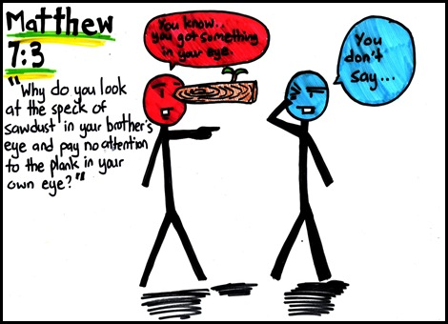
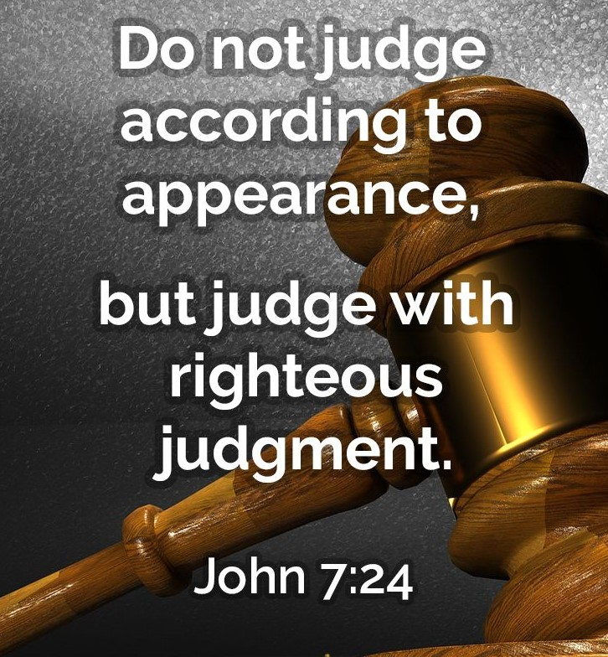
What It Does Mean
Hypocritical Judgment

