Slide 1
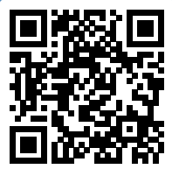
Please take a moment to complete this week’s survey.
For we are his workmanship, created in Christ Jesus for good works, which God prepared beforehand, that we should walk in them.
Ephesians 2:10

Slide 2
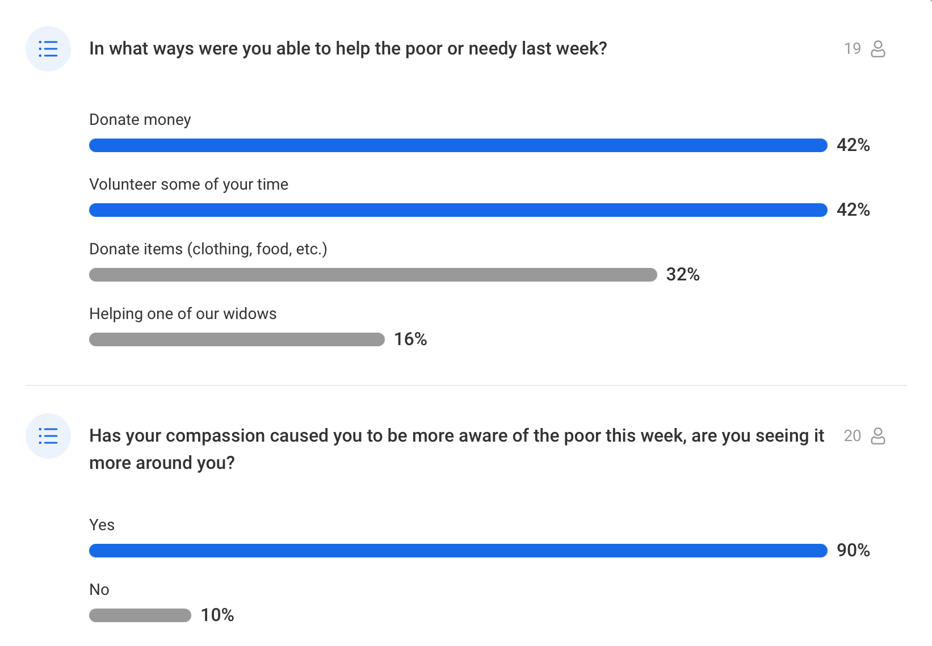

Slide 3
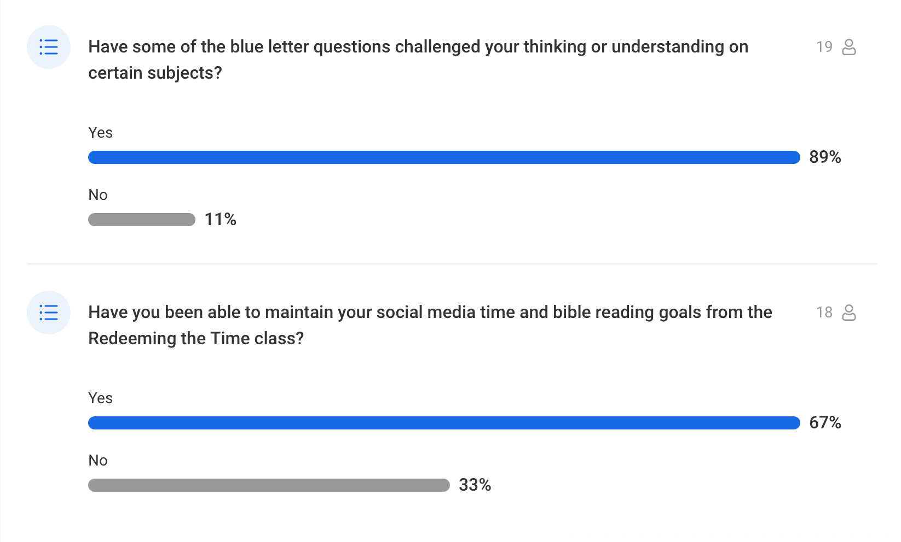

Slide 4
It’s the Little Things

Slide 5
Little things lead to Great Things
David took a small stone and defeated the Philistine’s “giant” hero
Using a piece of scarlet cord, Rahab preserved her entire family from certain death (Joshua 2:18).
“If ye have faith as a grain of mustard seed,” said Jesus, “ye shall say unto this mountain, Remove hence to yonder place; and it shall remove; and nothing shall be impossible unto you.” (Matt. 17:20) All we need is faith that He is Who He says He is, and that He will do as He promises.

Slide 6
Little things lead to Great Things
By the simple act of holding up his hands, Moses helped lead the Israelites to victory (Exodus 17:11).
With the jawbone of a donkey, Samson killed one thousand Philistines and protected his people (Judges 15:16).
By tithing two mites, the poor widow gave all that she had (Mark 12:42-44).
By following a star, the wise men found Jesus (Matt. 2:9).

Slide 7
The Bible is filled with small, seemingly random things, that don’t strike us as all that important –
until God uses them for His glory.

Slide 8
“He that is faithful in that which is least is faithful also in much: and he that is unjust in the least is unjust also in much.”
What does the small thing have to do with the big thing?
Luke 16:10

Slide 9
What does an encourager look like to you?

Slide 10
1 We who are strong have an obligation to bear with the failings of the weak, and not to please ourselves. 2 Let each of us please his neighbor for his good, to build him up. 3 For Christ did not please himself, but as it is written, “The reproaches of those who reproached you fell on me.” 4 For whatever was written in former days was written for our instruction, that through endurance and through the encouragement of the Scriptures we might have hope.
Romans 15: 1-7

Slide 11
5 May the God of endurance and encouragement grant you to live in such harmony with one another, in accord with Christ Jesus, 6 that together you may with one voice glorify the God and Father of our Lord Jesus Christ. 7 Therefore welcome one another as Christ has welcomed you, for the glory of God.
Romans 15: 1-7

Slide 12
Encourage / Welcome…
Widows
Elderly
Students
Socially shy
Spanish-speaking members
Children

Slide 13
What other little things have the potential to make a huge impact on others?

Slide 14
Some more “Little Things”
Share your money
Share your stuff
Share your talents
Share the Word
Just Ask

Slide 15
Some more “Little Things”
Be kind to strangers
Remember someone
Pray for those in need
Share food
Share your time

Slide 16
This Week’s Challenge
Complete the Good Works 5-day Sprint

Slide 17
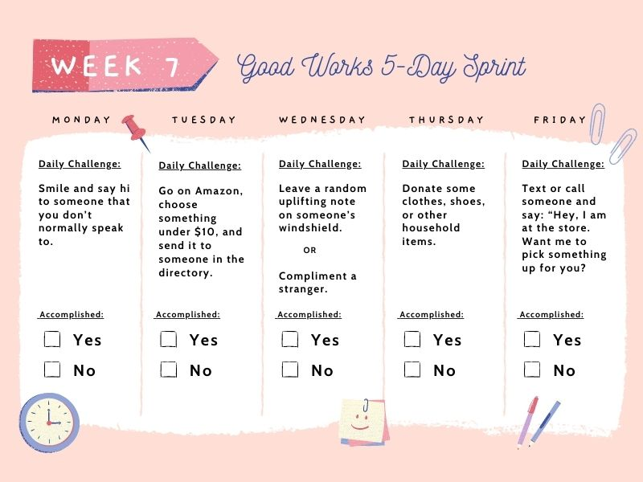

Slide 18
Join the Group!

Slide 19
Survey Results

