Slide 1
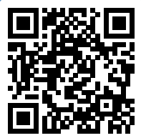
Please take a moment to complete this week’s survey.
For we are his workmanship, created in Christ Jesus for good works, which God prepared beforehand, that we should walk in them.
Ephesians 2:10

Slide 2
Survey Results

Slide 3
(not) To Be Seen of Men

Slide 4
And let us consider how to
stir up one another
to love and good works, not neglecting to meet together, as is the habit of some, but encouraging one another, and all the more as you see the Day drawing near.
Hebrews 10:24-25

Slide 5
How can you believe, when you receive glory from one another and do not seek the glory that comes from the only God?
John 5:44

Slide 6
In the same way, let your light shine before others, so that they may see your good works and give glory to your Father who is in heaven.
Matthew 5:16

Slide 7
“Beware of practicing your righteousness before other people in order to be seen by them, for then you will have no reward from your Father who is in heaven.
Matthew 6:1

Slide 8
3 But when you give to the needy, do not let your left hand know what your right hand is doing, 4 so that your giving may be in secret. And your Father who sees in secret will reward you.
Matthew 6:3-4

Slide 9
What is the difference in
Matthew 5:16 and Matt 6:3?
Let our light shine, or don’t let our left hand know what our right hand is doing?

Slide 10
So also good works are conspicuous, and even those that are not cannot remain hidden.
1 Timothy 5:25

Slide 11
“Good Works Anonymity Scale ”
TM
To be seen of men
Matt 6:1
Known
Let your light shine, Seeking God’s glory
Matt 5:16 & John 5:44
Inconspicuous, but later known
1 Timothy 5:25
Anonymous
Anonymous good works
Matt 6:3-4

Slide 12
Not to be seen of men
In Matthew 6, Jesus identifies the wrong motivation
Giving to be praised 2-4
Praying to be heard 5-8
Fasting to be seen 16-18
Jesus didn’t criticize the action, but rather gives modifications:
“…when you give to the poor”
“…when you pray”
“…when you fast”

Slide 13
sending the brother who is famous among all the churches for his proclaiming the good news; and not only that, but he has also been appointed by the churches to travel with us while we are administering this generous undertaking for the glory of the Lord himself and to show our goodwill
2 Corinthians 8:18-19

Slide 14
And with them we are sending our brother whom we have often tested and found earnest in many matters, but who is now more earnest than ever because of his great confidence in you.
2 Corinthians 8:22

Slide 15
How do I glorify God in my Good Works?

Slide 16
I thank you God for the opportunity to do good and for the ability and means you have blessed me with to perform this work. I pray that the recipient is blessed and feels your hand in their life. I thank you for using me in your kingdom to do works that bring glory to you. All praise and glory be to you! In the name of Jesus, Amen!

Slide 17
There is a difference between doing something that is seen and doing something to be seen.
There’s a difference between serving God and telling people I served God

Slide 18
This Week’s Challenge
Buy a bible (any version, any language) and leave a note on the outside.
“This is for you, yes you. God wrote it for you.” - Anonymous Christian
and leave it in a public place to be picked up while remaining completely anonymous. Don’t even tell your spouse, roommate, or significant other!
Or…

Slide 19
This Week’s Challenge
Fast and pray for someone facing a health problem
6:30 Wednesday night until 6:30 Thursday night
Or…
Drop an uplifting note on a stranger’s car (if you didn’t get to do it last week, or you just enjoyed the challenge)

Slide 20
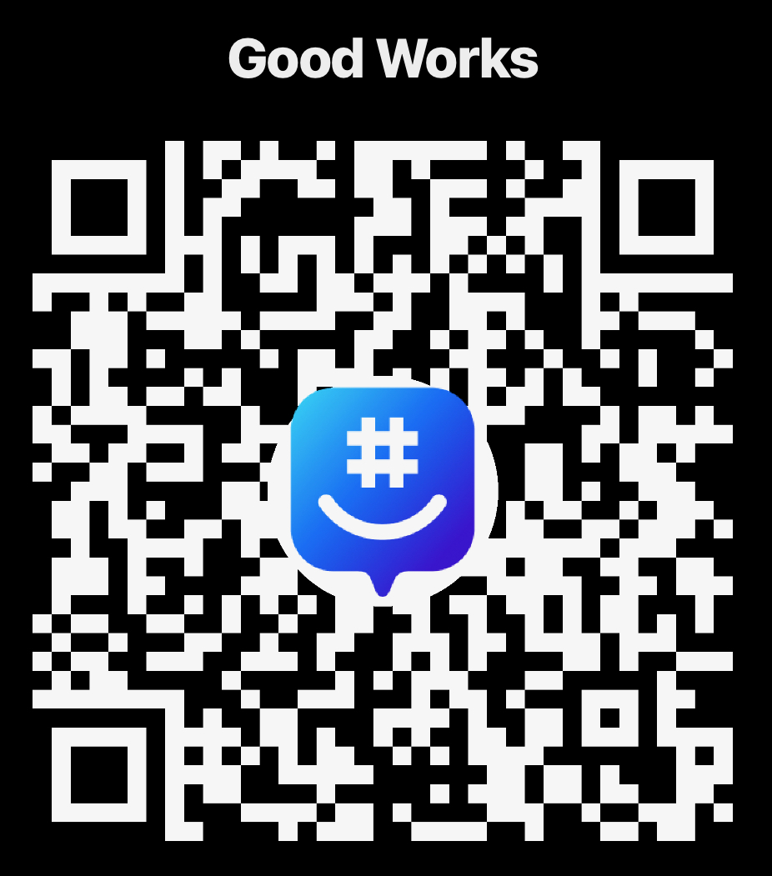
Join the Group!

