Slide 1
Little Girl, I Say to You, Arise
The Authority of Jesus

Slide 2
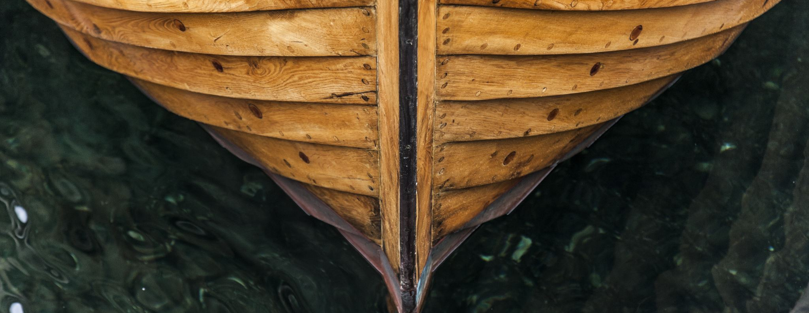
The Miracles
Mark 5:21-43

Slide 3
A desperate father.
Then came one of the rulers of the synagogue, Jairus by name… v 22
…and seeing him, he fell at his feet and implored him earnestly, saying, “My little daughter is at the point of death. Come and lay your hands on her, so that she may be made well and live.” vs 22-23

Slide 4
A despondent woman.
And there was a woman who had had a discharge of blood for twelve years, and who had suffered much under many physicians, and had spent all that she had, and was no better but rather grew worse. vs 25-26

Slide 5
A despondent woman.
She had heard the reports about Jesus and came up behind him in the crowd and touched his garment. For she said, “If I touch even his garments, I will be made well.” vs 27-28
And he said to her, “Daughter, your faith has made you well; go in peace, and be healed of your disease.” v 34

Slide 6
A dead girl.
But overhearing what they said, Jesus said to the ruler of the synagogue, “Do not fear, only believe.” v 36
“Why are you making a commotion and weeping? The child is not dead but sleeping.” v 39

Slide 7
A dead girl.
Taking her by the hand he said to her, “Talitha cumi,” which means, “Little girl, I say to you, arise.” v 41

Slide 8
Victory Over Death
The Book of Revelation

Slide 9
The keys of Death.
“Fear not, I am the first and the last, and the living one. I died, and behold I am alive forevermore, and I have the keys of Death and Hades.” Revelation 1:17-18

Slide 10
The obedience of Death.
And I looked, and behold, a pale horse! And its rider's name was Death, and Hades followed him. And they were given authority over a fourth of the earth, to kill with sword and with famine and with pestilence and by wild beasts of the earth. Revelation 6:8

Slide 11
The death of Death.
And the sea gave up the dead who were in it, Death and Hades gave up the dead who were in them, and they were judged, each one of them, according to what they had done. Then Death and Hades were thrown into the lake of fire. Revelation 20:13-14

