Slide 1
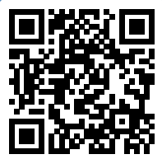
Please take a moment to complete this week’s survey.
For we are his workmanship, created in Christ Jesus for good works, which God prepared beforehand, that we should walk in them.
Ephesians 2:10

Slide 2
Survey results

Slide 3
And how does that make you Feel?
Good Works as Therapy

Slide 4
if you pour yourself out for the hungry
and satisfy the desire of the afflicted,
then shall your light rise in the darkness
and your gloom be as the noonday.
Isaiah 58:10

Slide 5
The saying is trustworthy, and I want you to insist on these things, so that those who have believed in God may be careful to devote themselves to good works. These things are excellent and profitable for people.
What are the things that are excellent and profitable for the people?
Titus 3:8

Slide 6
16 Now may our Lord Jesus Christ himself, and God our Father, who loved us and gave us eternal comfort and good hope through grace, 17 comfort your hearts and establish them in every good work and word.
2 Thessalonians 2:16-17

Slide 7
What does it mean to have your heart “established”?
What enables this?

Slide 8
He who cannot give anything away cannot feel anything either.
Friedrich Nietzsche, The will to power, Volume 2

Slide 9
“This giving behavior ultimately leads to lower cortisol (stress hormone) responses as a consequence of reduced feelings of shame. Giving money to others literally gets under our skin, with implications for longer term health.”
Konrath, S. (2014). The Power of Philanthropy and Volunteering. In Wellbeing, C.L. Cooper (Ed.). https://doi.org/10.1002/9781118539415.wbwell046

Slide 10
“As with money, how time is used seems more important than the amount of available time in terms of predicting psychological wellbeing.”
Konrath, S. (2014). The Power of Philanthropy and Volunteering. In Wellbeing, C.L. Cooper (Ed.). https://doi.org/10.1002/9781118539415.wbwell046

Slide 11
“All known studies find that regular volunteers experience increased life satisfaction, happiness, self-esteem, and psychological wellbeing and fewer depressive symptoms a few years later, compared to those who do not volunteer.”
Konrath, S. (2014). The Power of Philanthropy and Volunteering. In Wellbeing, C.L. Cooper (Ed.). https://doi.org/10.1002/9781118539415.wbwell046

Slide 12
“Interestingly, there is evidence that psychological wellbeing seems to promote more volunteering, which further promotes increases in psychological wellbeing…This parallels the above experimental findings that happy people are more likely to give time and money to others, but goes beyond these studies by directly providing evidence for a positive feedback loop.”
Konrath, S. (2014). The Power of Philanthropy and Volunteering. In Wellbeing, C.L. Cooper (Ed.). https://doi.org/10.1002/9781118539415.wbwell046

Slide 13
“Whether one jumps onto the loop through being happy (and giving more) or through giving time (and feeling more happy), there seems to be an upward spiral of giving and happier living.”
Konrath, S. (2014). The Power of Philanthropy and Volunteering. In Wellbeing, C.L. Cooper (Ed.). https://doi.org/10.1002/9781118539415.wbwell046

Slide 14
Happy
Emotion
Good Work
Action

Slide 15
?

Slide 16
Happy
(Emotion)
Good Work
(Action)

Slide 17
Happy
(Emotion)
Decision
(Thinking)
Good Work
(Action)

Slide 18
What was your reaction to the "good works" verses presented last week?
A little guilty in that I haven't spent much of my time focusing on good works, given how much the bible has to say about it 33%

Slide 19
How did you feel after you reached out to a member needing prayers?
A little more connected to them 40%
A little awkward (maybe you've not sent cards before) 16%
Surprised at how little effort it actually took to reach out 24%
Glad you took the time to message those needing prayers 60%
A little guilty that you haven't been doing this all along 56%

Slide 20
In attempting to better use the time God gave you this past week, how do you feel about your efforts?
I felt I was a better steward of my time 76%
I felt more connected to the people around me 59%
I felt more anxiety being separated from my social media feed 15%

Slide 21
How did you feel when the Elders announced we are helping the needy Christians in Malawi?
I was emotionally moved by the need for help by Christians in Malawi 38%
I felt blessed to be a part of the relief effort 92%

Slide 22
Has your compassion caused you to be more aware of the poor this week, are you seeing it more around you?
Yes 90%

Slide 23
How do you feel about developing your own "personal ministry" in God's Kingdom?
I'm glad God is using the talents and knowledge he gave me to bring glory to Him 64%

Slide 24
Did you feel more motivated knowing 50 members of the class were doing the same thing each day?
Yes 95%

Slide 25
What is your gut reaction to seeing these results?
Do you sense a change since the first survey?

Slide 26
This Week’s Challenge
Whichever good works exercise we’ve done so far that benefited you the most, do that again this week.
Keep in mind, we are trying to develop HABITS of good works

Slide 27
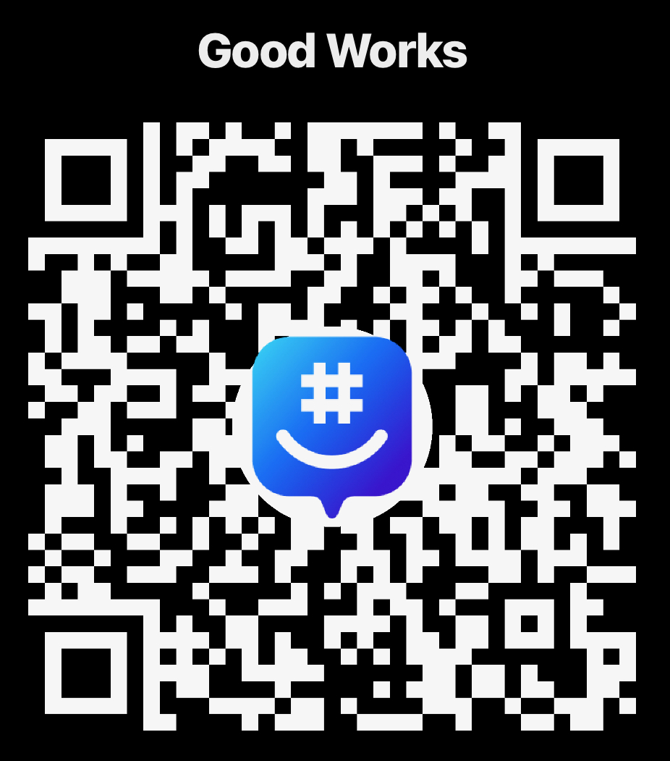
Join the Group!

