Slide 1
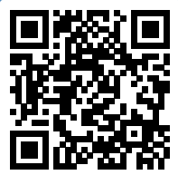
Please take a moment to complete this week’s survey.
For we are his workmanship, created in Christ Jesus for good works, which God prepared beforehand, that we should walk in them.
Ephesians 2:10

Slide 2
Survey Results

Slide 3
What an opportunity!
Opportunity to let our light shine that others may glorify God
Opportunity to let your love & compassion lead to action
Opportunity to redeem your time
Opportunity to remember the poor (or widows)

Slide 4
What an Opportunity!
Opportunity to encourage each other
Opportunity to improve your own emotional wellbeing
Opportunity to build better, closer relationships with fellow members

Slide 5
Stirring the Pot
Good works among groups

Slide 6
And let us consider how to stir up one another to love and good works
Hebrews 10:24

Slide 7
Why are opportunities for Christians to work together beneficial?

Slide 8
9 Two are better than one, because they have a good reward for their toil. 10 For if they fall, one will lift up his fellow. But woe to him who is alone when he falls and has not another to lift him up! 11 Again, if two lie together, they keep warm, but how can one keep warm alone? 12 And though a man might prevail against one who is alone, two will withstand him—
a threefold cord is not quickly broken.
Eccl 4:9-12

Slide 9
1
<2
<3

Slide 10
What are some group activities that you would like to see our class do?

Slide 11
This Week’s Challenge
Get involved with a good works group activity
Volunteer at the Food Bank on Thursday or Friday morning
Commit to going to the singing at Monarch Estates on Sunday afternoon
Landscaping maintenance at a couple of our member’s home

Slide 12
16 from whom the whole body, joined and held together by every joint with which it is equipped, when each part is working properly, makes the body grow so that it builds itself up in love.
Ephesians 4:16

Slide 13
Okay, time to commit…

Slide 14
Please take a moment to complete this week’s survey.
For we are his workmanship, created in Christ Jesus for good works, which God prepared beforehand, that we should walk in them.
Ephesians 2:10

Slide 15
While working, remember to…
Be Thankful
Encourage your fellow volunteers
Not complain
Do your best work
Enjoy the company of fellow Christians
Have spiritual conversations

Slide 16
23 Whatever you do, work heartily, as for the Lord and not for men,
Colossians 3:23

Slide 17
Here’s what you can expect…
Others will be helped
You will feel you have made a difference
You will be closer to your fellow volunteers
You will have the memories of serving together
You may establish new relationships
You will be encouraged

Slide 18
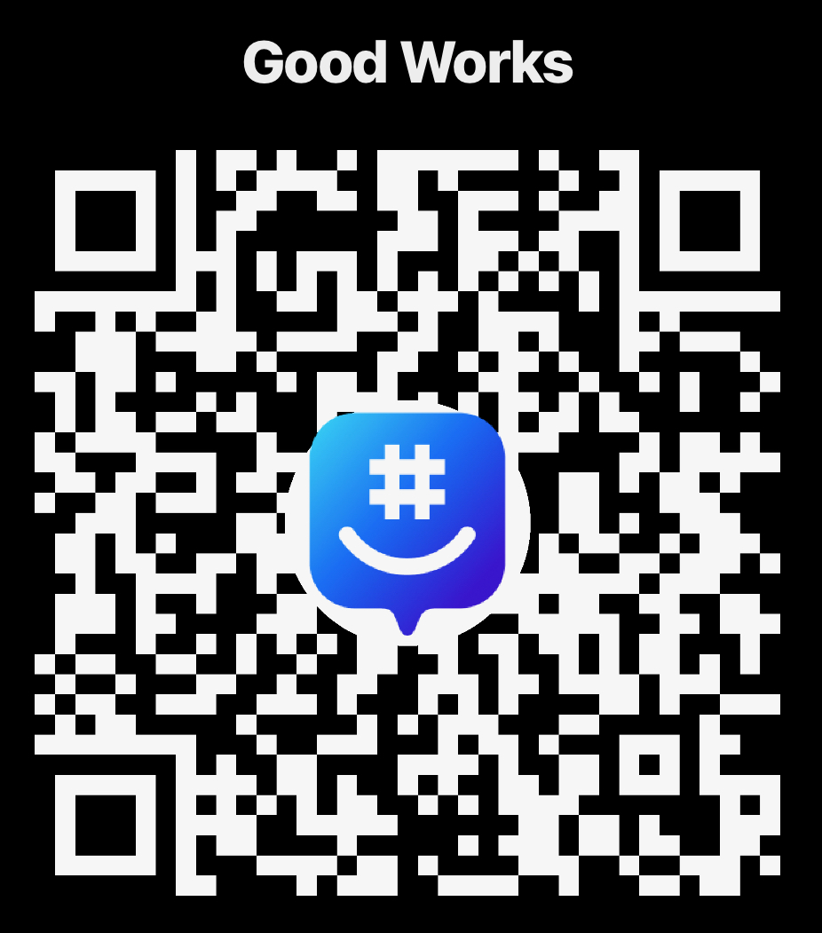
Join the Group!

