Slide 1
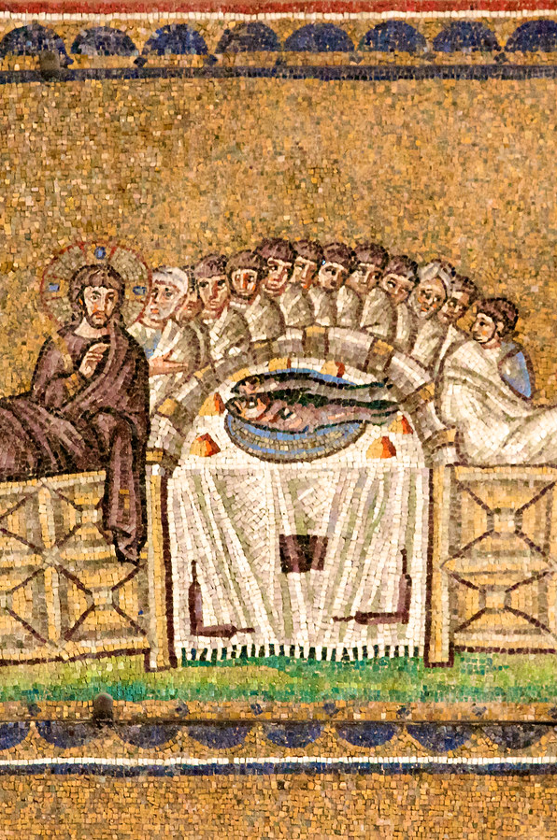
1 Corinthians 11
The Lord’s Supper: Memory, Rhythm, and Proclamation of Hope

Slide 2
The lord’s Supper as a language
1) The Lord’s Supper is an event of memory: we remember our redemption just as Israel remembered it’s redemption each year at Passover.
2) The Lord’s Supper is a constant rhythm: we take it on a regular, weekly basis.
3) The Lord’s Supper is a public meal of hope: we proclaim through this weekly habit of gathering and sharing a public symbolic meal with Christ at its head - our hope of a final, glorious banquet feast with God.

Slide 3
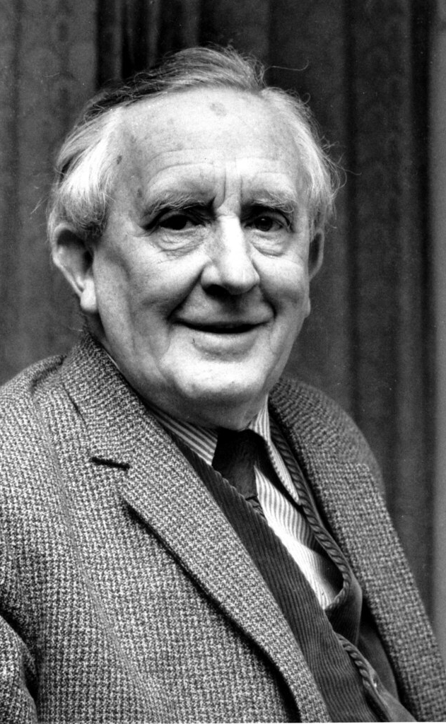
The Purpose of Language
“No language is justly studied merely as an aid to other purposes. It will in fact better serve other purposes, philological or historical, when it is studied for love, for itself.” -J.R.R. Tolkien
(“English and Welsh". Lecture at the University of Oxford on October 21, 1955. "The Monsters and the Critics, and Other Essays". Book edited by Christopher Tolkien, 1983).

Slide 4
The Problem of 1 Corinthians 11
This is no common meal.
Paul’s exasperation: disunity coming from what should have been a symbol of unity.

Slide 5
Memory
Memory or recollection involves action in response to God’s faithful work of deliverance.
Jesus giving himself for us effects a new kind of Exodus.
Lord’s Supper reminds us we live in the shadow of the cross.

Slide 6
Rhythm
Corinthians have fallen out of a rhythm of coming together for the purpose of communion – and into division.
Rhythm reminds us we are part of Christ’s body, which is bigger than ourselves.
A rhythm of meeting weekly to meditate on Jesus’ sacrifice stirs us up to be proactive about what we can do for those who have less than us.

Slide 7
Proclamation of Hope
This weekly symbol is a celebration and proclamation that Christ’s death was not the last word.
The Lord’s Supper is a process of continually dying and rising with Christ, not just once (1 Cor. 15:31).
The true language of the Lord’s Supper is about service to one another - we mirror Christ at the first supper.

Slide 8
Invitation:
Come to the table!
For those of us who have not yet put on Christ in baptism, he holds out the invitation to repent, and then join him in his death and resurrection through baptism, enabling us to commune with him and each other.

