Slide 1
an authentic relationship with God SPIRITUALITY
What is spirituality?

Slide 2
Putting Self in the Center
1
2
1

Slide 3
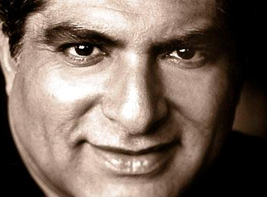
Deepak Chopra
From Deepak Chopra’s book How to Know God:
“You don’t have to believe in God to experience God.”
“God is our highest instinct to know ourselves.”

Slide 4
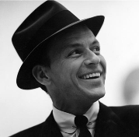
All About Me!
“I did it my way!”
“Have it your way!”
“No rules! Just right!”

Slide 5
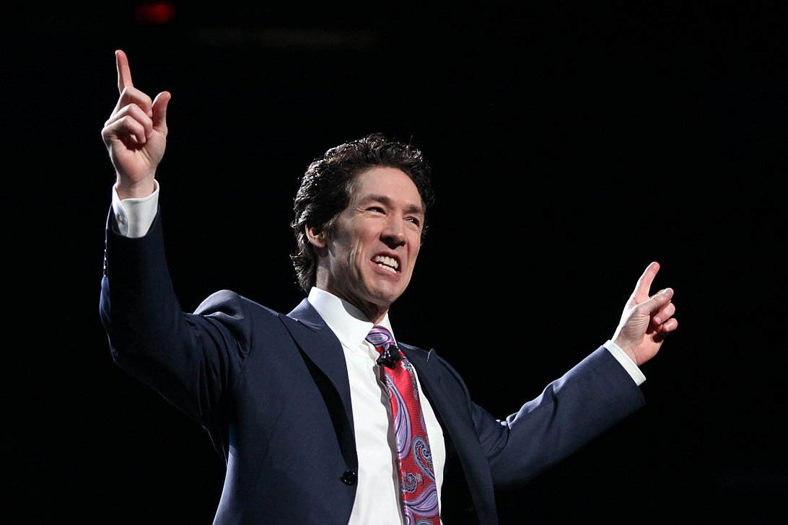
Joel Osteen
From Joel Osteen’s book Your Best Life Now:
“God wants this to be the best time in your life.”
“Do all you can to make your dreams come true.”

Slide 6
They exchanged the truth about God for a lie and worshiped and served the creature rather than the Creator… Romans 1:25
In those days there was no king in Israel. Everyone did what was right in his own eyes.
Judges 17:6
Their end is destruction, their God is their belly, their glory is their shame, with minds set on earthly things.
Philippians 3:19

Slide 7
What About Us?
2
2

Slide 8
“Beware of practicing your righteousness before other people in order to be seen by them…” Romans 1:25
This people honors me with their lips, but their heart is far from me; in vain do they worship me, teaching as doctrines the commandments of men.”
Matthew 15:8-9
“The scribes and the Pharisees sit on Moses’ seat, so practice and observe whatever they tell you—but not what they do. For they preach, but do not practice.”
Matthew 23:2-3

Slide 9
True Spirituality
3
2

Slide 10
true spirituality
It is a relationship with God,
rooted in knowledge,
evidenced by righteousness,
directed toward the Day of Christ,
all to God’s glory.

Slide 11
true spirituality
FAITH
HOPE
LOVE
It is a spiritual vision and direction that leads to a spiritual devotion.

Slide 12
40 DAY CHALLENGE
Take On The
Do something new to ignite your spiritual life!

Slide 13
PRAYER FOR REVIVAL
We ask You to push back
The horizons of our hopes;
And to push into the future
In strength, courage, hope, and love.
--Sir Francis Drake (1540-1596)
Disturb us, Lord, to dare more boldly,
To venture on wider seas
Where storms will show your mastery;
Where losing sight of land,
We shall find the stars.
Disturb us, Lord, when
With the abundance of things we possess
We have lost our thirst
For the waters of life;
Having fallen in love with life,
We have ceased to dream of eternity
And in our efforts to build a new earth,
We have allowed our vision
Of the new Heaven to dim.
Disturb us, Lord, when
We are too well pleased with ourselves,
When our dreams have come true
Because we have dreamed too little,
When we arrived safely
Because we sailed too close to the shore.

