Slide 1
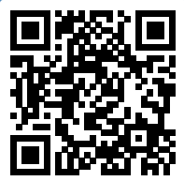
Please take a moment to complete this week’s survey.
For we are his workmanship, created in Christ Jesus for good works, which God prepared beforehand, that we should walk in them.
Ephesians 2:10

Slide 2
Rapid-Fire Review & Wrap

Slide 3
For we are his workmanship, created in Christ Jesus for good works, which God prepared beforehand, that we should walk in them.
And I am sure of this, that he who began a good work in you will bring it to completion at the day of Jesus Christ.
And let us consider how to stir up one another to love and good works
In the same way, let your light shine before others, so that they may see your good works and give glory to your Father who is in heaven.
So then, as we have opportunity, let us do good to everyone, and especially to those who are of the household of faith.
who gave himself for us to redeem us from all lawlessness and to purify for himself a people for his own possession who are zealous for good works.
Now there was in Joppa a disciple named Tabitha, which, translated, means Dorcas. She was full of good works and acts of charity.
Remind them to be submissive to rulers and authorities, to be obedient, to be ready for every good work
so as to walk in a manner worthy of the Lord, fully pleasing to him: bearing fruit in every good work and increasing in the knowledge of God
comfort your hearts and establish them in every good work and word.
And God is able to make all grace abound to you, so that having all sufficiency in all things at all times, you may abound in every good work.
and having a reputation for good works: if she has brought up children, has shown hospitality, has washed the feet of the saints, has cared for the afflicted, and has devoted herself to every good work.
They are to do good, to be rich in good works, to be generous and ready to share
Therefore, if anyone cleanses himself from what is dishonorable, he will be a vessel for honorable use, set apart as holy, useful to the master of the house, ready for every good work.
Jesus answered them, “I have shown you many good works from the Father; for which of them are you going to stone me?”
And let our people learn to devote themselves to good works, so as to help cases of urgent need, and not be unfruitful.
So also good works are conspicuous, and even those that are not cannot remain hidden.
They profess to know God, but they deny him by their works. They are detestable, disobedient, unfit for any good work.
The saying is trustworthy, and I want you to insist on these things, so that those who have believed in God may be careful to devote themselves to good works. These things are excellent and profitable for people.
Keep your conduct among the Gentiles honorable, so that when they speak against you as evildoers, they may see your good deeds and glorify God on the day of visitation.
that the man of God may be complete, equipped for every good work.
Show yourself in all respects to be a model of good works, and in your teaching show integrity, dignity
but with what is proper for women who profess godliness—with good works.

Slide 4
For we are his workmanship, created in Christ Jesus for good works, which God prepared beforehand, that we should walk in them.
And I am sure of this, that he who began a good work in you will bring it to completion at the day of Jesus Christ.
And let us consider how to stir up one another to love and good works
In the same way, let your light shine before others, so that they may see your good works and give glory to your Father who is in heaven.
So then, as we have opportunity, let us do good to everyone, and especially to those who are of the household of faith.
who gave himself for us to redeem us from all lawlessness and to purify for himself a people for his own possession who are zealous for good works.
Now there was in Joppa a disciple named Tabitha, which, translated, means Dorcas. She was full of good works and acts of charity.
Remind them to be submissive to rulers and authorities, to be obedient, to be ready for every good work
so as to walk in a manner worthy of the Lord, fully pleasing to him: bearing fruit in every good work and increasing in the knowledge of God
comfort your hearts and establish them in every good work and word.
And God is able to make all grace abound to you, so that having all sufficiency in all things at all times, you may abound in every good work.
and having a reputation for good works: if she has brought up children, has shown hospitality, has washed the feet of the saints, has cared for the afflicted, and has devoted herself to every good work.
They are to do good, to be rich in good works, to be generous and ready to share
Therefore, if anyone cleanses himself from what is dishonorable, he will be a vessel for honorable use, set apart as holy, useful to the master of the house, ready for every good work.
Jesus answered them, “I have shown you many good works from the Father; for which of them are you going to stone me?”
And let our people learn to devote themselves to good works, so as to help cases of urgent need, and not be unfruitful.
So also good works are conspicuous, and even those that are not cannot remain hidden.
They profess to know God, but they deny him by their works. They are detestable, disobedient, unfit for any good work.
The saying is trustworthy, and I want you to insist on these things, so that those who have believed in God may be careful to devote themselves to good works. These things are excellent and profitable for people.
Keep your conduct among the Gentiles honorable, so that when they speak against you as evildoers, they may see your good deeds and glorify God on the day of visitation.
that the man of God may be complete, equipped for every good work.
Show yourself in all respects to be a model of good works, and in your teaching show integrity, dignity
but with what is proper for women who profess godliness—with good works.

Slide 5
For we are his workmanship, created in Christ Jesus for good works, which God prepared beforehand, that we should walk in them.
And I am sure of this, that he who began a good work in you will bring it to completion at the day of Jesus Christ.
And let us consider how to stir up one another to love and good works
In the same way, let your light shine before others, so that they may see your good works and give glory to your Father who is in heaven.
So then, as we have opportunity, let us do good to everyone, and especially to those who are of the household of faith.
who gave himself for us to redeem us from all lawlessness and to purify for himself a people for his own possession who are zealous for good works.
Now there was in Joppa a disciple named Tabitha, which, translated, means Dorcas. She was full of good works and acts of charity.
Remind them to be submissive to rulers and authorities, to be obedient, to be ready for every good work
so as to walk in a manner worthy of the Lord, fully pleasing to him: bearing fruit in every good work and increasing in the knowledge of God
comfort your hearts and establish them in every good work and word.
And God is able to make all grace abound to you, so that having all sufficiency in all things at all times, you may abound in every good work.
and having a reputation for good works: if she has brought up children, has shown hospitality, has washed the feet of the saints, has cared for the afflicted, and has devoted herself to every good work.
They are to do good, to be rich in good works, to be generous and ready to share
Therefore, if anyone cleanses himself from what is dishonorable, he will be a vessel for honorable use, set apart as holy, useful to the master of the house, ready for every good work.
Jesus answered them, “I have shown you many good works from the Father; for which of them are you going to stone me?”
And let our people learn to devote themselves to good works, so as to help cases of urgent need, and not be unfruitful.
So also good works are conspicuous, and even those that are not cannot remain hidden.
They profess to know God, but they deny him by their works. They are detestable, disobedient, unfit for any good work.
The saying is trustworthy, and I want you to insist on these things, so that those who have believed in God may be careful to devote themselves to good works. These things are excellent and profitable for people.
Keep your conduct among the Gentiles honorable, so that when they speak against you as evildoers, they may see your good deeds and glorify God on the day of visitation.
that the man of God may be complete, equipped for every good work.
Show yourself in all respects to be a model of good works, and in your teaching show integrity, dignity
but with what is proper for women who profess godliness—with good works.

Slide 6
And let us consider how to stir up one another to love and good works
So then, as we have opportunity, let us do good to everyone, and especially to those who are of the household of faith.

Slide 7
And let us consider how to stir up one another to love and good works
So then, as we have opportunity, let us do good to everyone, and especially to those who are of the household of faith.
Notes:
Mark transition to next slide: Okay, Let’s cover the Major Principles of Good Works

Slide 8
Why Good Works?
Created for this (Eph 2:10)
It’s our identity (Titus 2:11-14)
To glorify God (Matt 5:16, I Peter 2:11-12)
It’s a responsibility (Proverbs 3:27)

Slide 10
The Compassion of Christ
He welcomed people. Luke 9:11
He fed people. Matt 15:32; Matt 15:36-37
He healed them. Matt 14:14
He taught people many things. Mark 6:34

Slide 11
How to Practice Compassion
Be gracious and kind in your speech
Apologize when you've made a mistake
Listen carefully and without judgment
Encourage people
Offer to help someone with a task
Be happy for someone else's success
Forgive people for making mistakes
Show respect
Express gratitude and appreciation
Be patient

Slide 12
“Are you a wondering generality,
Or a meaningful specific?”
- Zig Ziglar

Slide 13
Show me how you spend your day,
And I will show you your priorities.
Or lack of them…

Slide 14
According to DigitalMarking.org,
people spend almost
2 and ½ hours
each day on Social Media

Slide 15
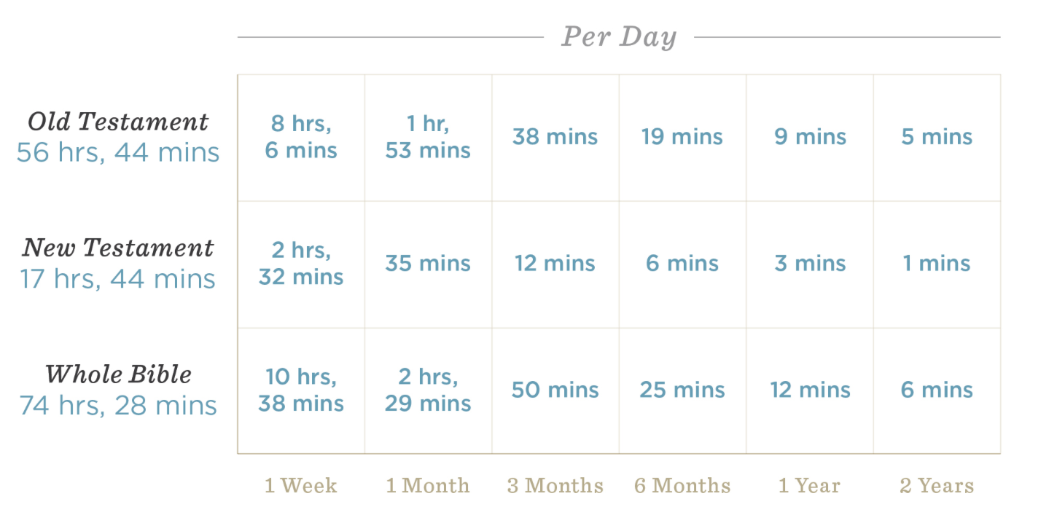
How much time would it take…?

Slide 16
How much time would it take…?

Slide 17
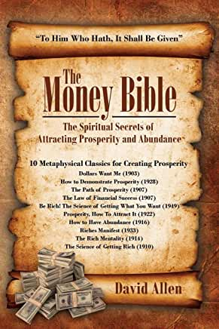
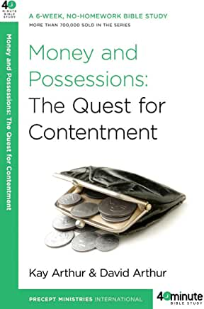

Slide 18
for in a severe test of affliction
their abundance of joy
their extreme poverty
a wealth of generosity
2 Corinthians 8:1-4

Slide 19
for in a severe test of affliction
their abundance of joy
their extreme poverty
a wealth of generosity
2 Corinthians 8:1-4

Slide 20
affliction (joy + poverty) = generosity
Biblical Algebra?

Slide 21
16 By this we know love, that he laid down his life for us, and we ought to lay down our lives for the brothers. 17 But if anyone has the world's goods and sees his brother in need, yet closes his heart against him, how does God's love abide in him? 18 Little children, let us not love in word or talk but in deed and in truth.
1 John 3:16-18

Slide 22
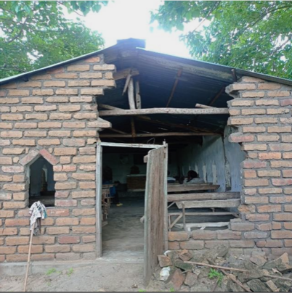

Slide 23
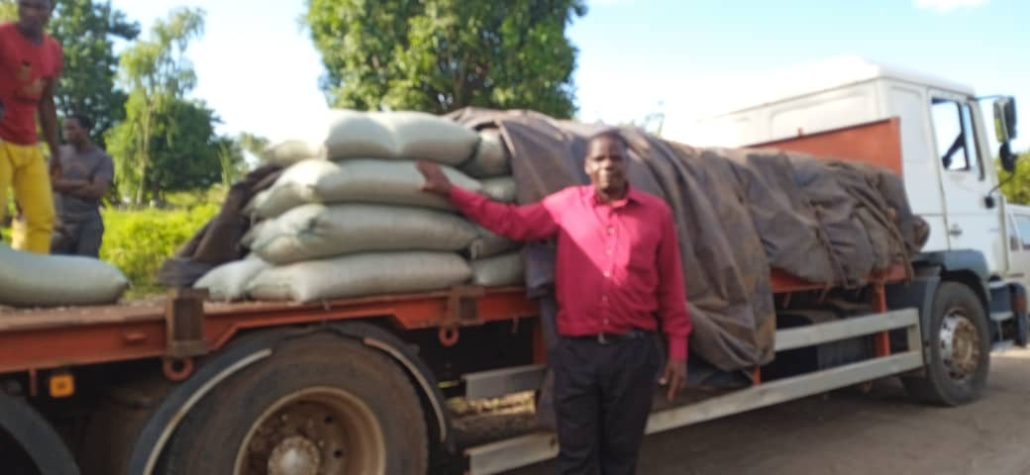

Slide 24
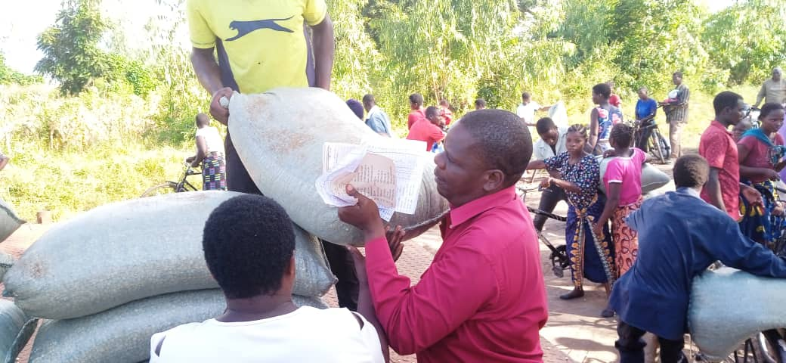

Slide 25
Your Personal Ministry
In your home
In the local church
At Work
In the community
Across cultures
To the World

Slide 26
How to find your Groove
Pray about it
Seek advice from elders, mature Christians
Review what you are good at and passionate about
Try something new
Something within the church walls or in the community
Notes:
\

Slide 27
Some more “Little Things”
Share your money
Share your stuff
Share your talents
Share the Word
Just Ask

Slide 28
Some more “Little Things”
Be kind to strangers
Remember someone
Pray for those in need
Share food
Share your time

Slide 29
The Bible is filled with small, seemingly random things, that don’t strike us as all that important –
until God uses them for His glory.

Slide 30
Little things lead to Great Things
David took a small stone and defeated the Philistine’s “giant” hero
Using a piece of scarlet cord, Rahab preserved her entire family from certain death (Joshua 2:18).
“If ye have faith as a grain of mustard seed,” said Jesus, “ye shall say unto this mountain, Remove hence to yonder place; and it shall remove; and nothing shall be impossible unto you.” (Matt. 17:20) All we need is faith that He is Who He says He is, and that He will do as He promises.

Slide 31
Little things lead to Great Things
By the simple act of holding up his hands, Moses helped lead the Israelites to victory (Exodus 17:11).
With the jawbone of a donkey, Samson killed one thousand Philistines and protected his people (Judges 15:16).
By tithing two mites, the poor widow gave all that she had (Mark 12:42-44).
By following a star, the wise men found Jesus (Matt. 2:9).

Slide 32
“Good Works Anonymity Scale ”
TM
To be seen of men
Matt 6:1
Known
Let your light shine, Seeking God’s glory
Matt 5:16 & John 5:44
Inconspicuous, but later known
1 Timothy 5:25
Anonymous
Anonymous good works
Matt 6:3-4

Slide 33
Perform a Good Work

Slide 34
Identify need
Perform a Good Work

Slide 35
Know the person
Identify need
Perform a Good Work

Slide 36
Relationship Process
Seek a Relationship
Know the person
Identify need
Perform a Good Work
Awareness
Action

Slide 37
Happy
(Emotion)
Decision
(Thinking)
Good Work
(Action)

Slide 38
Keeping the Peace (Eph 4)
honoring others above themselves
sharing with those in need
rejoicing with those who rejoice
mourning with those who mourn
consistently turning away from evil
and doing good

Slide 39
Restoring the Peace
If you have faulted someone, go to them (Matt 5:23-24)
If someone has hurt you, go to them (Matt 18:15-17)
In all cases, the ball is in your court. You have to take the initiative

Slide 40
And let us consider how to stir up one another to love and good works
Hebrews 10:24

Slide 41
Two can have a groove together.

Slide 42
Serving together is a good way to use
complimentary talents like
awareness and compassion.

Slide 43
Parents should look for opportunities to involve their children in the decision-making process of serving others.
This Photo by Unknown Author is licensed under CC BY

Slide 44
Good Works is not
the METHOD of our salvation,
it’s the MISSION
not of works, lest any man should boast Eph 2:9
created in Christ Jesus for good works Eph 2:10

Slide 45
The risk to each of us is
to abandon our focus on service to others
and let our old habits sneak back in
along with evil works we’ve pushed out.

Slide 46
Remember the summer of good works back in 2023?

Slide 48
Has this class motivated you to do something you’ve never done before?

Slide 49
Have any of your habits changed?

Slide 50
Have grown closer to those around you?

Slide 51
How are you letting your light shine in the community? (Hopefully more focus is going on outside of the building)

Slide 52
What was your favorite thing about
these last 16 weeks?

Slide 53
In regards to everything Good Works—What’s your plan moving forward?

Slide 54
Final Challenge!
Don’t forget what we’ve learned
Keep doing good for others to glorify God
Continue to stir one another up to love and good works
Be an Encourager!
Be an ACTIVE member in the new spiritual work groups
Identify and broadcast good works opportunities via the Good Works GroupMe.

Slide 55
Join the Group!
Notes:
Mark: Join the group!

