Slide 2
Alcohol
Its Aftertaste

Slide 3
Statistics
CDC: 149k deaths per year from alcohol
Advertisers spend >$600 million encouraging alcohol
>$25 billion spent by consumers this year alone
~17 million alcoholics in America
>$249B drain on our nation’s budget
55% of sexual assault victims were drinking before assault
97% of sexual assault victims were drinking at time of assault
Broken homes due to neglect, spousal abuse, child abuse, etc.
>55% of highway deaths are alcohol related
Mental & health problems, and ultimately death of many
6% of all deaths related to alcohol (Wikipedia)

Slide 5
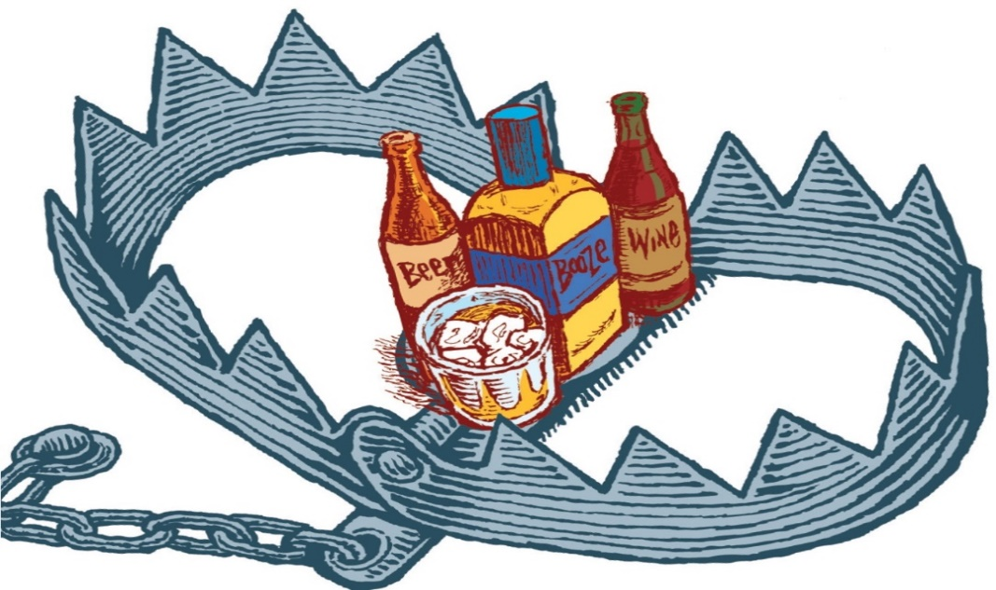
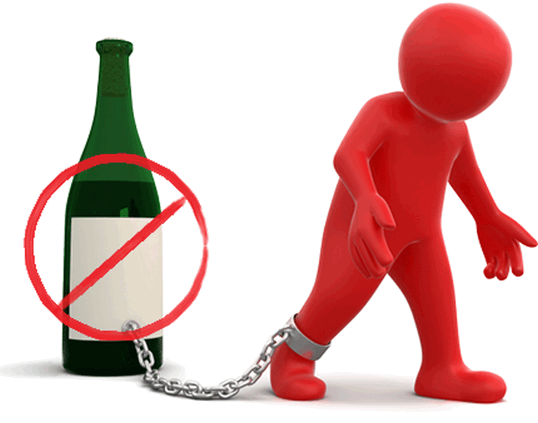
Bible Consequences
Mocks – Prov 20:1
Destroys – Nah 1:10
Poverty – Prov 23:21
Woes – Hab 2:15; Isa 5:11,22
Sorrow – Prov 23:29
Contention – Prov 23:29
Harms judgment – Prov 31:4-5; Isa 28:7
Complaining – Prov 23:29
Perversion – Prov 23:33b

Slide 6
Bible Consequences
Worries without cause – Prov 23:29
Inflames passions – Isa 5:11
Enslaves – Tit 2:3
Inappropriate business – Joel 3:3
Bad company – Hos 7:5
Takes away understanding – Hos 4:11
Bad influence – Isa 56:12
Vomiting – Isa 19:14; Jer 25:27
Staggering – Job 12:25; Psa 60:3

Slide 7
Bible Characters Effected
Noah was seen naked in front of family
Gen 9:21 – “He drank of the wine and became drunk, and uncovered himself inside his tent.”
Lot impregnated daughters
Gen 19:33 – “So they made their father drink wine that night, and the firstborn went in and lay with her father; and he did not know when she lay down or when she arose.”
Nadab & Abihu killed
Lev 10:9 – “Do not drink wine or strong drink, neither you nor your sons with you, when you come into the tent of meeting, so that you will not die—it is a perpetual statute throughout your generations”

Slide 8
Unfermented
Isa 65:8 – “Thus says the LORD, ‘As the new wine is found in the cluster, and one says, “Do not destroy it, for there is benefit in it,” so I will act on behalf of My servants in order not to destroy all of them.”
Isa 16:10 – “Gladness and joy are taken away from the fruitful field; in the vineyards also there will be no cries of joy or jubilant shouting, no treader treads out wine in the presses, for I have made the shouting to cease.”
Eccl 9:7 – “Go then, eat your bread in happiness and drink your wine with a cheerful heart; for God has already approved your works.”

Slide 9
Fermented
Prov 20:1 – “Wine is a mocker, strong drink a brawler, and whoever is intoxicated by it is not wise.”
Prov 23:29-35 – “Who has woe? Who has sorrow? Who has contentions? Who has complaining? Who has wounds without cause? Who has redness of eyes? Those who linger long over wine, those who go to taste mixed wine. Do not look on the wine when it is red, when sparkles in the cup, when it goes down smoothly; at the last it bites like a serpent and stings like a viper. Your eyes will see strange things and your mind will utter perverse things. And you will be like one who lies down in the middle of the sea, or like one who lies down on the top of a mast. They struck me, but I did not become ill; they beat me, but I did not know it. When shall I awake? I will seek another drink.””

Slide 10
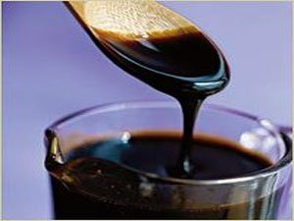
How Was Fermentation Prevented?
Boiling
Prov 9:1-5 – “Wisdom has built her house, she has hewn out her seven pillars; she has prepared her food, she has mixed her wine; she has also set her table; she has sent out her maidens, she calls from the tops of the heights of the city: ‘Whoever is naive, let him turn in here!’ To him who lacks understanding she says, ‘Come, eat of my food and drink of the wine I have mixed.’”
Aristotle – “The wine of Arcadia was so thick that it was necessary to scrape it from the skin bottles in which it was contained and to dissolve the scrapings in water.” (Meteorologica 388b, 6)
Horace – “There is no wine sweeter to drink than that of Lesbos; it was like nectar . . . and would not produce intoxication.”
Virgil described housewives boiling down “sweet must” (Georgics, 1.295)

Slide 11
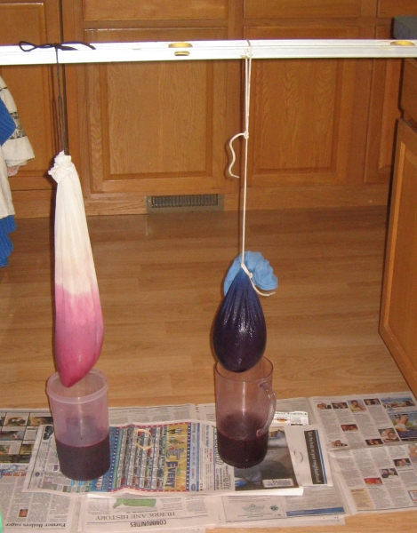
How Was Fermentation Prevented?
Filtering
Isa 25:6 (KJV) – “And in this mountain shall the Lord of hosts make unto all people a feast of fat things, a feast of wines on the lees, of fat things full of marrow, of wines on the lees well refined.”
Pliny The Younger – “The most useful wine has all its force or strength broken by the filter.” (Natural History, 23.24).
Plutarch – “Wine is rendered feeble in strength when it is frequently filtered. The strength or spirit thus being excluded, the wine neither inflames the brain nor infests the mind and passions, and is much more pleasant to drink.” (Symposiacs, 693b 3-5).
The Mishnah mentions the “wine filter” (Terumot 8.6)
The Babylonian Talmud records debates regarding whether wine should be filtered on the Sabbath or not (Shabbat, 139b)

Slide 12
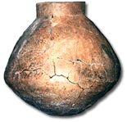
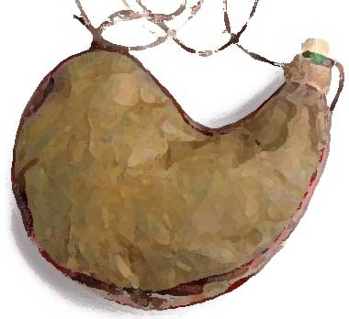
How Was Fermentation Prevented?
Storage
Earthenware vessels (Jer. 13:12; 40:10; Hab. 2:15)
Skins/Jugs (Gen 21:12; 1 Sam 1:24; 10:3; 16:20; 25:18; 2 Sam. 16:1)
Cato the Elder claimed that must stored in an amphora coated with pitch and stored for days in a water tank could be removed and kept as “must” all year (Cato, De Re Rustica 120, 3 )
Columella, the Roman tribune of Syria in 35 AD, claimed it was 40 days (Colimella, De Re Rustica 12.29)

Slide 13
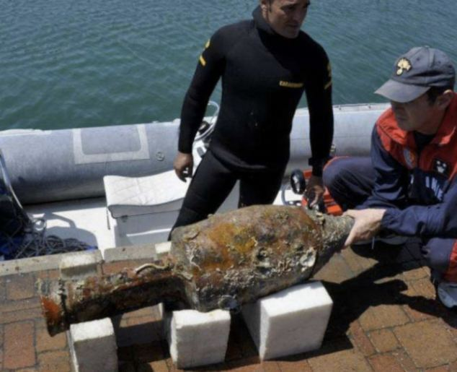
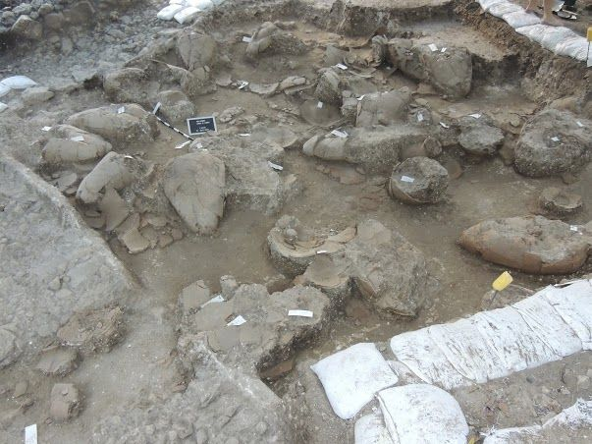
How Was Fermentation Prevented?
Refrigerating, Sealing
Horace mentions earthenware vessels sealed with a pitch coated cork (Carminum Liber 3, 8, 9-12)
Columella describes covering an amphora, plastering over the lid, and then covering it with leather (De Re Rustica 12.39)
The ancients recognized that “must” stored in the cold does not ferment (Plutarch, Natural Questions 27)
When attempting to keep “must” it was generally stored in a cool place and could be kept as sweet “must” for as much as a year (Columella, On Agriculture 12.20.1; 12.37.1; 12.29.1).

Slide 14
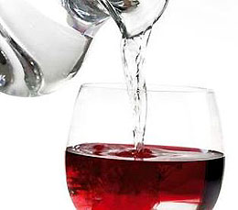
How Was Fermentation Prevented?
Dilution
Homer: 20 to 1 (Odyssey 9.208)
Pliny: 8 to 1 (Natural History 14.6)
Among the Jews 2 or 3 to 1 (Shabbat 77a)
Athenaeus cites ratios of 3 to 1, 4 to 1, 2 to 1, and 5 to 2. He mentions 3 to 2 as being “strong” (“The Learned Banquet”)
2 Macc 15:39 – “It is hurtful to drink wine or water alone…wine mingled with water is pleasant”
Mnesthus of Athens – “Mix it half and half, and you get madness; unmixed, bodily collapse.”
Plutarch – “We call a mixture ‘wine,’ although the larger of the components is water.”
Greeks and Romans refer to drinking unmixed wine as intemperate, something only fit for Barbarians (Will Durant, Caesar and Christ, p. 71)
Clement of Alexandria – “It is best for the wine to be mixed with as much water as possible…” (Instructor II, ii, 23.3-24.1)

Slide 16
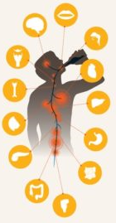
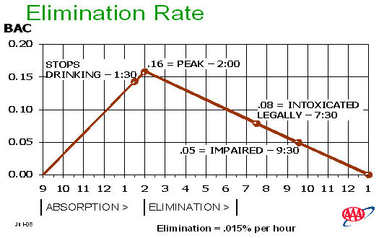
What About Moderate Consumption?
Gender
Weight
Height
Body Fat %
Body Temperature
Muscle Tissue
Mood
Medications
Health
Rate of Intake
Oxidation
Temp. of drink
Hydration
Hormones
Food in stomach
Ratio of protein, fat, carbs
Body size
Liver function
Fatigue
Carbonation

Slide 17
What About Moderate Consumption?
“Experts” say:
God says:
Alabama: DUI >= 0.08%
Germany: DUI >= 0.05%
Sweden: DUI >= 0.02%
Saudi Arabia: DUI > 0%
Hungary: DUI > 0%
Israel: DUI > 0%
Czech Republic: DUI > 0%
Mocks – Prov 20:1
Destroys – Nah 1:10
Poverty – Prov 23:21
Woes – Hab 2:15; Isa 5:11,22
Sorrow – Prov 23:29
Contention – Prov 23:29
Complaining – Prov 23:29
Perversion – Prov 23:33b
Worries w/o cause – Prov 23:29
Harms judgment – Prov 31:4-5
Inflames passions – Isa 5:11
Enslaves – Tit 2:3

Slide 18
Christian Influence
Matt 18:6-7 – “Whoever causes one of these little ones who believe in Me to stumble, it would be better for him to have a heavy millstone hung around his neck, and to be drowned in the depth of the sea. Woe to the world because of its stumbling blocks! For it is inevitable that stumbling blocks come; but woe to that man through whom the stumbling block comes!”
Rom 14:21 – “It is good not to eat meat or to drink wine, or to do anything by which your brother stumbles.”
1 Cor 4:2 – “In this case, moreover, it is required of stewards that one be found trustworthy.”

Slide 19
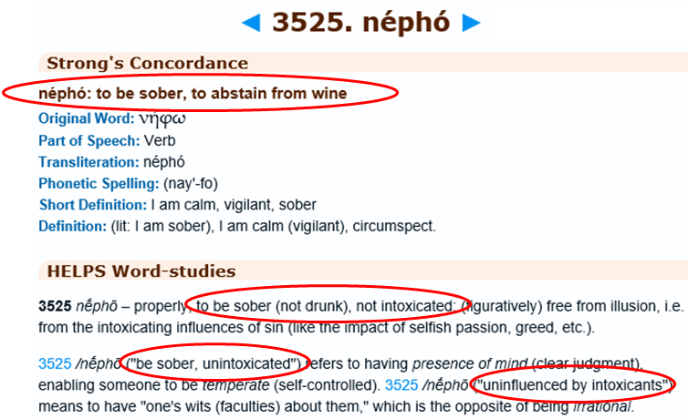
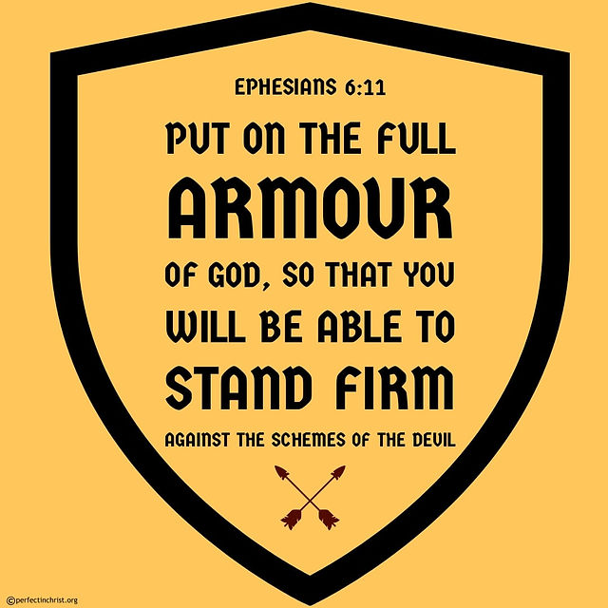
Christian Sobriety
1 Cor 15:34 – “Become sober-minded as you ought, and stop sinning.”
1 Thes 5:6 – “So then let us not sleep as others do, but let us be alert and sober.”
2 Tim 4:5a – “But you, be sober in all things…”
1 Pet 1:13a – “Therefore, prepare your minds for action, keep sober in spirit…”
1 Pet 4:7b – “…therefore, be of sound judgment and sober spirit…”
1 Pet 5:8 – “Be of sober spirit, be on the alert. Your adversary, the devil, prowls around like a roaring lion, seeking someone to devour.”

Slide 21
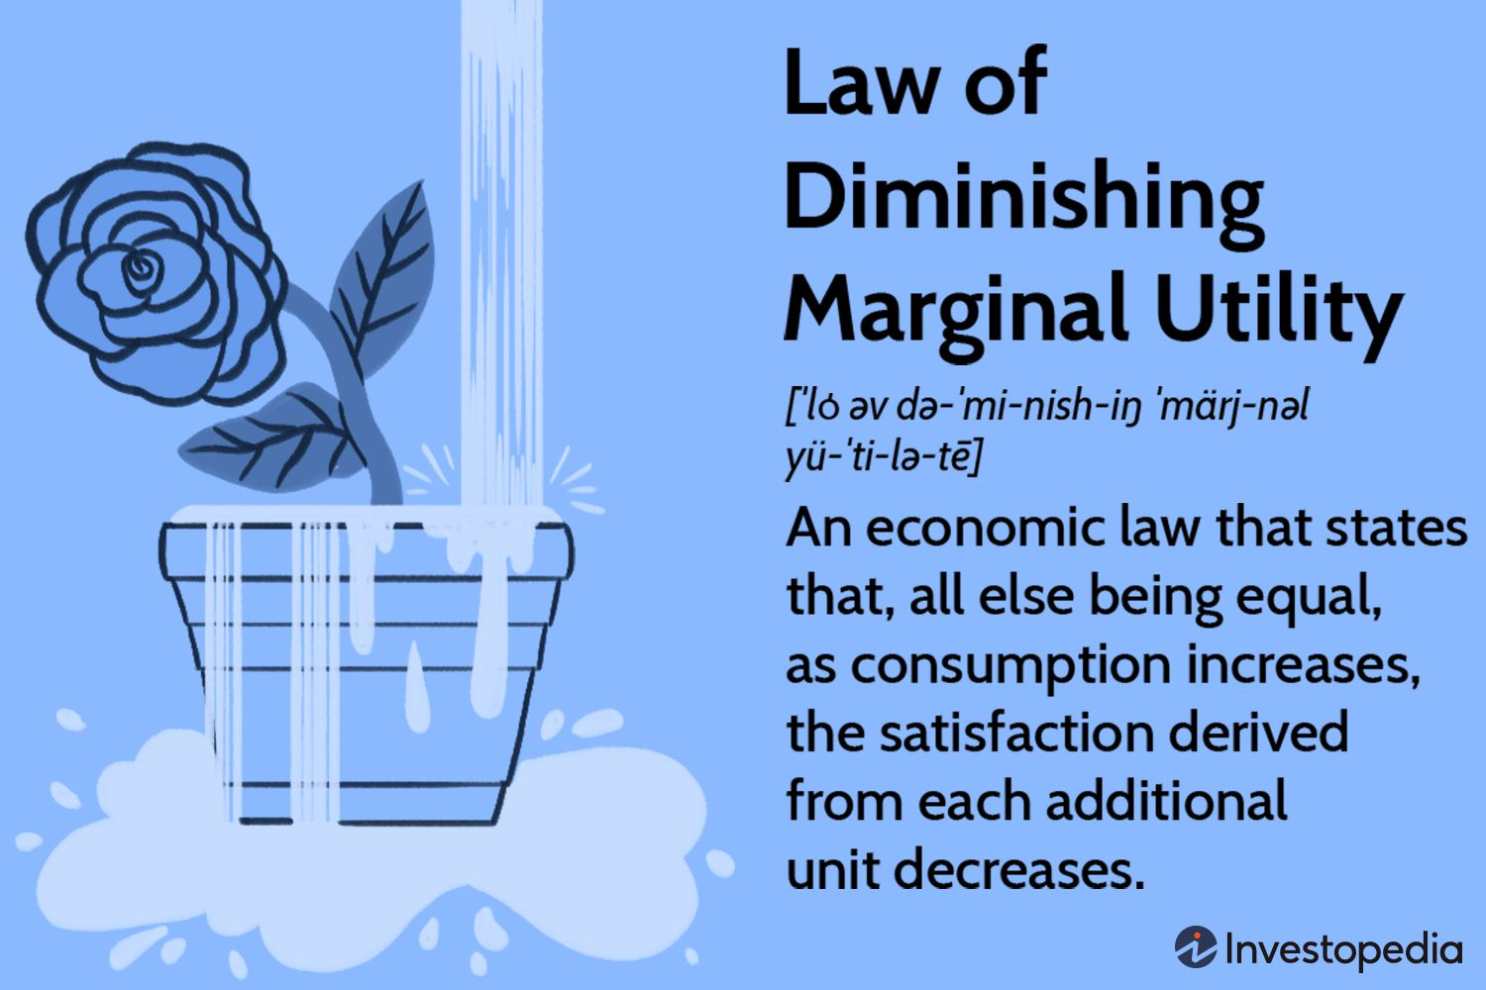
Jesus Turned Water Into Wine
Fermented or unfermented – Isa 16:10; 65:8
Where is the evidence it was fermented?
Will we take this to its logical conclusion?
Can we produce, sell, serve it, and make a living from it?
He made 120-180 gallons of it – John 2:6
This wouldn’t be social drinking – it’s a binge
They were already “well drunk” – John 2:10
Jesus used His 1st miracle to intoxicate?
Was Jesus a stumbling block? – Luke 17:1-2
I’m not ashamed to own my Lord

Slide 22
Gluttony Is A Sin Too
Is this really about gluttony?
Or is it a red herring to deflect from the subject of alcohol?
There are similarities, but also profound differences
Ethyl alcohol hinders rationality the moment we imbibe
Ethyl alcohol is not a food, it’s a poison – Col 2:16
What is worse in the pot brownie, the pot or the brownie?
The only health benefits are in the grape, not the alcohol
“Resveratrol”, antioxidants

Slide 23
Jesus was called a drunkard (Luke 7:34)
Jesus’ enemies never painted an accurate picture of Him
Called a Samaritan (John 8:48), demon-possessed (John 7:20), sinner (John 9:24)
His silence was not affirmation
He didn’t give Herod the time of day (Luke 23:9)
Proper contrast: John led austere lifestyle. Jesus mingled
Engaging people in social atmospheres is what led to charge
Puts more faith in claims of Jesus’ enemies than God Himself
God has spoken on this matter: Prov 20:1; 21:17; 23:29-35
Are Jesus’ enemies influencing my decisions more than God?

Slide 24
What about 1 Tim 5:23?
It was a matter of his health
Water supplies of the ancient world could be dangerous
Paul told him to take “a little”
Is this what I’m aiming for in social/recreational drinking?
Why did Paul have to instruct Timothy to do this?
Speaks well of Timothy’s character that he restrained himself to the point of being sick
Alcohol is not a controlled substance
Should I then encourage it medicinally?

