Slide 2
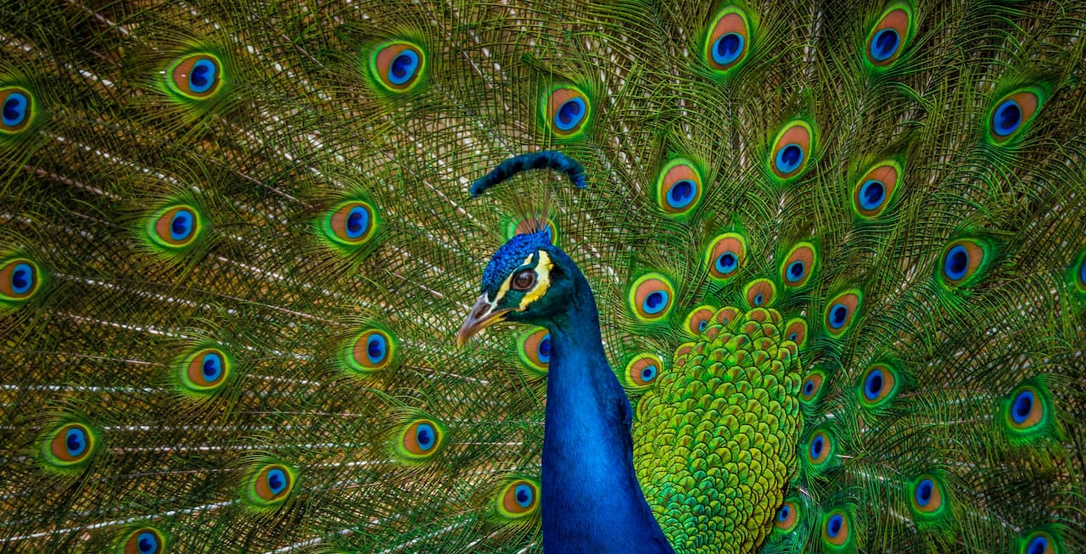

Slide 3
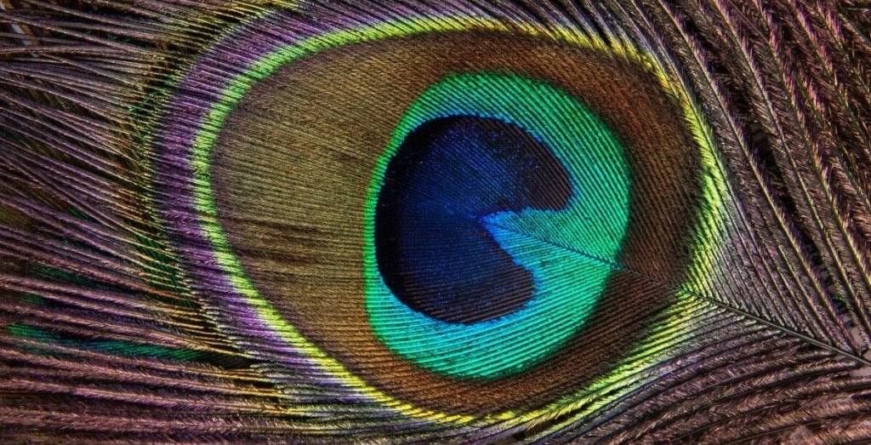

Slide 4
modesty
Transforming our view of dress

Slide 5
Proverbs 31
More precious than jewels.

Slide 6
An excellent wife who can find?
She is far more precious than jewels.
Proverbs 31:10

Slide 7
She dresses herself with strength…
Proverbs 31:17

Slide 8
Strength and dignity are her clothing…
Proverbs 31:25

Slide 9
…her clothing is fine linen and purple.
Proverbs 31:22

Slide 10
Charm is deceitful, and beauty is vain,
but a woman who fears the LORD is to be praised.
Proverbs 31:30

Slide 11
1 Timothy 2
Women who profess godliness.

Slide 12
First of all, then, I urge that supplications, prayers, intercessions, and thanksgivings be made for all people.
1 Timothy 2:1

Slide 13
This is good, and it is pleasing in the sight of God our Savior, who desires all people to be saved and to come to the knowledge of the truth.
1 Timothy 2:3-4

Slide 14
I desire then that in every place the men should pray, lifting holy hands without anger or quarreling…
1 Timothy 2:8

Slide 15
…likewise also that women should adorn themselves in respectable apparel, with modesty and self-control, not with braided hair and gold or pearls or costly attire…
1 Timothy 2:9

Slide 16
…but with what is proper for women who profess godliness—with good works.
1 Timothy 2:10

Slide 17
1 peter 3
Precious in God’s sight.

Slide 18
Likewise, wives, be subject to your own husbands, so that even if some do not obey the word, they may be won without a word by the conduct of their wives, when they see your respectful and pure conduct.
1 Peter 3:1-2

Slide 19
Do not let your adorning be external—the braiding of hair and the putting on of gold jewelry, or the clothing you wear…
1 Peter 3:3

Slide 20
…but let your adorning be the hidden person of the heart with the imperishable beauty of a gentle and quiet spirit, which in God’s sight is very precious.
1 Peter 3:4

Slide 21
Dress so that others can see your beauty.

Slide 22
Take cues from women who profess godliness.

Slide 23
Use the Song of Solomon for guidance.

Slide 24
Give your husband something special.

Slide 25
Dress for God.

