Slide 3
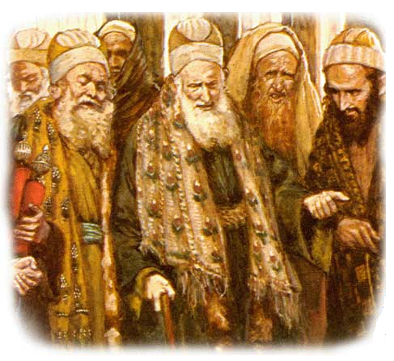
The Pharisees
Background
Emerged from Maccabean revolt
Pharisee – “Separated Ones”
Sought to avoid forefathers’ mistakes
Associated with scribes & lawyers
Most biblically literate
Sanhedrin’s majority-rule

Slide 4
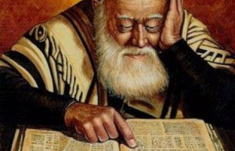
The Pharisees
Beliefs
Most strict (Acts 26:5b)
Inspiration of scripture (2 Tim 3:16)
Resurrection of the dead (Acts 23:8)
Free Will (Rev 22:17b)
Zealous in obedience (Matt 23:23a)
Temple Worshippers (Luke 18:10)
Morality/Holiness (1 Pet 1:16)
Givers (1 Cor 16:1-2)
Holy Days (Heb 10:25)
Disciplined Religion (2 Tim 1:7)
Evangelistic (Matt 23:15)
Restoration (Matt 23:30)

Slide 6
Spiritual Worldliness
All talk, no action
Matt 23:2-3,25-28; Jas 1:22
Shut people out
Matt 23:4,13; John 10:9
Sought honor from men
Matt 23:5-7; 6:2,5; 5:16
Demanded party loyalty
Matt 23:15; John 12:42; 7:47-48; 9:34; Gal 4:17
Self-serving traditions
Matt 23:16; 15:2-6
Unbalanced
Matt 23:23-24
Deluded & In Denial
Matt 23:29-33

