Slide 1
Notes:
PLEASE START HERE.

Slide 4
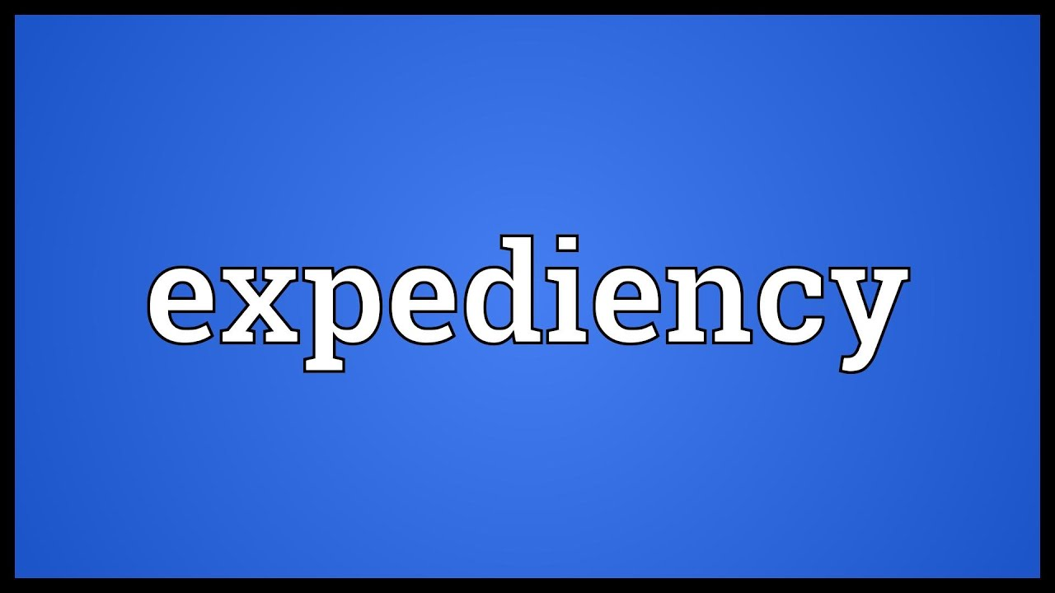

Slide 6
“appropriate to a purpose”
“a spiritually profitable or advantageous method for carrying out the Lord's instructions to us.”
“An advantageous means or method that one may use to accomplish a goal. It signifies that which is suitable for achieving certain ends.”
“useful for effecting a desired result; suited to the circumstances or the occasion”

Slide 7
Spiritually Profitable?
1 Cor 10:23 – “All things are lawful for me, but all things are not expedient: all things are lawful for me, but all things edify not.”
Mark 16:15-16 – “¹⁵And He said to them, ‘Go into all the world and preach the gospel to all creation. ¹⁶He who has believed and has been baptized shall be saved; but he who has disbelieved shall be condemned.’”

Slide 9
Spiritually Profitable?
Lawful?
1 Cor 10:23 – “All things are lawful for me, but all things are not expedient: all things are lawful for me, but all things edify not.”
Mark 16:15-16 – “¹⁵And He said to them, ‘Go into all the world and preach the gospel to all creation. ¹⁶He who has believed and has been baptized shall be saved; but he who has disbelieved shall be condemned.’”

Slide 10
Spiritually Profitable?
Lawful?
Edify?
1 Cor 10:23 – “All things are lawful for me, but all things are not expedient: all things are lawful for me, but all things edify not.”
1 Cor 14:26c – “Let all things be done for edification”
Rom 14:15b – “Do not destroy with your food him for whom Christ died.”
Rom 14:19 – “So then we pursue the things which make for peace and the building up of one another.”

Slide 11
Spiritually Profitable?
Lawful?
Edify?
Stumbling Block?
1 Cor 8:9 – “But take care that this liberty of yours does not somehow become a stumbling block to the weak.”
Rom 14:13 – “Therefore let us not judge one another anymore, but rather determine this—not to put an obstacle or a stumbling block in a brother’s way.”

