Slide 2
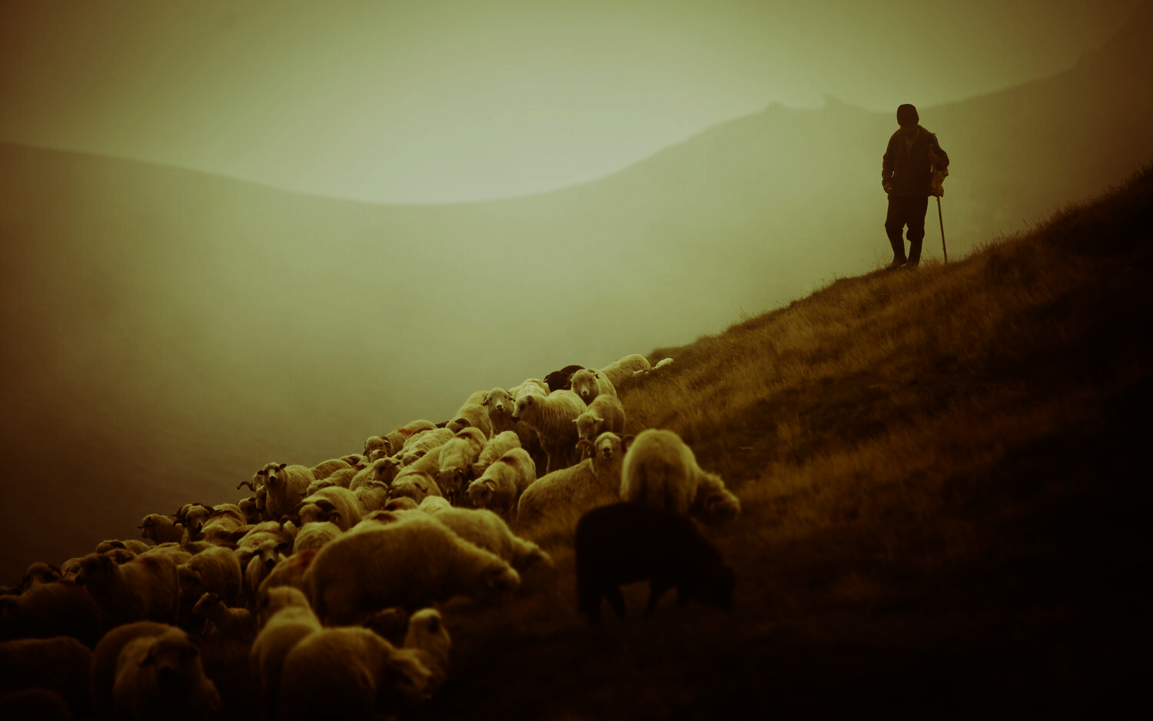
Contentment
Psalm 23

Slide 3
¹ The Lord is my shepherd; I shall not want.
² He makes me lie down in green pastures.
He leads me beside still waters.
³ He restores my soul.
He leads me in paths of righteousness
for his name's sake.

Slide 4
⁴ Even though I walk through the valley of the shadow of death,
I will fear no evil,
for you are with me;
your rod and your staff,
they comfort me.

Slide 5
⁵ You prepare a table before me
in the presence of my enemies;
you anoint my head with oil;
my cup overflows.

Slide 6
⁶ Surely goodness and mercy shall follow me all the days of my life
and I shall dwell in the house of the Lord forever.

Slide 7
I shall not want.

Slide 8
¹ The Lord is my shepherd; I shall not want.

Slide 9
² He makes me lie down in green pastures.
He leads me beside still waters.
³ He restores my soul.

Slide 10
³ He leads me in paths of righteousness
for his name's sake.

Slide 11
The shadow of death.

Slide 12
⁴ Even though I walk through the valley of the shadow of death,
I will fear no evil,
for you are with me;
your rod and your staff,
they comfort me.

Slide 13
⁵ You prepare a table before me
in the presence of my enemies;
you anoint my head with oil;
my cup overflows.

Slide 14
Goodness and mercy.

Slide 15
⁶ Surely goodness and mercy shall follow me all the days of my life…

Slide 16
⁶ and I shall dwell in the house of the Lord forever.

Slide 17
Write a list of physical and spiritual blessings.
Spend a few minutes in heaven every day.

