Slide 1
Notes:
Acts 14:15-17 – The prior studies have hopefully established the fact that God has truly not left us without witness. Existence itself lends evidence of a Creator, because the laws of our universe prevent something coming from nothing. For “something” to come about, something or someone greater than the physical laws of our universe must have started it all. And then last week, we observed how within existence, we find design of such intellectual and irreducible complexity, that the only rational explanation for their being here is an intelligent mind behind it.
And so everything we’ve looked at so far tells us a little something about God. We can infer that He is powerful, to quite an unquantifiable degree. And we see this in not just what He has created but in what He continues to sustain. We can observe the advanced, complex, yet orderly universe that we live in and conclude that He is vastly superior in intelligence to any one of us. And as Paul stated in Acts 14, we can understand from what He’s provided that He is looking out for our welfare through the very provisions He has set in motion: the rains from heaven, fruitful seasons, and the like. We can conclude all these attributes about God merely from what we call “general revelation”, observing the world around us and all of its amazing qualities.
In this study, we’re going to observe an even greater evidence for God’s existence than just looking to the cosmos. This is evidence that goes beyond proving the existence of God because it also helps us to begin understanding more about who He is. So while the human body is full of wonderful, intelligent design of such irreducible complexity that it cries of the existence of God, there is one aspect of our being that cries just a little louder. Within every human being, regardless of culture, race, gender, age, and time, there is an acute understanding of basic right and wrong.

Slide 2
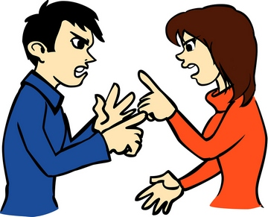
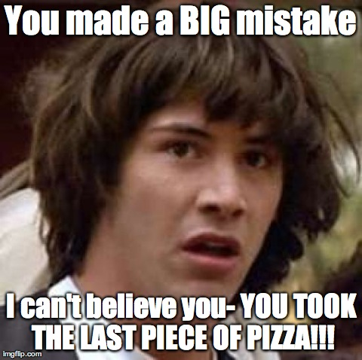
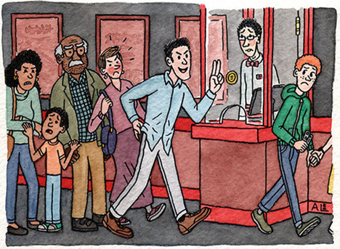
What Does Conflict Teach?
Notes:
Consider how human beings interact w/one another, particularly in those instances when a conflict has arisen. Examples:
1) “That was my piece of pizza you just ate!”
2) “Hey, you promised!”
3) “How would you feel if someone did that to you?”
4) “Hey, I was in line and you cut me!”
On the surface, these sound like conflicts you would simply see in children. However adults do it as well, both the educated and uneducated, the refined and unrefined. What is interesting about conflict is that the person making the accusation appears to be appealing to some standard of right and wrong that he just assumes the guilty party knows about. In each of these accusations, the accuser is saying that there is a general rule of fairness and decency and he just violated it, he knows he violated it, and the accuser is reminding them of that fact!

Slide 3
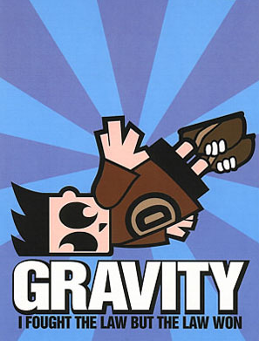
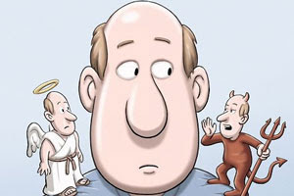
Scientific vs. Moral Law
Notes:
So, as we discussed the last couple of weeks, there are physical, biological, and chemical laws in nature that we are bound by such as the law of gravity. And we can’t choose whether to obey these laws or not because they are what they are. If you throw something off a 10-story building, it’s going to fall. But there’s another law intuitive of every single one of us that we can choose to violate and in fact often do violate, and that’s what has come to be called the “Moral Law”.
Within every single one of us, there is a fundamental standard of right and wrong that guides many of the decisions that we make throughout our lives. And if that were not the case, we’d have no cause whatsoever to say a single negative thing about groups like ISIS or Al Qaeda – that would include Christians, Muslims, and even Atheists. Who could blame them? If there is no such thing as fundamental right and wrong, the entire world would have no basis on which to criticize someone such as Hitler and accuse him of knowing what was right yet deciding to do the wrong thing anyway. If people like Hitler had no notion whatsoever of what was right and wrong, we’d have no grounds for blaming them for what he did unless we’re also ready to blame people like that for other things they can’t help such as the color of their eyes or the complexion of their skin.

Slide 4
Evidence for a Moral Law
Conflict
Notes:
So this Moral Law can be seen and understood just by observing conflicts between ourselves and our fellow man and assumptions made by the offended party toward the accused. And we’re aware of these standards from a very young age.

Slide 5
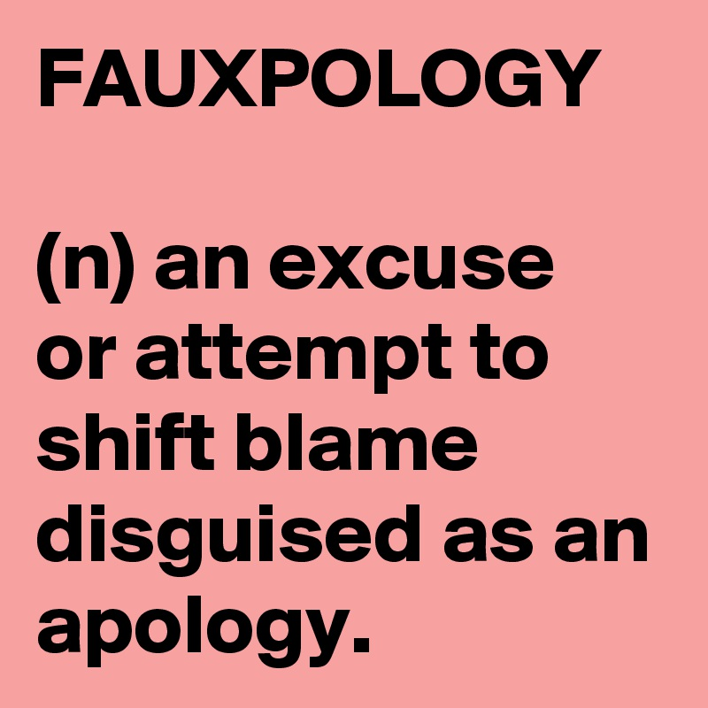
Evidence for a Moral Law
Conflict
Excuses
Notes:
But here’s even more evidence: if I’m the accused party, isn’t it interesting that my first instinct is to offer an excuse for my behavior?
“That was my piece of pizza you just ate!” Excuse: “I know, but I was hungry. I didn’t think you were going to eat it.”
“Hey, I was in line and you cut me!” Excuse: “I know, but I’m in a hurry.”
3) “Hey, you promised!” Excuse: “I know, but something came up that should let me off this promise. I was tired, I was stressed, I wasn’t in my ‘right min’” (interesting choice of words
When I’m confronted with a wrongdoing, I don’t look at that person and say, “Forget you and your standard.” No. Instead, I’ll come up with an excuse that affirms, “Yes, I know that’s wrong, but here’s the special reason why I did it.” Did you notice that in each of these excuses, there is an acknowledgement of a standard? There’s an agreement, an unwritten contract from individual to individual on certain basic things that ought to be and ought not to be present in our interactions w/one another. But then that agreement is followed by what I push on the offended party as an exception to the normal rule. These excuses are evidence of how deeply we believe in an intuitive law of right and wrong, whether we want to admit it or not.

Slide 6
Evidence for a Moral Law
Conflict
Excuses
Cultural Standards
Notes:
Third, this Moral Law has actually been consistent across every culture, society, and civilization since the beginning of time. Now some will object to this by asserting that civilizations of bygone years have had vastly different moral codes. Well, yes and no. There are absolutely differences in some of the nuances of their moralities, but not absolute differences on their most fundamental level, which I’ll explain in a moment.
C.S. Lewis wrote a book entitled “The Abolition of Man” and if you look up that book online and turn to the appendix, he provides a multitude of quotations from ancient, diverse civilizations: Greek, Roman, Chinese, Egyptian, Babylonian, and Hindu. And in all these quotes from these distinctive and different cultures, you will see that despite nuances of differences, it never amount to a total difference.
For example, you will find differences in cultures regarding the marriage law. Some cultures believed in one man to one woman, others one man to several women. That’s a difference in detail. However you will never find a culture that thought it was appropriate a man to take for himself any woman that he wanted. A basic law of marriage is still understood.
Isn’t it interesting that though idolatry is so frowned upon in scripture, that even those pagan nations understood, even if only on a fundamental level, that there was a higher power that needed appeasement?
So I have no problem conceding that there have been variances in the nuances and details of the application of the Moral Law because its’s never amounted to a complete and total difference. Fofr example, you’re never going to find a culture where selfishness is admired over selflessness. You’ll never find a nation who honored its citizens for running away from battle or who gives its citizens a pat on the back for their ability to steal from another individual.
Why? Because their are basic, fundamental rules of decency and fair play that have been consistent across every culture and society known to man since the beginning of time.

Slide 7
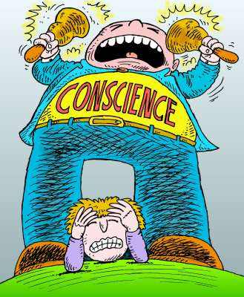
Evidence for a Moral Law
Conflict
Excuses
Cultural Standards
The Conscience
Notes:
And then fourth, and this is a big one, within each one of us there is a conscience that is attempting to direct us towards what it deems to be the “right” decision.
Now, the bible tells us that this conscience is a tool that God has placed within us by virtue of the fact that we are made in God’s image:
Gen 1:27a – “God created man in His own image”.
And even Paul acknowledged the conscious as a living, active compass to our understanding of basic right and wrong – Rom 2:14-15 – “For when Gentiles who do not have the Law do instinctively the things of the Law, these, not having the Law, are a law to themselves, in that they show the work of the Law written in their hearts, their conscience bearing witness and their thoughts alternately accusing or else defending them.”
But we don’t need the bible to know this basic point, that our conscience acts like an umpire that positions us to view life situations in a moral and ethical light. Our conscience judges and determines that some actions are right and some actions are wrong. When we do what is right, our conscience commends us and we can go throughout our day guilt-free and clear of blame. But when we go against our conscious, it causes us to feel guilt and even keeps us up at night reminding us over and over again that we knew better but we did wrong anyway.
And so our conscience proves that an objective moral law exists because it attempts to encourage us to act morally even when it is not in our own earthly interest to do so. And if the conscience proves the existence of an objective moral law, this would in turn prove that there is a God behind it giving authority to these truths. And when we haven’t seared our conscience by constantly disobeying it and allowing ourselves to become desensitized to moral convictions, the conscience works really hard to bring us in line with that Moral Law.

Slide 8
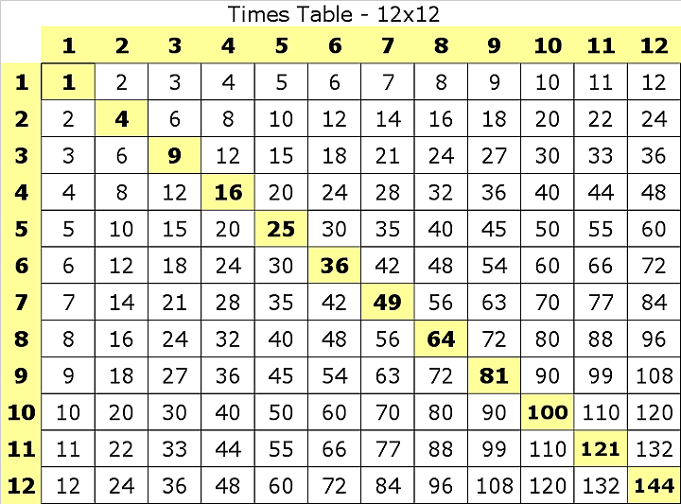
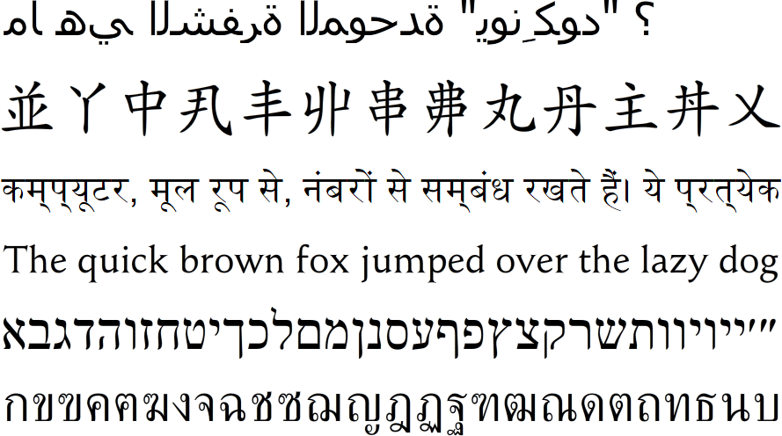
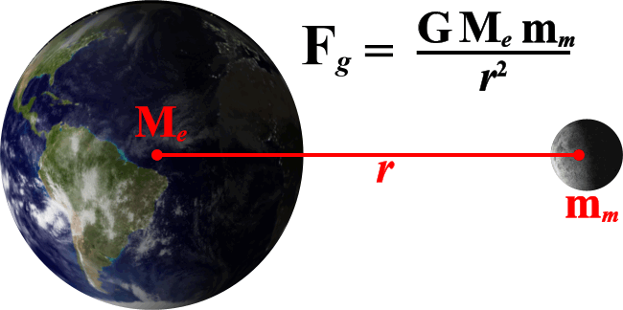
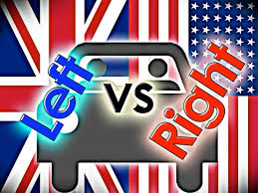
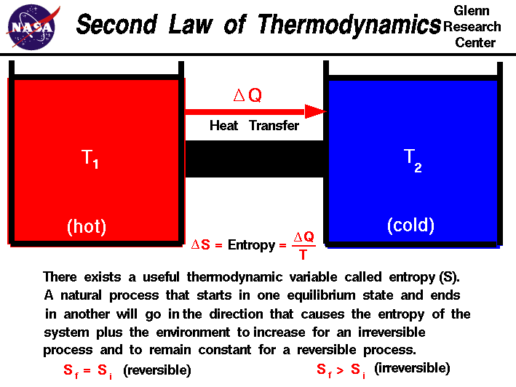
Taught by Society?
Vs
Notes:
Now, despite these evidences, there have been objections raised to the existence of a universal moral law, and it would help us to talk through these objections to understand why they’re not viable objections.
Objection #1 – “What you’re calling the Moral Law could simply be societal standards we have learned from parents, teachers, etc.”
This is one of those statements that is true in some ways and wrong in others. It’s true that there are things we learn from our parents and teachers and other authorities that would correlate with what we’re calling the Moral Law. But where this objection is incorrect is that it assumes that having taught certain things means those things originate from us. Going back to the cosmological argument, it’s similar to attributing existence to a big bang, but then not being able to account for all the energy and elements that would have caused such a cosmological event.
Rules that we are taught come from two different categories. First, there are rules taught that are different from culture to cultural: language, an alphabet, culinary tastes, the kinds of clothes we wear, or what side of the road is proper to drive on. But then there are other rules that are the same, culture to culture, such as the multiplication table, Newton’s gravitational law, etc. A desert nomad w/no access to books or the internet will have never heard of Newton’s gravitational law and would need to be taught that. But it’s not something that mankind invented. It just what it is. When that apple fell on Isaac Newton’s head, he didn’t invent the gravitational law and he certainly didn’t change it. He merely discovered what already existed and passed on that knowledge to subsequent generations.
I’m suggesting that the Moral Law falls into that 2nd category on the right. We may learn rules of fair play from our parents and teachers just as we learn anything else. But the Moral Law has been consistent throughout all cultures and times as I mentioned earlier. So the fact they are taught by society doesn’t mean the Moral Law originated or was invented by society. It just is what it is.

Slide 9
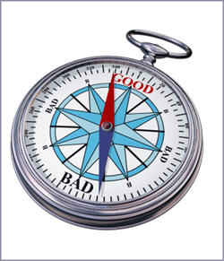
Herd Instinct?
Notes:
Objection #2 – “What if what you’re calling the Moral Law are just things that help us get along better in society. It’s herd instinct.” Again, there is some truth and error in this statement, and that’s what can make having these discussions so tricky sometimes, developing the ability to sniff out the error in a statement that is partially true. There are instincts that exist; strong desires to behave a certain way, such as wanting to help another person. No argument there.
But here’s the difference: having a desire to help someone is not the same thing as that feeling that you ought to help them whether you want to or not.
Example – let’s say you’re at the beach and you see a child getting pulled under by a rip tide. You’re going to feel two instincts in this situation. One instinct will be the desire help the child, and I’d have no problem classifying this as a herd instinct. But the other instinct will be a desire to keep yourself out of danger, which could be classified as an instinct of self-preservation. But in the very little time you have to work out these 2 instincts, there’s a third thing going on in our mind that isn’t an instinct at all. That third thing inside of you is telling you that the right thing to do is to follow the instinct to help that child and to suppress the instinct for self-preservation. This third thing, which is the conscience, is judging between the correctness of the two instincts, encouraging you toward one instinct over the other. And that is what we’re calling the Moral Law and it is completely independent from both instincts. Instincts are instincts, and any of them can certainly be herd instincts. But the Moral Law is the thing inside of us that is telling us which instinct is the right one.
A second way to see how the moral law is different than the instincts themselves. In the drowning situation, the instinct to jump in the water and swim into rip tide to help that child along w/the instinct to stay safe and out of the water are going to be in direct conflict with one another. Now the stronger of these two instincts will inevitably win, but which one is the stronger instinct in this case? It’s the instinct to stay safe, that’s going to be stronger because selfishness, self-interest, and self-preservation usually win out over selflessness and sacrifice. But, which is the moral law pointing to as the right thing to do? It’s pointing to the weaker instinct that is saying to help save that person. Yes, you may be risking your life but the Moral Law says to help him all the same. The Moral Law is what’s in the background reminding us, through our conscience, not to go with the more selfish instinct but to make the selfless one the stronger instinct – and so the Moral Law cannot be the herd instinct itself.
A third way to see this is that if the Moral Law is really just one of our instincts is we ought to be able to point to any one instinct inside of us that is always in agreement with right behavior. But we can’t. There is not one single instinct we have that the Moral Law will tell us to encourage while in another situation be telling us to suppress it. Examples: there are situations when sexual desire needs to be suppressed and other times when it needs to be encouraged when we’re explicitly talking about the duties of husbands and wives. A mother’s preference toward her children may need to be suppressed in certain situations or it could lead to unfairness towards other people’s children. The instinct to take drugs in one situation should be discouraged but when it is needed to suppress pain for a dying or hurting man it would be encouraged. What I’m suggesting is that there really are no instincts within us that are always right or always wrong. One can be right in one situation and wrong in another. The Moral Law we’re talking about is not an instinct; it’s the compass directing us toward the right instinct, from situation to situation. That’s the difference.

Slide 10
1 Tim 6:16 – “Who alone possesses immortality and dwells in unapproachable light, whom no man has seen or can see. To Him be honor and eternal dominion! Amen.”
Notes:
Point: if the Moral Law is a real thing, it’s not something we invented; it means there is a Supreme Being behind it who exists in a reality beyond our own and we somehow feel obligated to obey this Law. And if God put this within us, it reveals more about Him than what we can infer from just looking at existence and design from a scientific standpoint. See, the last two lessons on existence and design tell us nothing more about God than the fact that He is powerful, He is intelligent, and He is looking out for our benefit and well being. But when we consider the Moral Law that He has placed within us along with our conscience that is trying to guide us to obey it, what this reveals about God is that He has moral, ethical preferences. It means God is more than just an artist or an architect or an intelligent designer. The Moral Law teaches us about His personality. Because we’re no longer looking at a complex blueprint; the architect is talking to us directly.
What is He telling us through the Moral Law? That He is keenly interested in right conduct, fair play, selflessness, courage, and honesty. In other words, the Moral Law teaches us that God is good. And while this is a cause for adoration on our part, it is also cause for great dread. Why? Because one side of us agrees with that goodness and disapproval of human selfishness. But the other side of us embraces human selfishness in that we find ourselves often not living with a good conscience because we frequently violate the Moral Law. I may try and convince myself that I’m better than I really am and so surely God will make an exception for wonderful me, but God cannot be good unless he detests what is not good. And if God truly is absolute goodness, He must detest a whole lot of what I do – this is a terrifying fix to be in.
Let the paradox of this sink in. The reason we have the provisions that are in place is because of His goodness. And so without this goodness, we’d be hopeless. Yet every single day, as we resort to selfishness, dishonesty, and every other decision that violates the Moral Law, we’re making ourselves enemies of this Author of goodness every single day. We couldn’t live without goodness and we can’t live with it. God is our only comfort and hope, but He is also a Being of supreme terror. He’s the one Person we need the most and the one Person we try to hide from. He is our only possible ally and yet we’ve made ourselves His enemy. So let’s dispense w/the notion that being in the presence of God and His goodness is all blue skies and rainbows. We better think again. God’s goodness is either going to be our grand safety net or the greatest danger we could ever face, depending on what we decide to do about the demands of His goodness.
Any thinking person should be able to come to this very general conclusion w/o any specific, written revelation.

Slide 11
Notes:
But here’s the great thing: the bible teaches the exact same thing. See at some point in coming to these conclusions, I’m going to have to make a decision on which religious literature, if any, to begin investigating that will reveal my Creator and His plan for me more specifically. And next week, the case is going to be made that we ought to start by considering the bible because it and the Moral Law are in complete agreement in all their moral teachings. “Can two walk together unless they be in agreement?” The Moral Law and the bible agree. And this fact should conclusively prove that they both come from the same Author.
2 Cor 4:2 – What does he mean by the second part of that verse? I think Paul means that when he revealed the great truths of the gospel, it was appealing to every man's conscience in such a way that it forced the approval of each man’s conscience. The truth commended itself as truth. And no person who hasn’t seared his conscience can doubt its evidence. No person who understands the bible’s moral claims can dispute those claims. What truths are those? Supreme love toward God and equal love toward our neighbor. These are the two greatest commandments that Jesus tells us embody the entirety of scripture; and it is confirmed by our conscience.

