Slide 1
Notes:
2 Tim 3:16-17 – “All Scripture is inspired by God and profitable for teaching, for reproof, for correction, for training in righteousness; so that the man of God may be adequate, equipped for every good work.”
That word “inspired” comes from a Greek word that means “God-breathed” or “breathed out by God”, and if you are reading from the ESV or the NIV, that is how it is translated. And what this means is that the viability of scripture rests on whether or not the words we read are truly of divine origin. Because it is either going to be God’s words, or man’s words. Christians believe scripture is from God Himself, that He chose specific events and specific words that He wanted recorded to give us the best possible chance to come to Him through faith. And this is why scripture is able to equip us as God wants us equipped, to live as He wants us to live; because they’re not from our futile wisdom, but wisdom above, a wisdom beyond man’s ability to invent.

Slide 2
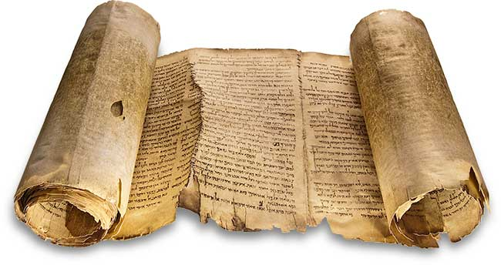
Inspiration Of The
Old Testament
Notes:
But how do we know? It’s one thing to prove the Old Testament’s reliability as a document of antiquity, but within the OT are some pretty phenomenal claims throughout history – miracles, divine intervention, prophets who claim to speak for God, and some pretty bold promises made hundreds and thousands of years before they would ever supposedly take place. So even if anyone convinced of the OT’s reliability is still going to struggle w/some of its claims.
So what evidence do we have for inspiration that goes beyond the mere claim of inspiration? We’re going to look at 2 subjects: fulfilled prophecy and scientific foreknowledge.
While it is true that there are radical, bold promises made throughout the OT, it’s inspiration rests on whether these promises have actually been fulfilled.

Slide 3
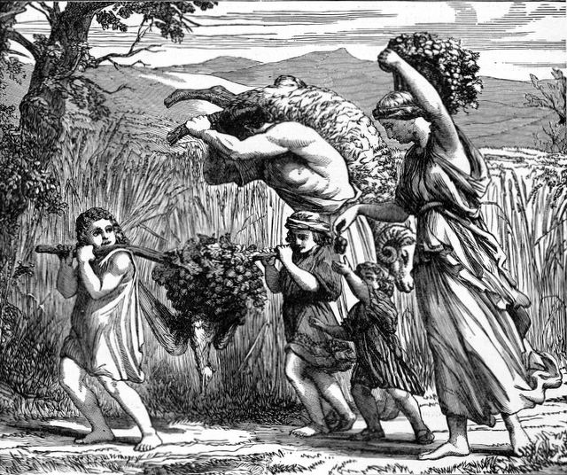
Fulfilled Prophecy
Jewish People
Promise of land, nation, & seed to Abraham’s descendants – Gen 12:2-3; 13:4-5
Warnings later given – Deut 28 – 33
Remove them from land
Scatter them among nations
Land would lose its fruitfulness
Notes:
In the early days of Genesis, God blessed Abraham and promised him, among other things, that He would give to his descendants a great land – the land of Canaan. 400 years later when the number of Abraham’s seed exploded, they are on the verge of taking Canaan’s land and Moses gives the people warnings in Deut 28 – 33. One of the warnings concerned the land. He basically tells them that the land He is going to give them is fruitful and its theirs. But if they do no obey His voice, God would remove them from the land and scatter them amongst the nations. He also tells them that He would cause the land to lose its fruitfulness.
Well, history is irrefutable that this is exactly what happened. The Jews’ sins got so out of hand, God sent the Babylonians as His tool of judgment who then conquered the Jews and deporting them and scattering them. And if we visit Canaan’s land today, does it look like the land of milk and honey? No, it looks like a barren wasteland. That’s not what we read about it in the first 5 books of the OT, though; it’s referred to as being the most fruitful and fertile land in the known world. God did what He said He’d do and that’s why today it looks nothing like described in the OT.

Slide 4
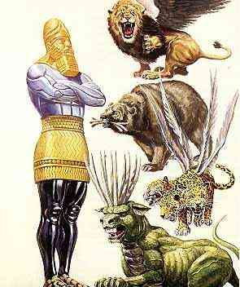
Fulfilled Prophecy
Daniel’s Prophecy (Dan 2 & 7)
Babylonian Empire (Head of Gold)
Nebuchadnezzar (605 – 539 BC)
Medo-Persian Empire (Breast of Silver)
King Darius (539 – 331 BC)
Grecian Empire (Torso of Brass)
Alexander the Great (331 – 146 BC)
Roman Empire (Legs of Iron)
King Nero (146BC – 476AD)
Kingdom of God (stone cut w/o hands)
Jesus Christ (∞ – ∞)
Notes:
In Dan 2, the Babylonian king Nebuchadnezzar is given a dream by God of a statue that he was not able to understand. Daniel is able to reveal both the dream and its interpretation and that it is referring to four powerful nations that would come about, beginning with the head of gold which is explicitly referred as representing Babylon. But the next 3 nations are not named, only described. And then Daniel mentions that during that 4th world power another nation not made with hands would come about. The stone cut w/o hands is w/o a doubt Jesus Christ and the kingdom He would establish called the church. And so we know from history that the world power in existence at that time was Rome. There were only two world powers in between Babylon and Rome, the Medo-Persian empire and the Grecian empire. How could Daniel have possibly known how many world empires there would be, describe them so accurately, and then be able to identify the one in which the church would come? Because God told Him.
This places the OT well beyond just being a reliable historical document and into the realm of being inspired by a divine presence that knows the future, making it inspired, breathed out by God.

Slide 5
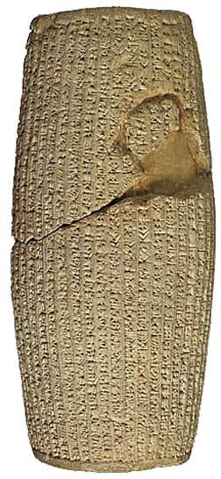
Fulfilled Prophecy
Cyrus
Isaiah (~750 BC) names Cyrus as the king who will say to Jerusalem that it shall be built and that the temple foundation shall be laid
Isa 44:28 – “It is I who says of Cyrus, ‘He is My shepherd! And he will perform all My desire.’ And he declares of Jerusalem, ‘She will be built,’ And of the temple, ‘Your foundation will be laid.’”
At the time of writing, Jerusalem was fully built and the entire temple was standing
In 586 BC, the city and temple would be destroyed by the Babylonians
Babylon was conquered by the Medo-Persians in 539 BC. Shortly after, a Persian King named Cyrus gave the decree to rebuild the temple in Jerusalem; >200 years after the prophecy of Isaiah (Ezra 1:1-4)
Notes:
The book of Isaiah was written ~700BC and is the most prophetically rich books of the entire OT. One of these prophecies is found in Isa 44:28 where God said that a man named Cyrus would one day give an order for the city of Jerusalem and its temple to be rebuilt. What is interesting about this prophecy is that when it was written, Jerusalem was still standing. Jerusalem would not fall to the Babylonians until 586BC. This was followed by a period of Jewish captivity in Babylon where the Medo-Persian empire would then sack Babylon in 539BC. A man named Cyrus was the king of the Persian Empire and it was this same Cyrus who gave the order in Ezra 1 for the Jews to return home to rebuild its city and its temple.
We have secondary evidence for this. The picture on the right is called the Cyrus Cylinder and it was discovered in the ruins of Mesopotamia in 1879 dating to the 6th century – you can see it today in the British museum. The cylinder names Cyrus as the king at this time and chronicles his victory over the king of Babylon as well as the fact that upon this victory, he repatriated all the captive nations and restored their temples and cult sanctuaries. The prophecy regarding Cyrus is one of many records in the OT that doesn’t just prove its authenticity, but its divine inspiration.

Slide 6
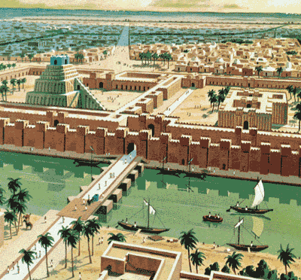
Fulfilled Prophecy
Fall of Babylon
Dan 4:30 – “Babylon the great”
Isa 13:19 – “the beauty of kingdoms”
Isa 47:5 – “queen of kingdoms”
Jer 51:13 – “Abundant in treasures”
Jer 51:41 – “the praise of the whole earth”
Isa 47:7-8 – “I will be a queen forever…I am, and there is no one besides me. I will not sit as a widow, nor know the loss of children.”
Isa 21:9 – “Now behold, here comes a troop of riders, horsemen in pairs. And one said, ‘Fallen, fallen is Babylon; and all the images of her gods are shattered on the ground.’”
Isa 44:27-28a – “I am the One who says to the depth of the sea, ‘Dry up!’ And I will make your rivers dry up. It is I who says of Cyrus, ‘He is My shepherd, and he will carry out all My desire.’”
Notes:
The Fall of Babylon is was one of the most shocking things to occur in the ancient world. No one could have ever guest it.
In it’s day, Babylon was a remarkable community, the New York City or London of the ancient world. The historian Herodotus (484-425 B.C.) once visited the great metropolis in the 5th century. He claimed that the town was laid out in an exact square, approximately fifteen miles on each side. The city was surrounded by a moat 260 feet wide, behind which was a massive wall—some seventy-five feet thick and three hundred feet high, with fifteen large gates of brass on each side. One of the prominent features of this illustrious city was Nebuchadnezzar’s hanging gardens, constructed for his wife, and was considered one of the seven wonders of the ancient world. Herodotus said that “in magnificence there is no other city that approaches to it” (The Histories I.178). And God’s word speak about Babylon in these same terms.
But Babylon was the epitome of arrogance. She boasted within the security of its mighty fortress and believed that the capital city would never be vanquished. Isa 47:7-8 – “I will be a queen forever…I am, and there is no one besides me. I will not sit as a widow, nor know the loss of children.” The Chaldean archives also illustrated the haughty disposition that characterized the Babylonian rulers (Millard 1985, 138).
Yet God determined its destruction in very graphic terms – Isa 21:9. How could such a magnificent city be taken down? Even when Cyrus surveyed Babylon’s fortifications, he himself said: “I am unable to see how any enemy can take walls of such strength and height by assault”. And so he devised a brilliant strategy for capturing the city. The Euphrates river ran under the walls through the center of Babylon. Just to the west of the city was a huge lake-basin, about 35 feet deep and covering 40 square miles, but which, at the time of the invasion, was but a marsh. Cyrus stationed soldiers at the point where the river entered the city, and also where it exited. At a given time, he diverted the Euphrates from its bed into the marshy lake area. His forces then entered Babylon under the city walls – Isa 44:27-28a.

Slide 7
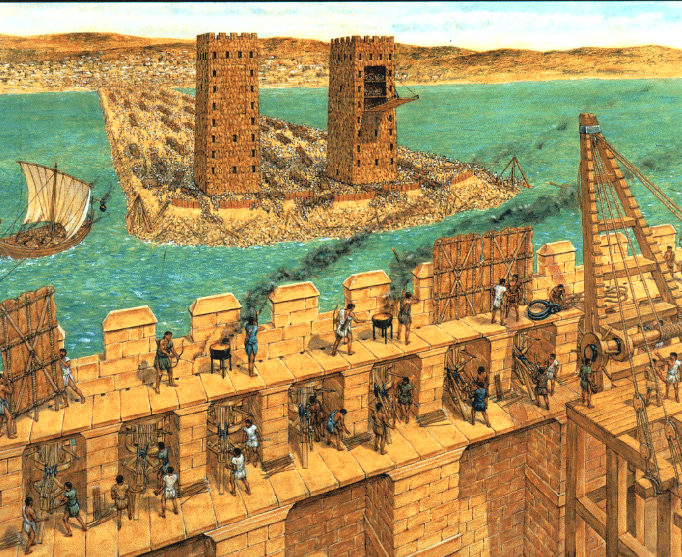
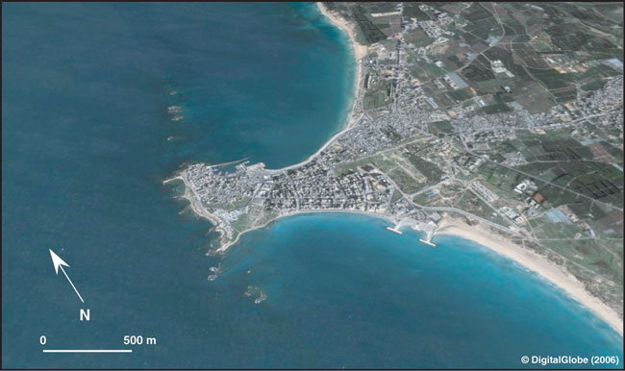
Fulfilled Prophecy
Fall of Tyre
Ezek 26:12 – “Also they will make a spoil of your riches and a prey of your merchandise, break down your walls and destroy your pleasant houses, and throw your stones and your timbers and your debris into the water.”
Notes:
In Ezek 26 – 28, God is laying out his plans to bring judgment upon a port nation in Phoenicia called Tyre. Tyre was a very prideful nation because of its wealth and commerce and its security. And God’s intention was to humble Tyre by bringing nations in judgment against them. One thing Ezekiel mentions in Ezek 26:12 deserves special attention as he claims that Tyre would not only be destroyed, but its building material and debris would be cast into the water. What is this alluding to?
Tyre was divided into two parts. One part was on the mainland of Phoenicia and the second part was an island about 800 yards off the coast that was deemed to be impregnable. Well, in 332BC, Alexander the Great basically said “I’m your huckleberry”, and he took on the task of besieging the entire nation of Tyre. He started by sacking the city on the mainland, but he had to figure out how to take the island. No one had ever done that before. Babylon hadn’t been able to do. Persia hadn’t been able to do it. How was Alexander going to accomplish a feat that the kings from those two mighty empires couldn’t even achieve?
He took the debris from the mainland city that he destroyed and built a causeway, a land bridge, out to the island where he then besieged and destroyed it. He was the first to do so. As you can see in this picture, the causeway was so well built that it stills exists today, though it has been widened and expanded upon, and now there are homes and other buildings standing on it. This is an amazing fulfillment of prophecy because no one had ever been able to take that island before Alexander the Great and so the prophecy in Ezek 26 would have seemed laughable, if not for the divine purpose and foreknowledge of God.

Slide 8
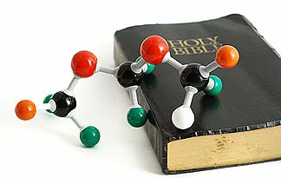
Scientific Foreknowledge
Notes:
Imagine a book that reveals scientific foreknowledge about things that could not have been known by man because science and technology had not yet progressed enough for man to have discovered it. If that were the case, we could rightly come to the conclusion that some greater mind was behind the revelation of this science, right? This is exactly what we find in the OT. Scientific foreknowledge, information revealed that covers a broad range of scientific disciplines that could not have been known during that time period.
Before we look into this subject, a little disclaimer. The subject of scientific foreknowledge has become so popular amongst Christians, that there are some things used to prove scientific foreknowledge that, IMHO, I would not consider to be strong evidence. I’m going to exclude some of these things from this study and just include what I believe to be the stronger cases.

Slide 9
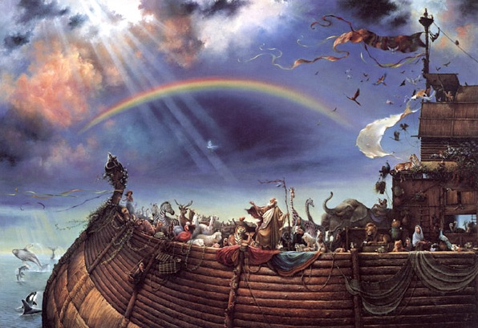
Scientific Foreknowledge
Noah’s Ark
1.5 million cubic feet
Ratio - 30:5:3
In 1858 at Isambard Brunnel built a ship after that same pattern revolutionizing ship-building
By the late 19th century, every large ship on the high seas was inclined toward the proportions of the ark (verified by "Lloyd's Register of Shipping" in the World Almanac)
Notes:
In Gen 6:15, God instructed Noah to build an ark that was 300 cubits long, 50 cubits wide, and 30 cubits high. In terms we can understand, the ark was 450 feet long, 75 feet wide, and 45 feet high. This is a ratio of 30 to 5 to 3 (length, breadth, and height). Up until 1858, the ark was the largest, floating ship ever created until a man named Isambard Brunnel built his giant ship called “The Great Britain” using the exact same ratio of the ark – 30:5:3. As it turns out, these dimensions are the perfect ratio for a huge boat being built for sea worthiness and not for speed. Obviously the ark was built for the former reason. So sea worthy is this ratio, ship builders during WW2 used the same ratio to build a ship known as the S. S. Jeremiah O’Brian which was a barge like boat built to carry tremendous amounts of cargo much like the ark was intended to haul. How did Noah know the perfect seagoing ratio for building the ark? Brunnel and others like him had many generations of shipbuilding knowledge to use, but Noah’s wasquite literally the first of its kind. Where did he get such information? The answer is he got it from the Master Shipbuilder and Designer Himself.

Slide 10
Scientific Foreknowledge
Circumcision
Gen 17:12 - “And he that is eight days old shall be circumcised among you, every man child in your generations, he that is born in the house, or bought with money of any stranger, which is not of thy seed.”
Medical science later discovered that the 8th day is the only day in the entire life of the newborn that the blood clotting element prothrombin is above 100%
Notes:
In Gen 17:12, God commanded Abraham to begin circumcising the newborn males in his bloodline on the 8th day. This would be a sign of the covenant between them. Why the 8th day? We’re not told. This is just what God commanded and we are told that Abraham did so as well as all of his descendants after him.
In the early 20th century, it was discovered that vitamin K is responsible for the production of a chemical in the liver called “prothrombin” which is the chemical that prevents us from hemorrhaging. Scientists know now that it is on the 8th day of a newborn baby’s life that the amount of prothrombin present is actually above 100% standard production, and it is the only day in the male’s life in which this will be the case. Even today, if surgery is performed on a newborn baby, every doctor knows that the 8th day is the perfect day to do it because prothrombin and vitamin K levels are at their peak. This instruction given to Abraham was not only scientifically accurate, but well ahead of its time. How did he possibly know such information? He got it from God. The OT is inspired.

Slide 11
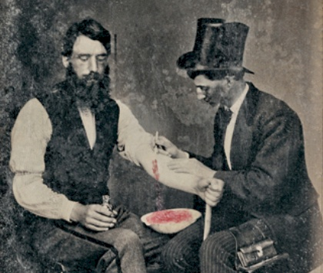
Scientific Foreknowledge
Blood letting
Lev 17:11 – “For the life of the flesh is in the blood, and I have given it to you on the altar to make atonement for your souls; for it is the blood by reason of the life that makes atonement.”
Gen 9:4 – “Only you shall not eat flesh with its life, that is, its blood.”
Notes:
In Lev 17:11, God declared through Moses to Israel that the life of all flesh is found in the blood. And in doing so explained why animals can provide a substitutionary atonement for man’s sin. Yet this Biblical truth was either ignored or not understood by scientists and doctors for thousands of years. Eventually, around 1620 the English physician and creationist scientist named William Harvey discovered the circulation of blood pumped throughout the body by the heart, that blood maintains and supports life by carrying nutrients to every cell of the body and taking away wastes. It reaches every cell via an extensive microscopic capillary network. BTW, the combined length end-to-end of an adult’s blood vessels is about 100,000 miles. This is about four times the circumference of the earth. The heart pumps about 100,000 times a day to send blood with oxygen, minerals, vitamins, and nutrients through the capillaries to each cell and carry away waste products. It pumps about 80 million gallons in a lifetime. What man-made pump could deliver this level of performance? Is it reasonable to believe it could have “evolved” as a result of accidental mutations?
But even as few as 200 years ago this biblical truth was ignored when it was common to try to heal people by draining their blood. Barbers, identified by their red-and-white-striped poles, were the usual operators. A famous example of bloodletting is George Washington. He was bled to death by his doctors in 1799 at age 67 after catching a cold from inspecting his farm in a snowstorm. The average adult body contains 160-170 ounces of blood. Yet over the course of 10 hours preceding Washington’s death, 125 ounces of his blood were withdrawn. When you lose your blood, you lose your life. And long before science proved it, the Israelites were told by the all-knowing God that life is found in the blood.

Slide 12
Scientific Foreknowledge
Running water
Lev 15:13 – “And when he that has an issue is cleansed of his issue; then he shall number to himself seven days for his cleansing, and wash his clothes, and bathe his flesh in running water, and shall be clean.”
100 yrs ago, doctors washed their hands in basins of still water, resulting in the death of 30% of mothers
After experimenting with washing their hands under running water, the deaths dropped to 2%
Notes:
In Lev 15:13, God commanded the Israelites regarding the cleansing of themselves of diseases like leprosy, discharges, and certain uncleannesses. It is specifically stated that they must bathe their flesh under running water. About a 100 yrs ago, doctors would examine seriously ill patients and in some cases dead bodies. Before moving on to deliver a baby, they would then wash their hands in a basin of still water. But they started losing about 30% of the mothers and couldn’t figure out why it was happening. Then they started experimenting with running water. The death rate dropped down to 2%.
Sometimes when we study our bibles, we can look over little details and little words thinking that perhaps the writers were being redundant in what they were saying. But God wasn’t being redundant when He said to use running water. It was divine foreknowledge regarding proper sanitation that they could not have possibly gotten from anywhere else.

Slide 13
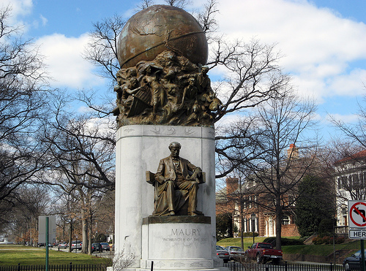
Scientific Foreknowledge
Paths of the Sea
Psa 8:8 – “And the fish of the sea, and whatsoever passes through the paths of the seas”
Matthew Maury (1806- 1873) discovered the existence of ocean currents in the 1850's
Maury discovered this from the bible
Notes:
In the 19th century, a US Naval officer by the name of Matthew Maury became gravely ill and asked his daughter to read him a passage from the bible. The story goes that his daughter picked a random verse and landed on Psa 8:8 – Maury was so stuck by this phrase “the paths of the sea” that when he got better, he set out to study the currents of the ocean and the wind circuits, designing charts and logging his findings. Maury ended up discovering and plotting most of the wind circuits and currents such as the great Gulf Current, 40 miles wide and 2000 feet deep, that comes out of the Gulf of Mexico into the Atlantic Ocean. He discovered the Japanese Current, the California Current, and many others. Sailboats today keep into account these currents and wind circuits in their navigations which reduces their ocean crossings up to 3 weeks.
Matthew Maury’s book on oceanography is still used in universities today and this monument was erected to honor his discovery. But Maury never took the credit unto himself. He was very vocal in giving credit to the bible as the source of his discovery.

Slide 14
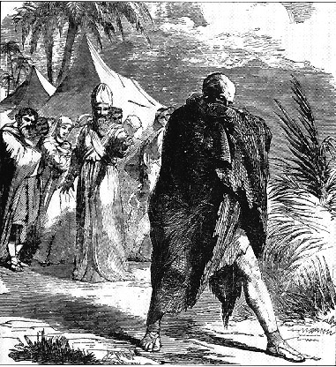
Scientific Foreknowledge
Bubonic Plague
Killed 1/3 of Europe (60 million)
Catholic church fixed the problem by searching the bible for answers
Lev 11:40, Lev 13:43-46, Num 19:14-16, Deut 23:12-13
After finding these verses, the Catholic church instituted the first know quarantine system that eventually evolved into the first hospitals
Notes:
And then finally, there is the Bubonic Plague. The Bubonic Plague killed over a 1/3 of Europe during the Middle Ages. Europeans just couldn’t figure out how to keep the sickness in check. It wasn’t until the Catholic church of that age began searching the scriptures for an answer that they ran across those passages in the Torah that spoke of sanitation. These were passages that spoke of not just washing but also of the importance separating the sick from those who were well to keep the diseases from spreading. This led the Catholic Church toward instituting the first known quarantine system to keep the spread of the disease in check. This in turn evolved into the first hospitals. They didn’t call this period the dark ages for nothing. But, you see, it was the bible that spoke of these sanitation procedures 1000s of years prior to this.

Slide 15
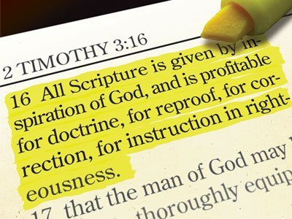
Notes:
So not only is the OT reliable and historically preserved, but it contains fingerprints of God’s own making, as it predicts things that could not have possible be known.

