Slide 1
Creation
Vs.
Evolution
What Does The Fossil Record Say?
Notes:
2 Tim 4:4-5 – “For the time will come when they…will turn away their ears from the truth and will turn aside to myths.”
Four things we’re going to look at relative to the fossil record in this section of our study.
If you cannot prove Darwinian Evolution from the fossil record, the entire hypothesis fails and must be abandoned
When you examine the fossil record, you will find that the animals within it do not change. Stasis prevails
When you examine the earliest layers of the geologic column, what scientists call the Cambrian Explosion, animals appear fully developed
There is far greater evidence for worldwide flood sedimentation based on the great deluge of Noah’s flood
The lectures for this quarter are going to be more “science” than prior lessons because our aim is to show that the evidence from Earth supports the bible account.

Slide 2
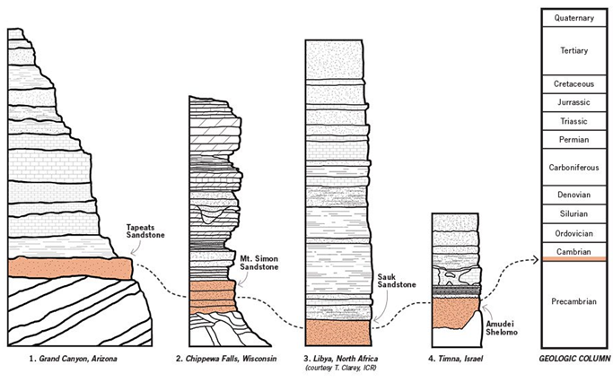
GEOLOGY
GEOLOGIC COLUMN
Notes:
I’m going to be using some terminology that might not be familiar to everyone so let’s first look at some definitions.
Geology: the study of the Earth, more specifically to this series it would be the study of the history of the earth as we see it preserved in the rock record.
Geologic Column: A graphical representation of all the different layers of rock that make up the earth’s crust, of which there have been many models developed by scientists who have compiled data from local areas. It is the sum total of all the sedimentary layers within the earth’s crust.

Slide 3
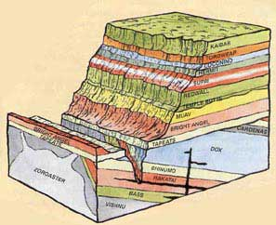
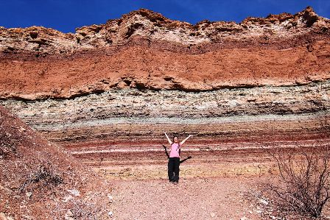
STRATA
LAW OF SUPERPOSITION
Notes:
Strata: parallel layers of rock that have been deposited in the geological column. There are many places on the earth where the strata is visible with the naked eye. I believe the picture on the right is from the Grand Canyon.
Super Position: This is how the layers of rock are deposited. This simply states that if one layer is underneath another layer, it is older. Whether it is a month older or a thousand years older is irrelevant to the definition. The law of super position says that, generally speaking, the lower the layer, the older it is.
Now there are geological processes that upturn layers, but they are generally understand as the exception and not the rule.

Slide 4
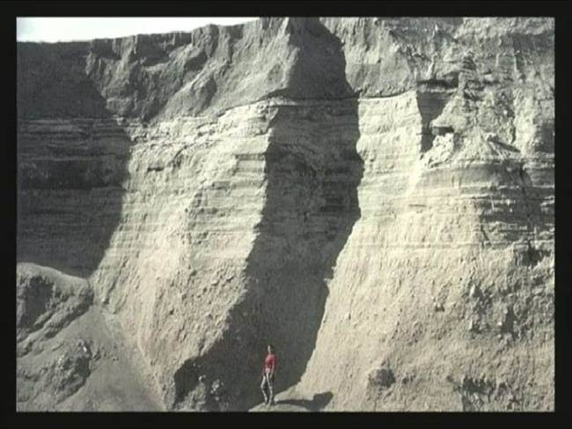
STRATIGRAPHY
March 19, 1982
June 12, 1980
May 18, 1980
Notes:
Stratigraphy: This is the branch of geology that studies, classifies, interprets, and attempts to date the strata that is within the geological column.
Without hindsight, how long do you suppose Evolutionists would claim it took to develop the 3 strata layers on this slide? Probably millions years, right?
The bottom layer was actually formed on May 18, 1980. The middle layer was formed a little over 3 weeks later on June 12 1980. And then less than 2 years after that the top layer was formed on March 19, 1982. Anyone know where this is? This is the rapid strata formation from landslides and mudflows as a result of the eruption at Mt. St. Helen’s on May 18, 1980. We’ll talk more about this later.

Slide 5
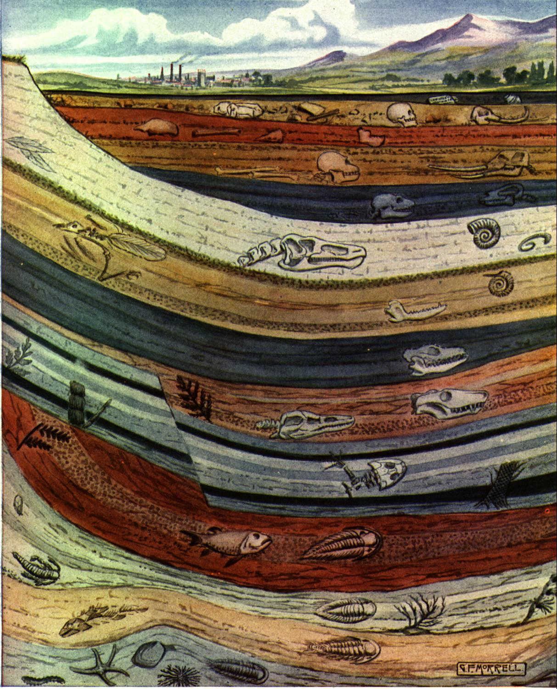
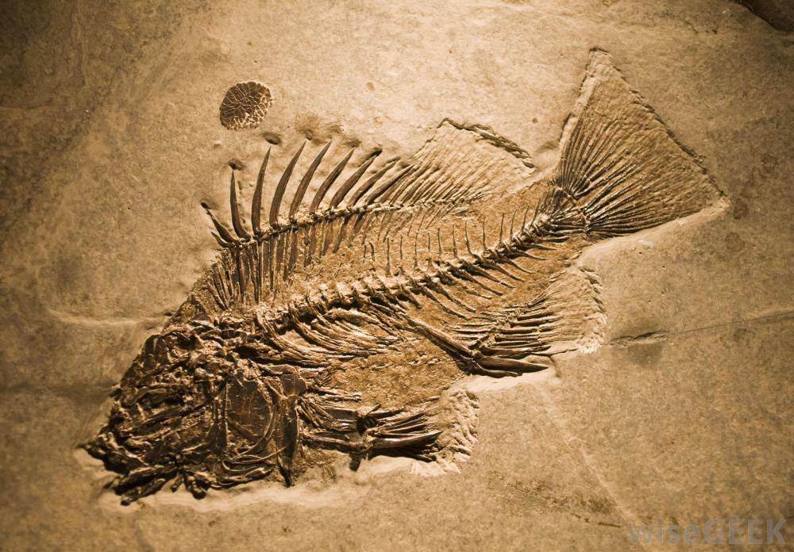
PALEONTOLOGY
Notes:
Paleontology: The study of the history of life as preserved in the fossils of the geologic column. Paleontologists study bone fossils, which are actual remains, and trace fossils like you see in the picture on the right where decomposition has set in, but the tracing of what it looked like remains. And in Paleontology, there is a broad scope of interpretation made.
So geology studies the rocks. Stratigraphy studies the layers within the geologic column. Paleontology studies the fossils that are found within those layers.

Slide 6
EVOLUTIONARY
TIME LINE
Origin
Of
Life
Fossil
Record
Atom
Man
Notes:
So as we keep these definitions in mind, let’s remind ourselves what Darwinian Evolution teaches. Darwinian Evolution teaches that all life evolved form one single celled organism over the course of 3.8 billion years. But if Darwinism is true, we would expect to find it clearly demonstrated from the fossil record or the hypothesis fails. And even before the hypothesis was ever derived and pushed upon society, there should have already existed abundant evidence in the fossil record for the evolutionary hypothesis.
This is key, because Creationists aren’t the ones making this argument. Many of the most well-known Evolutionists themselves are on record as affirming that the entire Evolutionary model stands or falls with the fossil record.
And I want to start by showing you some quotes from these very well-known Evolutionists because a common tactic you’ll hear from Evolutionists as you begin undermining one of their beliefs is that they’ll start backtracking, saying things like, “Well, I never believed that in the first place.” And this is exactly why I’ve shown you so many quotes in these classes, because what you need to say back to them is, “Here are quotes from the leading minds in Evolution, whose opinions you personally rely on to sculpt your worldview.”

Slide 7
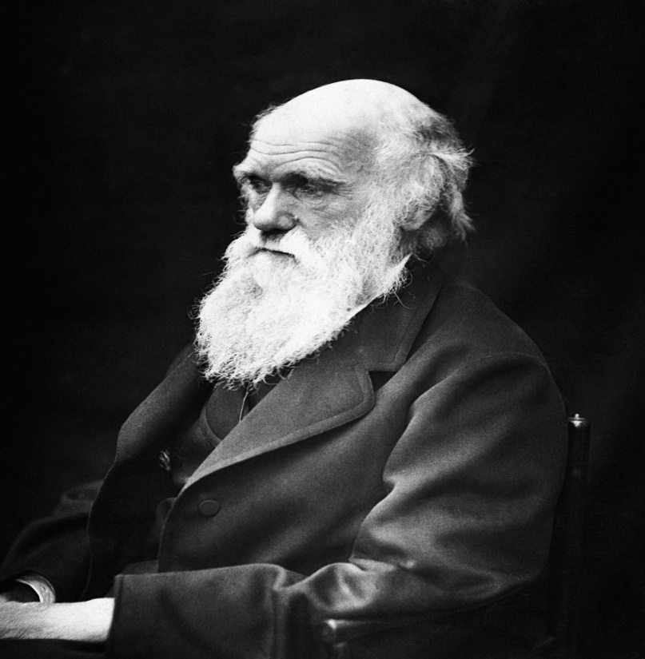
Charles Darwin – “The number of intermediate and transitional links, between all living and extinct species, must have been inconceivably great.” (Foard JM. "Fossils: History Written in Stone." The Darwin Papers, 1(5), 1996. Accessed October 21, 2008. )
Dr. Gerald Kerkut – “The most important evidence for the theory of evolution is that obtained from the study of paleontology [fossils]…provided the main factual basis for the modern view of evolution.” (G.A. Kerkut, Implications of Evolution (1960), p. 134.)
Notes:
Charles Darwin in 1872 in the 2nd edition of his book “On The Origin Of Species”, said – “The number of intermediate and transitional links, between all living and extinct species, must have been inconceivably great.”
Now if you were to ask him at that time, “Where are these links?”, he would have said, “Well we haven’t found them yet”. But Darwin just knew in his heart that they must be inconceivably great. Why? Because he had already made up in his mind that evolution had taken place.
This is Dr. Gerald Kerkut, a professor at the University of South Hampton – “The most important evidence for the theory of evolution is that obtained from the study of paleontology [fossils]…provided the main factual basis for the modern view of evolution”.

Slide 8
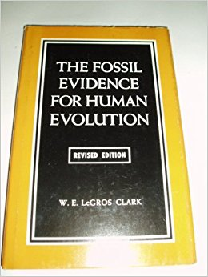
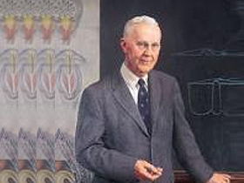
W. E. LeGros Clark – “That evolution actually did occur can only be scientifically established by the discovery of the fossilized remains.” (W. Le Gros Clark, Discovery, January 1955, p. 7).
Carl Dunbar – “Fossils provide the only historical, documentary evidence that life has evolved from simpler to more and more complex forms." (Historical Geology, p. 47)
Notes:
W. E. Le Gros Clark of the Smithsonian said, “That evolution actually did occur can only be scientifically established by the discovery of the fossilized remains.”
Carl Dunbar, a professor of Paleontology at Yale University, “Fossils provide the only historical, documentary evidence that life has evolved from simpler to more and more complex forms.“
In other words, if Evolution is going to be proven true, it has to be done so through the fossil record. And if it can’t be proven from the fossil record, it needs to be kicked to the curb. Let God be found true and every man a liar.

Slide 9
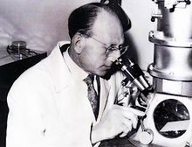
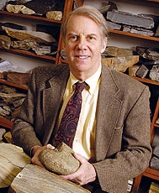
Pierre Paul Grasse – “Naturalists must remember that the process of evolution is revealed only through fossil forms…only paleontology can provide them with the evidence of evolution” (Evolution of Living Organisms, New York: Academic Press, 1977, pp. 3-4, 204)
Steven Stanley – “In the absence of the fossil record, the credibility of evolutionists would be severely weakened. We might wonder whether the doctrine of evolution would qualify as anything more than outrageous hypothesis.” (Stanley, S.M., New Evolutionary Timetable, Basic Books, p.72)
Notes:
Pierre Paul Grasse, a former president of the French Academy of Sciences – “Naturalists must remember that the process of evolution is revealed only through fossil forms…only paleontology can provide them with the evidence of evolution.”
Steven Stanley, who graduated from Yale and taught at Johns Hopkins, but now he’s a professor at the University of Hawaii – “In the absence of the fossil record, the credibility of evolutionists would be severely weakened. We might wonder whether the doctrine of evolution would qualify as anything more than outrageous hypothesis.”
And we would agree. So here are famous Evolutionists saying that the truth about Evolution stands or falls on the fossil record; this is heralded by the very scientists who are pushing this worldview on society. And you need to remember that for when you’re pointing out the lack of evidence from the fossil record to Evolutionists and then they try to back track and say, “Well I never believed the fossil record proved Evolution anyway.”

Slide 10
Notes:
So let’s compare the two models:
Evolutionists and Creationists have the same evidence available. It’s all published in papers and in museums. It’s really just a matter of not letting our emotions and our biases trump the evidence. We need to compare the two models against the evidence and determine which worldview holds more weight and predicts the best model.
The Darwinian model says “micro to man”. The Creation model says that all life suddenly appeared on Earth during the 6 days of Creation. So what should we expect to see in the fossil record if one of these models is going to be proven?

Slide 11
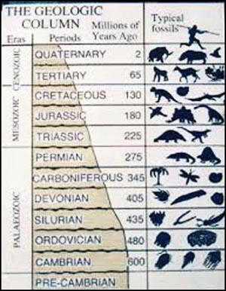
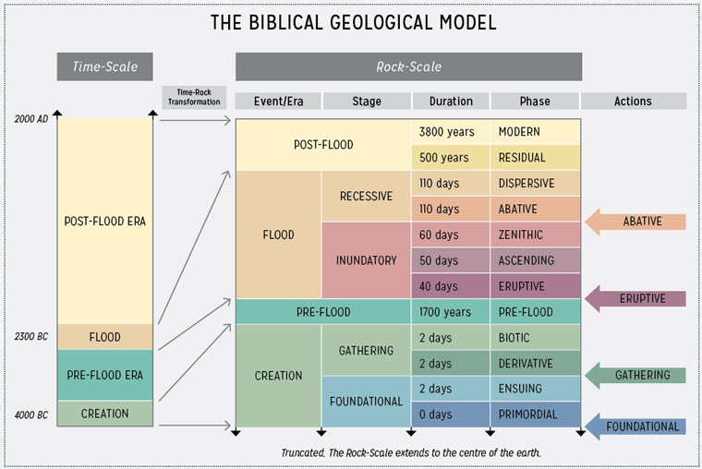
Evolution Model
Creation Model
Gradual Diversity
Increase in Quantity
Missing Links
“Explosion” of Life
No Transitional Fossils
Succession of Fossils
Notes:
The Darwinian model predicts that the simplest lifeforms should be at the very bottom of the geologic column. From there, they would have gradually evolved and become more complex and diverse. So there would be fewer lifeforms at the bottom but at the top we would find a great amount of diversity over millions of years.
The Darwinian model also predicts that millions and millions of intermediate links should exist between these animal kinds, what we call transitional fossils (missing links). But how ironic is it that they have been searching for these missing links for 150 years and they are still called “missing links”? More on that later.
On the other end, what would we expect to find in the geologic column if the Creation model is true? First, we’d expect to dig down into the earth and find highly diverse fully formed lifeforms appearing suddenly on the Earth in a vast explosion right at the bottom of the geologic column. Because in the bible, when God created the heavens and the earth and everything in it in 6 days, they were around for around 2000 years before the flood occurred and so we should find evidence of that.
Also, if the biblical Creation model is true, there would be no transitional fossils. Instead, we’d expect to find animal fossils appearing fully formed as distinct kinds in fixed categories.
Also, if the Creation is true, we’d find a succession of fossils as we went up the geologic column. Why? Because of Noah’s flood. As the flood waters first began ascending, they would have first covered the oceans, then the rivers and streams, than the banks and marshy areas, the low land forests, the up land forests, and finally at the very top it would engulf the animals who had the ability/intelligence to escape the ascending flood waters.
Later I will show you some amazing pictures. In the Grand Canyon, you always find the dinosaur tracks lower than their bones and they’re always going uphill. Why? The Creation Model explains it – they were escaping the flood waters as they washed back and forth across the earth as the tidal waves and tsunamis would cover an area and then recede.

Slide 12
2 Pet 3:3-6 – “³Know this first of all, that in the last days mockers will come with their mocking, following after their own lusts, ⁴and saying, ‘Where is the promise of His coming? For ever since the fathers fell asleep, all continues just as it was from the beginning of creation.’ ⁵For when they maintain this, it escapes their notice that by the word of God the heavens existed long ago and the earth was formed out of water and by water, ⁶through which the world at that time was destroyed, being flooded with water.”
Notes:
2 Pet 3:3-6 – “³Know this first of all, that in the last days mockers will come with their mocking, following after their own lusts, ⁴and saying, ‘Where is the promise of His coming? For ever since the fathers fell asleep, all continues just as it was from the beginning of creation.’ ⁵For when they maintain this, it escapes their notice that by the word of God the heavens existed long ago and the earth was formed out of water and by water, ⁶through which the world at that time was destroyed, being flooded with water.”
Some things to notice from this verse:
First, who are the modern day scoffers who question Jesus’ coming? Today it would be the atheists and evolutionists? They mock, come up with clever memes, and flood their arguments with ad hominum attacks.
Second, that phrase “formed out of water and by water” is significant to the Creation account. Gen 1:9-10 – “⁹Then God said, ‘Let the waters below the heavens be gathered into one place, and let the dry land appear”; and it was so. ¹⁰God called the dry land earth, and the gathering of the waters He called seas; and God saw that it was good.’” So the biblical model tells us that first the Earth was covered with water and then God gathered them together into one place and shoved the Earth up through the water.
And third, verse 6 introduces some general affects of the flood, that the world was flooded with water and destroyed.
But Darwinists have been mocking this model since the late 19th century. But you know what they’re admitting today? They’re admitting catastrophic events may have occurred, but they’re now claiming that it was a series of anywhere from 7 to 15 floods around the world while denying a single, worldwide flood.

Slide 13
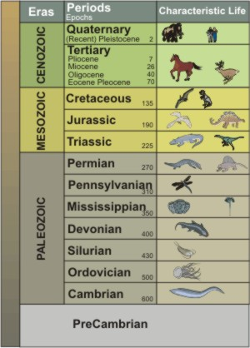
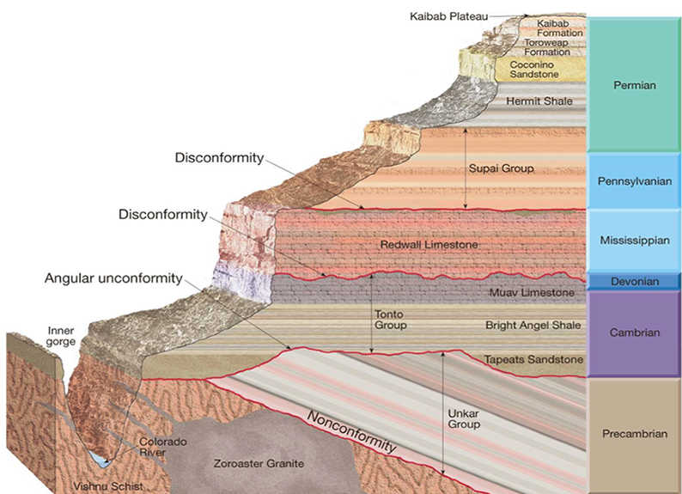
Problems:
Covers ~130 miles deep?
Average is only 1.5 miles deep
Grand Canyon? 6 periods
Notes:
Well, let’s notice how Darwinian Evolutionists interpret the geologic column. In their view, there are 13 different periods in the geologic column, beginning at the bottom with the Precambrian period all the way to the top in the period we’re in now, the Quaternary period. They think this represents up to 600 million years of geologic formations, or 550 million years from when the Cambrian period started. However, there are major, major, problems with this model.
First, these 13 periods, according to them, are supposed to cover up to 130 miles deep. Yet there is not one single place on Earth that has sediment that is 130 miles deep. Not one. They say it eroded…seriously?
Second, the average depth of sediment we see anywhere is 1.5 miles. It actually ranges from 0 to 5 miles of sediment….a far cry from 130 miles.
Third, one of the only places on earth you can see several of these strata on top of each other in one location is the Grand Canyon. But it is only about 4000 feet deep, about ¾ of a mile deep and it only has about 6 of these 13 periods in it.
So then how did they come up with these 13 periods that Evolutionists like to use in textbooks? They did so by taking different strata from around the world and jimmy-rigging a picture that we don’t actually see anywhere on Earth.

Slide 14
Notes:
So why do some Geologists and Paleontologists think the world is 4.5 billion years old and that the geological strata all the way down to the Precambrian represents 1 billion years? Not by empirical science.
Remember, the scientific method that Francis Bacon came up with in the 18th century? You see an observation, develop a hypothesis, devise an experiment, repeat the experiment, falsify it, and you’ve got science. But fields of science such as Paleontology, Archeology, and Geology is not actually empirical science because no one was there. No living person was there in the past to see how the rocks were developed and to see how the fossils got there. It is not empirically testable.
So what do Evolutionary Paleontologists, Archeologists, and Geologists do? They construct historical narratives to explain what they’ve seen based on their own biased worldview. That’s all they can do. And if that’s what they’re doing, they’re in essence imposing their own beliefs on the rocks. They’re imposing their own beliefs on the fossils based on their own preconceived view of the age of the Earth rather than the other way around.
This is not just me saying this. Evolutionists themselves admit this! So let me show you some more quotes to use with our friends when this is denied.

Slide 15
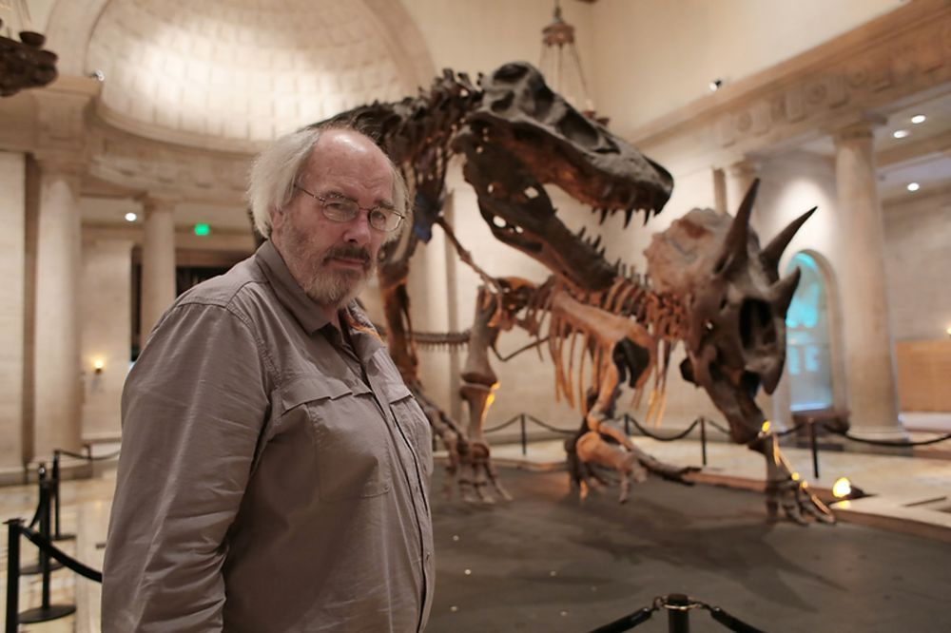
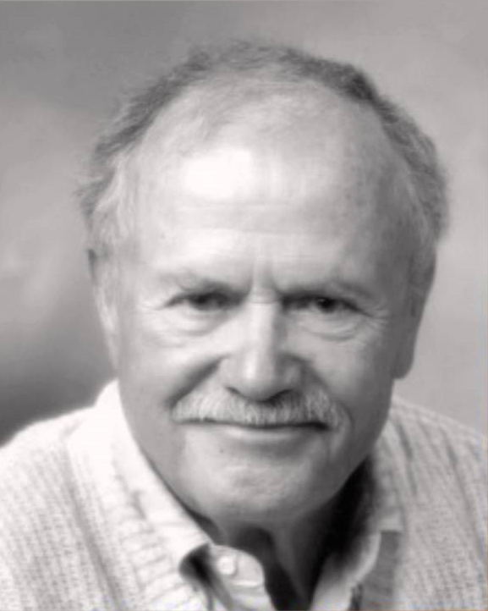
Jack Horner – “Paleontology is a historical science based on circumstantial evidence, after the fact. We can never reach hard and fast conclusions in our study of ancient plants and animals. These days it's easy to go through school for a good many years, sometimes even through college, without hearing that some sciences are historical or by nature inconclusive.” (Dinosaur Lives, 1997, p.19)
David Kitts – “Few paleontologists have, I think, ever supposed that fossils, by themselves, provide grounds for the conclusion that evolution has occurred…the record of evolution, like any other historical record, must be construed within a complex of particular and general preconceptions not the least of which is the hypothesis that evolution has occurred.” ("Search for the Holy Transformation," review of Evolution of Living Organisms, by Pierre-P. Grassé, Paleobiology, vol. 5, 1979, pp. 353-354)
Notes:
Jack Horner, the paleontologist who was the consultant for the Jurassic Park movies, said this: “Paleontology is a historical science based on circumstantial evidence, after the fact. We can never reach hard and fast conclusions in our study of ancient plants and animals. These days it's easy to go through school for a good many years, sometimes even through college, without hearing that some sciences are historical or by nature inconclusive.”
What he’s saying is that you cannot go out and run some experiment on these fossils and determine whether these animals evolved from one another becausue there isn’t enough data in rocks and fossils to determine this.
Dr. David Kitts, who was a Geology professor at the University of Oklahoma until he died in 2010, said – “Few paleontologists have, I think, ever supposed that fossils, by themselves, provide grounds for the conclusion that evolution has occurred…the record of evolution, like any other historical record, must be construed within a complex of particular and general preconceptions not the least of which is the hypothesis that evolution has occurred.”
What preconceptions? If you want to teach at a University in the field of Paleontology, what preconception must you have? Evolution.

Slide 16
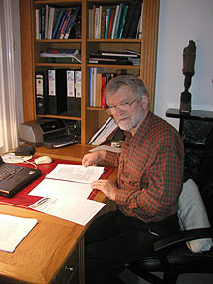
Stephen J. Gould – “…our ways of learning about the world are strongly influenced by the social preconceptions and biased modes of thinking that each scientist must apply to any problem. The stereotype of a fully rational and objective scientific method, with individual scientists as logical (and interchangeable) robots, is self-serving mythology.” (Dinosaur in a haystack: reflections in natural history, ed. Harmony, 1995)
Tom Kemp – “Of course, there are many in the synapsid fossil record, with intermediates found between the various known groups invariably unknown. However, the known groups have enough features in common that it is possible to reconstruct hypothetical intermediate stages.” (Gish, 1995, 159)
Notes:
Famous Evolutionist Stephen J. Gould, a Paleontologist at Harvard University, said – “…our ways of learning about the world are strongly influenced by the social preconceptions and biased modes of thinking that each scientist must apply to any problem. The stereotype of a fully rational and objective scientific method, with individual scientists as logical (and interchangeable) robots, is self-serving mythology.”
Tom Kemp, who is a Zoologist and Curator at Oxford University – “Of course, there are many in the synapsid fossil record, with intermediates found between the various known groups invariably unknown. However, the known groups have enough features in common that it is possible to reconstruct hypothetical intermediate stages.”

Slide 17
Gareth Nelson – “[It] is a mistake to believe that even one fossil species or fossil ‘groups’ can be demonstrated to have been ancestral to another…that a known fossil….is an actual ancestor of some other species or group, is an assumption scientifically unjustifiable.” (Nelson 1969, p. 27, a cited by Morris 1977, pp. i-ii)
Tom Kemp – “In no single adequately documented case is it possible to trace a transition, species by species, from one genus to another.” (Mammal-like Reptiles and the Origin of Mammals)
Notes:
Gareth Nelson, of the American Natural History museum in New York – “It is a mistake to believe that even one fossil species or fossil ‘groups’ can be demonstrated to have been ancestral to another….that a known fossil….is an actual ancestor of some other species or group, is an assumption scientifically unjustifiable.”
In other words, just because you find different animals in the ground doesn’t prove that one is the ancestor of another.
Tom Kemp again – “In no single adequately documented case is it possible to trace a transition, species by species, from one genus to another.”
But that is not what you read in school textbooks is it? So keep these quotes in mind when your Evolutionists claims that Paleontology, Archeology, and Geology is empirical. They are far more historical than empirical.

Slide 18
Notes:
So now let’s get into point #2. That is, when we dig into the geologic column and observe the fossils that are there, what we actually find is that animals do not change. Stasis prevails. What is stasis? It is simply the state of staying the same. Now, humans don’t stay in stasis throughout their lives. We change. And animal kinds also change.
But there are no transitional fossils. The missing links that are supposed to validate Evolution have never been discovered. This may be the strongest evidence for overturning the hypothesis of Evolution.
Again, your Evolutionist friends will insist intermediary links have been found so let me show you quotes from the experts who say that is not the case.

Slide 19
Darwin – “The number of intermediate varieties, which have formerly existed on the earth, (must) be truly enormous. Why then is not every geological formation and every stratum full of such intermediate links? Geology assuredly does not reveal any such finely graduated organic chain; and this, perhaps, is the most obvious and gravest objection which can be urged against my theory” (On the Origin of Species, 1859, p. 292).
David Raup – “In the years after Darwin, his advocates hoped to find predictable progressions… these have not been found -- yet the optimism has died hard, and some pure fantasy has crept into textbooks.” (Evolution and the Fossil Record, Science, vol. 213, July 1981, 289.)
“Well, we are now about 120 years after Darwin, and knowledge of the fossil record has been greatly expanded ... ironically, we have even fewer examples of evolutionary transition than we had in Darwin's time.” (Raup, 1979).
Notes:
Darwin recognized this. In 1872, he said, “The number of intermediate varieties, which have formerly existed on the earth, (must) be truly enormous. Why then is not every geological formation and every stratum full of such intermediate links? Geology assuredly does not reveal any such finely graduated organic chain; and this, perhaps, is the most obvious and gravest objection which can be urged against my theory”
In other words, he just knows in his heart that evolution is “true”, but he admits there is no transitional fossil record to prove it. So what he predicted was that the passage of time would reveal the enormous number of transitional forms that his theory demanded. However, it hasn’t happened.
David Raup, former curator of geology at Chicago's Field Museum of Natural History, put it this way: “In the years after Darwin, his advocates hoped to find predictable progressions…these have not been found -- yet the optimism has died hard, and some pure fantasy has crept into textbooks.”
“Well, we are now about 120 years after Darwin, and knowledge of the fossil record has been greatly expanded...ironically, we have even fewer examples of evolutionary transition than we had in Darwin's time.” (Raup, 1979).
And how many did Darwin have? None. There’s a pattern. Do they just need some more time? Do they just need to dig a little more and find more fossils?

Slide 20
Gareth Nelson – “The history of comparative biology teaches us that the search for ancestors is doomed to ultimate failure, this, with respect to its principle objective, this search is an exercise in futility…a more complete sample of the fossil record in itself would only complicate the problem...” (Origin and Diversification of Teleostean Fishes, Annals of the New York Academy of Sciences, 1971, pp. 22-23.)
David Kitts – “Despite the bright promise that paleontology provides a means of ‘seeing’ evolution, it has presented some nasty difficulties for evolutionists the most notorious of which is the presence of ‘gaps’ in the fossil record. Evolution requires intermediate forms between species and paleontology does not provide them.” (Kitts, David B., Paleontology and Evolutionary Theory, Evolution, vol. 28, 1974, p. 467)
Notes:
Gareth Nelson again – “The history of comparative biology teaches us that the search for ancestors is doomed to ultimate failure, this, with respect to its principle objective, this search is an exercise in futility…a more complete sample of the fossil record in itself would only complicate the problem of assessing the interrelationship of the fossil species.”
How would it complicate the problem if they dig up more fossils? Because the more they dig, the more evidence it lends to the Creationism model – the more we see animals in separate, distinct groups.
David Kitts again – “Despite the bright promise that paleontology provides a means of ‘seeing’ evolution, it has presented some nasty difficulties for evolutionists the most notorious of which is the presence of "gaps" in the fossil record. Evolution requires intermediate forms between species and paleontology does not provide them”

Slide 21
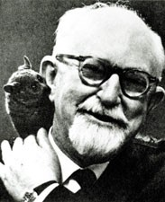
George Simpson – “The regular absence of transitional forms is an almost universal phenomenon...all orders of classes of animals [and] analogous categories of plants.” (The Sudden Appearance of Higher Categories, in Evolution of Life. 149, S. Tax ed. 1960)
Stephen J. Gould – “The absence of fossil evidence for intermediary stages between major transitions in organic design, indeed our inability, even in our imagination, to construct functional intermediates in many cases, has been a persistent and nagging problem for gradualist accounts of evolution.” (Gould, Stephen J., 'Is a new and general theory of evolution emerging?' Paleobiology, vol 6(1), January 1980, p. 127)
Notes:
George Gaylord Simpson of Harvard – “The regular absence of transitional forms is an almost universal phenomenon...all orders of classes of animals [and] analogous categories of plants.”
Stephen J. Gould again – “The absence of fossil evidence for intermediary stages between major transitions in organic design, indeed our inability, even in our imagination, to construct functional intermediates in many cases, has been a persistent and nagging problem for gradualist accounts of evolution.”
He later said it was the most puzzling fact of the fossil record. This is one of the most premier Paleontologists to have ever lived, an expert on Evolution, and even he admits that the missing links are the most puzzling fact about the fossil record. So which model does that fact better represent?

Slide 22
Colin Patterson – “I fully agree with your comments on the lack of direct illustration of evolutionary transitions in my book. If I knew of any, fossil or living, I would certainly have included them…Gould and the American Museum people are hard to contradict when they say there are no transitional fossils…I will lay it on the line – there is not one such fossil for which one could make a watertight argument.” (Patterson as quoted by Sunderland.)
Stephen J. Gould – “The extreme rarity of transitional forms in the fossil record persist as the trade secret of paleontology. The evolutionary trees that adorn our textbooks have data only at the tips and nodes of their branches; the rest is inference, however reasonable, not the evidence of fossils …Most species exhibit no directional change during their tenure on earth. They appear in the fossil record looking much the same as when they disappear...We fancy ourselves as the only true students of life's history, yet to preserve our favored account of evolution by natural selection we view our data as so bad that we never see the very process we profess to study.” (Evolution's Erratic Pace, Natural History, vol. 86 (May 1987), p. 14.
Notes:
Now if you study this issue, this particular quote is going to surface as one of the most famous because Colin Patterson was arguably one of the top 10 Paleontologists in the 70s and 80s. He was the curator at the British Museum of Natural History so he had enough clout to say what he wanted to say without risking his career, which he was close to the end of anyway so he didn’t have much to lose. But toward the end of his career, he began going around the world telling people that everything we’ve been taught about Evolution is wrong. And he was an Evolutionist. He wrote a book about Evolution but in the book he didn’t list any transitional fossils. So a man named L. D. Sunderland wrote to him and said, “Dr. Patterson, why didn’t you include any transitions in your book? Where are the intermediate species?” And this very famous quote is what Patterson wrote back:
“I fully agree with your comments on the lack of direct illustration of evolutionary transitions in my book. If I knew of any, fossil or living, I would certainly have included them…I will lay it on the line-There is not one such fossil for which one might make a watertight argument.”
So if Patterson didn’t believe they were there and if Gould didn’t believe they were there, what did they do? We’ll talk about “Punctuated Equilibrium” later on, an alternate idea for Evolution. They don’t doubt Evolution, they just think its needs to be explained differently.
Gould again – “The extreme rarity of transitional forms in the fossil record persist as the trade secret of paleontology.”
What he’s saying is that what everyone doesn’t know about Paleontology is that they don’t know of any transitions in the fossil record. The high school teachers don’t talk about it and the undergrads aren’t taught it.
“The evolutionary trees that adorn our textbooks have data only at the tips and nodes of their branches; the rest is inference, however reasonable, not the evidence of fossils”
What does he mean by them only having data at the tips and nodes? He’s saying there is no branching evidence. And that is what Creationists would believe when we see the fossil record. We see animals dispersed throughout the fossil column without the connecting branches. This is what we’d expect to see as animals were escaping the ascending flood waters. They would begin being destroyed until finally they were extinct. In fact 98% of all species that have ever lived are gone. They are extinct.
“Most species exhibit no directional change during their tenure on earth. They appear in the fossil record looking much the same as when they disappear…We fancy ourselves as the only true students of life's history, yet to preserve our favored account of evolution by natural selection we view our data as so bad that we never see the very process we profess to study.”

Slide 23
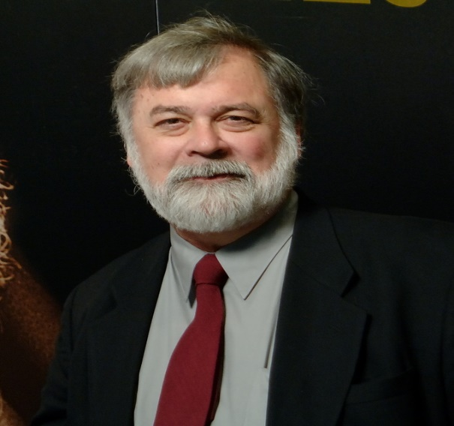
Niles Eldredge – “Paleontologists have been insisting that their record is consistent with slow, steady, gradual evolution…they’ve known for over a hundred years that such is not the case.” (Eldredge, Niles, “Did Darwin Get It Wrong?” Nova, November 1, 1981, 22 p. 6.)
Steven Stanley – “The known fossil record fails to document a single example of phyletic evolution [i.e., a species becoming a new species] accomplishing a major morphological transition and hence offers no evidence that the gradualistic model can be valid.” (Macroevolution, Freeman, San Francisco, 1977, p. 39)
David Woodroff – “The fossil species remain unchanged throughout most of their history and the record fails to contain a single example of a significant transition.” (SCIENCE, Vol. 208, 1980, p. 716)
Notes:
Gould’s colleague whom he worked a lot with, Niles Eldredge, was at the American Museum of Natural History – “Paleontologists have been insisting that their record is consistent with slow, steady, gradual evolution…they’ve known for over a hundred years that such is not the case.”
Steven Stanley again – “The known fossil record fails to document a single example of phyletic evolution [i.e., a species becoming a new species] accomplishing a major morphological transition and hence offers no evidence that the gradualistic model can be valid.”
David Woodroff from UC San Diego – “The fossil species remain unchanged throughout most of their history and the record fails to contain a single example of a significant transition.”

Slide 24
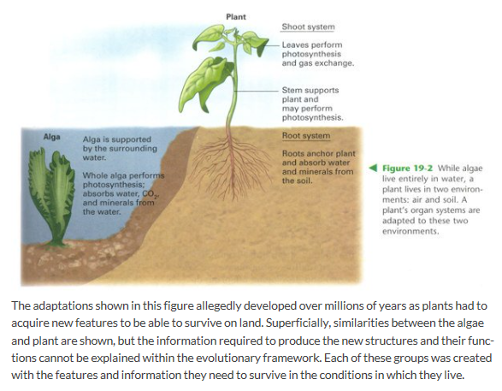
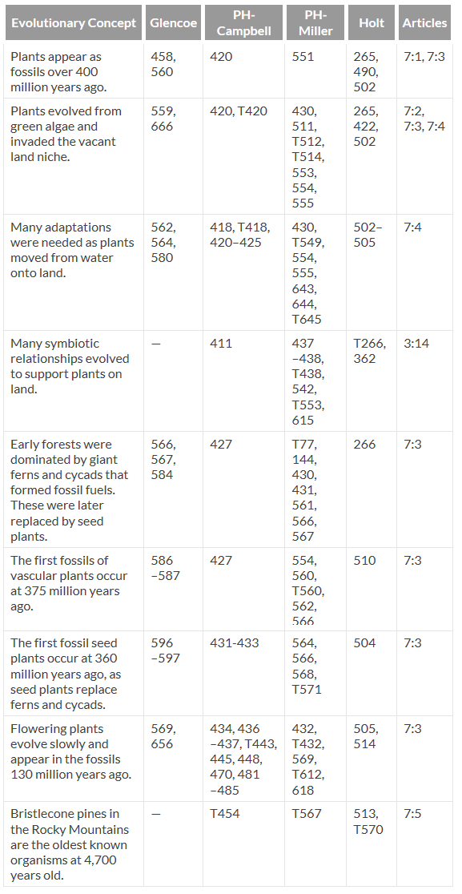
Patricia Gensel – “We still lack any precise information concerning the presumed aquatic ancestors from which land plants evolved, and the search for evidence of these precursors and of probable transitional stages continues.” (The Evolutions of Early Land Plants, American Scientist, Vol. 75, Sept./Oct. 1987, p. 480.)
Notes:
So now let’s look at the different lifeforms. In addition to animals, we’re told that plants evolved. But how did plants evolve from aquatic plants to terrestrial plants?
Patricia Gensel, a professor of Paleo botany, is one of several paleo botanists who try to go through the fossil record and determine how plants evolved.
“We still lack any precise information concerning the presumed aquatic ancestors from which land plants evolved, and the search for evidence of these precursors and of probable transitional stages continues.”
In other words, “We haven’t found any but we’re still looking for them.” Yet this is what we see in text books, that aquatic plants evolved into land plants.

Slide 25
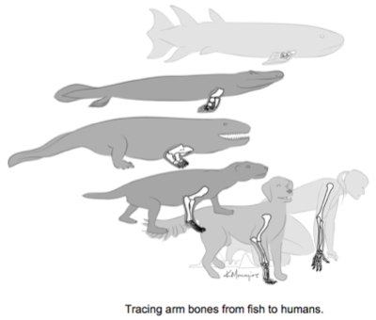
Gerald Todd – “All three subdivisions of the bony fishes first appear in the fossil record at approximately the same time… How did they originate? What allowed them to diverge so widely?.. And why is there no trace of earlier, intermediate forms?” (“Evolution of the Lung and the Origin of Bony Fishes: A Casual Relationship”, American Zoologist, Vol 26, No. 4, 1980, p. 757)
F. D. Ommanney – “How this earliest chordate stock evolved, what stages of development it went through to eventually give rise to truly fishlike creatures we do not know.” (The Fishes, Life Nature Library, New York: Time, Inc., 1963, p. 60.)
Notes:
What about supposed fish evolution? They talk about how all the fish evolved from one another. But where did fish come from? Evolutionists don’t know and you’ll be hard pressed to find anything on the internet suggesting an answer. But you’ll find pictures like this in textbooks saying that it happened.
Evolutionary Paleontologist Gerald Todd of UCLA said this – “All three subdivisions of the bony fishes first appear in the fossil record at approximately the same time… How did they originate? What allowed them to diverge so widely?.. And why is there no trace of earlier, intermediate forms?”
So why is it? There’s a perfectly good explanation. Because those fish were covered up in the sediment during the flood.
Notice what F. D. Ommanney said. He wrote the documentary “Fishes” for Nature and Wildlife series: “How this earliest chordate stock evolved, what stages of development it went through to eventually give rise to truly fishlike creatures we do not know.”
In other words, Evolutionists have no idea where the evidence is for how fish evolved. They just “know” its true.

Slide 26
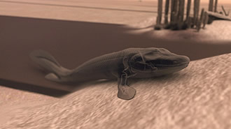
Dr. Hopson & Radinsky – “No clear intermediate form in the fish-tetrapod transition has ever been discovered.” (Vertebrate Paleontology, p. 258)
Notes:
What about fish evolving to amphibians? We’re told fish gradually evolved into amphibians. This bottom pic is from a PBS episode they did a few years back called “Your Inner Fish”, in an attempt to explain how we came from fish. Since it was PBS, that means our tax dollars are paying for it.
But what do the Evolutionary experts say about fish to amphibian evolution?
Dr. Hopson and Radinsky from the University of Chicago – “No clear intermediate form in the fish-tetrapod (meaning it has form limbs for walking) transition has ever been discovered.”

Slide 27
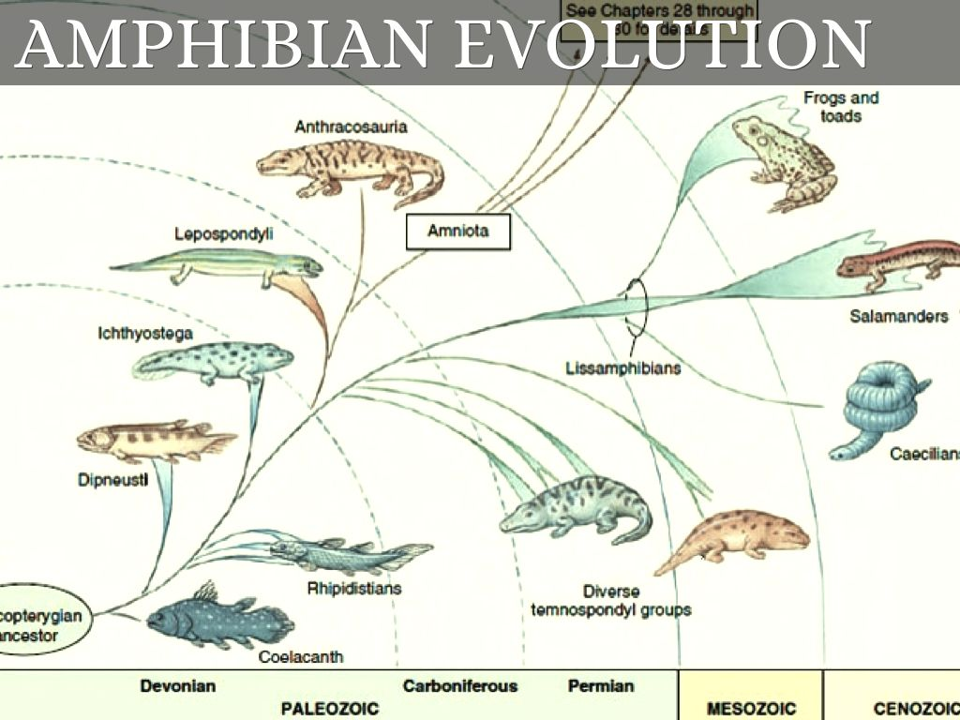
Robert Carroll – “In the absence of fossil evidence that frogs, salamanders and caecilians evolved from a close common ancestor, we must consider the possibility that each of the modern orders evolved from a distinct group of Paleozoic [supposedly 200 million to 500 million years ago] amphibians.” (Evolution: The Fossils Still Say No!, Institute for Creation Research, CA, USA, pp. 93–94, 1995.)
Notes:
What about the appearance of amphibians on land? Where did salamanders and frogs evolve from?
Professor Robert Carroll at McGill University – “In the absence of fossil evidence that frogs, salamanders and caecilians evolved from a close common ancestor, we must consider the possibility that each of the modern orders evolved from a distinct group of Paleozoic [supposedly 200 million to 500 million years ago] amphibians.”
In other words, since they don’t have it in the fossil record, they have to interpolate. And that’s what these fancy pictures in textbooks, the drawings and models, really are. Interpolations, not facts.

Slide 28
Robert L. Carrol – “Unfortunately, not a single specimen of an appropriate reptilian ancestor is known prior to the appearance of true reptiles. The absence of such ancestral forms leaves many problems of the amphibian-reptilian transition unanswered.” (Problems of the Origin of Reptiles, Biological Reviews of the Cambridge Philosophical Society, Vol. 44, p. 393.)
Notes:
What about amphibians evolving into reptiles? Aren’t we all taught this? So shouldn’t there be strong evidence for it?
Louis Carrol – “Unfortunately, not a single specimen of an appropriate reptilian ancestor is known prior to the appearance of true reptiles. The absence of such ancestral forms leaves many problems of the amphibian-reptilian transition unanswered.”
They don’t see it in the fossil record, yet they assume it must have occurred?

Slide 29
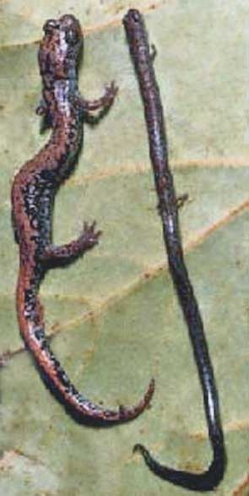
Dr. Colbert, Dr. Moralis, Dr. Minkoff – “Unfortunately, the fossil history of snakes is very fragmentary, so that it is necessary to infer much of their evolution from the comparative anatomy of modern forms.” (Colbert. E. H., M. Morales, and E. C. Minkoff. 2001. Evolution of the vertebrates: A history of the backboned animals through time, 5thed., New York: Wiley-Liss, Inc. p. 154)
Notes:
What about the snakes? Do you ever remember seeing in text books how all the snakes evolved? No. And there’s not really anything out there about snake evolution. You can’t find pictures of diagrams anywhere like I’ve found for some other things. Why? Because they have no idea. In the fossil record, snakes just appear out of nowhere.
The closest you can find to show the evolution from snakes to amphibians is what I found here where they took a salamander and put him next to what I think is some kind of legless lizard, which a lot of people think are snakes when you see them when they’re not. This is used on the internet as an example to show how salamanders “might” have evolved into snakes. Not “how” they evolved, but how they “might” have evolved.
But on what basis? Because they look so similar. But we should be able to find it in the fossil record and we don’t.
The experts, Dr. Colbert, who was Paleontologist for Columbia University, and 2 others, Dr. Moralis and Dr. Minkoff, said – “Unfortunately, the fossil history of snakes is very fragmentary…”
So then how do you decide that snakes indeed evolved? Here’s how
“…so that it is necessary to infer much of their evolution. from the comparative anatomy of modern forms.”
Do you understand what he is saying? He’s saying, “We don’t find it in the fossil record, and so the only way we know how to do it is to line up a salamander and a legless lizard and show how similar they look.”
But remember what we discussed about Animal Homology? Do similarities prove evolutionary relationship? Not even according to Darwinists because our eye is almost identical to the eye of the octopus. Yet Darwinists say we didn’t evolve from the same line.

Slide 30
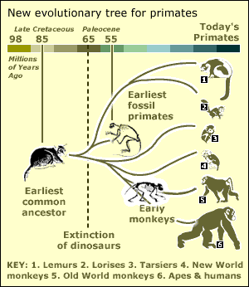
Robert Carroll – “No specific derived characters have been demonstrated as being uniquely shared between early primates and the early members of any other order.” – (Vertebrate Paleontology and Evolution, New York: W. H. Freeman and Co., 1988, p. 467
Notes:
What about the Evolutionary appearance of primates? Where do primates come from?
Robert Carrol, again, from McGill University, said – “No specific derived characters have been demonstrated as being uniquely shared between early primates and the early members of any other order”
In other words, “We don’t see the similarity so where do they come from? We don’t know.”

Slide 31
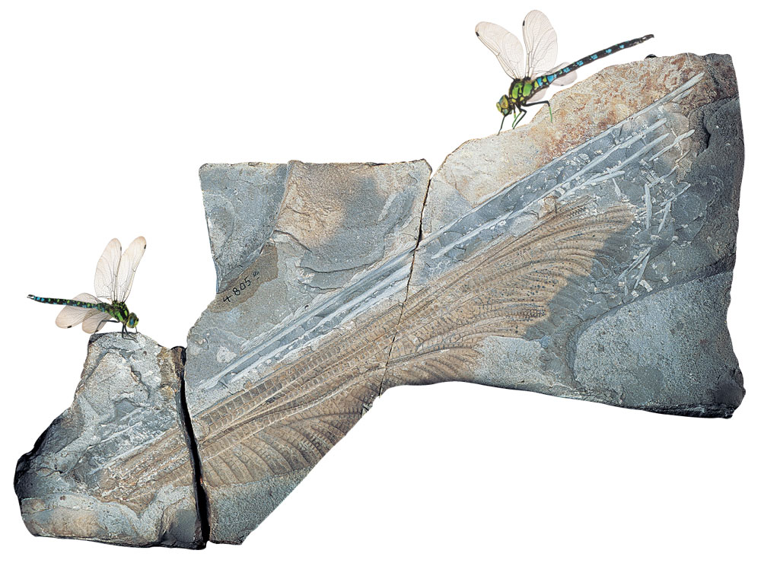
Pierre-Paul Grosse – “We are in the dark concerning the origin of insects.” (Evolution of Living Organisms, Academic Press, New York, 1977, p. 30.)
Niles Eldredge – “Expectation colored perception to such an extent that the most obvious single fact about biological evolution-nonchange-has seldom, if ever, been incorporated into anyone’s scientific notions of how life actually evolves. If ever there was a myth, it is that evolution is a process of constant change.” (Myths of Human Evolution, 1982, 8)
Notes:
What about the appearance of insects? If you want to back an Evolutionist in a corner, ask them how insects evolved. You can look all the way back to the Cambrian layer in the geologic column and the insects there look identical to the insects of today, except some of them were bigger. There have been some dragon flies discovered with 27” wing spans.
Notice what Pierre-Paul Grosse says – “We are in the dark concerning the origin of insects.”
Ever seen charts of insect evolution in textbooks? Nope. Why? Because Evolutionists have no idea where they came from.
Niles Eldredge – “Expectation colored perception to such an extent that the most obvious single fact about biological evolution–nonchange–has seldom, if ever, been incorporated into anyone’s scientific notions of how life actually evolves. If ever there was a myth, it is that evolution is a process of constant change.”

Slide 32
Cambrian Explosion
Notes:
So the last thing we’re going to look at is the Cambrian Explosion. If the Creation Model is true, it would make sense that we’d see an explosion of all different kinds of animals all the way at the bottom of the fossil column – and that is exactly what we see. Every single major phyla appears at the bottom of the fossil column in the Cambrian layer. Meaning, in the first 2% of the geologic column, we find all 100 phyla that have ever existed. In fact, there were a 100 in the Cambrian layer but today there are only 36 of them left. The other 64 have disappeared – they’ve become extinct.

Slide 33
Notes:
So the Darwinian interpretation is that we go from simple to complex, right? But that’s not what we see. We don’t see gradual evolution ascending up the fossil column.
Evolutionistss would say that evolution gradually occurred according to branching patterns. And yet we see this broken pattern where animals just appear in the fossil column but are not connected by transitions.

Slide 34
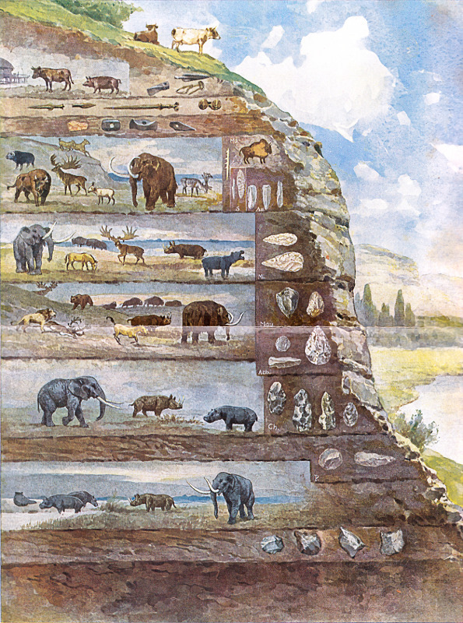
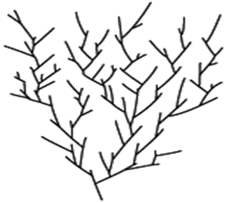
X
Notes:
But if all animals appear at the bottom of the column, and fewer of them are still around today, is the Darwinian theory the correct representation? No, because it shows more diversity at the top. What we see in the fossil column is more diversity at the bottom. You have to turn it upside down to represent it more accurately to show decimation and extinction.
Stephen J. Gould from Harvard recognized this in the earlier quotes we saw from him. He recognizes it doesn’t fit because we don’t see this cone of diversity. What he said we do see is decimation and diversification. Gould recognized that at the very bottom, we have this Cambrian explosion of animals, though he suggests they evolved very rapidly (punctuated equilibrium).
Which model makes more sense? If I wanted to believe in evolution, I certainly wouldn’t believe that animals just all of the sudden evolved very rapidly in a short period of time, like Gould suggests. But Gould admits the Darwinian model of Gradualism doesn’t work, which the fossil record confirms. The Creation model is what makes sense, which is very similar to Gould’s model except it doesn’t include the branches at the bottom. Gould assumes his doctrine of Punctuated Equilibrium but had zero evidence to back it up.
If you cut off the branches at the bottom, that’s what the Creation model predicts and that is exactly what you see in the fossil record. Great diversity at the bottom of the fossil column and further up to the top, you get decimation and extinction. And so everything we get taught in school is incorrect. Things didn’t gradually evolve. They appeared all at once in the Cambrian layer at the bottom.

Slide 35
Roger Lewin – “The Cambrian explosion established virtually all the major animal body forms -- Bauplane or phyla -- that would exist thereafter” (Science, vol. 241, 15 July, p. 291 )
Douglas Erwin – “All of the basic architectures of animals were apparently established by the close of the Cambrian explosion.” (American Scientist, March/April 1997, p. 126.)
Stefan Bengtson – “If any event in life’s history resembles man’s creation myths, it is this sudden diversification of marine life…” (Nature 345, 1990: 765)
Stephen J. Gould – “The problem of the Cambrian explosion has not receded, since our more extensive labor has still failed to identify any creature that might serve as a plausible immediate ancestor for the Cambrian faunas.” (A Short Way to Big Ends, Natural History, vol. 95, January 1986, pp. 18)
Notes:
So the question is, “Where are all the PreCambrian ancestors? If all the animals appeared suddenly in the Cambrian, where then are the ones that appeared before?”
Roger Lewin who was a news editor for Science Magazine said, “The Cambrian explosion established virtually all the major animal body forms -- Bauplane or phyla -- that would exist thereafter”
Dr. Douglas Erwin: “All of the basic architectures of animals were apparently established by the close of the Cambrian explosion.”
Does that not sound odd, that all the major animal types just evolved all of the sudden 600 million years ago, and in the last 600 million years no more have evolved?
Stefan Bengtson – “If any event in life’s history resembles man’s creation myths, it is this sudden diversification of marine life…”
In other words, he doesn’t believe in Creation, but if anything were to look like it in nature, its this great diversification in the fossil record.
Gould went on to say, “The problem of the Cambrian explosion has not receded, since our more extensive labor has still failed to identify any creature that might serve as a plausible immediate ancestor for the Cambrian faunas."

Slide 36
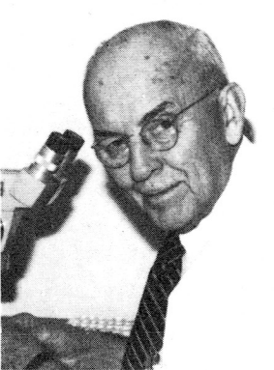
H. S. Ladd – “Most paleontologists today give little thought to fossiliferous rocks older than the Cambrian, thus ignoring the most important missing link of all. Indeed the missing PreCambrian record cannot properly be described as a link for it is in reality, about nine-tenths of the chain of life: the first nine-tenths.” (Geo. So. of Am. Mem. 1967, Vol. ll, p.7)
Steven Stanley – “In the absence of the fossil record, the credibility of evolutionists would be severely weakened. We might wonder whether the doctrine of evolution would qualify as anything more than outrageous hypothesis.” (Stanley, S.M., New Evolutionary Timetable, Basic Books, p.72)
Notes:
So how did things get off to such a big start? I think we could explain that – the Creation model in Gen 1. Where are all the Precambrian ancestors? The answer to this mystery is they do not exist. The only thing found in the Precambrian layer are some microorganisms, some bacteria, and some algae. This would represent the preflood world. The Precambrian layer is composed of Crystalline basement granite rock, the rock God created at the beginning of Creation and so there would be some bacteria and algae in it before the flood. But then after the flood it would be covered over by the Cambrian layer which would have all the animals in it.
H. S. Ladd From UCLA said – “Most paleontologists today give little thought to fossiliferous rocks older than the Cambrian, thus ignoring the most important missing link of all. Indeed the missing PreCambrian record cannot properly be described as a link for it is in reality, about nine-tenths of the chain of life: the first nine-tenths.”
Why? Because Evolutionists say in the Precambrian, life began evolving 3.8 billion years ago. It then continued to evolve for 3.2 billion years until the Cambrian, and then all these animals appear all of the sudden.
All of this is to remind us of an earlier quote we looked at by Steven Stanley – “In the absence of the fossil record, the credibility of evolutionists would be severely weakened. We might wonder whether the doctrine of evolution would qualify as anything more than outrageous hypothesis.”
What we have shown from the Evolutionists themselves is that it is indeed an outrageous hypothesis. We don’t find Evolution in the fossil record.

Slide 37
Notes:
But recognizing this very fact, Evolutionists have in recent years pulled the ole bait and switch. For years, Evolutionists cried, “The fossil record, the fossil record, the fossil record!” Now that it has been disproven, they now say, “Well, the fossil record never mattered in the first place.”

Slide 38
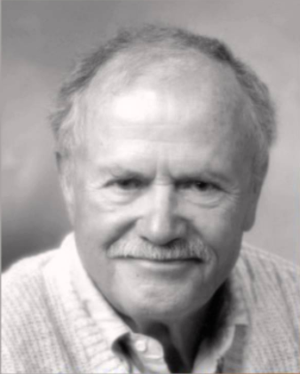
Pierre Grasse – “Since Paleontology does not shed any light on the genesis of the phyla, one must have recourse to the data drawn from comparative anatomy and embryology.” (Evolution of Living Organisms, Academic Press, Page 27, 1977).
Mark Ridley – “In any case, no real evolutionist…uses the fossil record as evidence in favor of the theory of evolution as opposed to special creation…” (Who Doubts Evolution? New Scientist, vol. 90; June 25, 1981, p. 831.)
Mark Ridley – “If the creationists want to impress the Darwinian establishment, it will be no use prating on about what the fossils say. No good Darwinian’s belief in evolution stands on the fossil evidence for gradual evolution, so nor will his belief fall by it.” (New Scientist 90:830–38).
David Kitts – “Few paleontologists have, I think, ever supposed that fossils, by themselves, provide grounds for the conclusion that evolution has occurred. The fossil record doesn’t even provide any evidence in support of Darwinian theory except in the weak sense that the fossil record is compatible with it, just as it is compatible with other evolutionary theories, and revolutionary theories, and special creationist theories, and even ahistorical theories.” (“Search for the Holy Transformation,” Paleobiology, Vol. 5; Summer 1979, p 353)
Notes:
Pierre Grasse – “Since Paleontology does not shed any light on the genesis of the phyla, one must have recourse to the data drawn from comparative anatomy and embryology.”
This is why they push the embryos so hard – evolutionists know there is no proof in the fossil record.
Mark Ridley, professor of zoology at Oxford University – “In any case, no real evolutionist…uses the fossil record as evidence in favor of the theory of evolution as opposed to special creation…”
They don’t? Isn’t that what the entire theory of Evolution is based on; the fossil record?
He pulls the bait and switch again saying this – “If the creationists want to impress the Darwinian establishment, it will be no use prating on about what the fossils say. No good Darwinian’s belief in evolution stands on the fossil evidence for gradual evolution, so nor will his belief fall by it.
David Kitts – “Few paleontologists have, I think, ever supposed that fossils, by themselves, provide grounds for the conclusion that evolution has occurred. The fossil record doesn’t even provide any evidence in support of Darwinian theory except in the weak sense that the fossil record is compatible with it, just as it is compatible with other evolutionary theories, and revolutionary theories, and special creationist theories, and even ahistorical theories.

Slide 39
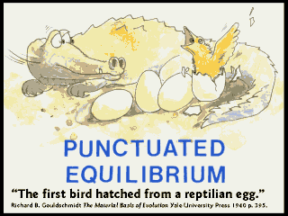
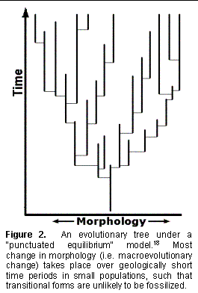
Notes:
So where do the Evolutionists go from here? If you can pin them down and get them to admit that they you cannot see evolution in the fossil record, which many are now honestly admitting, where do they go? They’ve developed what is called the “Doctrine of Punctuated Equilibrium” or sometimes called “Saltational Evolution”.

