Slide 1

Evidence For
The Global
Flood
Notes:
As discussed in the last couple of weeks, uniformitarianism relies on the hypothesis that the Earth’s sediment was laid down gradually over a long period of time, that radioactive decay from rocks and fossils is constant, and that the speed of light has always had the same rate.
However, if the global flood of Noah’s day happened, that one, singular event would account for all the sediment we see as well as the changes in the radioactive decay used to date the rocks and fossils, a dating mechanism that is so misleading because of its assumptions and inability to be falsifiable.
What I’m going to show you in this study is the plethora of evidence from the earth that provides evidence for the global flood of Noah’s day. In addition, we’ll like at lines of evidence from other catastrophic events and circumstances that will help us further valid the global flood.

Slide 2

The Creation
Gen 1:6-9 – “⁶Then God said, ‘Let there be an expanse in the midst of the waters, and let it separate the waters from the waters.’ ⁷God made the expanse, and separated the waters which were below the expanse from the waters which were above the expanse; and it was so. ⁸God called the expanse heaven. And there was evening and there was morning, a second day.”
Notes:
As we compare the macroevolution model and the creation model, its important to remember that as it pertains to the age of the earth, the creation model depends on two events. First, there is the Creation where it says in Gen 1:6-9 – “⁶Then God said, ‘Let there be an expanse in the midst of the waters, and let it separate the waters from the waters.’ ⁷God made the expanse, and separated the waters which were below the expanse from the waters which were above the expanse; and it was so. ⁸God called the expanse heaven. And there was evening and there was morning, a second day.”
So essentially what happened is God took the rock that was in the earth underneath the waters and pushed/shoved them to create a continent, likely the creation of what we call the Pangea. The evidence today is strong that continents we have today came from one continent, confirming what Antonio Snyder published in a French paper 1859. Snyder was a Creationist who looked at the continents and observed they looked like a jigsaw puzzle. But he was ignored for a hundred years until modern geologists started to confirm this in the 1960s. And this is nothing new; creationists have come up with many ideas that naturalists have balked at only to eventually begin to accept, even if not the biblical version of it.
What we’ll show in this study is that all the sediment had to have already been laid down while the Pangea was still in tact. Then sometime after that, the Pangea broke up, the tectonic plates collided, creating things like mountains. For example, when the India plate collided with the Eurasia plate, it would have created the Himalayan mountains. That’s how you get these high mountain ranges - tectonic plates collide. Evolutionists claim it happened over millions of years
One problem with this, though, is that the Rocky mountains keep rising every year but the elevation stays the same. How does that happen? Erosion. If it took millions of years, do you think they would keep rising without erosion? No, these mountains would have had to have been pushed up very rapidly.

Slide 3

The Flood
Gen 7:11b – “all the fountains of the great deep burst open, and the floodgates of the sky were opened.”
Gen 7:19 – “The water prevailed more and more upon the earth, so that all the high mountains everywhere under the heavens were covered.”
Notes:
The second is of course Noah’s flood in Gen 7:11b – “all the fountains of the great deep burst open, and the floodgates of the sky were opened”. Gen 7:19 – “The water prevailed more and more upon the earth, so that all the high mountains everywhere under the heavens were covered.”
Now this is nothing unique to the bible, and that is the first evidence I want to show you. There are over 500 global flood traditions throughout the world. And in every single one, there is at least one element of the Noahic flood, and several contain every element of the biblical representation. This chart shows some of the major traditions throughout the world and the Assyrian-Babylonian tradition contains a full representation of the Noahic flood.

Slide 4
The Chinese Language
Simple pictures were combined to make more complex thoughts
+
=
Mouth
Man (legs)
Older Brother
The “mouth man” or “spokes person” for the family was usually the oldest son or brother
Notes:
But let’s just consider one, that being the Chinese. Consider this: the Chinese language is the oldest, continuous written language in the known world, first written over 4500 years ago. The inventors of the written language drew pictures to express their words and ideas. Then they expanded on those simple pictures by combining them together to make more complex words or ideas
For example, this is the symbol for mouth and this is the symbol for man. When you combine them, you get the Chinese symbol for older brother. Most of the Chinese language is in fact constructed from smaller pictures that get combined into these bigger pictures.

Slide 5
The Chinese Language
+
+
=
DUST BREATH/ ALIVE MOUTH
TO TALK
Then the LORD God CREATED man of dust from the ground, and breathed into his nostrils the breath of life; and man became a living being. (Gen 2:7)
Notes:
Why is this significant? It’s significant because when God scattered the people from Babel in Gen 10, those who settled in China brought the oral traditions of the early days of man with them, and they used those stories to create the Chinese language
For example, the Chinese phrase “to talk” comes from the words “dust” plus “breath/mouth” plus “alive”. So this is a “Dust Man”. He did breath. Thus a “Living Dust Man”.
Why is this significant? Because Gen 2:7 – “Then the Lord God formed man of dust from the ground, and breathed into his nostrils the breath of life; and man became a living being.”

Slide 6


The Chinese Language

Slide 7




The Chinese Language
Large Boat
+
+
Boat
Eight
Person
Notes:
But more specific to our study is the Chinese symbol for a large vessel/boat. It is composed of 3 different words: “eight” plus “person” plus “boat”. So the Chinese don’t just have a tradition of a flood, but their language for a large boat contains the number 8. How many people were saved on Noah’s large vessel? Noah, his wife, his 3 sons Shem, Ham, and Japheth, and their 3 wives. 8 people total. Coincidence?
If you’re interested in learning more about this, there is a good book out there called “The Discovery of Genesis – How The Truths of Genesis Were Found Hidden in the Chinese Language”.

Slide 8
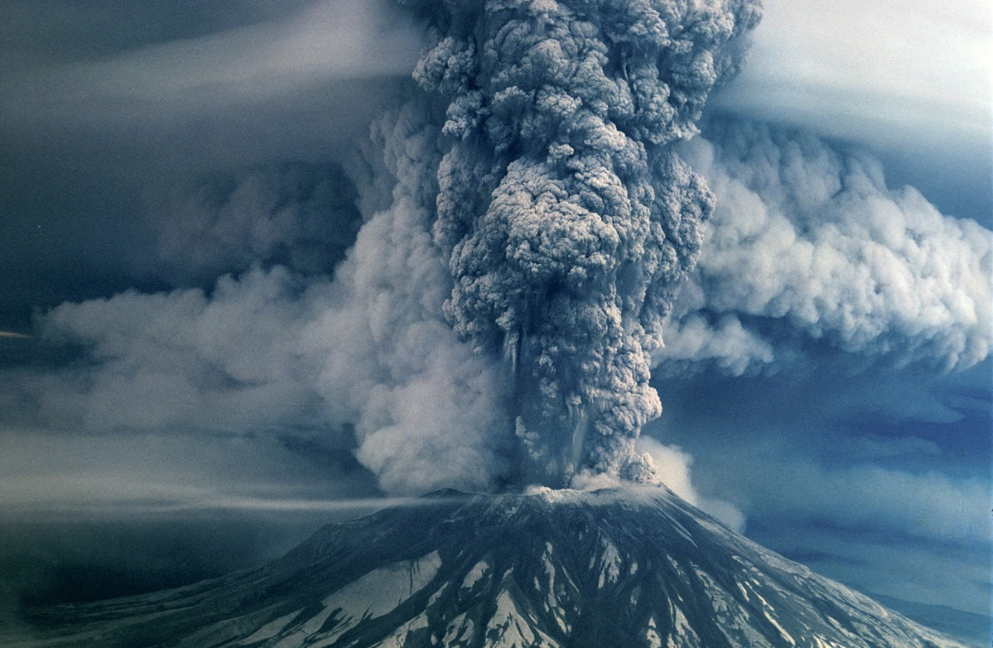
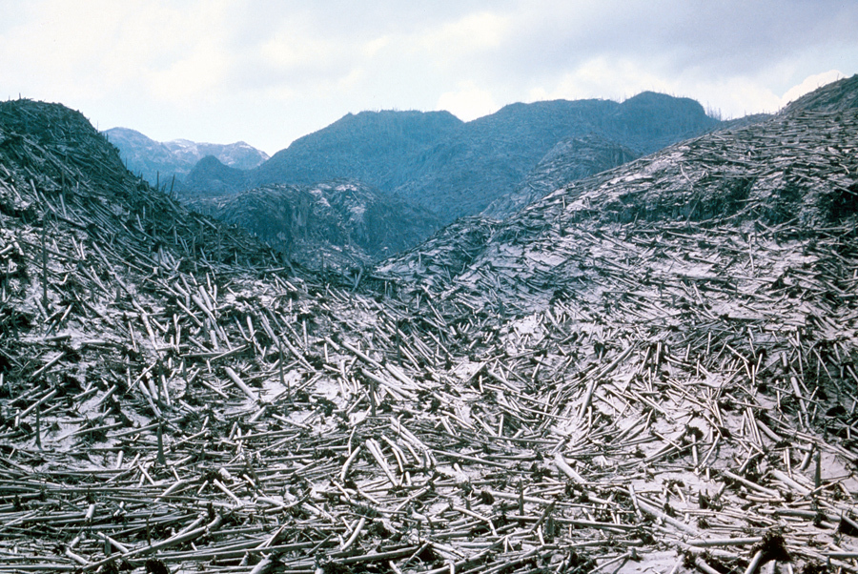
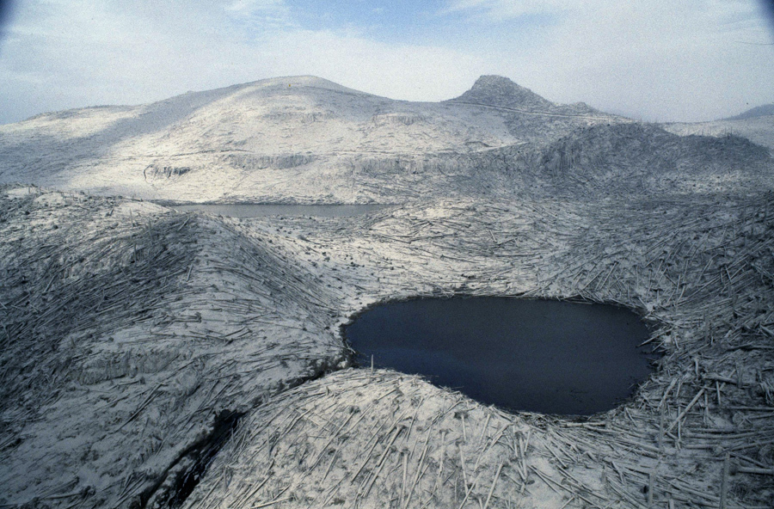
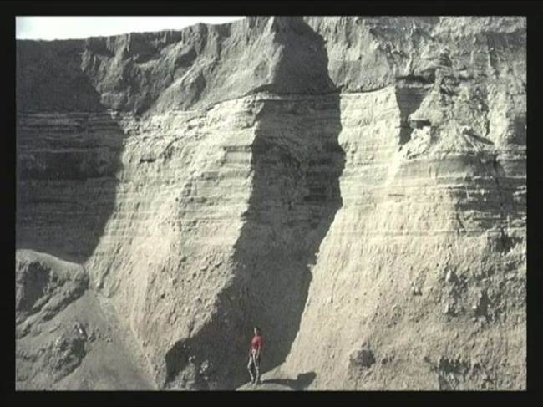
Mt. St. Helens Eruption
Notes:
Now let’s look at Mount St. Helens. In May 1980, a blast of steam, ice, water, rock, and ash exploded out of this mountain, with the gas moving at 650mph. The landslide that resulted moved at 150mph and the mud flows moved at 90mph. 200 square miles around Mount St. Helens was destroyed and the trees were leveled to the ground like toothpicks.
The bottom right picture is sediment that formed as a result of this eruption. Prior this, geologists w/their uniformitarianism bias would have said that sediment like this took millions of years to develop. Do you know how long this took for the bottom layer, about 25ft of sediment, to form? 3 hours. It doesn’t take millions of years for these layers to develop.
This event changed the way many geologists looked at rapid sedimentation. In fact, they found mudstone and shale, whom geologists claim develop slowly over millions of years, had aggregated and compacted and formed rapidly as a result of the eruption at Mount St. Helens.

Slide 9
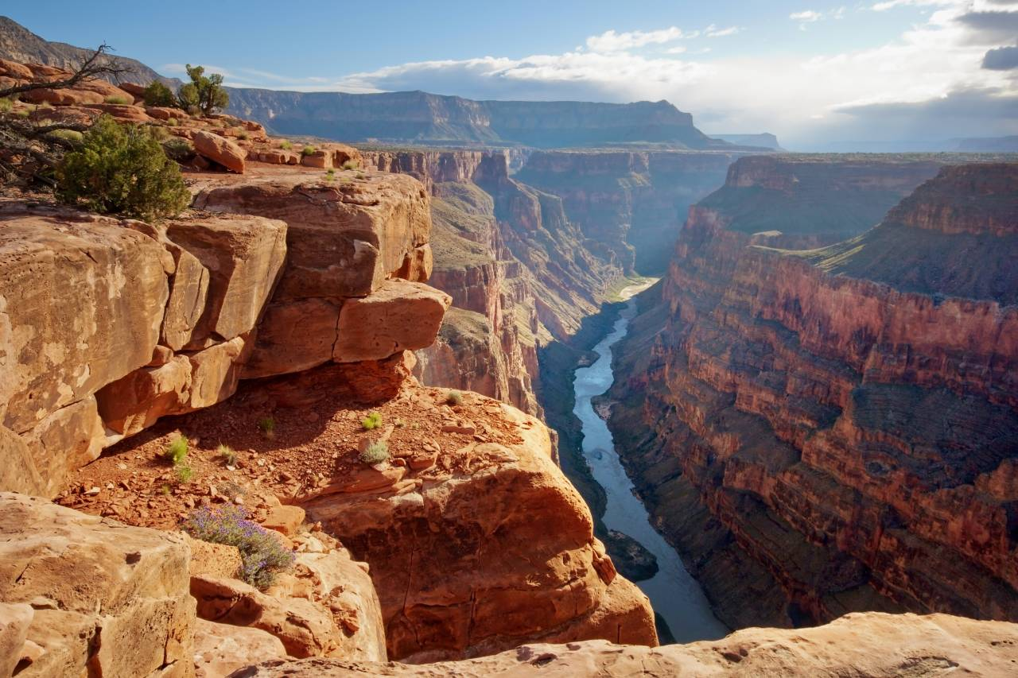
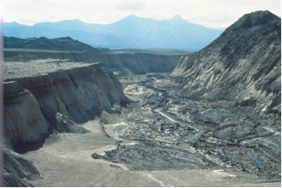
Mt. St. Helens Erosion
Notes:
Also, for almost 200 years, conventional geology has taught that the Grand Canyon was formed by the Colorado River, that as a result of millions of years of erosion, formed the canyon. Creationists have suggested for a long though that evidence suggests the Grand Canyon had to have formed rapidly as a result of a massive amount of moving water. Creationists were laughed at.
However, when Mount St. Helens erupted in 1980, something happened that caused naturalists to start taking Creationist geologists a little more seriously….and something else happened two years later. At the north face of Mount St. Helen, in May of 1980 and March 1982, the crater dam at the top of the canyon that was holding a bunch of water broke through and eroded a canyon up to 600 ft all the way down to the bedrock forming a mini grand canyon of the Toutle River, a 1/40th scale of the Grand Canyon. This happened in one day’s time.
If 1/40th of the Grand Canyon can be cut in one day, why must it take a million years to cut the entire Grand Canyon? The answer is that it doesn’t…unless you bring in subjective observations and biased conjecture. And there are other little grand canyons in other states, even in GA, that were formed very rapidly.

Slide 10
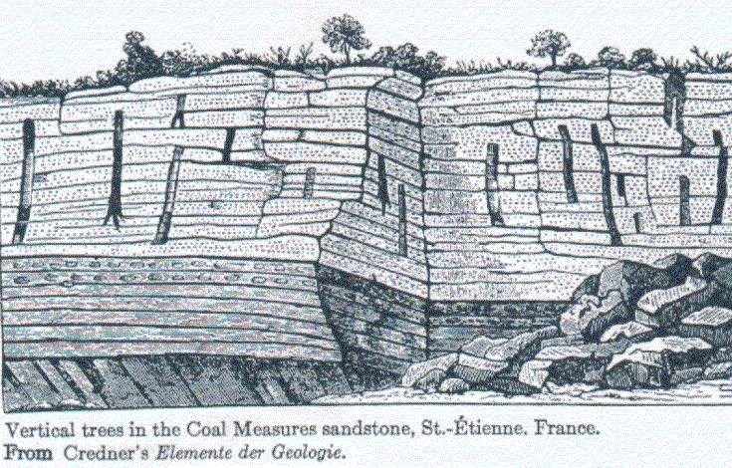
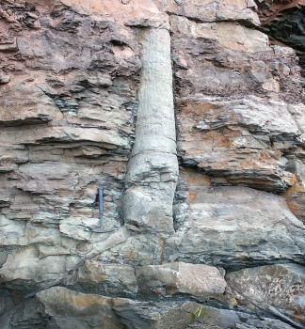
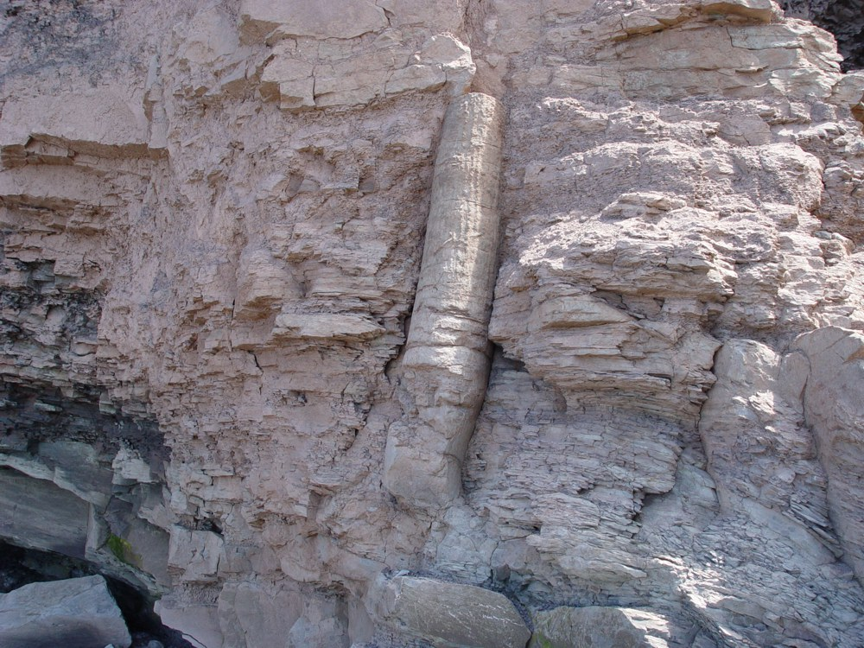
Polystrate Fossils
Notes:
Let’s now look at Polystrate Fossils. Polystrate Fossils are fossils that traverse through multiple layers of sediment. And the problem this poses for naturalists is that this sediment was supposed to have taken millions of years to form. But bones and trees don’t just stick out of the ground for millions of years waiting to petrify and turn into fossils. Wood deteriorates very quickly. Organisms get in there and break it down.

Slide 11
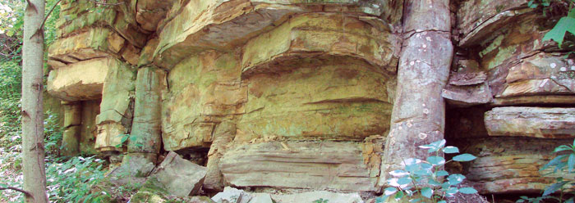
Polystrate Fossils
Notes:
Anyone know where this? This is the Kettles Coal Mines in Cookeville, TN. This is a Polystrate fossil, a tree, over 12ft high that was supposedly buried over millions of years in rock sediment. No, that tree didn’t sit there for millions of years until it was covered. It would have decomposed long before that.

Slide 12
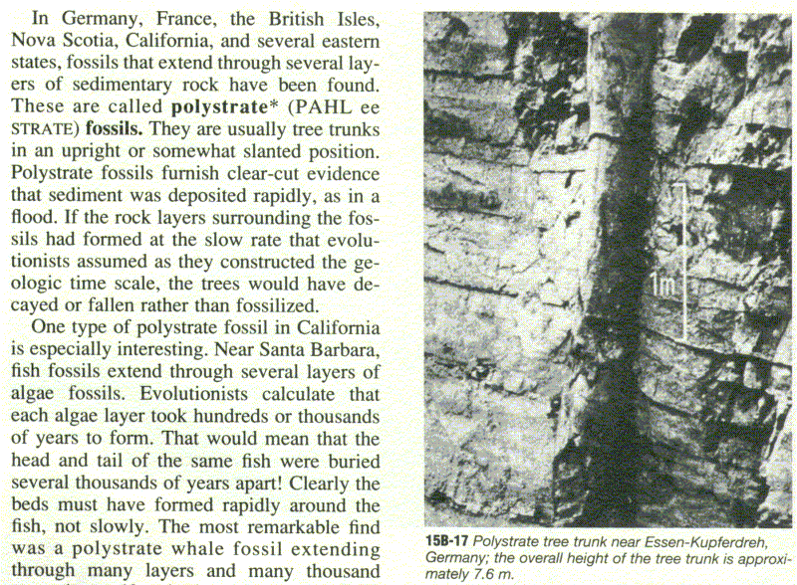
Polystrate Fossils
Notes:
Here is a Polystrate Fossil in Germany that is 24ft tall that was supposedly covered in millions of years of sediment. Did that happen slowly? No, it had to have happened quickly and the Creationists have been saying this for 200 years. But they were ignored by naturalists. There is simply no way to explain fossils of this size through gradualism and uniformitarianism.

Slide 13
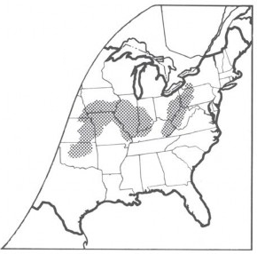

Polystrate Fossils
Derek Ager – “In the late Carboniferous Coal Measures of Lancashire, a fossil tree has been found, 38 feet high and still standing in its living position. Sedimentation must therefore have been fast enough to bury the tree and solidify before the tree had time to rot.” (Ager, Derek, The Nature of the Stratigraphical Record, Halsted Press, 1973, p. 41)
Notes:
These aren’t isolated incidences. There are actually parts of the world where we find Polystrate Forests of fossilized trees and petrified trees. We’ve quoted Derek Ager before…he used to be the president of the British Geological association and though he is an Evolutionist and would disagree with our assessments about Creation, he pushes the idea of neo-catastrophism and rejects uniformitarianism. Here is what he said:
“In the late Carboniferous Coal Measures of Lancashire, a fossil tree has been found, 38 feet high and still standing in its living position. Sedimentation must therefore have been fast enough to bury the tree and solidify before the tree had time to rot.”
38ft is 4 stories high, buried quickly, and not just in any sediment, but in the Coal Measures. How are we taught in textbooks about how coal forms? Marshes and swamps over millions of years . How could that have been?

Slide 14
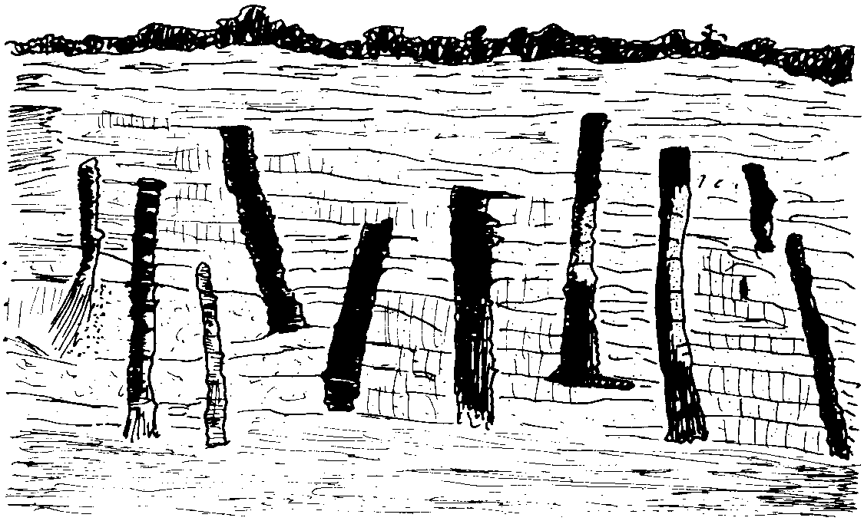
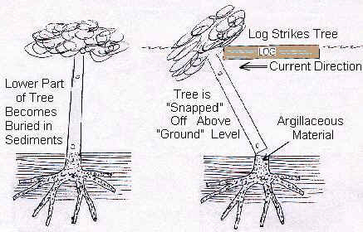
Polystrate Fossils
Notes:
Now, whenever these Polystrate Trees are discovered, there’s a couple things to note:
First, they’re always at different layers and elevations. Some are higher in the geologic column and some are lower.
Second, they either have no roots because the bottom of the tree was broken off or they have a small root bulb at the bottom where the rest of the roots had broken off. There are no branches, leaves, or twigs on the tree.
Some are even sideways and that’s important to remember because Evolutions will try to argue that the trees were buried in gradual sediment over millions of years. But even the experts will denounce that because in these forests, we find so many that are side ways.

Slide 15
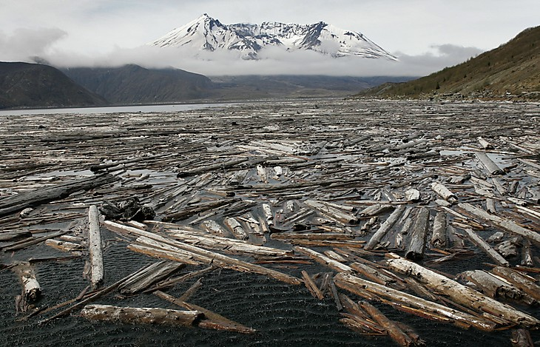
Polystrate Fossils
Notes:
So what creates petrified forests? And why do we find them nestled together in certain parts of the world and not others?
Remember that 200 square miles around Mt. St. Helens that was leveled in just seconds from 600 mph gases. Look at these trees just leveled like toothpicks and mowed down to the ground. What also happened at the base of Mt. St. Helens is that a lake formed, now called “Spirit Lake”. These may look like twigs and toothpicks on the slide, but they are trees/logs – one million logs estimated to be floating on top of Spirit Lake. As the wind picked up, this great log sheet moved back and forth. What would eventually happen after months or years of this? The logs rub up against each other and all the branches and bark are rubbed off.

Slide 16
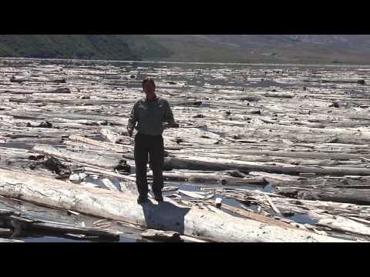
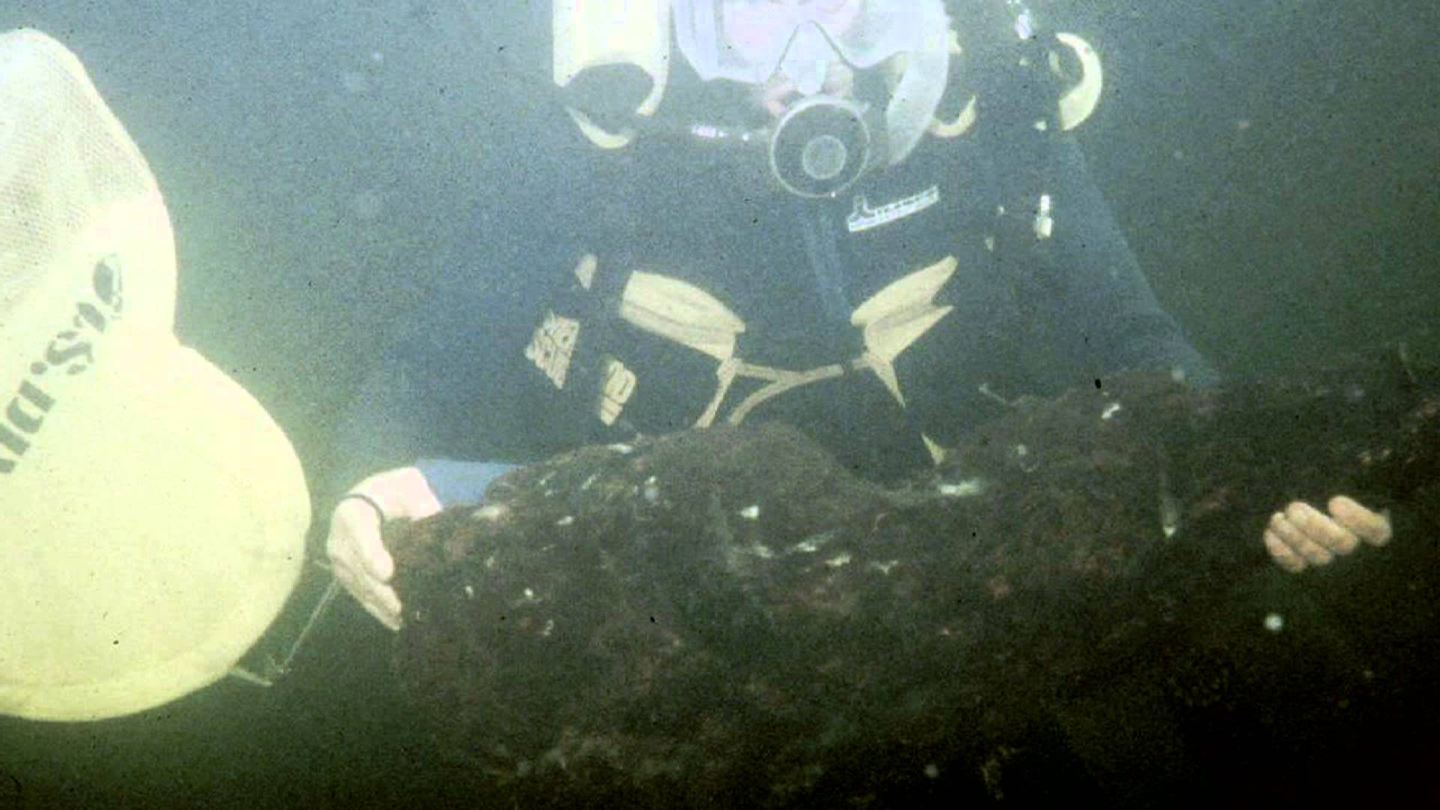
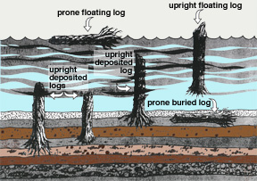
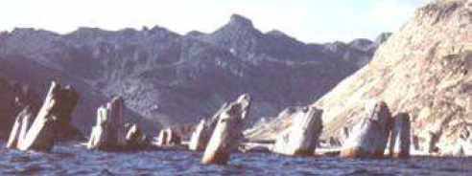
Polystrate Fossils
Notes:
Well, a geologist named Steve Austin was a PHD student and he studied these logs shortly after the eruption in 1980. He is a Creationist, but he is respected by both camps. As he studied these logs, he discovered that the logs would eventually become waterlogged on the root end where the root bulb had formed, causing the log to swing down under the water and bob around like a cork for a period of time.
Austin scuba dived down to the bottom of the lake, a dangerous undertaking, because over time these logs become too water logged and they sink. He recorded in 1985 that 20,000 trees having become water logged had fallen to the bottom of the lake, vertical, and had lodged themselves in the peat that is at the bottom that had been formed from the bark of all the trees on the top rubbing each other. The first trees that went down would have been lower in the peat/sediment and the trees that sunk later would have been higher in the peat/sediment and at a different elevation.
What Austin discovered is exactly what we see in the fossil columns all over the world – trees with no limbs, roots, or bark, that look like they’ve been ripped out of the ground, and dropped down at different layers in the strata. And so Mount St. Helens solved the puzzle for all the petrified forests that we find around the globe.
This is flood geology, but it was only localized. However imagine a global flood and billions and billions of trees? Think about how much sediment would be produced from the missing bark from that many trees?

Slide 17
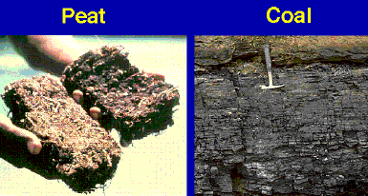
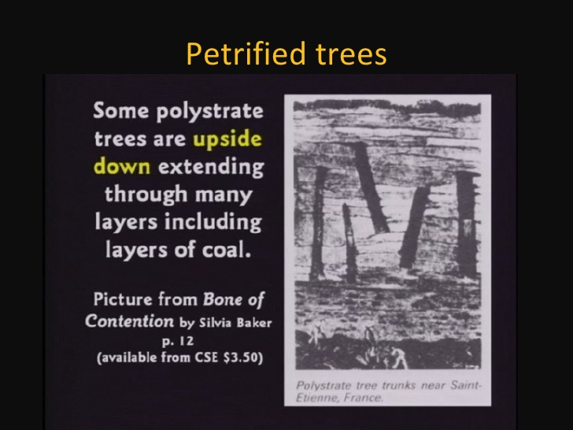
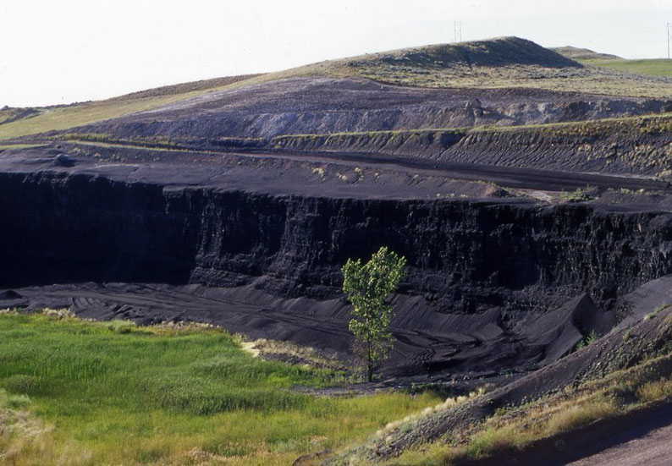
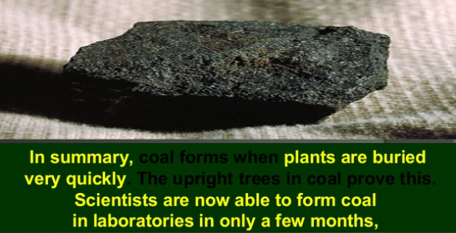
Laminated Coal
Notes:
This is significant because it solves another riddle – course/rough laminated coal. So some coal has a very fine/thin consistency and other coal is rough. In fact most of the coal that dominates the eastern US is dominated by tree bark, which is what makes the very rough coal. Naturalist geologist have been puzzled over this for years – why is this rough coal dominated by tree bark? If they were growing for millions of years, were these trees just losing their bark and nothing else was falling?
Well, because of Steve Austin’s research at Mount St. Helens, we know that all this coal likely formed from the flood. Because given the right conditions in Spirit Lake, coal will eventually develop down there in the midst of all the peat from the bark. But multiply those millions of trees by how many trees would have been floating during Noah’s flood. That would be millions of pounds of bark being rubbed off these logs. So Austin’s research proved that this rough coal is formed from the peat that develops from bark that gets rubbed off of floating logs banging against each other.

Slide 18
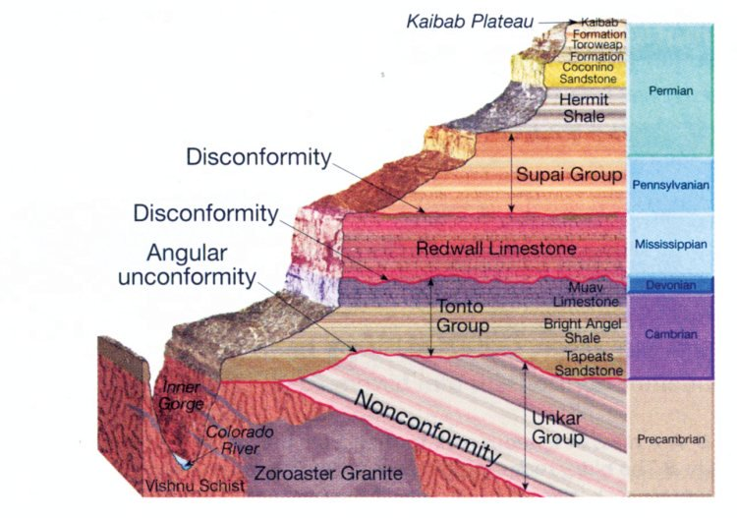
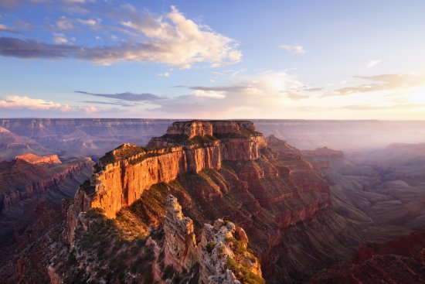
Grand Canyon
Gen 7:24 – “The water prevailed upon the earth one hundred and fifty days.”
Notes:
The Grand Canyon is not some narrow canyon cut by a river, it is large and vast and was created by what some would call a wash, where large amounts of water comes through and clears out a large spot. The Grand Canyon is composed of several layers. The very bottom layers in red and purple and pink are the basement layers, metamorphic rock. And right above that is the first sedimentary layer, Tapeats Sandstone. And Creationist geologists believe that this is where Noah’s Flood would have started, at the Tapeats Sandstone with everything under probably there during the pre-flood world.
Now naturalist geologists claim that from the Tapeats sandstone to the Kaibab Plateau was about 540 million years. But one scientist, Dr. Ron Blakley from Northern Arizona University, who is an Evolutionist, ran calculations and predictions on models he has seen, and determined it could have formed as rapidly as a 150 days. Why is this significant?
Gen 7:24 – “The water prevailed upon the earth one hundred and fifty days.” And Ron Blakey and Evolutionists, has shown this was possible though he would deny Creationism and the Noahic flood.

Slide 19
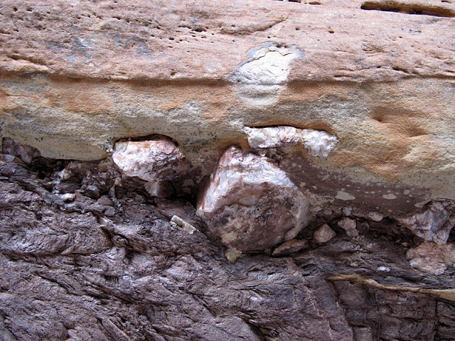
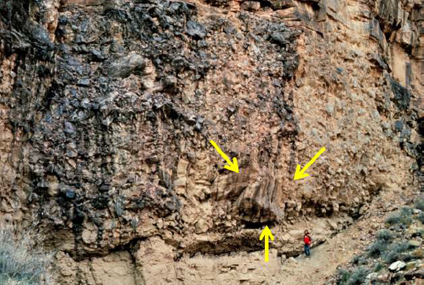
Tapeats Sandstone
Notes:
So let’s look at the Tapeats Sandstone that is all the way at the bottom above those basement layers. The problem naturalistic geologists have with explaining how the Tapeats Sandstone took millions of years to develop is the fact that these layers are littered with large boulders up to 15 feet in diameter. What kind of force would it take to move a rock 15 feet in diameter? The bottom right picture is of a boulder about 8 feet in diameter embedded in Tapeats Sandstone.

Slide 20
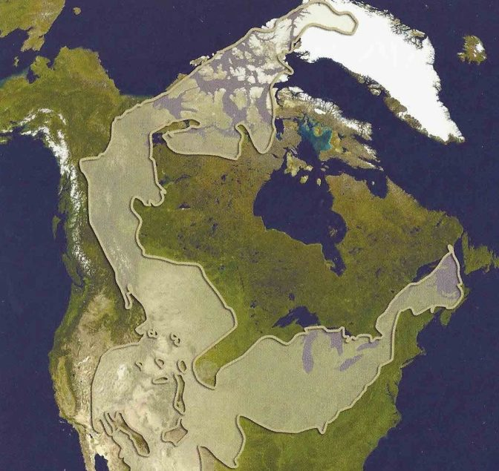
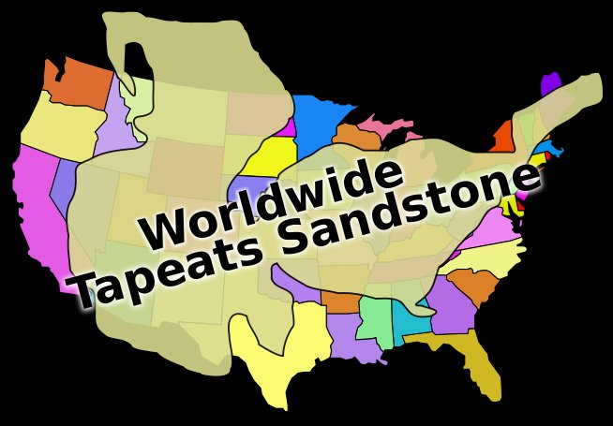
Tapeats Sandstone
Notes:
And this is not localized to the Grand Canyon, but its all over the United States and in fact is worldwide. There are Tapeats Sandstone layers with boulders embedded in Southern Israel, Jordan, and Petra. This means it had to have formed from rapid movement, fast, rushing water moving boulders that are fifteen feet in diameter. This was a continental scale flood deposition that took place when the continents were still together as the Pangea, before they broke up.

Slide 21
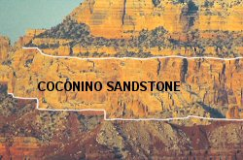
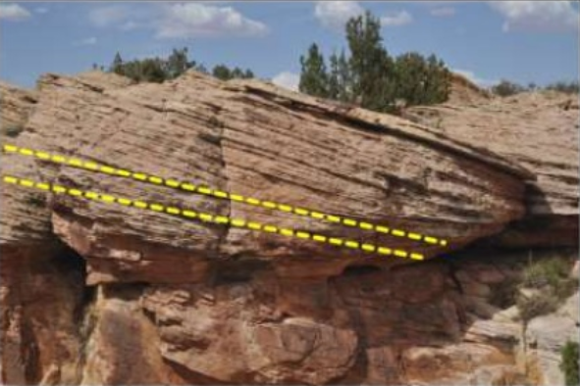
Coconino Sandstone
Notes:
Next is the Coconino Sandstone, about 325 ft thick here near the top, a light colored sandstone. The Coconino Sandstone covers about tens of thousands of square miles all across the country and the most significant thing about the Coconino Sandstone is that it has these slanted dunes in it.
Now naturalists will claim that these slants formed from dry desert dunes as a result of wind erosion over millions of years. But Creationists interpret it as being a result not of wind erosion, but from storm beds during Noah’s flood as a result of rapidly moving water. So how do we know which is right?

Slide 22
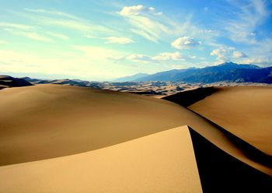

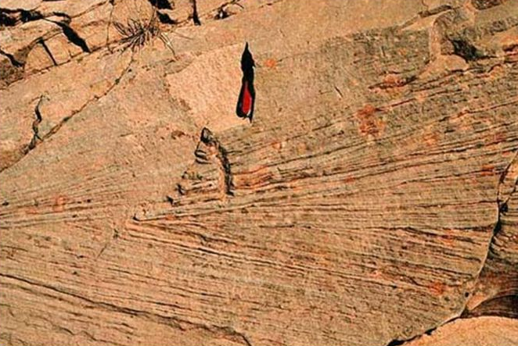
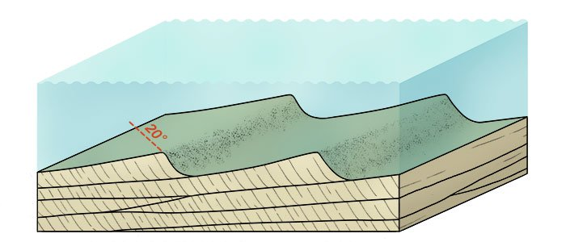
Coconino Sandstone
Notes:
There are actually certain ways we can test for it. We can look at dry sand dunes from deserts today and measure their slopes and they always measures at 30 degrees or greater slope. And they also have these avalanche faces off the backside of the dune where it just drops off. That’s what a sand dune looks like. (Grand Sand Dunes National Park).
So what we then do is go back to the Coconino Sandstones and compare what we know from dry sand dunes and see if it matches. And what we find in the Coconino Sandstone is that the slope is not great enough to be a dry sand dune because it has to be at least 30 degrees. But the average slope of all the Coconino Sandstones is 25 degrees and a lot of them are 20 – 22 degrees and so they cannot be dry sand dunes.
So the Coconino Sandstones are the result of wet storm beds, and you can see the same thing underneath the Golden Gate bridge in San Francisco Bay where the waters from the Pacific come rushing into the bay and bring in sand, creating these sand beds which look identical to the Coconino Sandstone beds.

Slide 23

Coconino Sandstone
Notes:
These Coconino storm beds cover 10,000 square miles at 30 feet high. Studies have shown that storm beds that are 30 feet high can be created in just a few short days. They do these experiments in flume tanks where they move rapidly rushing water through and then dump all this sediment in to see how it reacts. They then extrapolate the data to larger experiments in creeks and rivers. What they found was that 60 foot waves moving at 3 to 5 mph can create these whole array of dunes in just a few days. And that’s exactly what we believe caused the Coconino Sandstone deposits, Noah’s flood.

Slide 24
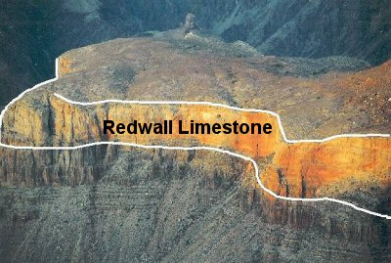
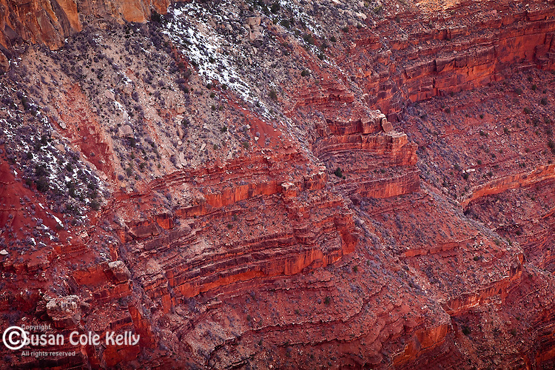
Redwall Limestone
Notes:
Then there is the Redwall Limestone which is the single thickest layer at 400 – 800 feet thick. Evolutionists say it formed about 65 million years ago. However, what makes this sediment layer significant for Creationists is the fact that all throughout this limestone we find fossils of oceanic creatures, particularly animals that live at the bottom of the ocean. Now Evolutionists will say the ocean used to be where the Grand Canyon is and vice versa. There’s actually a better explanation.

Slide 25
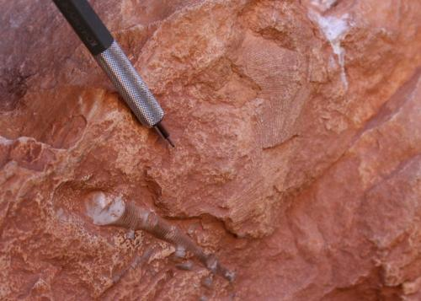
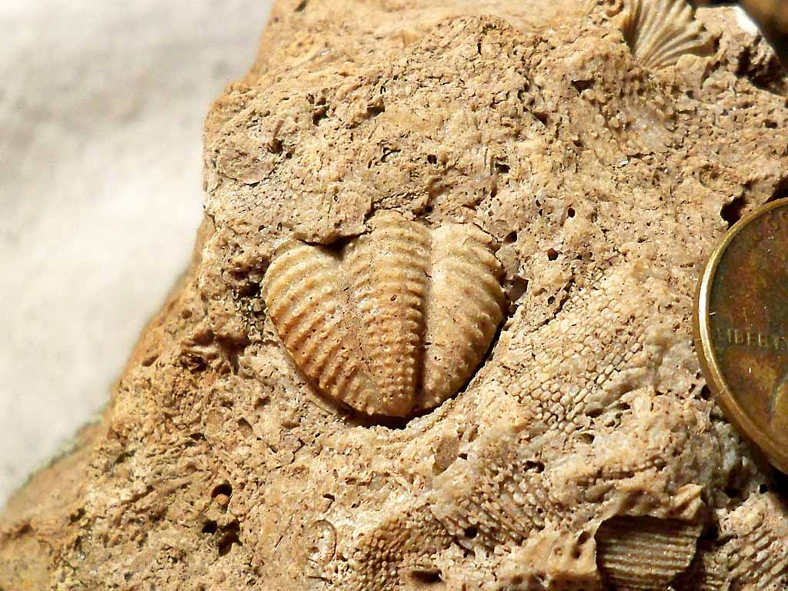
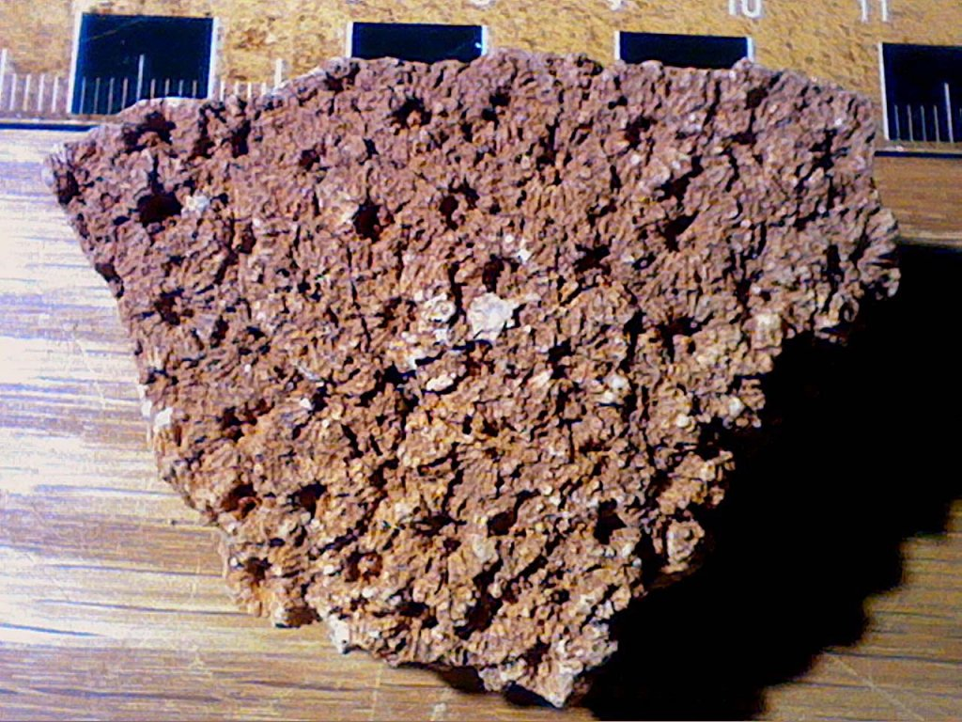
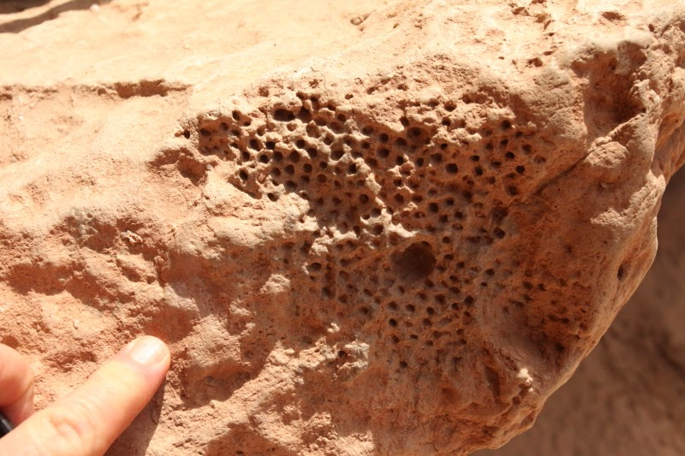
Redwall Limestone
Notes:
The upper left picture contains crinoids and bryozoan. The upper right picture is of a trilobite pygidium. The bottom left picture is of some brachiopods in red cherts and the bottom right picture is of a sponge.
Now notice in the bottom left picture how all these brachiopods washed together in one place. And when you study other fossils in the Redwall Limestone, you find the same thing happens with the sponges, that they were washed together all in one place. If all of this developed gradually, as Evolutionists insist, you would expect more variety and randomness to the fossils.
Well, based on studies from the past, you can take a flume tank and mix in, say, 10 different size particles – sand, silt, pebbles, stone, and mix it all together. While the water is rushing through your flume tank, if you dump in all this mixture of particles, a self-sorting mechanism starts to occur based on the size and the mass of those particles. Even though they went in mixed together, they start sorting themselves out and this is exactly what we see in the Redwall Limestone despite the fact that they were all once on the ocean floor but then swept up at the same time.

Slide 26
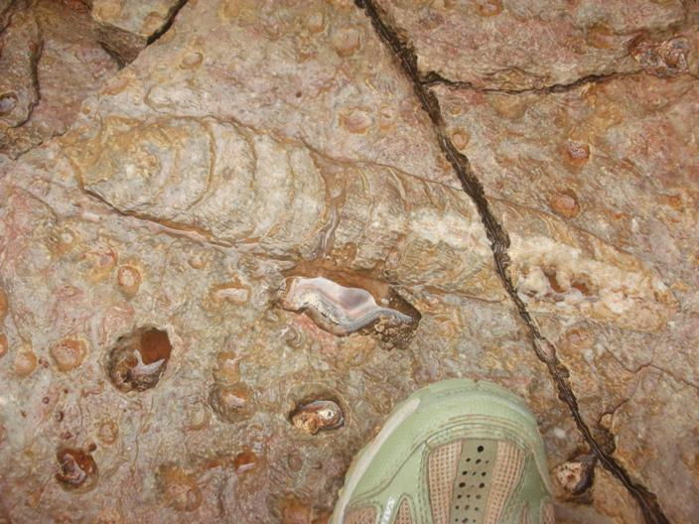
Redwall Limestone
Notes:
Also, we see these nautiloids in the Redwall Limestone. They’ve conducted research and found that these Nautiloids are contained within only one 7 foot thickness that covers an area of 11,000 square miles from southern Utah all the way down to Las Vegas. There are 2 per every 10 square feet. It’s as if they had been washed in a slurry and distributed evenly. There aren’t pockets where some live and other pockets where others live, but mixed perfectly within the same 7 foot thickness of the limestone over 11,000 square miles. This could have only happened in a continental slurry flood very rapidly.
This Redwall limestone is not only found all over the United States, but in England and also in the Himalayan Mountains on Mount Everest itself. This was a worldwide global flood.

Slide 27
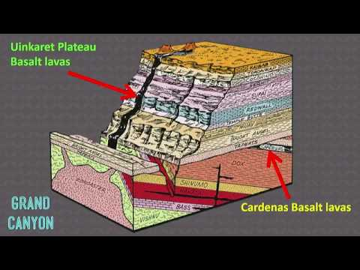
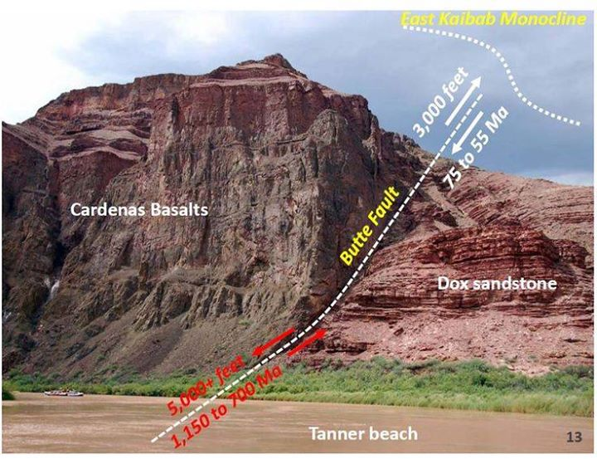
Cardenas Basalt
Kaibab Plateau (top most strata) – 250 million yrs
Cardenas Basalt (Potassium-Argon) – 516 million yrs
Cardenas Basalt (Rubidium-Strontium) –1.1 billion yrs
Cardenas Basalt (Samarium-Neodymium – 1.6 billion yrs
Notes:
A basalt is a lava formed rock, and it is actually down in the basement layer of the Grand Canyon so it is considered by secular geologists to be some of the oldest rock. However, what they’ve found is that some of it, as a result of a volcanic eruption at the top, flowed out as magma and then over the side and covered every single layer all the way down to the basement rock in the Precambrian layer. So secular geologists would claim that this rock is younger than all the layers since according to their uniformitarianism views would have been formed after all the other strata was laid in place.
But here is how messed up radiometric dating is: they say the very top strata called the Kaibab Plateau is only 250 million years old. But look at what all of these different radiometric dating methods say the age of the Cardenas Basalt is, how off they are not only with the Kaibab Plateau but even with each other. Radiometric dating is not a measure of age. It is a measure of chemical composition

Slide 28
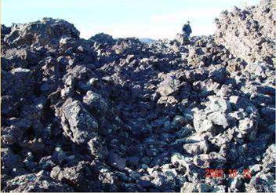
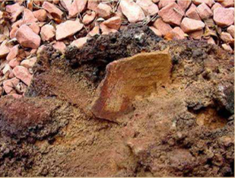
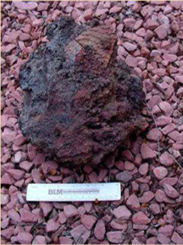
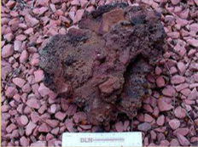
Cardenas Basalt
Notes:
Which age is right? The answer is none of them, because we have evidence that humans were there when this lava flowed. Researchers at the University of Arizona found out that Indians of the area, as recorded in their traditions, would create rock shards for religious purposes, made out of the magma they would capture from pottery. These researchers found 150ish of these shards at the site where the Basalt flowed. This did not flow millions and billions of years ago. Its estimated that it flowed about 800 years ago.

Slide 29
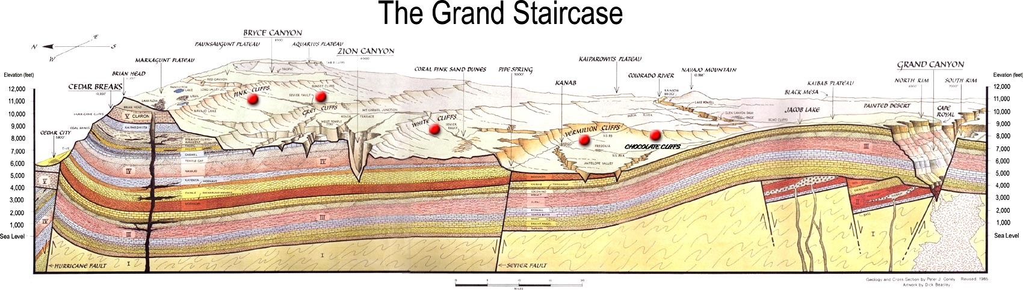
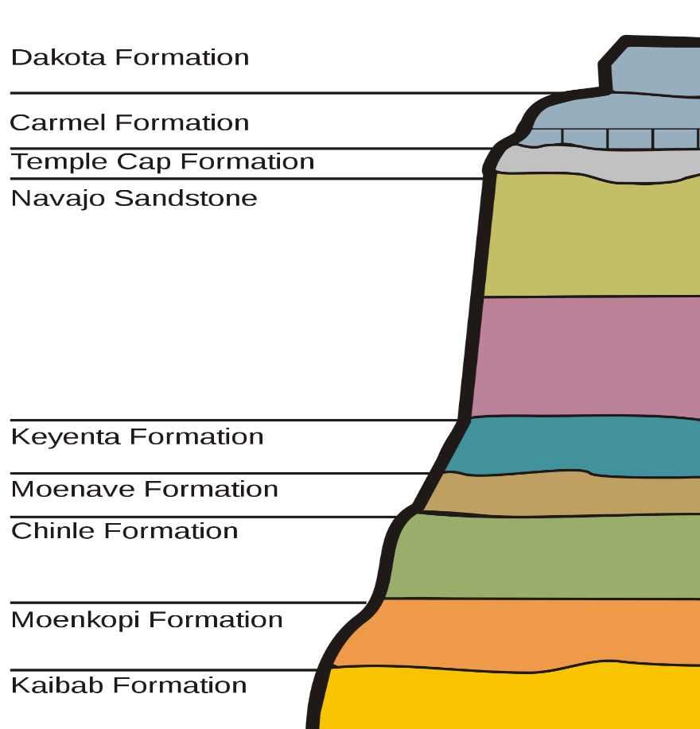
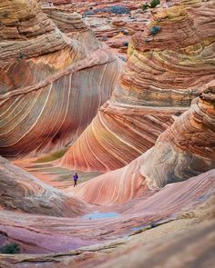

Navajo Sandstone
Notes:
Next is the Navajo Sandstone, which is very close to the top of the Grand Canyon geologic column, in the section at the top called the Grand Staircase. What is unique about this sandstone is that it didn’t come from this area. There are no other rocks in that area that are like the Navajo Sandstone. So secular geologists have been baffled as to how it all got here. We know it eroded from some mountain, but what mountain could it have been?
Well, using a technique called “Mass Spectrometry”, they tested this sandstone and determined it came from 1250 miles away from the Appalachian Mountains in Pennsylvania and New York. So what event could have transferred all this Navajo Sandstone 1250 miles and deposited it at the Grand Canyon? Secular geologists can’t explain it.
See all the big washes in these pictures? Does this suggest slow gradual build up or that it happened quickly?

Slide 30



Missing Layers
Notes:
Then there are the missing layers. In the top right picture, those white, light grayish layers at the bottom are the Muav Limestone that are identified as Cambrian layers because they have Cambrian fossils in them, creatures that once lived at the bottom of the ocean. Secular geologists claim that the Cambrian layer existed 500 – 600 million years ago.
Yet the Redwall Limestone is found lying right on top of it. Redwall Limestone is considered Mississippian and there is supposed to be 150 million years between these layers. Evolutionists claim erosion but look at the contact lines, the knife edges. Erosion doesn’t look like that. With erosion you see weathering, unevenness, burrows, turbidzation, trees, roots, gullies, depression valleys, stream beds, ponds, caves, caverns, craters, and canyons. None of that is there.
If we zoom in (bottom right picture), notice the interface between these 2 layers. You see Muav, Redwall, then Muav again, then Redwall again – the two are interbedded 7 times. Secular Geologists can’t rationally explain this according to what they teach in textbooks about the geologic column. What we actually see here is called a pseudoconformity, where supposedly older layers exists on supposedly younger layers.

Slide 31



Rapid Sedimentation
Notes:
Look at these pictures that show the clean, razor thin edges between layers of sediment. When they are so distinct with such a sharp transition, does that speak to slow gradual accumulation with erosion in between, or being laid down quickly? These edges are horizontal, clean boundaries between the strata. There is no weathering, no unevenness, valleys, or gulleys.

Slide 32



Nonmetamorphic Geologic Folds
Notes:
Next is the nonmetamorphic geologic folds. Don’t let that big name fool you – metamorphic folds are folds in the rock that happen when the rock is hot and under pressure. This creates what is called metamorphic rock, once sediment, but has been crystalized.
And yet, at the Grand Canyon, we see rock like this that is nonmetamorphic. The picture on the left is of the Tapeats Sandstone that shows folds of 90 degrees. Yet there are no cracks or fractures and most importantly, there is no crystallization. This means they were not hot when they did this. It means they were folded when they were soft, just like playdough. You can bend and morph play dough but what happens when you try to do that when its hard? It breaks.

Slide 33

Limestone Chalkbeds
Notes:
Finally, there is the Limestone Chalkbeds. Chalk is made from billions of protozoa called Foraminifera, calcite exoskeletons, that supposedly developed in the ocean over millions of years. There are thousands of feet of this sediment in places all over the world composed of this chalk.

Slide 34



Limestone Chalkbeds
Notes:
These are the cliffs of Dover in Southern England, and people travel from all over the world to see them. Movies are filmed here sometimes.

Slide 35




Limestone Chalkbeds
naturalistjourneys.com
Notes:
They’re also in Texas, in a place called Chalk bluff and the bottom left picture is from right here in Alabama in Demapolis. The bottom right picture is from the Cumberland Plateau in Tennessee

Slide 36



Limestone Chalkbeds
Notes:
This left picture is from Dorset Ireland, the top right picture is from Normandy France, and the bottom right picture is from Israel on the Mediterranean coast. All the times the bible mentions “whitewash”…they would have made whitewash from the chalk from these very cliffs in Northern Israel next to Lebanon.
Now secular geologists will claim that they developed very slowly at the bottom of the ocean over millions of years but Creationists would say they developed from a very rapid, global flood. What kinds of tests could we run in these limestone chalk beds to determine which worldview makes more sense?
So here’s a test. Is there anything in these Limestone Chalk beds that shouldn’t be at the bottom of the ocean? There is indeed.

Slide 37




Limestone Chalkbeds
Notes:
These are a little hard to see, but these are some carnivore tracks found inside the Limestone Chalk Beds in Arizona. There are cats tracks as well as terrestrial plant fossils and roots that shouldn’t be there. What were they doing at the bottom of the ocean?

Slide 38



Limestone Chalkbeds
Notes:
These fossils were found in the Kansas Limestone Chalk Beds in a place called Smoky Hill Chalk, buried within the layers. Can anybody guess what these fossil are? It’s a dinosaur, called Niobrarasaurus. These guys are measured at 16’ long, over 1300lbs.
Now evolutionists will say they just got caught in a river and got washed out in the ocean where they were then buried. Well it would take millions of years for this to be buried gradually and somehow that happened and it didn’t decompose…who can believe it?

Slide 39




Limestone Chalkbeds
Notes:
They also found a Claosaurus, which is 15’ tall and weighed 1000 lbs. They also found an Ankylosaur that was 30’ long and weighed over 10,000 lbs, that’s 5 tons. How often do animals that big get washed out to sea? Do we see elephants getting washed out to sea all the time? That never happens and if it did, it would be rotted and decomposed before all these millions of years that would be required to develop this chalk.
But if a global flood occurred, that would have taken these animals and swooshed them around and they’d get buried get in this limestone chalk layer. That would easily explain it.

Slide 40
Conclusion
Matt 24:37-39 – “³⁷For the coming of the Son of Man will be just like the days of Noah. ³⁸For as in those days before the flood they were eating and drinking, marrying and giving in marriage, until the day that Noah entered the ark, ³⁹and they did not understand until the flood came and took them all away; so will the coming of the Son of Man be.”
Notes:
“Well I believe in Jesus, I just can’t believe in a global flood.” That doesn’t work because Jesus believed in Noah’s flood.
Matt 24:37-39 – “For the coming of the Son of Man will be just like the days of Noah. For as in those days before the flood they were eating and drinking, marrying and giving in marriage, until the day that Noah entered the ark, and they did not understand until the flood came and took them all away; so will the coming of the Son of Man be.”

