Slide 1
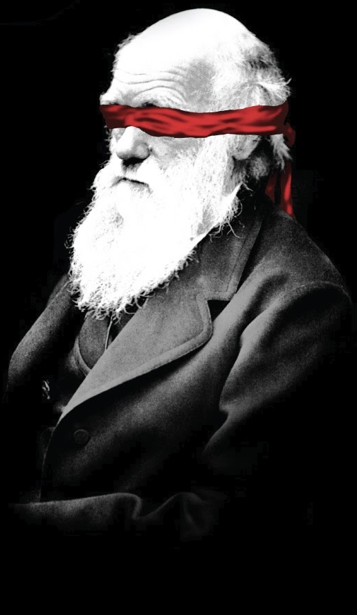
Do They
Believe
What They
Believe?
Notes:
When I personally encounter people who believe in Evolution over Creationism, I’ll usually ask them certain well-intentioned questions in order to gauge why they believe that particular worldview. I might ask, “Can you name one example of an observable beneficial mutation that changes one species into another? Do you know of an observable example of nonlife creating life? Can you give me an example of a fossil that represents an actual missing link between species?”
bbbI don’t ask these questions with snark, but with genuine interest because I want to know what the depth of this person’s faith is in the evolutionary worldview. And rarely do I get actual answers, and the few who do give answers only mention things that have been debunked even by Evolutionists a long time ago, oh which we’ll talk about in the coming weeks. And so then I’ll ask if they are aware of evidence related to Creationism, the lines of evidence for the global flood, evidence we see at Mt. Saint Helens or the Grand Canyon, the Cambrian Explosion (we’ll talk about these down the road), and rarely do I run across a person who is even aware of this evidence. Other preachers I talk to share the same experiences I’ve had.
And so it begs the following question: why do people believe in Darwinian Evolution when so few of them have actually done their homework, research, and considered both sides of the issue. Even amongst those who are scientists in their field, you’ll find that many of them have not even bothered to read the scientific papers from the Creationists standpoint, discounting it up front simply for the fact that they disagree. Many of them also have barely opened their bibles and are unaware of the remarkable evidence there is for the validity and inspiration of God’s word.
So why do most people believe in Evolution? I would never suggest that there are not people out there who have studied both sides of the position who take the opposite position from me. But I have been teaching biblical apologetics for years and I have been in some knock-down-drag-outs with folks. There are other factors involved in why people trend toward this worldview, and I’m going to make a few suggestions to you tonight on what I believe those reasons are. Understanding how a person comes to believe in a false worldview will aid us in bringing them the gospel.
Why is Darwinian Evolution so accepted in today’s culture?

Slide 2
Once upon a time, a man left home jogging. He jogged a little ways and turned left. He jogged a little ways and turned left. He jogged a little ways, turned left and jogged back home.
As he was jogging home, he noticed two masked men waiting for him at home.
Who were the masked men?
Why did he leave home jogging?
Notes:
Has anyone ever been brainwashed? Raise your hand. That’s certainly not the kind of thing anyone wants to admit, but its true to some degree for all of us. I’ve been brainwashed before and so have you. I want to show you how brainwashing works by going through a demonstration with you:
I’m going to try to brainwash you by telling you a story, and at the end of the story I’m going to ask 2 questions that have very simple answers. If you have never heard this demonstration before and you are able to come up with the answer to the 2 questions, you have not been brainwashed. But if you don’t know the answer to the questions, I’ve successfully brainwashed you – I was able to get you to think the way I wanted you to think.
Now if you’ve heard this demonstration before or you know the answer to the questions, don’t spoil it for everyone else.
Once upon a time, a man left home jogging. He jogged a little ways and turned left. He jogged a little ways and turned left. He jogged a little ways, and turned left and jogged back home.
As he was jogging home, he noticed two masked men waiting for him at home. The questions are:
Who were the masked men?
Why did he leave home jogging?
Now if you know the answers, don’t yell it out loud, but raise your hand. Who knows the answer? Ok, so ___ % of you have been brainwashed. Don’t you just feel fantastic?

Slide 3
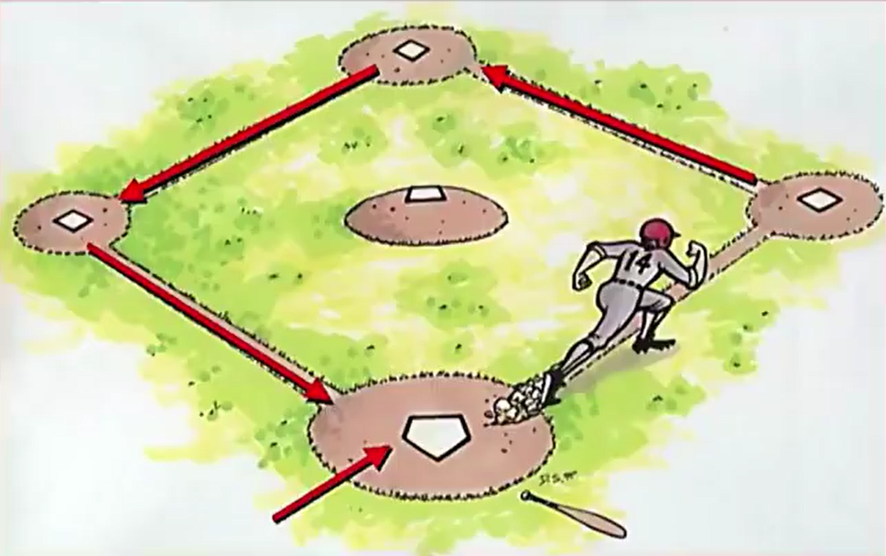
Once upon a time, a man left home jogging….
Notes:
Now I’m going to un-brainwash you with a very simple picture.
Once upon a time, a man left home jogging…
[Reveal picture]
He jogged a little ways and turned left. He jogged a little ways and turned left. He jogged a little ways, and turned left and jogged back home.

Slide 4
Who were the masked men?
Why did he leave home?
Notes:
First question, who were the masked men? The catcher and the umpire.
Second question, why did he leave home jogging? He hit the ball.
Now how did I brainwash you? It was really simple, when I said the word “home”, you thought about the man’s house and that he was leaving his house to on a jog, but then when he got home, there were 2 robbers waiting for him. And once you began to see these words/phrases in one particular way, it became almost impossible in your mind to see them any other way, right? That’s how brainwashing works.

Slide 5
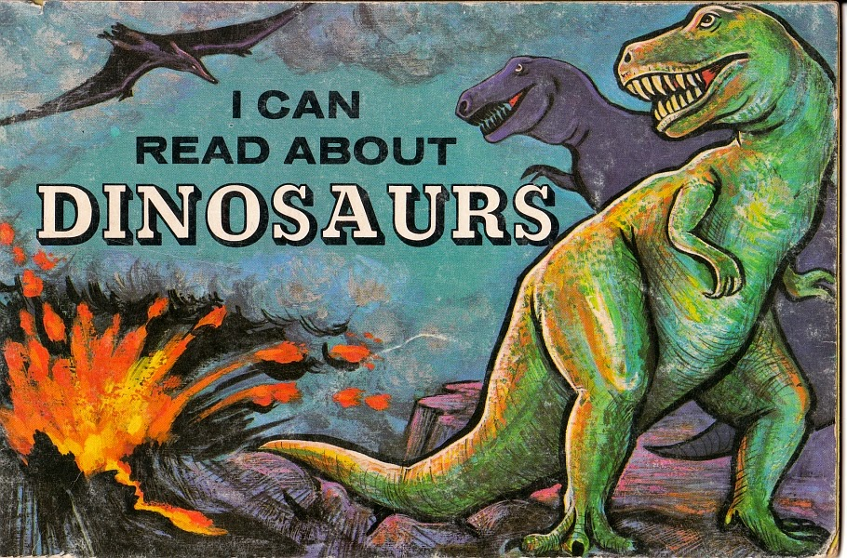
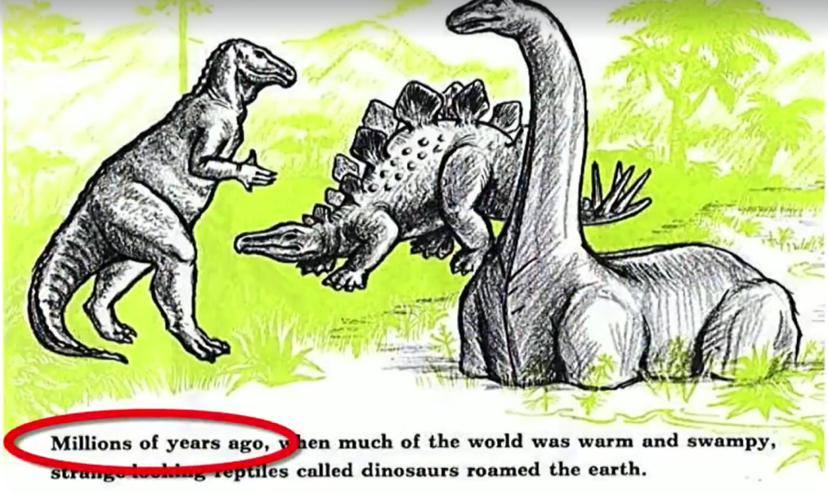
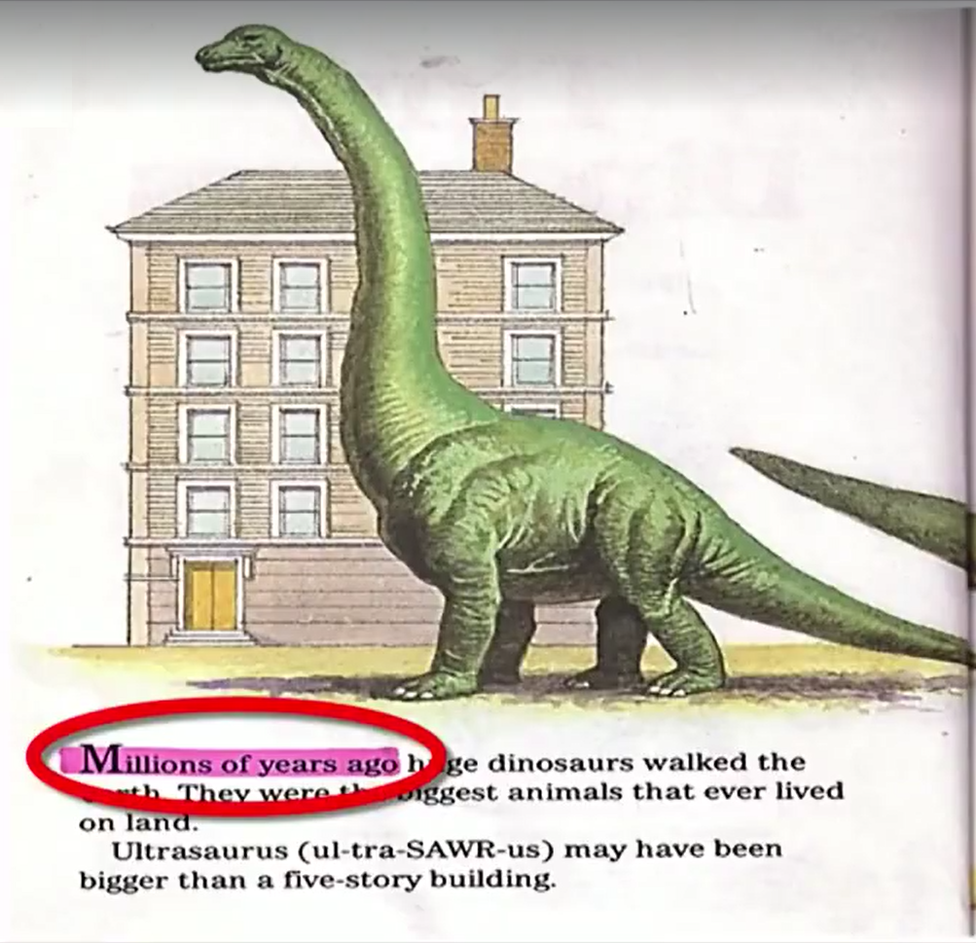
Brainwashing
Notes:
And I want to suggest to you that this is one of top reasons, if not the #1 reason, why most people believe in Darwinian Evolution. Do you want to know how to not just brainwash one individual, but an entire generation of people? Give the children of that generation a book like this…
[Reveal Picture]
…because do you know what the very first words in the book are?
[Reveal Picture]
“Millions of years ago…”

Slide 6
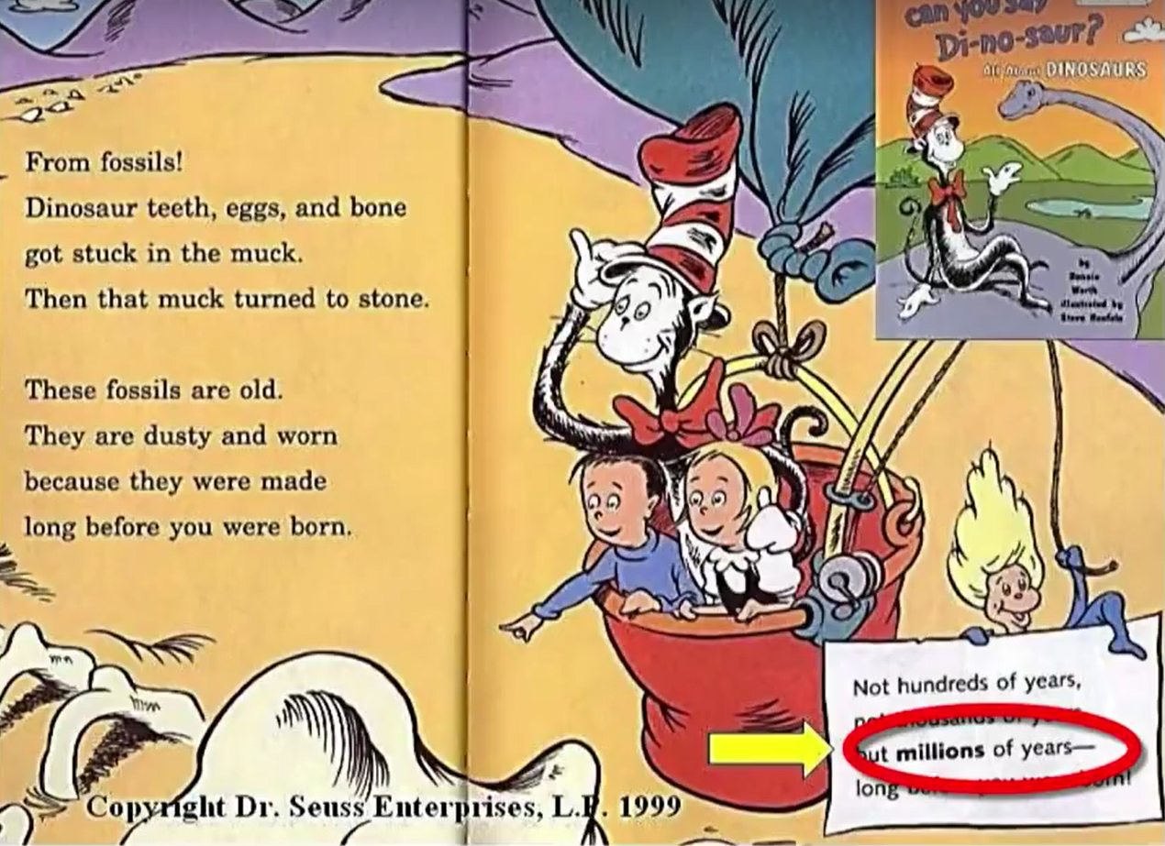
Brainwashing
Notes:
Even our beloved Dr. Seuss does this. This stuff has spread throughout our culture like a virus and it is getting in our children’s brains at a young age. Studies show that the human brain reaches its peak information absorption rate at 4 years old. And so this is the kind of propaganda that is getting put in their brain at a young age.

Slide 7
Brainwashing
Notes:
And by the time they are 5 years old and starting public school, they have already learned from these books that dinosaurs lived millions of years ago, macroevolution, the big bang, that people evolved from apes. How does he know all this? Because before children had teachers in public schools, they had these guys as teachers: [reveal pic]
They seem so cute and harmless right?

Slide 8
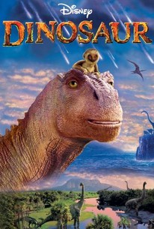
Brainwashing
2 Cor 11:14-15 – “…Satan disguises himself as an angel of light. Therefore it is not surprising if his servants also disguise themselves as servants of righteousness, whose end will be according to their deeds.”
Notes:
The problem, though, is that after watching these shows over and over again, they are being indoctrinated by them with a different worldview than what the bible teaches. 2 Cor 11:14-15 – “Satan disguises himself as an angel of light. Therefore it is not surprising if his servants also disguise themselves as servants of righteousness, whose end will be according to their deeds.” In this case, Satan’s servants use cute dinosaurs and cartoons to captivate our children’s mind. Don’t underestimate the power behind these shows/films.

Slide 9
Brainwashing
Deborah Kelemen – “…capitalizing on young children’s drive for coherent explanation, factual knowledge, and interest in trait function, along with their affinity for picture storybooks, is a viable initial step toward overcoming conceptual pitfalls that can undermine later learning about adaptation.”
“…children in early elementary school can be taught the basic logic of adaptation by natural selection via a brief but comprehensive storybook intervention…the intervention resulted in approximately 40-fold increases in children’s odds of increasing their factual and theoretical understanding.” (Young Children Can Be Taught Basic Natural Selection Using a Picture-Storybook Intervention, 2014, Psychological Science. 25(4): 893–902)
Notes:
Unless you think I go too far…
In 2014, an Evolutionist and Psychologist named Deborah Kelemen wrote a technical report in the journal “Psychological Science” where she admitted that the aim of her research was to suppress design intuition within children. Meaning, she admitted that children appear to be programmed to see signs of design in living creatures and since, in her mind, Evolution is the correct worldview, she started researching the best way to suppress design intuition and replace it with seeing natural selection instead.
Can anyone guess what her research concluded would best achieve this? She attempts to exploit characteristics in early childhood mentality through the use of story books:
“…capitalizing on young children’s drive for coherent explanation, factual knowledge, and interest in trait function, along with their affinity for picture storybooks, is a viable initial step toward overcoming conceptual pitfalls that can undermine later learning about adaptation.” (Kelemen, D. et al. 2014. Young Children Can Be Taught Basic Natural Selection Using a Picture-Storybook Intervention. Psychological Science. 25(4): 893–902)
And here is one of her books, “How the piloses evolved skinny noses.” What are piloses? They are insect-eating mammals with trunk like noses that she invented to make point. In her book, she says they experienced sudden extinction because of the effects of extreme climate change on the location of their food source.
She goes on to explain some of the result of her experiment:
“…children in early elementary school can be taught the basic logic of adaptation by natural selection via a brief but comprehensive storybook intervention…the intervention resulted in approximately 40-fold increases in children’s odds of increasing their factual and theoretical understanding.” (Young Children Can Be Taught Basic Natural Selection Using a Picture-Storybook Intervention, 2014, Psychological Science. 25(4): 893–902)
What does she mean by “increasing their factual and theoretical understanding”? She’s talking about training kindergartners to suppress competing intuitions that would make it more difficult for them to learn Evolution later.
This reeks of Orwellian mental manipulation. Would it not be better to teach our children objective methods of interpretation, how to take the evidence and factual data and test it against each worldview? It is if our goal is the truth. If our goal is brainwashing, than we have Deborah Kelemen’s idea.
http://www.icr.org/article/brainwashing-children-suppress-design/

Slide 10
Brainwashing
Notes:
Here’s what we need to remember: Christians are not the only ones out there who are fishers of men. Dinosaurs are one of the primary tools the secular media uses to try to reel our children in to the Evolutionary worldview. Then as our children get older, they are taught it more fully in elementary, junior high, and high school in textbooks that present it as scientific fact before they’re whisked away to universities where they’re immersed in it yet again, surrounded by peers who will mock you if you take any other worldview – a few of you have confessed this to me privately.

Slide 11
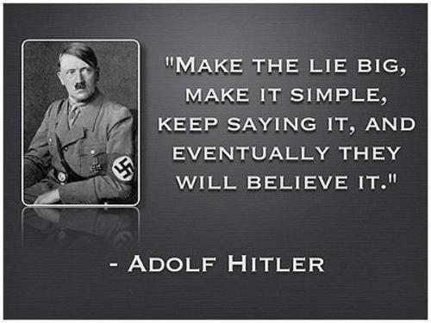
Brainwashing
John Scopes – “…if you limit a teacher to only one side of anything the whole country will eventually have only one thought, be one individual. I believe in teaching every aspect of every problem or theory.” (Scopes Trial, “The World of Biology”, p.610
Notes:
It is then that the parrot effect sets in. A parrot doesn’t understand what its saying, its just repeating what it’s been told over and over again. So many students believe evolution because teachers teach evolution because they were taught it by other teachers who were taught by other teachers and so on. And some of them are trained to make argument they haven’t really thought through, canned remarks that they would never make had they really done their homework.
John Scopes, of the famous Scope Monkey Trial, made an interesting comment. This is the guy who volunteered for the ACLU to break the law in TN that banned the teaching the Evolution so that the law could be challenged in court. So he willing put himself on the side of the Evolutionists. But even he said, “if you limit a teacher to only one side of anything the whole country will eventually have only one thought, be one individual. I believe in teaching every aspect of every problem or theory.”
And we’d agree with him right? I’m giving my personal opinion on this: I have no problem with them laying out Evolutionary Hypothesis in schools as long as they’ll also lay out the Creationism Hypothesis, compare the evidence of both worldviews, and teach children to critically think through the issues. The problem, though, is that the overwhelming majority of pubic schools and universities, with very few exceptions, only teach Evolution and in doing so call it science and present it as the only plausible explanation for our origins, while at the same time criticizing Creationism. And that’s how you brainwash people.

Slide 12
Brainwashing
Mark Singham – “And I use that trust to effectively brainwash them…our teaching methods are primarily those of propaganda. We appeal -- without demonstration -- to evidence that supports our position. We only introduce arguments and evidence that supports the currently accepted theories and omit or gloss over any evidence to the contrary.” (“Teaching & Propaganda,” Physics Today, vol. 53, Jun 2000, p. 54.)
C. Wickramasinghe – “From my earliest training as a scientist, I was very strongly brainwashed to believe that science cannot be consistent with any kind of deliberate creation. That notion has had to be painfully shed. At the moment, I can't find any rational argument to knock down the view which argues for conversion to God. We used to have an open mind; now we realize that the only logical answer to life is creation--and not accidental random shuffling.” (Interview in London Daily Express, Aug 14, 1981)
Notes:
And some Evolutionists make no bones about this fact – meaning, they admit to being out to brainwash and indoctrinate people with this worldview.
Mark Singham, an evolutionary physicist from I believe Cornell University, who authored “Teaching & Propaganda”, said this about the natural trust placed by students in college professors – “And I use that trust to effectively brainwash them…our teaching methods are primarily those of propaganda. We appeal -- without demonstration -- to evidence that supports our position. We only introduce arguments and evidence that supports the currently accepted theories and omit or gloss over any evidence to the contrary.” Pretty brash isn’t it? Not much room left in that comment for another interpretation.
Chandra Wickramasinghe is a Mathematician and Professor of Astronomy, at University College in Cardiff. He is a brilliant astronomer who argues for design in the university and he is often found on the side of the Creationists in debates against Evolutionists though he has some wild views about some of the design being attributed to extraterrestrial origins – interesting guy.
He said the following about his early days – “From my earliest training as a scientist, I was very strongly brainwashed to believe that science cannot be consistent with any kind of deliberate creation. That notion has had to be painfully shed. At the moment, I can't find any rational argument to knock down the view which argues for conversion to God. We used to have an open mind; now we realize that the only logical answer to life is creation--and not accidental random shuffling”

Slide 13
Brainwashing
Prov 18:13 – “He who gives an answer before he hears, it is folly and shame to him.”
Prov 18:17 – “The first to plead his case seems right, until another comes and examines him.”
Isa 1:8a – “Come now, and let us reason together”
Notes:
Yet few are shown the other side. And people need to see the other side. The bible says it like this:
Prov 18:13 – “He who gives an answer before he hears, it is folly and shame to him.”
Prov 18:17 – “The first to plead his case seems right, until another comes and examines him.”
Isa 1:18a – “Come now, and let us reason together”
If we can learn to apply these principles in our life, it will serve as some of the strongest brain wash for brainwashing.

Slide 14
Intimidation
Dr. Thomas Dwight (1911) – “The tyranny in the matter of evolution is overwhelming to a degree of which no outsider has any idea. How very few leaders in the field of science dare to tell the truth as to the state of their own minds. How many of them feel themselves forced in public to do lip service to a cult that they do not believe in.” (pg. 7, of “The Criterion”)
2 Cor 11:20 – “For you tolerate it if anyone enslaves you, anyone devours you, anyone takes advantage of you, anyone exalts himself, anyone hits you in the face.”
Notes:
Conformity through intimidation is another reason why people so easily accept this worldview. The common temptation virtually all mankind experiences is that we don’t want to feel rejected or out of place, and so we’re tempted to simply conform.
Dr. Thomas Dwight, a professor of Anatomy of Harvard University in 1911 said the following – “The tyranny in the matter of evolution is overwhelming to a degree of which no outsider has any idea. How very few leaders in the field of science dare to tell the truth as to the state of their own minds. How many of them feel themselves forced in public to do lip service to a cult that they do not believe in.”
And for scientists who come along and refute Evolution, you know what happens? They’re told, “You’re not really scientists”. How would you like to spend half or more of your life studying a specialized field in science, trying to do so unbiasedly, only to be told when you disagree with Darwinian Evolution that you’re not really a scientist? In essence, you’re being told you’ve wasted a large portion of your life. And if you’re employed by a major university and begin to question it, start packing your bags.
One scientist said that he estimates that 10 – 15% of all university professors have serious problems with Darwinian Evolution but won’t say anything because it could cost them their career.
The Judaizing teachers used tactics of intimidation on 1st century Christians, and Paul said about those who fell prey to it in 2 Cor 11:20 – “For you tolerate it if anyone enslaves you, anyone devours you, anyone takes advantage of you, anyone exalts himself, anyone hits you in the face.” We must be better than that.

Slide 15
Intimidation
Paul Ricci – “The reliability of evolution not only as a theory but as a principle of understanding is not contested by the vast majority of biologists, geologists, astronomers, and other scientists.” (1986, p. 172)
Stephen J. Gould – “The fact of evolution is as well established as anything in science (as secure as the revolution of the earth around the sun), though absolute certainty has no place in our lexicon.” (1987, p. 64)
Marshall & Sandra Hall – “How, then, are people with little or no special knowledge of the various sciences and related subjects to challenge the authorities? It is natural to accept what ‘experts’ say, and most people do.” (1974, p. 10).
Notes:
But its tough, because we run across publications like this one from Discover Magazine. In the middle left section of the cover, it says, “Scientists uncover the second creation 100 million years after the Big Bang.” What’s our first thought after reading something like this? Isn’t our first thought, “What if they’re right?” This stuff is very well written. It is written persuasively and definitively with phrases like, “This is what we know, science has shown, science has proved!” And if we express doubt, demand evidence, or even offer competing evidence, we’re laughed at.
Many people give into the temptation of caring what other people think about them. Don’t we face that temptation? It’s a strong temptation And so what happens to people who want to be thought of as “educated” when they have been led to believe that “all educated people believe in evolution”? What happens to them? Many of them defect to the Darwinian camp – all because intellectual pride and the desire for intellectual respectability gets the best of them.
Notice these quotes by evolutionists that speak of Evolution as so basic/obvious:
The philosopher Paul Ricci said, “The reliability of evolution not only as a theory but as a principle of understanding is not contested by the vast majority of biologists, geologists, astronomers, and other scientists” (1986, p. 172).
Stephen J. Gould said, “The fact of evolution is as well established as anything in science (as secure as the revolution of the earth around the sun), though absolute certainty has no place in our lexicon (1987, p. 64).”
These kinds of statements leave the impression that evolution simply cannot be doubted by well-informed, intelligent people. The message is: “All scientists believe it; therefore so should you.” And many do, because, as Marshall and Sandra Hall have inquired: “How, then, are people with little or no special knowledge of the various sciences and related subjects to challenge the authorities? It is natural to accept what ‘experts’ say, and most people do” (1974, p. 10).
So what happens? Many people simply line up for the sake of conformity. Yet, again, so many of these individuals I encounter personally cannot cite one solitary, evidence based argument in defense of evolution; they simply believe it is fact because “the scientists say so. Who am I to disagree? I’m no a geologist, paleontologist, geneticist, etc.” Guess what? Me neither. You don’t have to be.

Slide 16
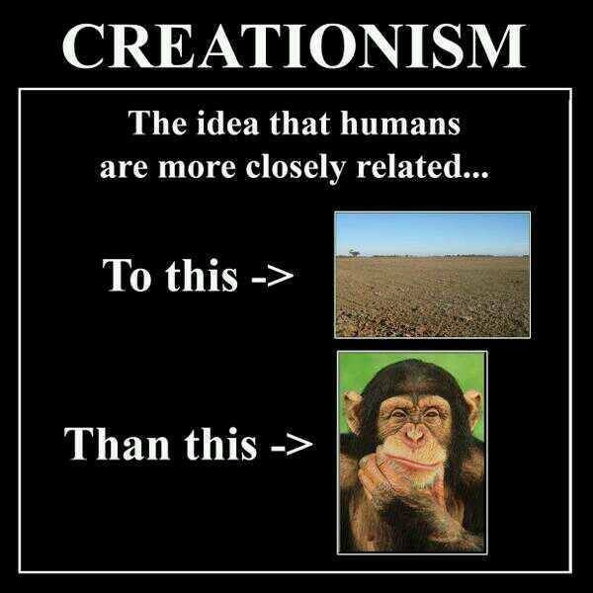
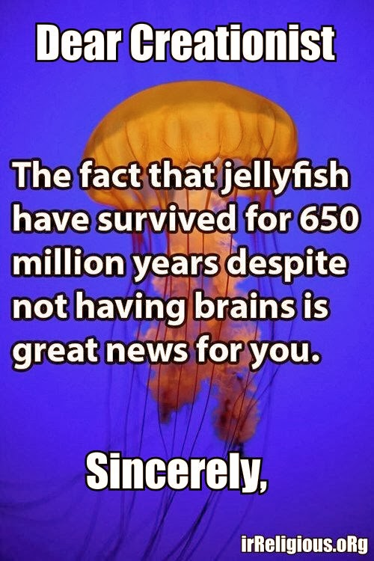
Intimidation
Notes:
Here are examples of some memes you’ll see on social media. And to be fair, there are just as many memes out there of Creationists mocking Evolutionists as there are of Evolutionists mocking Creationists. But when finding our sense of self-worth becomes one of our biggest hurdles, how do memes like this make us feel? Pretty low. Pretty stupid. But since when did memes become authority? Satire does not establish truth. It can be a useful tool, but it is not evidence of the worldview in question.
Why do Evolutionists use intimidation tactics? The answer is simple. Because it works. It forces people into positions for the sake of conformity. It’s school yard bullying.

Slide 17
Intimidation
2 Tim 1:7 – “For God has not given us a spirit of timidity, but of power and love and discipline.”
1 Pet 3:14 – “But even if you should suffer for the sake of righteousness, you are blessed. And do not fear their intimidation, and do not be troubled.”
Notes:
If we’re looking for acceptance from the world, it’s not happening. It is impossible to shine our light to the degree Jesus would have us to do so w/o bringing ridicule and scoffing upon ourselves. What we need is courage and greater resolve to keep doing what we know is right. We need to find our sense of self-worth in the cross of Jesus Christ so that when someone comes along and tries to make us look stupid for what we believe, we can resist the temptation knowing what a friend we have in Jesus.
2 Tim 1:7 – “For God has not given us a spirit of timidity, but of power and love and discipline.”
1 Pet 3:14 – “But even if you should suffer for the sake of righteousness, you are blessed. And do not fear their intimidation, and do not be troubled.”
Deut 31:6 – “Be strong and courageous, do not be afraid or tremble at them, for the Lord your God is the one who goes with you. He will not fail you or forsake you.”
As I’m going to continue to attempt to show in the coming lessons, Darwinian Evolution is not scientific law – it is a hypothesis; a hypothesis that falls well beyond the pale of the scientific method of observations, experimentation, and verification. It contradicts numerous and fundamental laws of science such as the laws of thermodynamics and genetics as well as others. And so it is hardly necessary to yield to the brow beating of those who espouse this pseudo-science. Rather, we should earnestly demand that those who affirm their confidence in evolution argue their case logically rather than with rhetorically.

Slide 18
Escape Accountability
Richard Dawkins – “Darwin made it possible to be an intellectually fulfilled atheist” (The Blind Watchmaker, New York: W.W. Norton, 1986, p. 6).
Clarence Darrow - “I do not believe there is any sort of distinction between the real moral conditions of the people in and out of jail. One is just as good as the other. The people here can no more help being here than the people outside can avoid being outside. I do not believe that people are in jail because they deserve to be. They are in jail simply because they cannot avoid it on account of circumstances which are entirely beyond their control and for which they are in no way responsible.” (Arthur Weinberg, Attorney For The Damned, New York: Simon & Schuster, 1957, pp. 3-4; emp. WJ).
Notes:
Another reason why many so readily accept evolution is that in doing so, it allows them to “break ties” with God and to therefore be free from moral and religious obligations, at least in their mind. Doing this allows a person to in essence become their own god and write their own rules.
Richard Dawkins, one of the most outspoken atheists of our day, said, “Darwin made it possible to be an intellectually fulfilled atheist”
This viewpoint was vividly illustrated some years ago when a man name Clarence Darrow spoke to the inmates of the Cook County jail in Chicago. This is what he said (buckle up for this one):
“I do not believe there is any sort of distinction between the real moral conditions of the people in and out of jail. One is just as good as the other. The people here can no more help being here than the people outside can avoid being outside. I do not believe that people are in jail because they deserve to be. They are in jail simply because they cannot avoid it on account of circumstances which are entirely beyond their control and for which they are in no way responsible”
This shocking statement reveals the motive of some evolutionists.

Slide 19
Escape Accountability
Julian Huxley – “Our faith in the idea of evolution depends on our reluctance to accept the antagonistic doctrine of special creation” (Dogma of Evolution, p. 304).
D. M. S. Watson – “The theory of evolution itself, a theory universally accepted not because it can be proved by logically coherent evidence to be true but because the only alternative, special creation, is clearly incredible.” (1929 article, “Adaptation”)
Notes:
Many of the world’s most famous Evolutionists have gone on record in expressing that their opposition to a divine Creator is major contributor to their acceptance of Evolution (we’ll discuss this more when we get into the subject of Theistic Evolution later). Because there are only 2 choices in this debate. We either came from a divine Creator or we are the product of chance and happenstance. It can only be one or the other. And if you do away with the Evolutionary idea, you’re back at Creationism. Evolutionists freely admit that.
Famous Evolution, Julian Huxley, said, “Our faith in the idea of evolution depends on our reluctance to accept the antagonistic doctrine of special creation” (Dogma of Evolution, p. 304).
D. M. S. Watson, who held the position of the Chair of Evolution at the University of London for more than twenty years, said the following: “The theory of evolution itself, a theory universally accepted not because it can be proved by logically coherent evidence to be true but because the only alternative, special creation, is clearly incredible.”
And so many people force themselves into this position not because they have evidence or know of any evidence or have searched out the evidence or rationally thought it through, but simply because of an anti-theistic bias. Naturalistic Evolution is used to drive God out of the classrooms. Why? Because it is the only alternative to God. And so not only do teachers neglect to teach Creationism, many teachers use the classroom to mock Creation, as many of you can attest to.

Slide 20
Escape Accountability
Jeremy Rifkin – “We no longer feel ourselves to be guests in someone else’s home and therefore obliged to make our behavior conform with a set of preexisting cosmic rules. It is our creation now. We make the rules. We establish the parameters of reality. We create the world, and because we do, we no longer feel beholden to outside forces. We no longer have to justify our behavior, for we are now the architects of the universe. We are responsible to nothing outside ourselves, for we are the kingdom, the power, and the glory forever and ever.” (Algeny, p. 244, Viking Press, New York, 1983)
Notes:
This is another quote from an environmentalist and economist named Jeremy Rifkin, who strongly believes that there is an underlying motivation behind Darwinism that is nonscientific. This guy, in his writings, goes back to the history of Darwinism and shows how it is used as a tool to manipulate countries and governments in order to leverage finances that will create a powerful sociopolitical order that, according to him, has destroyed the environment. Now he is not a Christian so he wouldn’t share any deference towards us; there is no religious bias on his part when he says this:
“We no longer feel ourselves to be guests in someone else’s home and therefore obliged to make our behavior conform with a set of preexisting cosmic rules. It is our creation now. We make the rules. We establish the parameters of reality. We create the world, and because we do, we no longer feel beholden to outside forces. We no longer have to justify our behavior, for we are now the architects of the universe. We are responsible to nothing outside ourselves, for we are the kingdom, the power, and the glory forever and ever.”

Slide 21
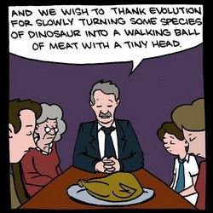
Escape Accountability
Henry Fairfield Osborn – “In truth, from the earliest stages of Greek thought man has been eager to discover some natural cause of evolution, and to abandon the idea of supernatural intervention in the order of nature” (1917, p. ix).
Henry Morris – “Evolution is the natural way to explain the origin of things for those who do not know and acknowledge the true God of creation. In fact, some kind of evolution is absolutely necessary for those who would reject God” (1966, p. 98).
A.E. Wilder-Smith – “Darwinism and Neo-Darwinism, rightly or wrongly, have been used everywhere in the East and West, in the hands of the atheists and agnostics, as the main weapon against the biblical doctrine of origins” (Man’s Origins: Man’s Destiny, 1975, p. 31).
Notes:
For those who refuse to believe in the Creator because of a desire not to be accountable for their actions, evolution becomes a natural escape. And many of them, as these quotes show, make no pretense of believing it based on anything other than their disbelief in God.
Henry Fairfield Osborn, one of the most famous evolutionists of the early twentieth century, suggested: “In truth, from the earliest stages of Greek thought man has been eager to discover some natural cause of evolution, and to abandon the idea of supernatural intervention in the order of nature” (1917, p. ix).
Henry Morris noted: “Evolution is the natural way to explain the origin of things for those who do not know and acknowledge the true God of creation. In fact, some kind of evolution is absolutely necessary for those who would reject God” (1966, p. 98).
These kinds of statements leave little to the imagination, and make it clear that those who say such things believe in evolution not because of any evidence, but instead because they have made up their minds that they are just not going to believe in God.
In his text, Man’s Origin: Man’s Destiny, the eminent United Nations scientist, A.E. Wilder-Smith, observed that “Darwinism and Neo-Darwinism, rightly or wrongly, have been used everywhere in the East and West, in the hands of the atheists and agnostics, as the main weapon against the biblical doctrine of origins” (1975, p. 31).
So whenever you have a person who stubbornly refuses to believe in God, belief in evolution becomes automatic. Similarly, opposition to God as the Creator, the Bible as His Word, and the biblical explanation of origins become just as automatic. Whenever a person rids himself of God, he simultaneously (even if unknowingly) embraces evolution. By his disbelief, he has eliminated creation as an option regarding his origin.

Slide 22
Religious Confusion
Notes:
Confusion over what Christianity is really about certainly plays a role as well. Some with even less than a cursory knowledge of scripture will point to religionists who sacrificed their children, the Crusades, witches burned at the stake by so-called Christians, God allowing Israel to kill all the men, women, and children of the pagan nations of Canaan’s land. Without seeing the errors in man claiming to represent Christianity and not seeking answers to the difficult questions in the bible will create the kind of confusion that leads to discounting the biblical God.
So they’ll ask questions like, “Why do Christians follow a book written by men?” or “What makes you Christians so right and Muslims so wrong?”
They never bother to seek actual answers to the question or an understanding behind these events. Rather than schedule a “Q&A” with another Christian, they simply want a “Q&Q”…always asking questions but never seeking answers to those questions because as long as they can find something that can’t be answered by a Christian, or if the answer doesn’t satisfy them, they’ll use that as justification in their minds that Jesus is not worth giving their life to. Evolution then becomes the natural drawback.

Slide 23
Religious Confusion
John 17:20-23 – “²⁰I do not ask on behalf of these alone, but for those also who believe in Me through their word; ²¹that they may all be one; even as You, Father, are in Me and I in You, that they also may be in Us, so that the world may believe that You sent Me. ²²The glory which You have given Me I have given to them, that they may be one, just as We are one; ²³I in them and You in Me, that they may be perfected in unity, so that the world may know that You sent Me, and loved them, even as You have loved Me.”
Notes:
Add to that all the denominational confusion within the realm of Christendom. Catholics allege that the bread and wine of “the Eucharist” magically turn into the body and blood of Jesus, while Protestants insist that such does not occur. Some contend that “baptism” is administered only by immersion, while others allege that “sprinkling” or “pouring” is sufficient.
This disunity has driven many to disenchantment toward religion in general, which includes a rebellion against divine revelation. This, of course, is precisely what Jesus indicated 2000 years ago would happen:
John 17:20-23 – “²⁰I do not ask on behalf of these alone, but for those also who believe in Me through their word; ²¹that they may all be one; even as You, Father, are in Me and I in You, that they also may be in Us, so that the world may believe that You sent Me. ²²The glory which You have given Me I have given to them, that they may be one, just as We are one; ²³I in them and You in Me, that they may be perfected in unity, so that the world may know that You sent Me, and loved them, even as You have loved Me.”
To the degree that we cannot find unity with other believers is the degree to which Christ’s cause will be abandoned. And many, not wanting to make the extra effort, will simply turn to Evolution as a viable alternative.
But those seeking this as a unified faith system won’t find it amongst other Evolutionists because they are just as divided. Sir Francis Crick, co-discoverer of DNA, contended that biological life evolved here on earth. On the other hand, Sir Fred Hoyle has argued that “spontaneous generation” occurred in outer space! Some Darwinians speculate that the evolutionary process has occurred quite gradually, over eons of time. Supposedly this explains the lack of transitional forms in the fossil record. Others (e.g., Richard Goldschmidt, and more recently, Stephen Gould of Harvard), suggest that evolution has proceeded rapidly, almost in snatches (the doctrine of punctuated equilibrium that we’ll look at later).
There is wholesale disagreement among the advocates of evolution. Those, therefore, who have fled from religion because of its disunity, will find no haven of unity in Darwinian Evolution.

Slide 24
Religious Confusion
Matt 7:21-23 - “Not everyone who says to Me, ‘Lord, Lord,’ will enter the kingdom of heaven, but he who does the will of My Father who is in heaven will enter. Many will say to Me on that day, ‘Lord, Lord, did we not prophesy in Your name, and in Your name cast out demons, and in Your name perform many miracles?’ And then I will declare to them, ‘I never knew you; depart from me, you who practice lawlessness.”
Notes:
But inconsistency in Christians has a played a roll in this religious confusion too hasn’t it? Those professing Christ in the past have burned witches at the stake and popular televangelists have been caught in adultery. We’ve all heard people say that the reason they don’t come to church is because of all the hypocrites, never once thinking about the fact that if they don’t’ straighten up they’re going to spend an eternity with them in torment. Nobody stops going to a gym because there are fat people there.
Add to that the hypocrisy of, or word spoken in anger by, a person who wears the name “Christian,” and the damage may be such that even in a lifetime it cannot be repaired. The result is that those who have been offended want nothing whatsoever to do with the God of the Bible, and as they reject Him, they also reject His account of the creation of the world in which they live.
As much as we don’t want to admit it, believers have set poor examples in the past and will probably continue to do so in the future – and sensitive, emotional, and spiritually unstable people seem to be greatly affected by this. And this is a reason why some gravitate towards Evolution.
And this is all the more reason that as we give a defense, we make sure to maintain the highest caliber of character imaginable, that we not try to win people over with our cunning arguments/wit, but that Christ always be at the center. What I mean is that while we’re debunking Evolution and proving Christianity, let us be sure that we’re introducing people to Jesus in the process, but in evidence and in the evidence of our lives.
What I’m suggesting is many who espouse Evolution having rejected Christianity have some serious burrs under their saddle, and if they’re going to be healed, they need to be introduced to the Great Physician.

Slide 25
Suffering
Notes:
Another reason why some believe in evolution has to do with how much evil, pain, and suffering there is in the world. Certainly no one can deny the widespread and unmistakable occurrence of “bad” things that happen, even those occurrences which engulf those who seem so undeserving of it. This often leads to a strong, emotionally charged stigma against any idea of a loving God in control of the universe that dismisses any and all explanations from religionists regardless of how elaborately stated or elegantly defended that explanation may be.

Slide 26
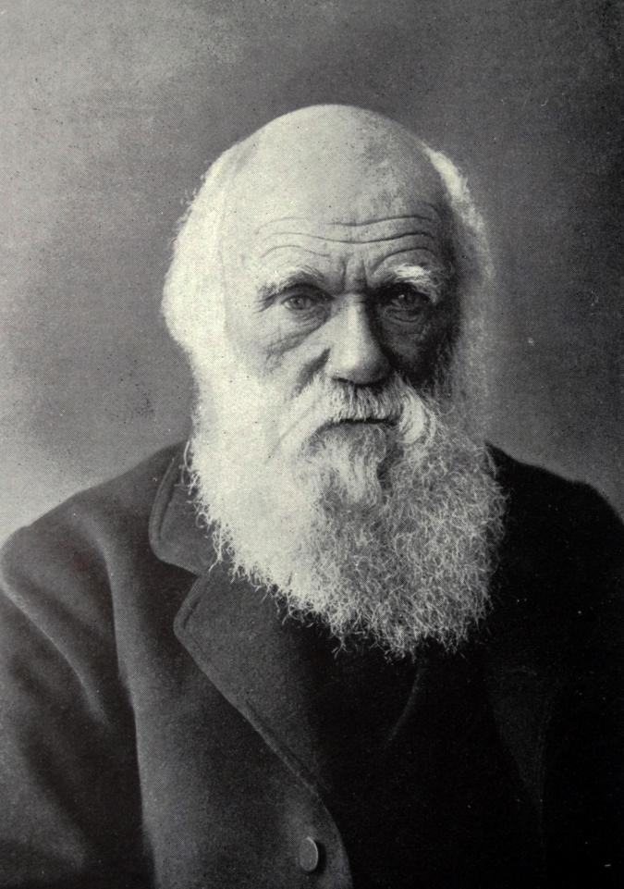
Suffering
Charles Darwin – “If the truth of this conclusion be granted [i.e. that there is more happiness than misery in the world], it harmonises well with the effects which we might expect from natural selection. If all the individuals of any species were habitually to suffer to an extreme degree they would neglect to propagate their kind.” (The Autobiography of Charles Darwin, with original omissions restored, edited with appendix and notes by his grand-daughter Nora Barlow, Collins, London, ‘Religious Belief’, pp. 85–96, 1958.)
Notes:
In fact, Darwin is on record as stating he believed natural selection, rather than belief in God, accounted for both the happiness and misery in the world.
“If the truth of this conclusion be granted [i.e. that there is more happiness than misery in the world], it harmonises well with the effects which we might expect from natural selection. If all the individuals of any species were habitually to suffer to an extreme degree they would neglect to propagate their kind.”

Slide 27
Suffering
Charles Darwin – “[Many sentient beings] occasionally suffer much. Such suffering, is quite compatible with the belief in Natural Selection, which is not perfect in its action.” (ibid)
“A being so powerful and so full of knowledge as a God who could create the universe, is to our finite minds omnipotent and omniscient, and it revolts our understanding to suppose that his benevolence is not unbounded, for what advantage can there be in the sufferings of millions of the lower animals throughout almost endless time?” (ibid)
Notes:
He then added that “[many sentient beings] occasionally suffer much. Such suffering, is quite compatible with the belief in Natural Selection, which is not perfect in its action.”
He continued, “A being so powerful and so full of knowledge as a God who could create the universe, is to our finite minds omnipotent and omniscient, and it revolts our understanding to suppose that his benevolence is not unbounded, for what advantage can there be in the sufferings of millions of the lower animals throughout almost endless time?”

Slide 28
Suffering
Isa 55:8-9 – “For My thoughts are not your thoughts, nor are your ways My ways,” declares the Lord. “For as the heavens are higher than the earth, so are My ways higher than your ways and My thoughts than your thoughts.”
Notes:
Now I want you to understand that Darwin was far from unbiased in this observation; his observation was highly personalized because of the death of his 10 year old daughter Annie in 1851 which, many have observed, including evolutionists, destroyed his faith. He himself struggled with his health most of his life and that seems to have likewise shattered his faith.
So like many, Darwin did not base his faith on a Being that is higher and greater than he and therefore operates outside of his own inflated intellect. He reduced God down to the level of his own personal understanding and would not concede that there could be alternative explanations for the suffering around him.
Let this be a reminder to us that even the most scientific and intellectual in our society are still shaped by preconceived beliefs, stereotyping, and bias. I’m making going to make this point again and again throughout this series to make sure it sticks with us all. Book smarts is not equivalent to wisdom and it certainly does not in any way guarantee an unbiased worldview. In fact, Paul warns us that more often than not, knowledge ferments into pride – 1 Cor 8:1 – “Now concerning things sacrificed to idols, we know that we all have knowledge. Knowledge makes arrogant, but love edifies”.
Submitting ourselves to God means we’re submitting ourselves to someone we acknowledge thinks and operates on a plane infinitely greater than my wisdom and my intellect. And isn’t that why we worship God? What kind of God would He be if He was only as smart and as wise as me?

