Slide 1
Notes:
Isaiah 28 – 35 is in a lot of ways parallels chapters 7 -12 in that it gives us an inside look into the political and religious climate of Judah during a time of significant national threat. But instead of King Ahaz being threatened by a coalition of Israel and Syria, we now find Hezekiah being threatened by the Assyrian juggernaut. And there are many similarities. In chapters 7 – 12, despite Isaiah’s counsel to trust in God, Ahaz chose to align w/Assyria to help them. But in chapters 28 – 35, the temptation is to align w/Egypt. How much Hezekiah was involved in this is a bit of a mystery. There is plenty of evidence that he resisted relied more on God than alliances w/nations. On the other hand, it’s hard to imagine that Judah could already be immersed in any alliance w/Egypt w/o their king’s say so, and there is textual evidence that Judah has already committed to this alliance.
And so, in chapters 28 – 35, there is a 3-fold purpose. 1) God both rebukes and comforts Judah concerning the coming Assyrian threat. 2) He makes it absolutely clear that He will not allow Egypt to become Judah’s savior against Assyria. 3) When it is time for Assyria to be defeated, God will be the one to do it, not man.
Isaiah helps us to outline these chapters through an inclusio of “woes”, and these “woes” are divided into 2 sections of 3. Woes #1 - #3 are what we just studied in chapters 28 – 29 in which Isaiah expounds upon the principles of the situation, contrasting false vs. true foundations, revealing Judah’s blindness vs. how He will use that blindness to illuminate them, and how despite their scheming, they will be transformed. Now, God never mentions Egypt or Assyria by name in these 2 chapters because the first 3 woes are designed to develop principles. But in the 2nd set of 3 “woes” that we’ll begin in this study, He specifically applies the principles of the prior 2 chapters to Egypt and Assyria by name, explaining how Judah will go from obstinance to prominence, be delivered and renewed, and He will contrast His judgments toward them all vs. redemption. And just as we saw in chapters 13 – 27, there are common themes found in the parallel “woes” (woe #1 w/woe #4, etc.) in which we will look at in more detail as we come across them.
One more thing to keep an eye on as we cover these chapters. You are going to notice many words, phrases, and themes that we learned in the book of Exodus. This is no accident – it’ is God’s way of saying, “Remember what I did to Egypt back in that day? Why then would you trust them over me. And if I can do that to Egypt, I can do it to Assyria, too.” Keep an eye on these Exodus themes as we progress through these chapters.

Slide 2
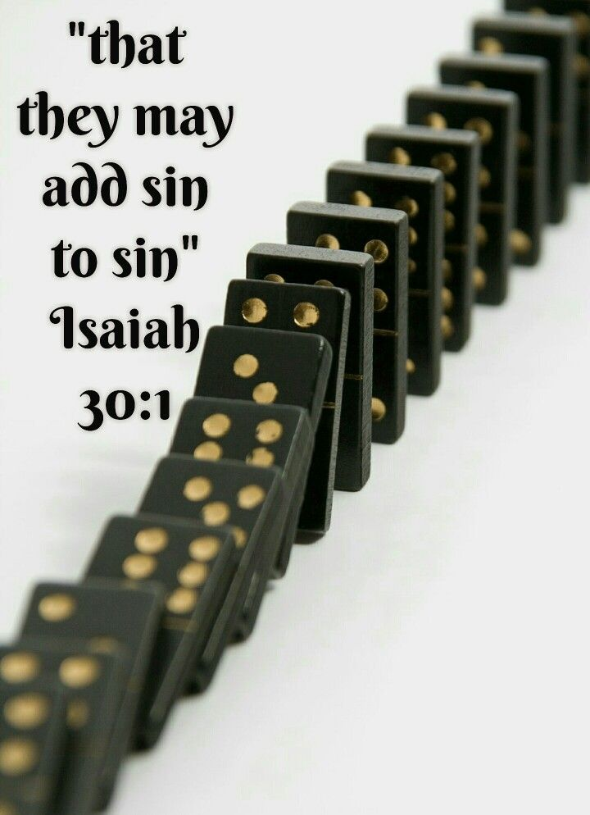
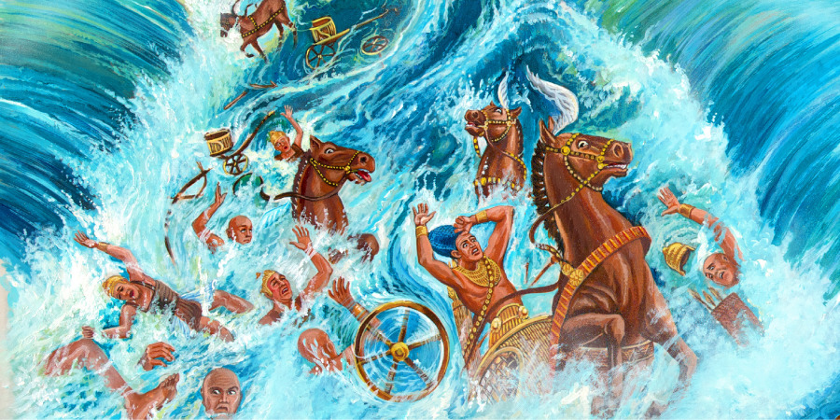
Obstinance & Prominence
Embassy To Egypt
Isa 30:1-2 – “¹‘Woe to the rebellious children,’ declares the Lord, ‘Who execute a plan, but not Mine, and make an alliance, but not of My Spirit, in order to add sin to sin; ²who proceed down to Egypt without consulting Me, to take refuge in the safety of Pharaoh and to seek shelter in the shadow of Egypt!”
Deut 17:16 – “Moreover, he shall not multiply horses for himself, nor shall he cause the people to return to Egypt to multiply horses, since the Lord has said to you, ‘You shall never again return that way.’”
Notes:
We’ve already seen from chapter 28 – 29 that the people were bent on making plans w/o divine prompting. Now we see what those specific plans are – Isa 30:1 – So, they’re seeking aid from a worldly power who once enslaved them, Egypt, rather than depending on God who freed them from that slavery through very powerful signs. God says, “This is not My plan…this is not of My Spirit.”
And the funny thing is, they didn’t need a new word from God on this, they just needed to obey what His word already said! – Deut 17:16.
So why is this so egregious as to deserve a “woe” from God, adding “sin to sin”? Because it was for Judah’s sin that God raised up Assyria to be His rod of anger to begin with. But rather than repenting of their sin, they’re looking to Egypt to help get themselves out of this mess, which is even worse. So now their sin has become cumulative.
Is 30:2 – We saw in chapter 18 that Egypt was coming to them offering help. But now they’re proceeding down to Egypt, which means they’re deliberate in their scheme. God would have spoken if asked, but He would have contradicted what they had already made up their mind to do it. The words “refuge” and “shelter” are often intimately spoken of in psalms as being found in God. But they’re trading these affections for Pharaoh’s empty promises.

Slide 3
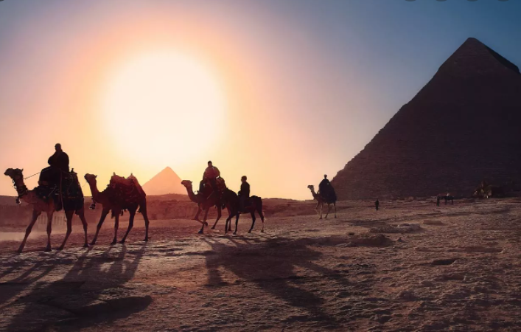
Obstinance & Prominence
Embassy To Egypt
Isa 30:3-5 – “³Therefore the safety of Pharaoh will be your shame and the shelter in the shadow of Egypt, your humiliation. ⁴For their princes are at Zoan and their ambassadors arrive at Hanes. ⁵Everyone will be ashamed because of a people who cannot profit them, who are not for help or profit, but for shame and also for reproach.”
2 Chron 30:1 – “Now Hezekiah sent to all Israel and Judah and wrote letters also to Ephraim and Manasseh, that they should come to the house of the Lord at Jerusalem to celebrate the Passover to the Lord God of Israel.”
Notes:
Isa 30:3 – As has been mentioned in previous studies, Egypt was known for promising what it couldn’t deliver. Allying w/them would bring nothing but disgrace.
Could this be the reason why one of the first things Hezekiah did when he became king was restitute the Passover feast? It is speculation, but perhaps he knew the people needed a reminder of the stark contrast between the nation of Egypt and the sovereignty of Jehovah.
Isa 30:4 – Zoan was in the northern Delta and Hanes was well below the Delta, showing the vastness of the Egyptian union under Ethiopian control. This is to show that Judah’s delegates are already well immersed in Egypt.
But despite this, their plans will still fail – Isa 30:5 – The shame is nothing short of certain, and if they proceed w/their plans, it will merely plunge Judah into deeper disgrace. All God’s people ever received from Egypt was shame and reproach – that this is all that Egypt is good for. This is one of the tie-ins to woe #1, where in 28:15 God mentioned the covenant they made w/death. Now we see the specifics – Egypt.

Slide 4
Obstinance & Prominence
Embassy To Egypt
Isa 30:6-7 – “⁶The oracle concerning the beasts of the Negev. Through a land of distress and anguish, from where come lioness and lion, viper and flying serpent, they carry their riches on the backs of young donkeys and their treasures on camels’ humps, to a people who cannot profit them; ⁷even Egypt, whose help is vain and empty. Therefore, I have called her ‘Rahab who has been exterminated.’”
Ex 12:35-36 – “³⁵Now the sons of Israel had done according to the word of Moses, for they had requested from the Egyptians articles of silver and articles of gold, and clothing; ³⁶and the Lord had given the people favor in the sight of the Egyptians, so that they let them have their request. Thus they plundered the Egyptians.”
Notes:
Isa 30:6-7a – The phrase “beasts of the Negev” is a cryptic title similar to what we saw in the oracles of chapters 21 and 22. Who are the “beasts of the Negev”? They’re the ones carrying riches down to Egypt in order to purchase protection against Assyria.
This is anther Exodus them, but in reverse – Ex 12:35-36. Now look how far the apple’s fallen from the tree. Moses would be rolling over in his grave if he could see Israel trekking back to Egypt w/treasure for them.
Isa 30:7b – “Rahab” is the Hebrew word for “pride”, and it refers to “a stormy sea that is blustery.” The phrase “Rahab who has been exterminated” is a terrible translation in the NASB. In Hebrew, it is pronounced “Rahab-Hem-Shebeth” which literally means “Rahab sits idle” or “Rahab the do-nothing”. This is referring to Egypt (51:9; Psa 87:4), who, like sin, is full of promises but ultimately will do nothing for you. Egypt is a blustering, big fat colorful balloon full of nothing but hot air.

Slide 5
Obstinance & Prominence
Rejecting God’s Word Leads To Collapse
Isa 30:8-11 – “⁸Now go, write it on a tablet before them and inscribe it on a scroll, that it may serve in the time to come as a witness forever. ⁹For this is a rebellious people, false sons, sons who refuse to listen to the instruction of the Lord; ¹⁰who say to the seers, ‘You must not see visions’; and to the prophets, ‘You must not prophesy to us what is right, speak to us pleasant words, prophesy illusions. ¹¹Get out of the way, turn aside from the path, let us hear no more about the Holy One of Israel.’”
Notes:
Now, this all makes sense to us. But was Judah in a state of mind to believe God’s word as He is presenting it to them then? No. What did Isaiah refer to them as at the beginning of chapter 22? “The Valley of Vision”. They are blind, and as we’ve already seen in Isa 28 and 29, they are mocking Isaiah for trying to warn them. So, in order that Isaiah’s message might be later vindicated, notice the next instruction.
Isa 30:8 – This is very similar to what we saw in chapter 8 regarding Maher-shalal-hash-baz. They may not see Isaiah’s message as important in the present, but it would be in time, and the words he writes were to be a witness to the coming generations of the great folly of supplanting trust in God w/trust in man. Right now, they’re rebellious, and so God must wait for their circumstances to reduce them to utter and complete helplessness, just as he had to wait on their father Jacob. But this, too, is grace.
Now, remember in woe #1 from chapter 28 how they mocked Isaiah saying, “order on order, line on line”? Here is the tie-in to woe #4 – Isa 30:9-11 – Listening can be so hard for people who have already made up their mind to do what they want to do, can’t it? People don’t typically ask to be told when they’re wrong, and many who do don’t really mean it. The people in Isaiah’s day didn’t want holiness; they wanted prophetic teaching that would leave their surface lives unruffled, and so they attempt to tell the prophet what he is to preach. Understand that they weren’t asking him not to preach, only that the preaching be innocuous. You always have to have a “preacher” present in religion, and they are free to preach as long as their preaching doesn’t address the true condition of the nation. They wanted a preacher who’d pioneer a new morality w/smooth, affirming words, not reminders about a God whose holiness demands what they were unwilling to give. They wanted religion, but not the truth. Every time Isaiah would use the title “Holy One of Israel”, it would cut deep into their sinful souls. But not only do they not hear, they don’t want anyone else to hear.
2 Tim 4:3-4 – Preachers have to tell us things we don’t want to hear when we’re not acting right. And if we have the right attitude, we’ll want this; it’s how we grow to being the kind of people God wants us to be.

Slide 6
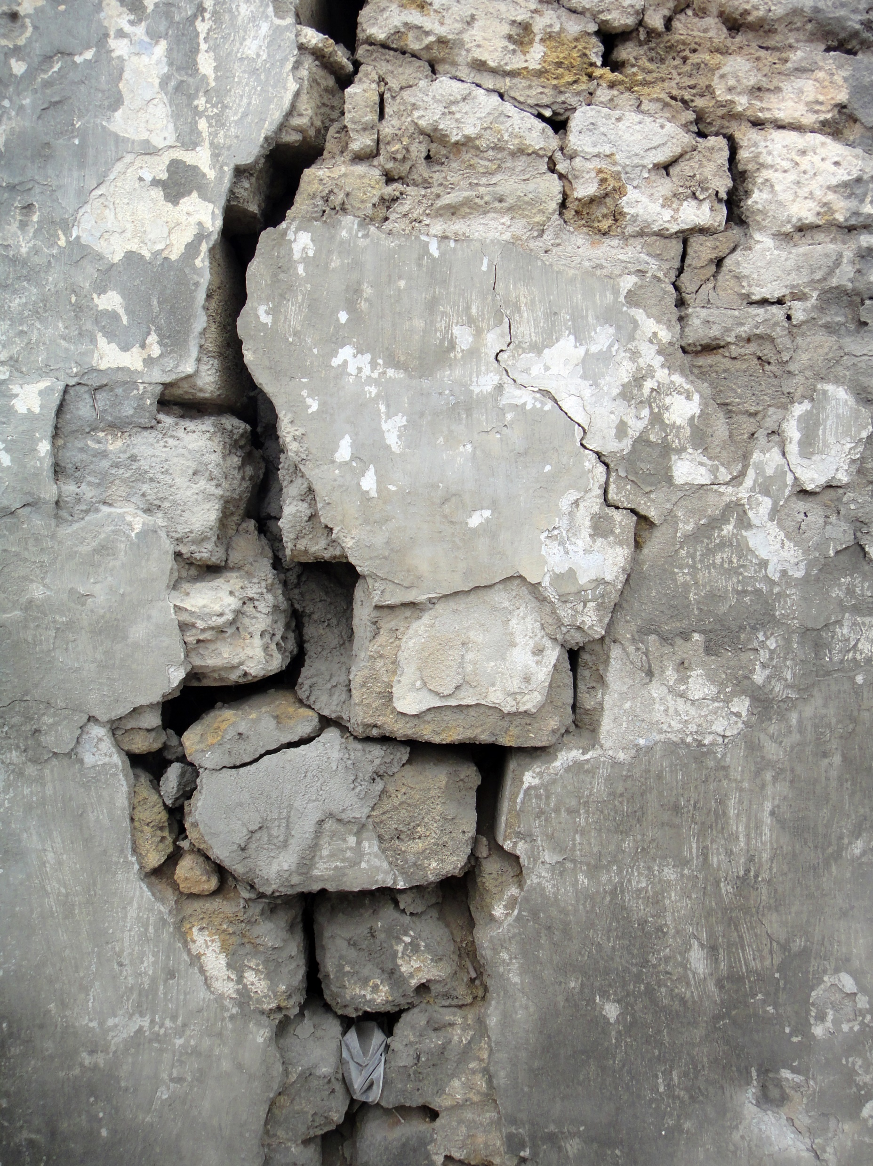
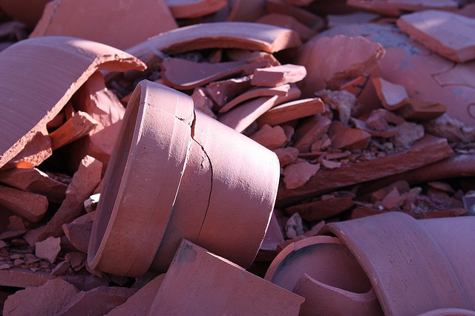
Obstinance & Prominence
Rejecting God’s Word Leads To Collapse
Isa 30:12-14 – “¹²Therefore thus says the Holy One of Israel, ‘Since you have rejected this word and have put your trust in oppression and guile, and have relied on them, ¹³therefore this iniquity will be to you like a breach about to fall, a bulge in a high wall, whose collapse comes suddenly in an instant, ¹⁴whose collapse is like the smashing of a potter’s jar, so ruthlessly shattered that a sherd will not be found among its pieces to take fire from a hearth or to scoop water from a cistern.’”
Notes:
Now, don’t miss the transition from vs. 11 to vs. 12. Because in vs. 11 they say, “We don’t want to hear anything more about the Holy One of Israel.” And now look at Isaiah’s response to that – Isa 30:12 – Meaning, as much as they tried to escape from the Holy One of Israel, there is no escape, and there will be consequences of their attempt to do so. The one they had thrust out of their lives will now thrust them down. The oppression and guile is probably what was manifest toward prophets like Isaiah, and the “perverted” will often use oppression to accomplish their agenda.
What will happen? Isa 30:13 – This is another tie-in to the first “woe” regarding “true vs. false foundations”. Here’s a vivid picture of that metaphorical house being built on the sand, the first picture being of a wall collapsing under its own weight. When cracks begin to form, it takes a while for the structural integrity to be apparent. But once it is, the crash is sudden and irreversible. The idea is that they may get away w/their sin for a little while, but eventually the Assyrians will come knocking on their door, and it will come suddenly. If only they had “built” on the one true foundation (28:15-16) rather than a foundation of lies.
Then he gives a 2nd metaphor – Isa 30:14 – This 2nd metaphor is of a pot smashed by an external force. This will be a complete shattering in which nothing left over can be used for performing any minute tasks such as scooping up a flame from a hearth or scooping up water.

Slide 7
Obstinance & Prominence
Rejecting God’s Word Leads To Collapse
Isa 30:15-17 – “¹⁵For thus the Lord God, the Holy One of Israel, has said, ‘In repentance and rest you will be saved, in quietness and trust is your strength.’ But you were not willing, ¹⁶and you said, ‘No, for we will flee on horses,’ therefore you shall flee! ‘And we will ride on swift horses,’ therefore those who pursue you shall be swift. ¹⁷One thousand will flee at the threat of one man; you will flee at the threat of five, until you are left as a flag on a mountain top and as a signal on a hill.”
Repentance
Rest
Quietness
Trust
Lev 26:8 – “five of you will chase a hundred, and a hundred of you will chase ten thousand, and your enemies will fall before you by the sword.”
Lev 26:17 – “I will set My face against you so that you will be struck down before your enemies; and those who hate you will rule over you, and you will flee when no one is pursuing you.”
Notes:
But in contrast, notice what the Holy One of Israel, who they don’t want to hear anymore about, is offering them:
Isa 30:15 – “Repentance” is turning from our sin. “Rest” are those moments of tranquility in which God can be seen most clearly, the green pastures of Psa 23. It’s the same word in 30:30 “descending of”, implying a relinquishing and surrendering of all our anxieties to God and letting Him work out our trouble. “Quietness” is an absence of despair, an outward undisturbed disposition amidst obvious turmoil. And then “trust” is a settled confidence in both God’s willingness and ability to take care of situations that are out of our hands. This is where true strength is found. This ties in w/woe #1, as 28:12 talks about the rest and repose God was willing to offer them. And this is also an Exodus theme – Ex 14:14 – “The Lord will fight for you while you keep silent”.
But they were not willing, instead… - Isa 30:16-17 – They thought the answer was to obtain the latest military hardware, because a big part of their expectation from Egypt would be calvary. But in trading God’s power for Egypt’s so-called “power”, the tables would be turned. Assyria’s army would be swifter than any horse they acquired, and their fleeing would be as the pursued rather than the pursuer. This is a reversal of the blessing promised to Israel in Lev 26:8 and a fulfillment of the curse promised in Lev 26:17. Prior to this, we read that there would be a banner/flag raised to rally all nations to Zion. But as it stands in the present, it pictures a nation whose people and places are all gone.

Slide 8
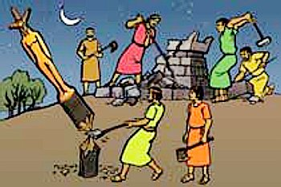
Obstinance & Prominence
God’s grace instructs
Isa 30:18-22 – “¹⁸Therefore the Lord longs to be gracious to you, and therefore He waits on high to have compassion on you. For the Lord is a God of justice; how blessed are all those who long for Him.¹⁹O people in Zion, inhabitant in Jerusalem, you will weep no longer. He will surely be gracious to you at the sound of your cry; when He hears it, He will answer you. ²⁰Although the Lord has given you bread of privation and water of oppression, He, your Teacher will no longer hide Himself, but your eyes will behold your Teacher. ²¹Your ears will hear a word behind you, ‘This is the way, walk in it,’ whenever you turn to the right or to the left. ²²And you will defile your graven images overlaid with silver, and your molten images plated with gold. You will scatter them as an impure thing, and say to them, ‘Be gone!’”
Notes:
But in a shocking reversal, there will be grace:
Isa 30:18-19 – The idea being that God is so great, even as He inflicts judgment and justice, He can still show grace, a theme to be more fully developed in chapters 40 – 66. The God who asks us to wait? He Himself waits, waiting for the time to bless those who are undeserving. Right now, they’re insisting on horses, and so the Lord must wait to show grace for a time when they are in the correct frame of mind to receive it. This is part of the training we need for complete dependence on Him, because one of the positive effects of judgment is that it has the tendency to shatter our vain reliances and get our attention when nothing else does. And that’s when grace comes along to motivate the broken to believe and obey. See, neither is effective w/o the other. It’s the cry of our heart through faith that activates God’s grace, but we won’t cry until we see the consequences of our sinful actions. It’s the old saying, “We’ll never be saved until we see just how lost we are”. And so, there is dual waiting and dual longing between us and God.
Isa 30:20-21 – Meaning, in their prosperity, they wouldn’t listen. So, He provided them nourishment that was scarce. This in turn would open the eyes of the blind so that they would behold their Teacher once again w/renewed fervor, having seen the results of their prior blindness. They’ll no longer reject His word as we just read, but like a pupil whose back is to his teacher, he will be corrected at once. They’ll no longer have to be like animals dragged and beaten, but they’ll be like sheep who follow their shepherd, who in the immortal words of the Mandalorian says, “This is the way”. This is why subjects like “church discipline” need to be enforced and reenforced in congregations. While there are some amongst God’s people like Isaiah and Hezekiah who respond positively to God out of love and not compulsion, there are others who need to feel the back of the hand. And while there are many brethren in the church who are willingly faithful to God, there are others who will never straighten up until there is discipline applied. And we need to stop thinking of church discipline, as gut wrenching as it can be, as such a negative thing. It’s a wonderful tool commanded by a gracious God who knows what it takes to bring back stubborn people to His fold who have hearts to return, but just need a push.
Isa 30:22 – This would be a complete change of attitude in which God’s people finally see the polluting influence of idols, which we’re going to discuss in more detail in Isa 40 – 48. It was customary to overlay idols w/expensive metals, making it that much more difficult to disregard for what it was “worth” materially. But for those who truly turn back to God, the things that are valuable to the world will be cast away.

Slide 9
Obstinance & Prominence
God’s grace instructs
Isa 30:23-26 – “²³Then He will give you rain for the seed which you will sow in the ground, and bread from the yield of the ground, and it will be rich and plenteous; on that day your livestock will graze in a roomy pasture. ²⁴Also the oxen and the donkeys which work the ground will eat salted fodder, which has been winnowed with shovel and fork. ²⁵On every lofty mountain and on every high hill there will be streams running with water on the day of the great slaughter, when the towers fall. ²⁶The light of the moon will be as the light of the sun, and the light of the sun will be seven times brighter, like the light of seven days, on the day the Lord binds up the fracture of His people and heals the bruise He has inflicted.”
Notes:
Isa 30:23 – Meaning there will be agricultural and pastoral blessings that contrast the bread of privation and water of oppression of vs. 20. Not a materialistic windfall, but God lifting the restraints he had previously placed on the productive forces of the land. One of the reasons they worshipped idols was their belief they could supply abundance. But when they come to realize God as the source of all blessings, He would prove this to them through what He gives. This is another tie-in to woe #1 where at the end of chapter 28 He teaches that agricultural principles and spiritual principles work the same way.
Even the beasts share in the blessing – Isa 30:24 – Meaning, the beasts are no longer innocent victims of Judah’s sins. That they eat such high-quality meal testifies to the abundance and the caring hearts of the people to feed their animals from the abundance God bestowed.
Isa 30:25 – This contrasts the water of tears from vs. 19. Those formerly arid hilltops that the pride of man caused to be barren and dry will be lavishly watered. Water and fruitfulness are associated w/trust in God, but the “towers” of Judah’s pride must be smashed before this new era of blessing.
Isa 30:26 – Now, if this were literal, it would be a curse and not a blessing. This could mean that the moon and sun will be delivered from its bondage of corruption, or it could signify that perfect clarity that comes from having formerly blinded eyes opened once again, as alluded to in vs. 20, as opposed to the darkness brought on by their former sin. Either way, that sin is a disease has been a constant theme since 1:5-6, and now all the breaches of vs. 13-14 will finally be healed.

Slide 10
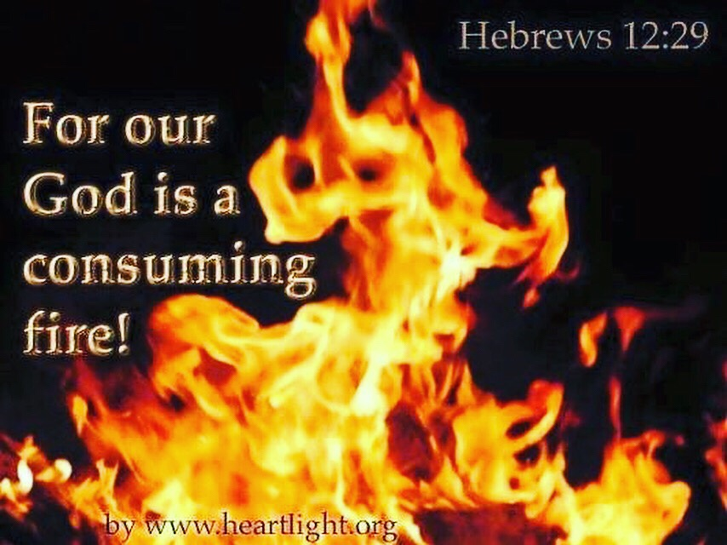
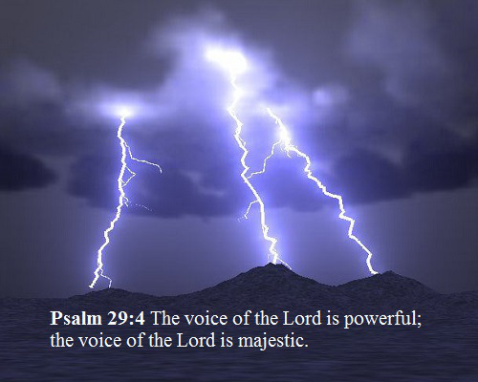
Obstinance & Prominence
Assyria no match for God
Isa 30:27-30 – “²⁷Behold, the name of the Lord comes from a remote place; burning is His anger and dense is His smoke; His lips are filled with indignation and His tongue is like a consuming fire; ²⁸His breath is like an overflowing torrent, which reaches to the neck, to shake the nations back and forth in a sieve, and to put in the jaws of the peoples the bridle which leads to ruin. ²⁹You will have songs as in the night when you keep the festival, and gladness of heart as when one marches to the sound of the flute, to go to the mountain of the Lord, to the Rock of Israel. ³⁰And the Lord will cause His voice of authority to be heard, and the descending of His arm to be seen in fierce anger, and in the flame of a consuming fire in cloudburst, downpour and hailstones.”
Notes:
And part of God’s grace toward His people is the promise to take care of the very element of judgment itself, the Assyrians.
Isa 30:27-28 – God’s name is the summary of His revealed character, and that He comes from afar may indicate how far Judah had removed Him from their presence. But when He comes, He brings w/Him smoke and fire, symbols of His divine presence and holiness. We’ve already seen from 11:4 that the coming Messiah would strike the earth w/the rod of His mouth, and that what Assyria was doing to Judah, coming up to its neck, will be what God does to them. The sieve exposes the false and worthless. The bridle controls and directs. But the overall point is that each leads to destruction: the flood to drowning, the sieve to dividing good grain from chaff, and the bridle leading an unbreakable horse to its death. The idea is that Judah will not experience in judgment anything of the scale that her enemies will. God will deliver them, not Egypt. Egypt is the loser ex-boyfriend that your wife used to date, and who used to beat and humiliate her. But then you rescued her and married her and had children w/her. Time has passed and now someone else is threatening her. Are you going to let her call her old boyfriend to come to her rescue or are you going to come to her rescue?
And how do God’s people respond during judgment? – Isa 30:29 – The most popular night festival was Passover. This would fit the Exodus symbolism of fire and cloud, the Lord as Rock (26:4), and especially the fact that it shows God is far greater a deliverer than Egypt. This would be a time of great joy as they approach God’s sanctuary to worship Him.
And in another allusion to 11:4… - Isa 30:30 – God’s will accomplished through speaking. His “Arm” represents action, another Exodus theme. Flame of consuming fire fits the burning bush in Ex 3:2. The strange mixture of lightening and hail is found in Ex 9:23. It’s as if God is trying to bring the people’s remembrance back to their history. Again, is this why Hezekiah was so intent on reinstating the Passover celebration in 2 Chron 30? God is saying, “Remember what I did to Egypt – I’m going to do something similar to Assyria!”

Slide 11
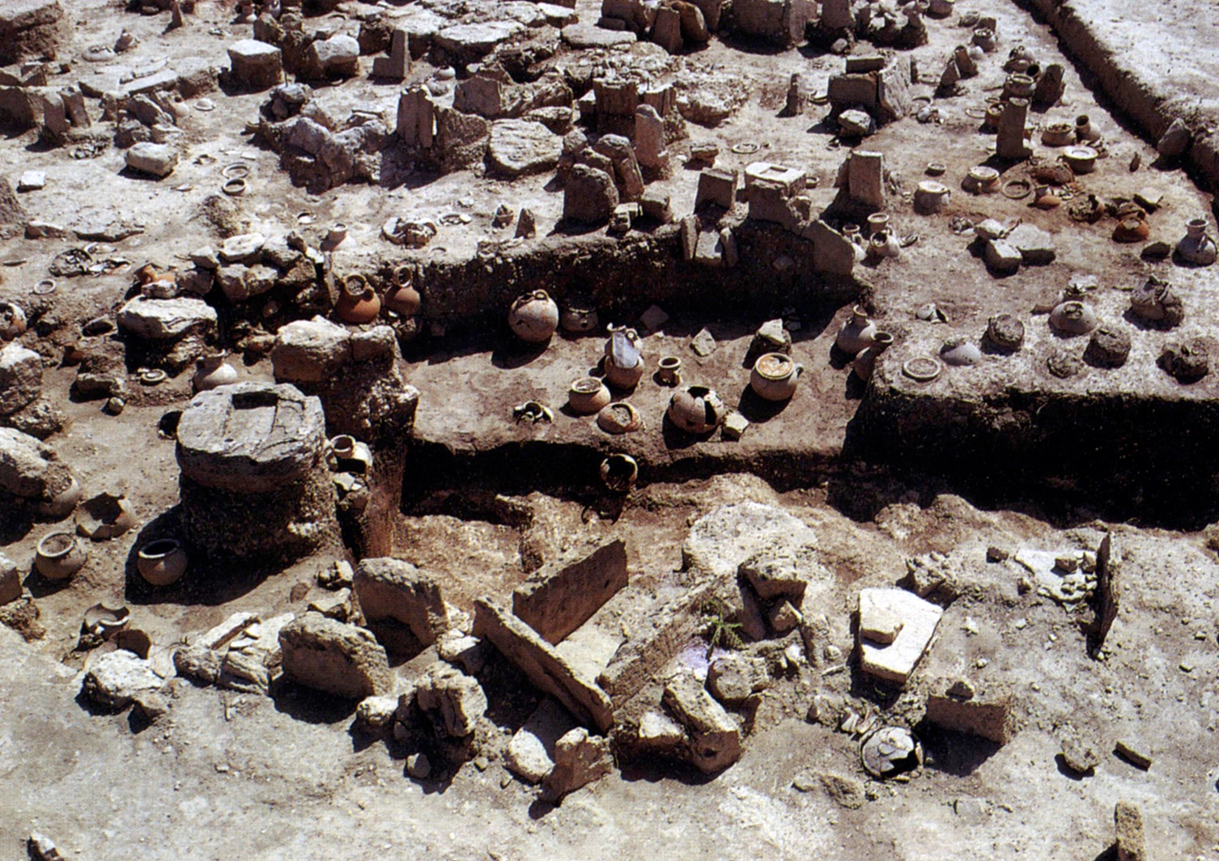
Obstinance & Prominence
Assyria no match for God
Isa 30:31-33 – “³¹For at the voice of the Lord Assyria will be terrified, when He strikes with the rod. ³²And every blow of the rod of punishment, which the Lord will lay on him, will be with the music of tambourines and lyres; and in battles, brandishing weapons, He will fight them. ³³For Topheth has long been ready, indeed, it has been prepared for the king. He has made it deep and large, a pyre of fire with plenty of wood; the breath of the Lord, like a torrent of brimstone, sets it afire.”
Notes:
And so, so there is no mistake who the Lord is referring to, He names the specific object of God’s judgment:
Isa 30:31-32 – And so, Assyria, who had been the “rod of My anger”, now it’s their turn to get the rod. And God’s people will celebrate it; not because people are suffering, but because wickedness, cruelty, and idolatry are being purged and judged and the righteous delivered. Judah will be a joyous spectator in this judgment.
Isa 30:33 – Topheth was a place in the valley of Hinnom. It was where unbelieving Israelites offered their children to Molech, but became Jerusalem’s land fill, and is where the Hebrew word for hell, “gehenna”, comes from. In other words, God has a special place in hell reserved for Assyria’s king. When Assyria marched against Judah, it was marching toward its own funeral. All the funeral pyre needed was the Lord’s breathe to kindle the flame.

